Slide 1
First Annual Data Briefing for the AIDD Grantees
May 21, 2018

Slide 2


The State of the States in Intellectual and Developmental Disabilities Project
May 21, 2018
AIDD Webinar
Shea Tanis, PhD
David Braddock, PhD
Amie Lulinski, PhD
Richard Hemp, MA
Coleman Institute for Cognitive Disabilities
University of Colorado

Slide 3

Power of Data
Data describes realities,
delivers insights, and drives innovation.

Slide 4

State of the States in Intellectual and Developmental Disabilities Project
Financial and Programmatic Trends in Supports and Services for People with IDD in the
United States

Slide 5
Key Federal and State Financial Supports
INSTITUTIONAL SERVICES FINANCIAL DATA (16 or more persons)
A. Public 16+ Institutional Services Funds
1. State Funds
  a. ICF/ID Medicaid Match
  b. General Funds (not including state ICF/MR match)
  c. Other State Funds (not including state ICF/MR match)
  d. Local Funds in Excess of Match
2. Federal Funds
  a. Federal ICF/ID
  b. Title XX/Social Services Block Grant
  c. Other Federal Funds
B. Private 16+ Institutional Services Funds
1. State Funds
  a. ICF/ID Medicaid Match
  b. General Funds (not including state ICF/ID match)
  c. Other State Funds (not including state ICF/ID match)
  d. Local Funds in Excess of Match
2. Federal Funds
  a. Federal ICF/ID
  b. Other Federal Funds

Slide 6
Key Federal and State Financial Supports (Continued)
COMMUNITY SERVICES FINANCIAL DATA (15 or fewer persons)
A. Community Services Funds for 15 or Fewer Persons
1. State Funds
  a. ICF/ID Medicaid Match
  b. General Funds (not including state ICF/ID match)
  c. Other State Funds (not including state ICF/ID match)
  d. Local/County Funds in Excess of Match
  e. SSI State Supplement Funds
2. Federal Funds
  a. Public ICF/ID (<16)
  b. Private ICF/ID (<16)
  c. HCBS Waiver
  d. Other Medicaid Services
  1. Rehabilitation Services
  2. Clinic Services
  3. Targeted Case Management
  4. Personal Care Services
  5. Other Medicaid Services
  e. Title XX/Social Services Block Grant
  f. Other Federal Funds
  g. SSI and Adults Disabled in Childhood (ADC) benefits – HCBS Waiver participants

Slide 7
Key Program and Participant Categories
COMMUNITY RESIDENTIAL SETTINGS (1-6 PERSONS)
  Public ICFs/ID
  Private ICFs/ID
  Supported living
  Personal assistance
  Other residential settings (group homes, apartments, foster, host homes)
COMMUNITY RESIDENTIAL SETTINGS (7-15 PERSONS)
  A. Public ICFs/ID
  Private ICFs/ID
  Other residential settings (7-15 persons)
III. DAY/WORK PROGRAM PARTICIPANTS
  Sheltered employment/work activity
  Day habilitation (“day training”)
  Supported/competitive employment
IV. HCBS WAIVER PARTICIPANTS
V. PUBLIC & PRIVATE INSTITUTIONAL SETTINGS (16+)
State operated institutions
Private ICFs/ID
Other private residential facilities
Nursing facility residents with I/DD
Sources: Braddock (1981, 20002), Braddock, Hemp, & Fujiura (1987).

Slide 8

Source of Data
State survey instruments (primary data sources)
National data sources (secondary data sources)

Slide 9

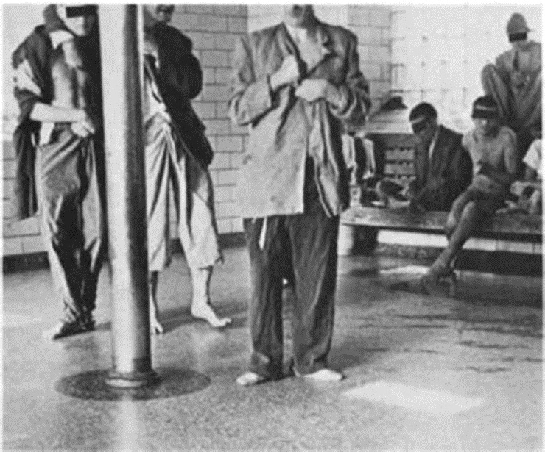
Closing of IDD Institutions
Story

Slide 10
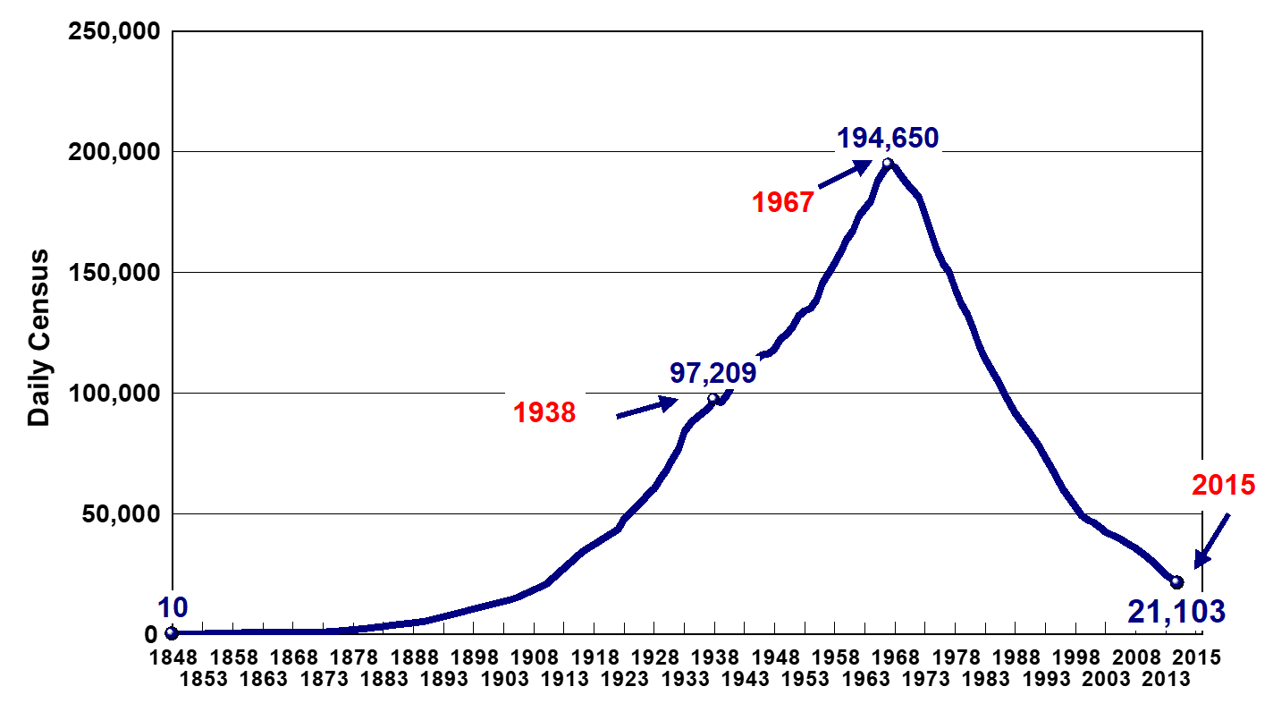
U.S. IDD Institutional Census (1848-2015)
Source: Braddock, et al.(2017).The State of the States in Intellectual and Developmental Disabilities:2017

Slide 11
Public IDD Institutional Closures Through 2015
District of Columbia (1991)
New Hampshire (1991)
Rhode Island (1994)
Vermont (1995)
Alaska (1997)
New Mexico (1997)
West Virginia (1998)
Hawaii (1999)
Maine (1999)
Minnesota (2000)
Indiana (2007)
Michigan (2009)
Oregon (2009)
Alabama (2012)
Source: Braddock, et al.(2017).The State of the States in Intellectual and Developmental Disabilities:2017

Slide 12
Projected Institutional Closures Through 2020
Source: Braddock, et al.(2017).The State of the States in Intellectual and Developmental Disabilities:2017

Slide 13
Projected Trend in Public Institutional Census (1977 – 2030)
Source: Braddock, et al.(2017).The State of the States in Intellectual and Developmental Disabilities:2017

Slide 14
Who’s Next?
Smallest IDD Institutional Censuses
State | FY2015 census | FY2017 census | % change
1. Idaho | 23 | 25 | 9%
2. Nevada | 47 | 48 | 2%
3. Delaware | 54 | 48 | -11%
4. Montana | 55 | 21 | -62%
5. Oklahoma | 66 | 50 | -24%
6. Wyoming | 70 | 64 | -9%
7. North Dakota | 82 | 74 | -10%
8. Arizona | 93 | 83 | -11%
9. Nebraska | 116 | 111 | -5%
10. Maryland | 122 | 92 | -25%
Source: Braddock, et al.(2018).Preliminary Data from The State of the States in Intellectual and Developmental Disabilities:2018

Slide 15
Ten Largest IDD Institutional Censuses
State | FY2015 census | FY2017 census* | % change
1. Texas | 3,541 | Not yet reported | n/a
Illinois | 1,724 | 1,656 | -4%
3. New Jersey | 1,701 | 1,437 | -15%
4. North Carolina | 1,194 | 1,125 | -6%
5. Mississippi | 1,063 | 938 | -12%
6. California | 1,011 | 787 | -22%
7. Pennsylvania | 971 | 880 | -9%
Ohio | 923 | 702 | -24%
Arkansas | 918 | 907 | -1%
10. Florida | 774 | 774 | 0
Source: Braddock, et al.(2018).Preliminary Data from The State of the States in Intellectual and Developmental Disabilities:2018

Slide 16
Story of Increased Investments in Supports and Services for People with IDD

Slide 17
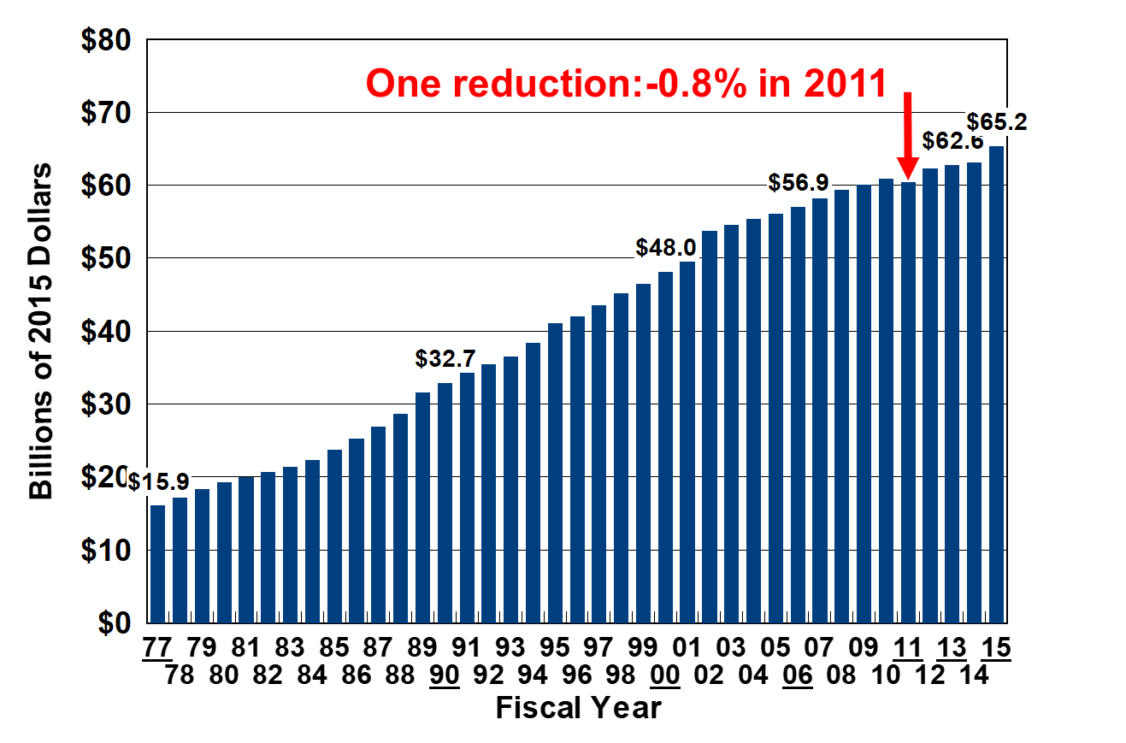
Total IDD Service Spending in the U.S. (1977- 2015)

Slide 18
Federal, State, and Local Medicaid Spending in FY 2015
Total federal-state Medicaid: $49.4 billion
HCBS Waiver (70%)
Public & private ICFs/ID (22%)
State plan Medicaid (8%)

Slide 19
HCBS and ICF/ID Spending (1977 – 2015)
-23%
Source: Braddock, et al.(2017).The State of the States in Intellectual and Developmental Disabilities:2017
Notes:
Of that group of almost 3.6 Million, 24% live with a caregiver who is over the age of 60.

Slide 20
Story of Family Caregiving

Slide 21
Estimated Distribution Of People With IDD By Living Arrangement FY 2015

Slide 22
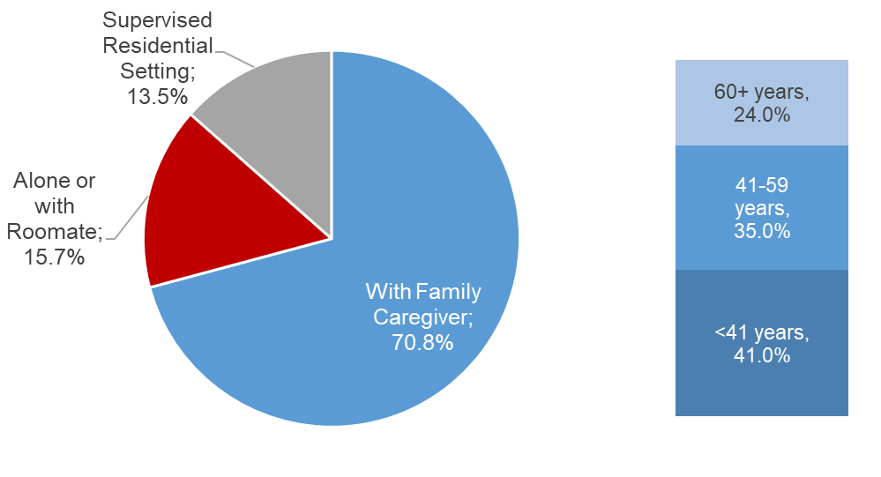
Estimated Number Of Individuals With IDD Living With Family Caregiver By Age Group FY 2015
Total: 3,590,998 Caregivers
Source: Braddock, et al.(2017).The State of the States in Intellectual and Developmental Disabilities:2017
Notes:
Of that group of almost 3.6 Million, 24% live with a caregiver who is over the age of 60.

Slide 23
17% of Caregiving Families Received Formal IDD Agency Supports
Source: Braddock, et al.(2017).The State of the States in Intellectual and Developmental Disabilities:2017

Slide 24
Story of Emerging Technology Solutions for People with IDD

Slide 25
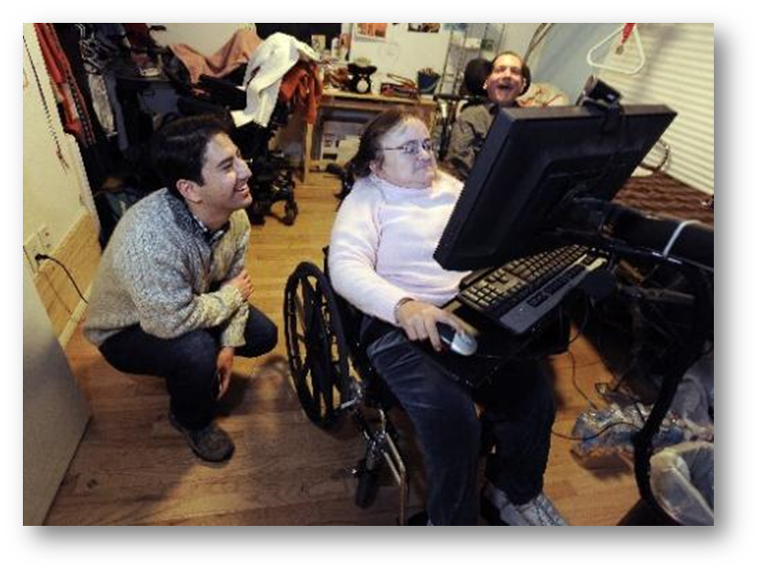
Ubiquity of Technology

Slide 26
Increases in State IDD Agency Technology Funding
YEAR | SMART HOMES |  | PERSONAL SUPPORT TECHNOLOGY |  | REMOTE MONITORING |  | TOTAL STATE IDD TECHNOLOGY
 | Spending | Participants | Spending | Participants | Spending | Participants | Spending | Participants
2008 | $91,690 | 208 | $0 | 0 | $0 | 0 | $91,690 | 208
2009 | $103,744 | 235 | $0 | 0 | $0 | 0 | $103,744 | 235
2010 | $213,631 | 490 | $2,965,600 | 1,123 | $0 | 0 | $3,179,231 | 1,613
2011 | $210,053 | 462 | $3,911,250 | 1,248 | $0 | 0 | $4,121,303 | 1,710
2012 | $255,267 | 473 | $6,621,792 | 1,239 | $0 | 0 | $6,877,059 | 1,712
2013 | $167,698 | 445 | $4,974,429 | 1,805 | $626,237 | 53 | $5,768,364 | 2,303
2014 | $212,033 | 550 | $4,460,988 | 2,204 | $1,337,804 | 98 | $6,010,825 | 2,852
2015 | $388,896 | 680 | $4,400,450 | 1,918 | $2,076,858 | 156 | $6,866,204 | 2,754
2016 | $710,863 | 742 | $9,945,786 | 4,672 | $3,231,956 | 587 | $13,888,606 | 6,001
2017 | $827,285 | 470 | $12,169,885 | 4,676 | $3,633,991 | 652 | $16,631,161 | 5,798
Source: Braddock, et al.(2018).Preliminary Data from The State of the States in Intellectual and Developmental Disabilities:2018

Slide 27
What story do you want to tell?

Slide 28
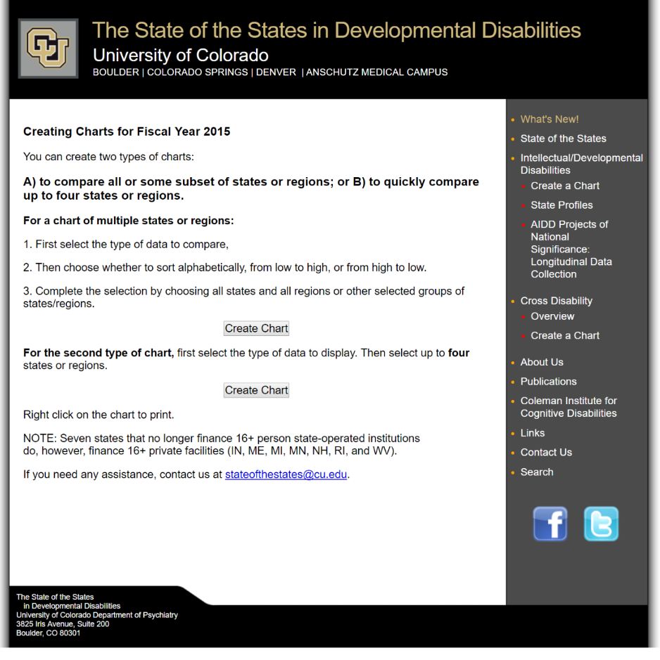
Personalize a Chart for Your State or Region
http://www.StateoftheStates.org/

Slide 29
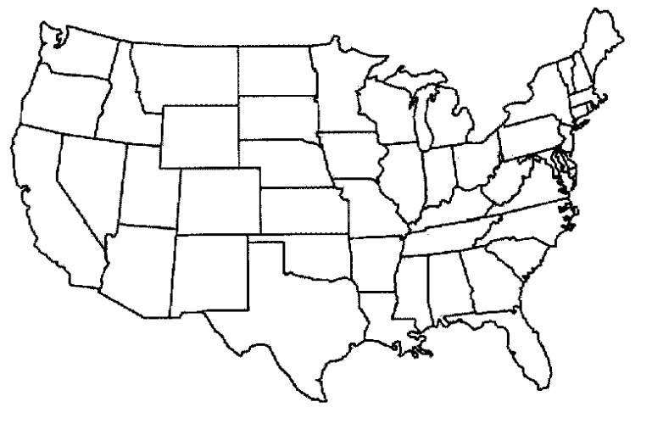
Personalize A Chart For Your State Or Region
www.StateoftheStates.org
1. Total Fiscal Effort for IDD Services
2. Community Fiscal Effort for IDD Services
3. Institutional (16+) Fiscal Effort for IDD Services
4. Community Spending as a Percent of Total IDD Services
5. Percent of Total Out-of-Home Placements in Settings for 6 or Fewer Persons
6. Percent of Total Statewide I/DD Caregiving Families Supported by State IDD Agencies
7. Aging IDD Caregivers as Percent of Total Persons with IDD
8. Individual and Family Support Spending per Capita
9. Home and Community Based Services (HCBS) Waiver Federal-State Spending per Capita
10. Average Annual Cost of Care in State-Operated 16+ Person IDD Institutions
11. Average Daily Cost of Care in State-Operated 16+ Person IDD Institutions
12. Nursing Facility Residents with IDD, Per 100,000 of the State Population
13. Six-or-fewer Person Community Spending as a Percent of Total IDD Spending
14. Unmatched State Funds Potentially Available to Match Additional Federal Medicaid Funding
15. Medicaid Percent of Total IDD Spending
16. Public Spending for Family Support and Supported Living as a % of Total IDD Spending

Slide 30
269 Technical Assistance Events
(2012-2017)

Slide 31



Keep in Touch!
Like us on Facebook
Follow us on Twitter@SOS_in_DD
Email us:
  Shea.Tanis@cu.edu
  Rick.Hemp@cu.edu
  Amie.Lulinski@cu.edu

Slide 32

THANK YOU!
U.S. Administration on Intellectual and Developmental Disabilities and the Coleman Institute for Cognitive Disabilities, University of Colorado.
For more information about State of the States visit: http://www.StateoftheStates.org

Slide 33
Using Residential Information Systems Project (RISP) data for policy & practice risp.umn.edu
May 21, 2018
Presented by Heidi Eschenbacher
University of Minnesota
Preparation of this presentation was supported, in part, by cooperative agreements (90DN0297, 90DN0291, and 90RT5019-01-00) from the US Health and Human Services, Administration on Community Living. Grantees undertaking projects under government sponsorship are encouraged to express freely their findings and conclusions. Points of view or opinions do not, therefore necessarily represent official AIDD policy.
Notes:
The RISP project has been around since 1977. It started as a way to track where people with IDD were living and has tracked deinstitutionalization.
RISP data has been used both nationally and on a state level to track deinstitutionalization and community supports, for advocating systems changes, for policy decisions, and for making both national and state level information available to Congress, State Legislatures, and Courts.

Slide 34
How is RISP data being used?
Historically: Track status and trends in LTSS for people with IDD
(e.g., deinstitutionalization)
  Nationally
  State-by-state
Used by federal and state policy makers, advocates and other stakeholders to:
  Review national and state progress toward LTSS goals
  Compare a state’s performance to the nation or other states
  Prepare reports
  Advocate for systems change
Enhances ongoing programs of research:
  Provides state level data to help explain variability in outcomes
  Provides a local context for proposed changes
Notes:
RISP data has been used both nationally and on a state level to track deinstitutionalization and community supports, for advocating systems changes, for policy decisions, and for making both national and state level information available to Congress, State Legislatures, and Courts.
Recently RISP data was used in Congressional Testimony in a law suit regarding ICF/IIDs
March 6, 2018 “Examining Class Action Lawsuits Against Intermediate Care Facilities for Individuals with Intellectual Disabilities (ICF/IID)”
https://judiciary.house.gov/hearing/examining-class-action-lawsuits-intermediate-care-facilities-individuals-intellectual-disabilities-icf-iid/

Slide 35
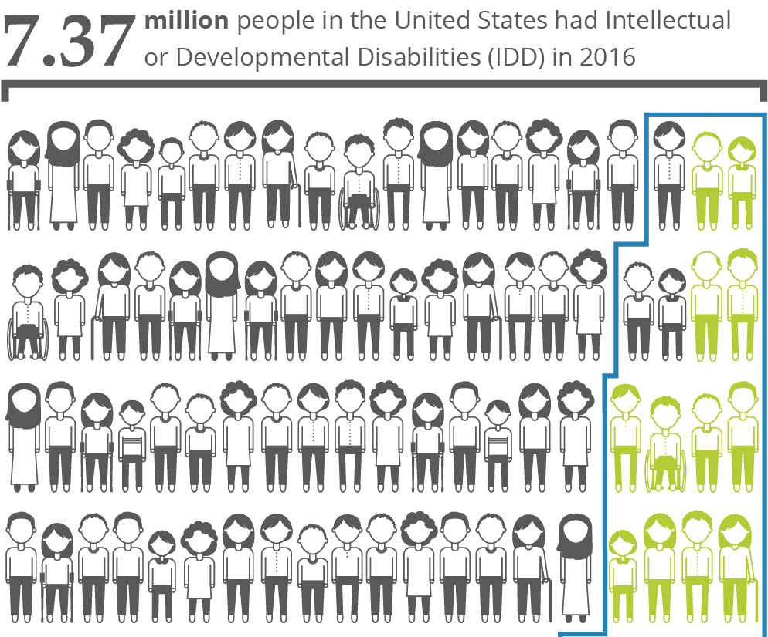
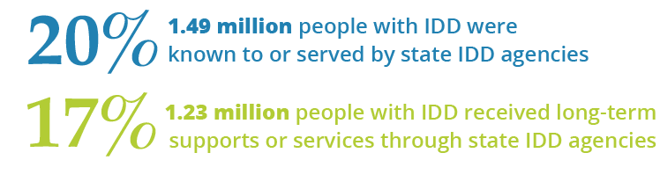
People with IDD in the US in 2016
2% of the U.S. population
Notes:
7.37 million people in the United States have IDD. This estimate was calculated from prevalence rates from the National Health Information Survey (NHIS) Disability Supplement using 1994/5 rates applied to the 2016 population for people in non-institutionalized settings. RISP data is used for those in institutional settings. 2016 CDC data is used for people age 18 and under (Zablotsky et al, 2017).
1.49 million people with IDD were known to or served by state IDD agencies. (this is 20% of all people with IDD in the US).
This is represented by the blue line.
1.23 million people with IDD received long-term supports or services through state IDD agencies (this 1.23 million is 17% of all people with IDD in the US).
This is represented by the people in green
The RISP data covers people who are served by IDD Agencies, so given this prevalence estimate there is a much larger population (about 80% nation wide) who are not accessing supports and services from IDD agencies. NASDDDS has a list of IDD Agencies if you want clarification of who we are talking about.

Slide 36
Long-Term Supports and Services (LTSS)
Long-Term Supports and Services (LTSS) assist people experiencing ongoing difficulties as a result of aging, chronic illness, or disability to perform activities of daily living (such as eating, bathing, and dressing), instrumental activities of daily living (such as cooking, housekeeping, and managing money or medications), and to participate in employment, educational, recreation, and community activities of their choice.
LTSS include, but are not limited to,
residential supports,
in-home supports,
personal care assistance,
family supports,
day or employment supports,
case management,
behavioral supports,
support for participant direction,
therapeutic services,
non-medical transportation,
equipment,
technology and modifications,
home delivered meals,
community transition services,
family and caregiver training,
respite, and
financial management services.
Notes:
Although the name of our report is the Residential Information Systems Project, we do not seek information exclusively about residential services. What we want to know is information about people, settings, and expenditures related to long term services and supports– both those delivered in home and out.
The term “Long-term supports and services” has been used my Medicaid for a long time. To be considered long-term, the service doesn’t have to be provided over a long period of time, rather the impact of the service or support (such as a technology that is installed periodically and used frequently) has to assist with ongoing living enhancements over time. Here are components of LTSS we use for RISP to describe it to survey users.
I bring this up because when you’re using any data source, particularly RISP, there are many times that interpreting the data benefits from looking at the definitions or asking us about how to interpret the data. We field questions all of the time and like it when people come to us with questions for clarification about what the data means or technical assistance to create customized reports.

Slide 37
Historic Trends: RISP tracks LTSS for people with IDD (e.g., deinstitutionalization)
Notes:
RISP can show data over an extended period of time (usually since 1977 or 1991). This is a classic RISP figure – it shows the rise and decline of state-operated facilities with sixteen or more people.
2016 was the first time since 1920 that there were fewer than 20,000 people living in state-operated institutions for people with IDD.
But like with all data, one has to look a bit more at the details, because there are still non-state (private / non-profit) institutions out there. This data looks at what we call state-operated (or government operated putting another way). Getting back to definitions, state-operated means that the staff involved in a facility are government employees.

Slide 38
Historic Trends: State IDD Agencies are serving more people, particularly in community settings
Notes:
Let’s start from the top. The orange dotted line is the total number of people with IDD receiving LTSS from State IDD agencies, Nursing homes or Psychiatric facilities. The green dashed line is like the orange line, but adjusted to the 2016 population. So you can see if the population was like it is today in 1998, there would be over 800,000 people served --- so there’s about 450,000 more people in the service system in 2016 compared to 1998. Notice that most of this increase is in community based settings like family home, own home, host or foster family.
You can also see where LTSS recipients tend to live over time. The blue represents families – light blue families with no Medicaid Waiver and dark blue with a waiver. The tan color is own home, dark red is host or foster family home or individualized settings with 1-3 people. The green on this chart are the group homes, ICF/IID facilities and other group settings. Light green is group settings with 4-6 people, followed by the middle green for settings with 7-15 people and dark green combines 16+ facilities, nursing homes and psychiatric settings.

Slide 39
Comparing States: Nonfamily setting sizes with six or fewer people and three or fewer people
Notes:
One could use data from RISP to see progress over time or across states for the Medicaid 2014 settings rule. This particular data is for nonfamily settings (which includes own home, host/ foster family home, group homes, other group settings, and ICF/IIDs).
82% of all nonfamily settings in the U.S. have six or fewer people, while 56% have three or fewer people.
Note that there is quite a range among states for setting size. Also note that those states with a star by them had data for six or fewer people, but the number for 1-3 value is based on a national average and may not be a reflection of what is actually happening in that state. So when using size 1-3 for the starred states, it would be accurate to say that the data is a reflection if the state was similar to national levels, though the actual size proportions are not known.
Note: The states tell us that many times they don’t have data for size 1-3 because they use another standard like size 1-4 in their state.

Slide 40
Comparing States: Estimated LTSS Recipients per 100,000 of the Population by State and Setting Type in Fiscal Year 2016
Notes:
The numbers on this chart reflect the overall number of LTSS recipients of IDD Agencies per 100,000 of the population. When one looks at data proportionate to the state population, you can see the extent to which a state serves people with IDD within the state.
This particular chart also shows what type of settings those LTSS recipients live if that information is known. If setting information is not known, it is grey.
380 people per 100,000 of the U.S. receive LTSS from state IDD agencies, but the range is rather great from 87 in Georgia to 908 in Ohio. Taking a look at the colors is important too, here one can see that Vermont uses a lot of Host / Foster Family homes while Minnesota has a lot of group homes with six or fewer people, though both states serve more than the national average number of people.
The RISP report indicates per 100,000 proportions for LTSS, Waiver, and ICF/IID, so many times people use this information to compare across states to understand why people may move to another state or try to balance services with neighboring states.

Slide 41
Number of Individuals by Medicaid Funding Authority and Residence Type with Average Per Person Expenditure FY 2016
Cost Per Person
Notes:
It can also be helpful to compare similar types of data. Here we have the total number of people served for waivers and ICF/IID compared to the average cost per person. While you can see that there are fewer people in ICF/IID than using Waivers, the costs involved with ICF/IID are much larger. Overall, people who live an ICF/IID receive more than double the funding those who receive waivers. Similarly, Waiver in family home is quite high for people 21 and younger (this is not surprising), but they amount young people with IDD receive for waivers is low… this may be in part because educational services may take up some of their time and education is not a part of RISP data.
When looking at waiver costs versus settings, there are more people age 22 and over in non-family waiver settings (here marked Waiver – other setting) and on average people in those settings receive $72,224 per year.
People with IDD who receive waivers while living in the family home receive about half of those who live in other settings. Other settings include Foster Family, Own Home, Group Home and Other.
The number of people and expenditures by funding authority and age has been on the RISP survey since 2013.

Slide 42
Average Waiver Cost Per Person by State FY 2016
Notes:
This figure combines data from two tables in the RISP report. Average annual per person Medicaid Waiver expenditures averaged $43,928 in FY 2016 (shown in the red line) but differed dramatically across states. The average ranges from $5,676 in Oregon to $118,910 in DC. However, this graph does not explain why states differed. Other factors need to be considered before using this graph for policy decisions. For instance, Oregon began to implement the State Plan (1915(k), so Oregon’s waiver numbers went down as more people shifted to the k plan.
States are ranked from lowest to highest per person expenditures. States serving more children have high light green bars while states serving more adults on the waiver, have dark green bars. The black line for each state is the waiver recipients per 100,000 of the population.
Several of the states with the lowest average Waiver expenditures per person (e.g., OR WA, and CA) offer optional State Plan Home and Community Based Services to people with IDD. AZ has an 1115 demonstration waiver. Oregon’s average per person state plan expenditures increased to $46,042 in 2016 as they shifted away from Waiver based services
The proportion of Waiver recipients living with a family member is correlated with the proportion of Waiver recipients who were 21 years or younger.

Slide 43
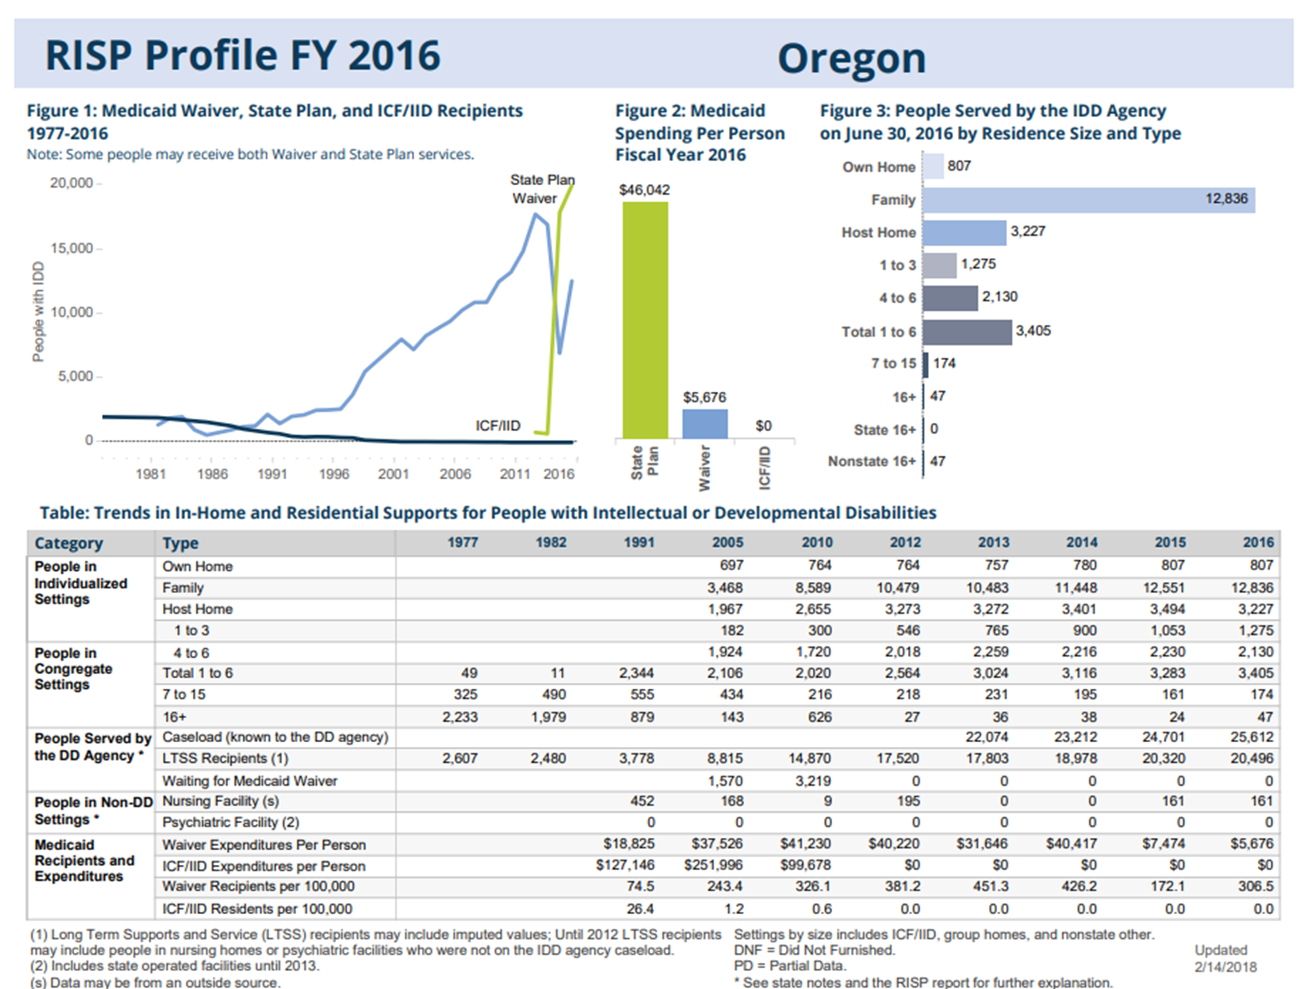
Trends over time & current year data: State Profiles
Notes:
Since we were just considering how Oregon shifted it’s service model, looking at State profiles can help to see the shift. In figure 1 the green line is State Plan 1915(k) in the case of Oregon.
All State Profiles are available online.
Using state profiles, you can compare similar information across states by looking at similar data or compare a state to the U.S.
One question for this group is if there are key pieces of data you need for your own purposes that are not covered in these profiles. We are currently redesigning the profile for FY2017, so your feedback would be helpful.

Slide 44
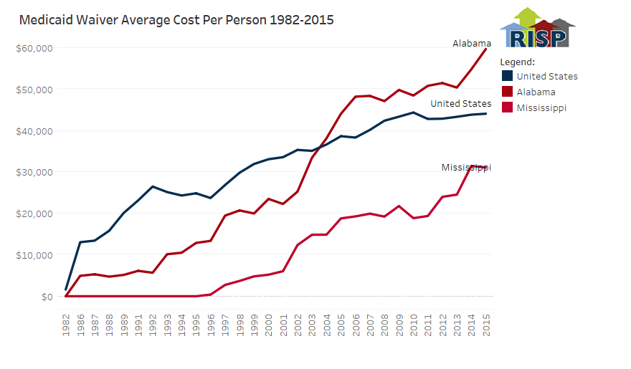
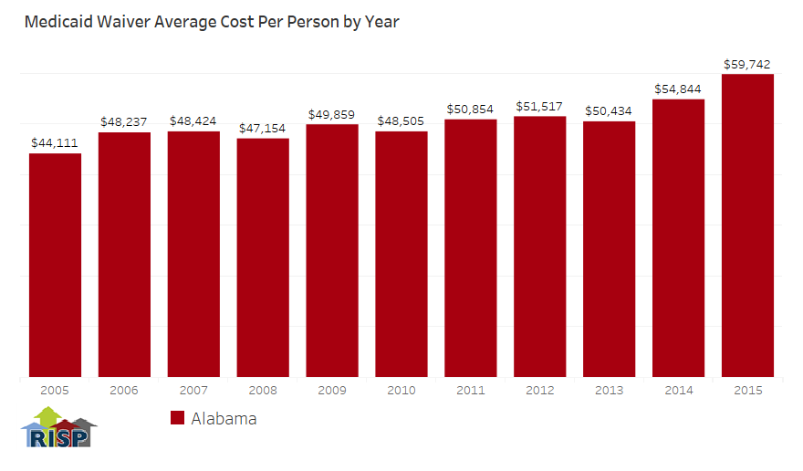
What’s available online
State Profiles
Interactive Visualizations
Reports
(2016 will be out soon)
Infographic pages
Notes:
We have a lot of products available online.
We are starting to do a limited printing of the reports since most of our users want the electronic version.
The interactive visualizations in the Chart Gallery section of the website allow you to make customized charts like the ones on this page. There are both line and bar charts available to view single states (bar charts) or multiple states (line). This example is the average waiver cost per person in Alabama, Mississippi and the United States on the top chart and Alabama alone on the bar chart.

Slide 45
Contact Us with questions or for technical assistance
For general questions:
Heidi Eschenbacher hje@umn.edu
Sheryl Larson, Ph.D. Principal Investigator
  RISP MN: Amy Hewitt (Director, RTC), Sheryl Larson (Principal Investigator), Heidi Eschenbacher, Lynda Anderson, Sandy Pettingell, Kristin Dean, Jonathan Walz, Shawn Lawler, John Westerman, Sarah Hollerich
  HSRI: Brittany Taylor, Yoshi Kardell, John Agosta
  NASDDDS: Mary Lee Fay, Mary Sowers, Mary Lou Bourne
      Research and Training Center on Community Living
      Institute on Community Integration (UCEDD)
      University of Minnesota, Twin Cities
      214 Pattee Hall, 150 Pillsbury Drive SE
      Minneapolis, MN 55455
risp@umn.edu

Slide 46
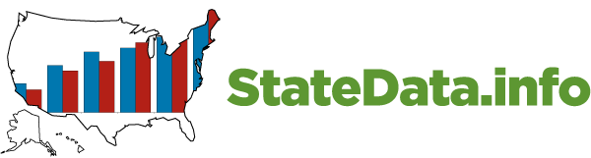





Access to Integrated Employment
National Data Collection on Day and Employment Services
Notes:
Brief summary of where we are nationally
We have challenges at three levels:
Systems that establish a priority for employment
Organizations that get there
Supports that are innovative, flexible, and creative

Slide 47
Core Activities
National Survey on Day and Employment Services
State IDD Agencies
VR services and outcomes
RSA 911
National Core Indicators
American Community Survey
Employment participation and outcomes
Social Security Administration
Work incentive use, work participation
Workforce development
Number of customers, entry into employment

Slide 48
Core Activities
Promising Practices
IDD Agency, Community Providers,
Community Life Engagement
National Survey of Community Rehabilitation Providers
1987, 1992, 2002-2003, 2010, 2013-14
Employment first case studies
Young Adult Outcomes and Services Report
Real People Real Jobs
www.realworkstories.org

Slide 49

Number in Employment and Day Services
632,000
312,448
Source: ICI National Survey of
State IDD Agencies
Notes:
JB

Slide 50
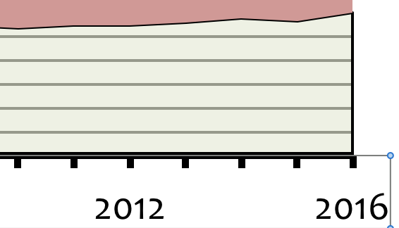
Number in Employment and Day Services
632,000
312,448
+12%
Source: ICI National Survey of
State IDD Agencies
Notes:
JB

Slide 51
Participation in integrated employment services varies widely
Source: ICI National Survey of
State IDD Agencies 2015
Notes:
JB

Slide 52
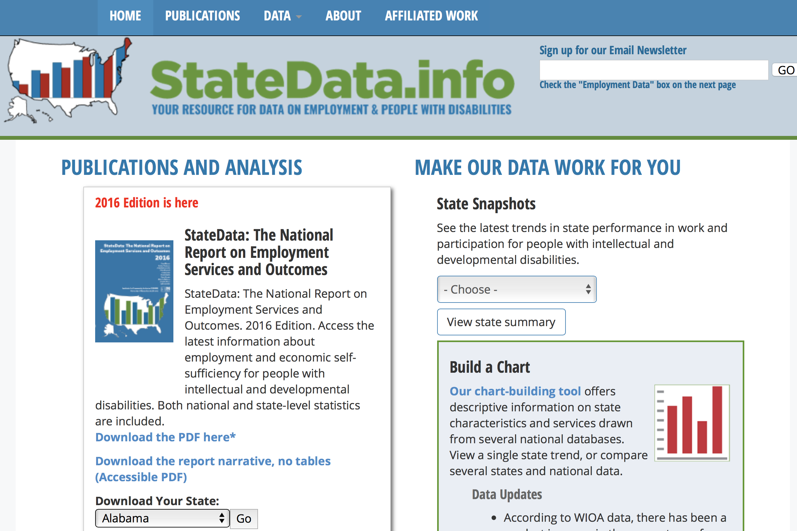

Slide 54
Works in integrated employment
Mean Hours and Wages per 2 weeks
 | % | Hours worked | Gross Wages
In an integrated job | 19% | * | *
In an individual job | 14% | 26 | 230
Individual job with funded supports | 7% | 25 | $222
Individual job without funded supports | 5% | 27 | $237
In a group supported job | 6% | 26 | $167

Slide 55
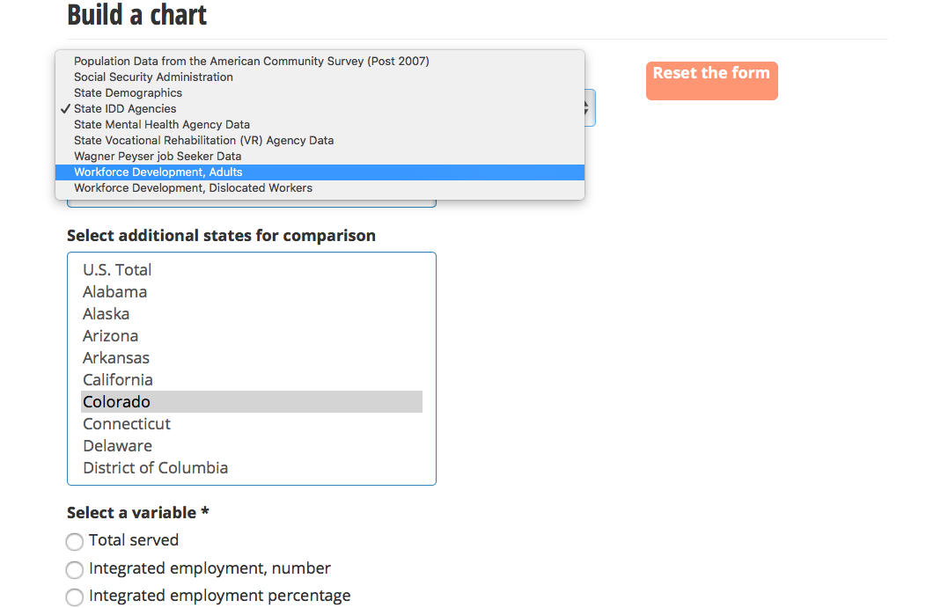

Slide 56

VR trends: Number closed into employment: Persons with ID
Recession
Source: RSA 911

Slide 57
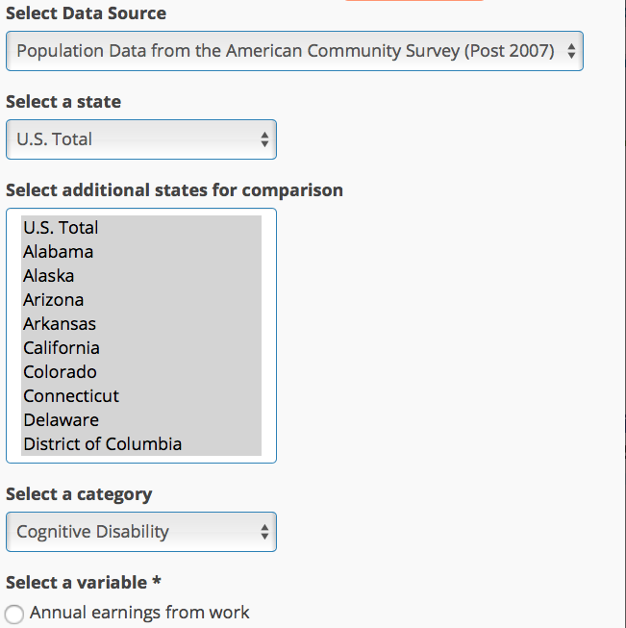
Pro tip #1: Select all states to see a state by state table

Slide 58
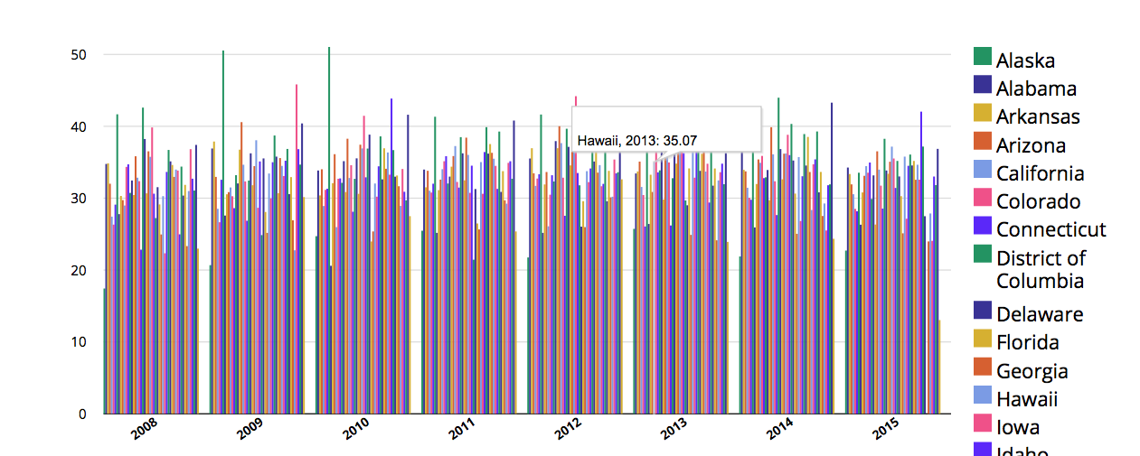
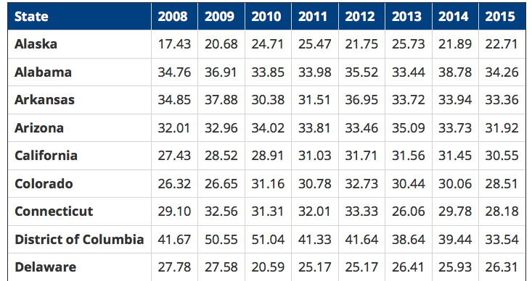

Slide 59
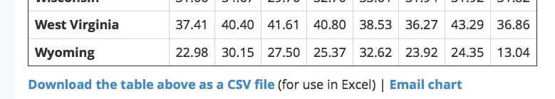
Pro tip 2:
Download
the table
Email
the chart

Slide 61

+

Slide 62


Slide 63
Jean Winsor
Jean.winsor@umb.edu
John Butterworth
john.butterworth@umb.edu
www.ThinkWork.org
www.RealWorkStories.org

