Slide 1
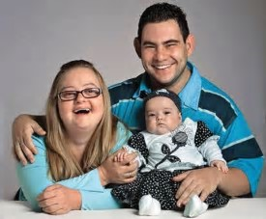
Creating a Vision for a Good Life: An Introduction to the Tools and Principles of Supporting Families

Slide 2
Background
Oklahoma is one of the fourteen states participating in the national “Community of Practice” on supporting families that include a person with disability.
Core value: Families are the core unit of society, serving as a source of support for all its members.
For people with disabilities, this is especially true and unique, as families often provide daily supports across the life span.

Slide 3
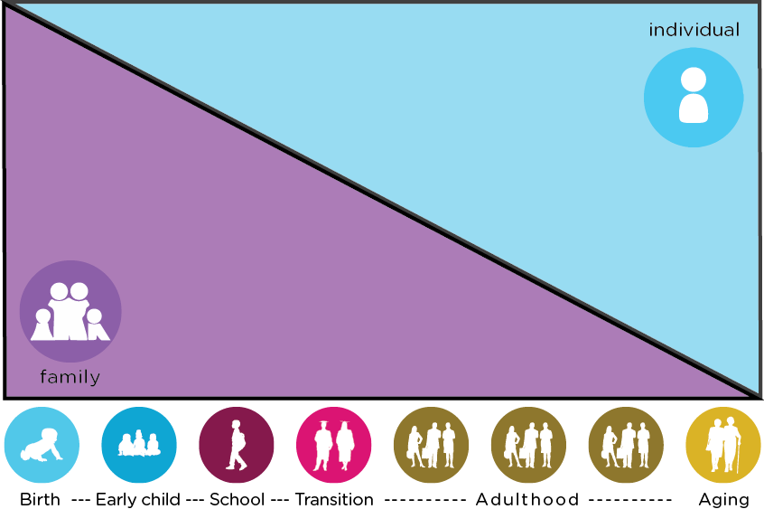
Goal of Supporting Families
Because of the role families play in the lives of adults with disabilities, future policy and practice MUST reflect the family as part of the support system!

Slide 5
So…
Supporting the family is defined as a set of strategies targeting the family unit, but that ultimately benefit the individual with a disability.
The strategies are intended to assist family members who have a key role in the provision of support and guidance of the individual with a disability to address social, physical, and material well-being of the ENTIRE family.
Strategies must be designed, implemented, and funded in a manner directed by the family. They should be flexible, comprehensive, and coordinated.

Slide 6
First, there is the individual
Notes:
First show the person,
Then show the family, `
then bring up the domains
And then the buckets
And then the outer layers
All these things work together to make a good life.

Slide 7
That individual is part of a family unit, which can be defined as biological, foster, or family of choice – friends.
Notes:
First show the person,
Then show the family, `
then bring up the domains
And then the buckets
And then the outer layers
All these things work together to make a good life.

Slide 8
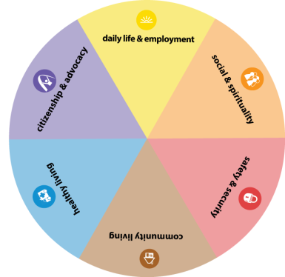
We consider that there are six major domains to every person’s life:
Daily Life (how one spends his or her day; including employment)
Social and Spiritual involvement
Safety and Security concerns
Community Living (the economic part of living – shopping, banking, etc.)
Healthy Living
Citizenship and Advocacy
Notes:
First show the person,
Then show the family, `
then bring up the domains
And then the buckets
And then the outer layers
All these things work together to make a good life.

Slide 9
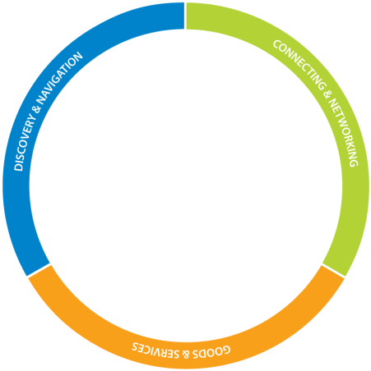
Surrounding those six domains are what we call the Three Buckets of Support:
Discovery and Navigation
Connecting and Networking
Day-to-Day Services
Notes:
First show the person,
Then show the family, `
then bring up the domains
And then the buckets
And then the outer layers
All these things work together to make a good life.

Slide 10
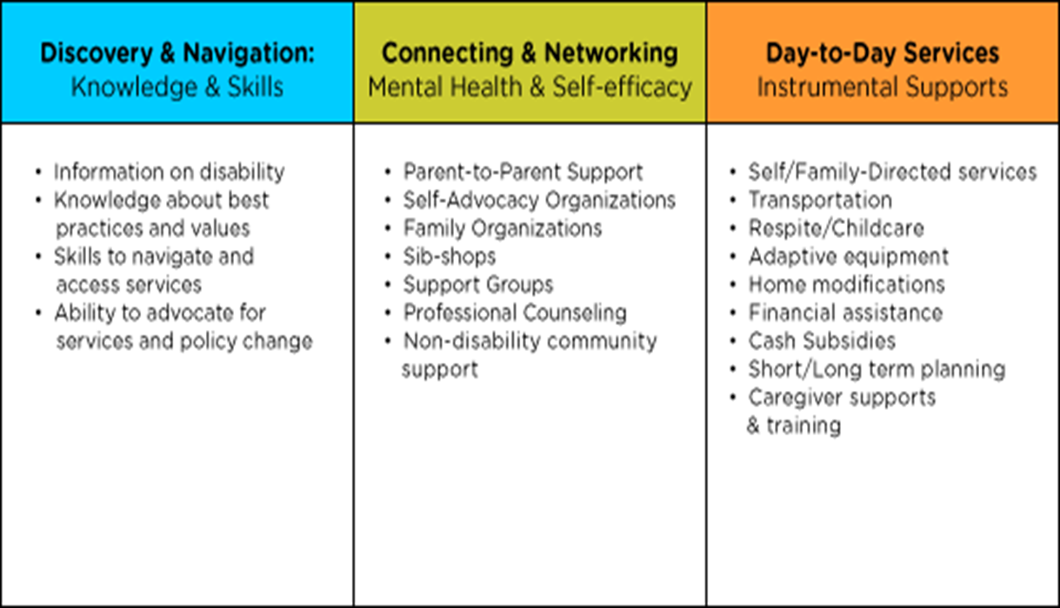
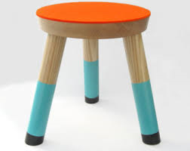

Slide 11
Surrounding the Three Buckets of Support are
five areas we call Integrated Supports:
One’s personal strengths, assets, and preferences
Relationship-based supports (family and friends)
Community-based supports
Technology supports
Eligibility-based supports
Notes:
First show the person,
Then show the family, `
then bring up the domains
And then the buckets
And then the outer layers
All these things work together to make a good life.

Slide 12
Notes:
First show the person,
Then show the family, `
then bring up the domains
And then the buckets
And then the outer layers
All these things work together to make a good life.

Slide 13
How to think about these components
Ann Trudgeon needs two hip surgeries, separated by eight or more weeks on massive antibiotics. The “fake” hip is prone to dislocation so I am strongly encouraged to stay home for the duration.
Employed by the ODDC for 28 years, paying into insurance and accruing leave. I have five co-workers and a laptop, and live 5 miles from my office.
I live on my own in a house that I own. Installed wireless internet before my surgery.
My immediate family includes my father, a brother and his family in OKC; a sister and her family in Colorado; and my grandmother.
I have several friends living in OKC, including one who essentially lives up the street.
I have a church home, but do not attend regularly. I consider myself a Christian.
Civic involvement is very important to me. I volunteer regularly, mostly through the Junior League of OKC.

Slide 14
How to think about these components
What I WANT to happen:
Infection in my leg killed
Work with medical personnel I like and trust
To walk better, and have more stamina
To spend my “recovery time” doing something worthwhile personally or professionally
Get back to work!
What I DON’T Want to Happen:
For my co-workers to have extra work because I’m not in the office daily
To have any medical complications that would require additional surgeries or hospitalizations
To be a burden on my Dad or others
Run out of leave or insurance

Slide 15
How to think about these components
LIFE DOMAINS:
Daily Life: I worked at home and had lots o’ doctor appointments; after doctor appointments I went to office for an hour or so to check in and do a little work from the hard-wired computer. Co-workers could get to my house quickly if I needed to sign any paperwork. I even hosted meetings at my house.
Social & Spiritual: My friends took turns coming over for lunch, bringing me my fave Starbucks; a friend brought members of her church to pray over me; and I had several sessions with a spiritual healer at my home; my friend up the street brought me cards and small gifts at least weekly. My grandmother came over often!
Safety & Security: My dad moved in; I used my walker to get around; bathroom had a shower bench and raised toilet seat; phone NEVER not with me; and I called 911 twice for ambulance services.
Community Living: My dad ran my errands; business I could do over the phone or on-line got done; I actually did do a furniture shop on a walker and have the most gorgeous new sofa! It took efforts and some “letting go” for both Dad and me; Matilda was on-call for errands and as taxi; I used Uber a couple of times to get to meetings.
Healthy Living: Home health/PT three times per week for 8 weeks; I asked friends who delivered meals to make them healthy meals without dessert.
Citizenship and Advocacy: I voted absentee; my JLOC committee co-chair and I did lots of work over the phone and over the internet.

Slide 16
How to think about these components
The Three Buckets of Support:
Connecting and Networking: got recommendations on the best doctors and hospitals
Discovery & Navigation: took a long look at my insurance coverage and FMLA; got approval to work at home from my boss; hospital social workers helped with discharge needs and services
Goods & Services: Medical personnel, hospitals, temporary parking permit, “hip kit”; but also Blue Apron, Postmates, & Amazon

Slide 17
How to think about these components
Integrated Supports:
Personal strengths, assets, & preferences: I talked with my family and friends about how I wished to be treated and cared for; I’ve done hip operations before and knew I had to “do the work” to get well; pain management considerations
Relationship-based supports: My dad lived with and cared for me; my sister came to town when dad needed to be elsewhere; friends were constantly supporting Dad and me; friends suggested non-physical therapies like the faith healer
Community-based supports: Co-workers and colleagues came to my house for meetings; a cleaning service to the house work; we signed up for Blue Apron; and I seriously had Postmates deliver me two bean burritos one night when I could not stomach another of my dad’s pasta creations
Technology: Walker and hip kit; wireless internet to connect with office email; banking by phone; electronic bill-paying; Uber; Amazon
Eligibility-Specific Supports: Insurance through my employer, which provided medical bills, prescription payments, and home-health care (physical therapy); paid and flexible leave; FMLA

Slide 18
Putting this to work with your family
Vision for the life I want for myself or my family member
Vision of what I DO NOT want for myself or my family member

Slide 19
Trajectory
Defined: “The path followed by a projectile flying or an object moving under the action of given forces.”
Each of our lives has a trajectory, and every day of our lives provides “action of given forces.”
Trajectories can change every day, but it’s up to us to face the “given forces” and change the course of the trajectory when necessary.

Slide 20
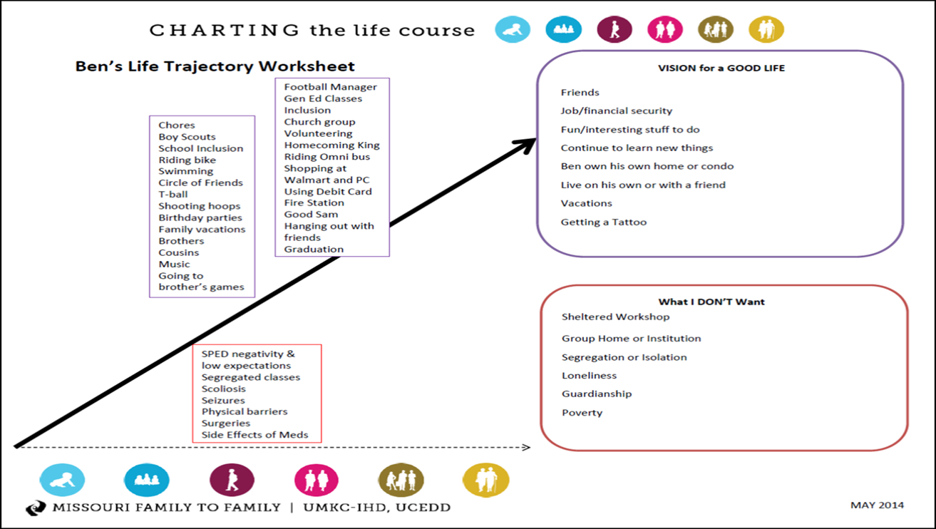
The Trajectory Worksheet

Slide 21
The Trajectory Worksheet

Slide 22
The Integrated Supports Star
What are you good at? What are your hobbies and interests?
What are your goals?
Who’s in your life and how can they support you to reach your goals?
What organizations are available in your community? How can they help you reach your goals?
Formal, eligibility-based services, typically offered by state agencies or schools are JUST ONE part of this picture!
What technology can support you? Low-, medium-, and
high-tech

Slide 23
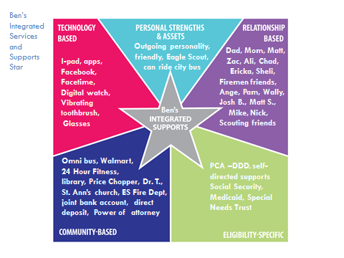

Slide 24
Goal: My own place to live

Slide 25
And one more tool: The One Page Profile
A One-Page Profile is a snapshot of an individual at a given stage in life. These are living documents and should be updated and customized to any potential audience.
These documents capture the REAL essence of an individual in an easily accessible and personalized format, providing a personality to someone who might otherwise be known just as their diagnosis.
One-Page Profiles typically consist of three parts:
What people like and admire about a person
What’s important TO and FOR a person
How to support an individual in community situations

Slide 26
Important To
Things in life which help us to be satisfied, content, comforted, fulfilled, and happy.
Important For
Issues of health, safety, and what others see as necessary to help the person.

Slide 28
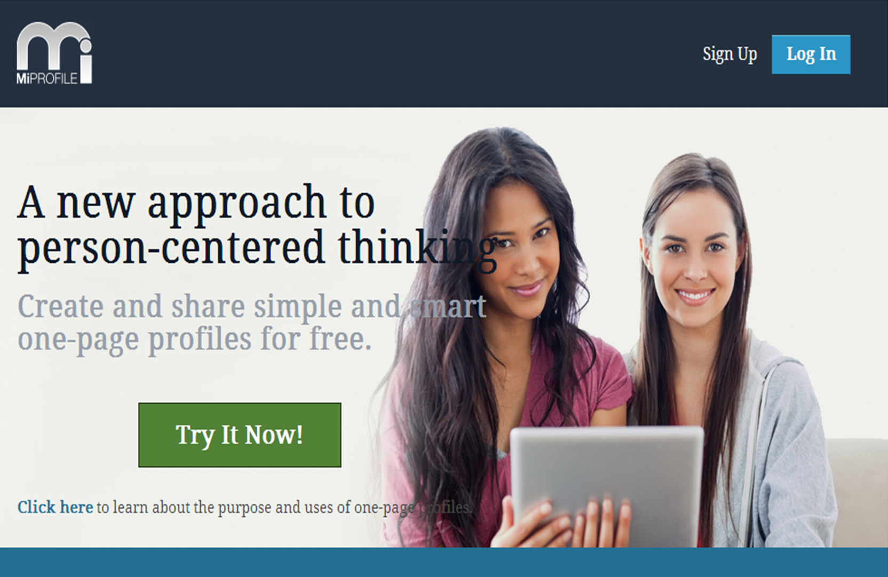
WEBSITE: Miprofile.ca

Slide 29
Building the One-Page Profile: Like and Admire
Ask friends and family what they like an admire about your family member; you will be astonished at their answers!
You’ll be able to tell from these responses who knows you and your family member REALLY well – and this could help you build your relationship-based supports!

Slide 30
Building the One-Page Profile: Important To and Important For
Important to:
Important for:

Slide 31
Building the One-Page Profile: How to Support Me
Thinking about the “Important To” and “Important For” allows you to best articulate how to support your family member.
“Important To” Example: If your family member reacts to loud noises by having a melt down, the “how to best support me language” is “I like a quiet environment.”
“Important For” Example: If your family member has an endocrine issue that means she cannot have prolonged exposure to heat, the “how best to support me” language is “Don’t let Kayla sweat,” or “I need to be in a cool environment. If I do need to go out into the heat, it needs to be for short periods only.”.

Slide 32
We know this went fast, but don’t worry!
We’ll keep going on this – the goal for us is to expose you to these tools and principles MANY TIMES over the course of Partners in Policymaking!

Slide 33
In the meantime,
There are two websites with information about the Community of Practice and its tools and principles:
Supportstofamilies.org
Lifecoursetools.com
The Oklahoma Team would be delighted to share our print and electronic materials, and can provide training for your family and any groups you can convene! (We’re free – but our schedules get full!)

