Slide 1

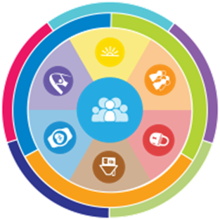
Community of Practice:
Supporting Individuals with Intellectual/Developmental Disabilities and Families over the Life Course
Supporting Individuals
and Families toward
A Good Life

Slide 2
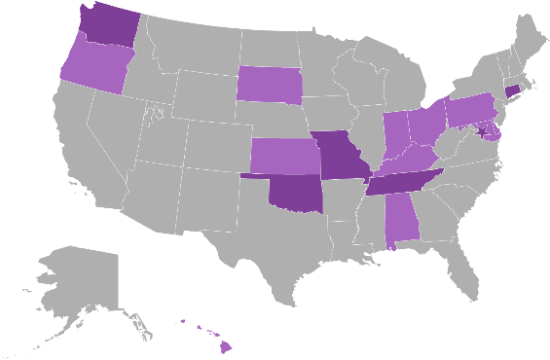



National Community of Practice for
Supporting Families
Project Goal
To build capacity through a community of practice across and within States to create policies, practices and systems to better assist and support families that include a member with I/DD across
the lifespan.
Project Outcome
State and national consensus on a national framework and agenda for improving support for families with members with I/DD.
Enhanced national and state policies, practices, and sustainable systems that result in improved supports to families.
Enhanced capacity of states to replicate and sustain exemplary practices to support families and systems.
Notes:
COP charged with developing a framework for supporting families
Chose to model after the life course theory
Informed by Wingspread-Building a National Agenda for Supporting Families with a member with IDD
Framework started with Mo F2F stakeholders. Plain language, not systems jargon.

Slide 3
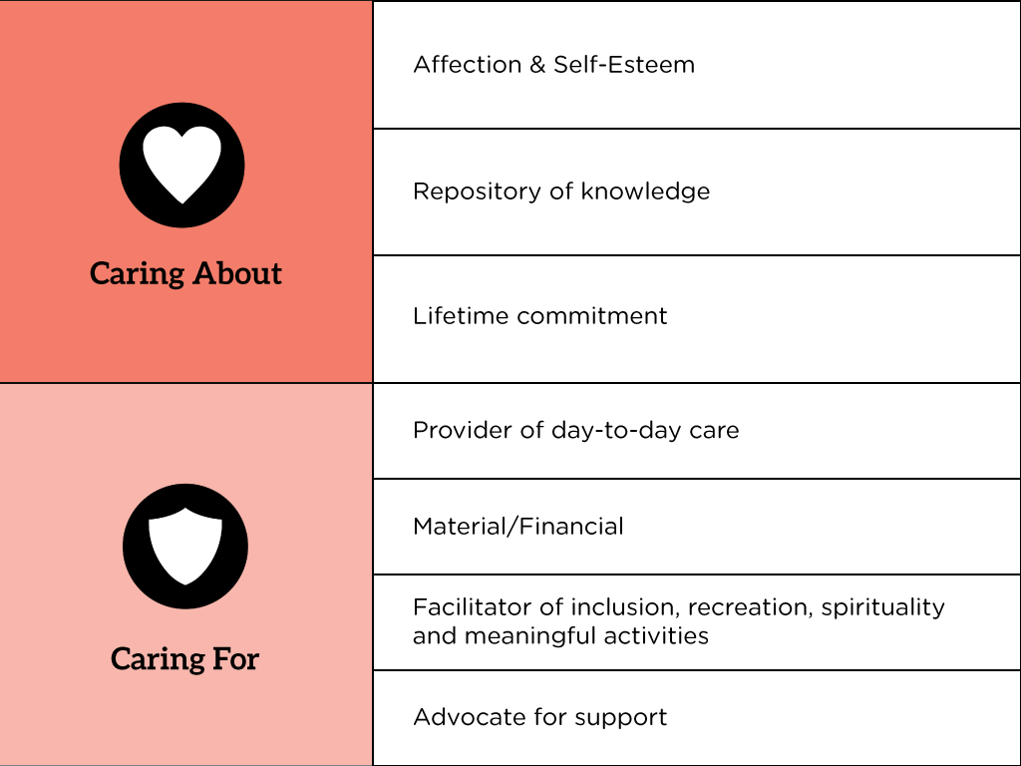
Advocates CARE ABOUT
& CARE FOR
That’s why you’re here – right?

Slide 4
Principles of Supporting
Individuals and Families
Focusing on the ALL
Life Stages
Life Domains
Trajectory
Integrated Supports Star
Three Buckets of Support

Slide 5
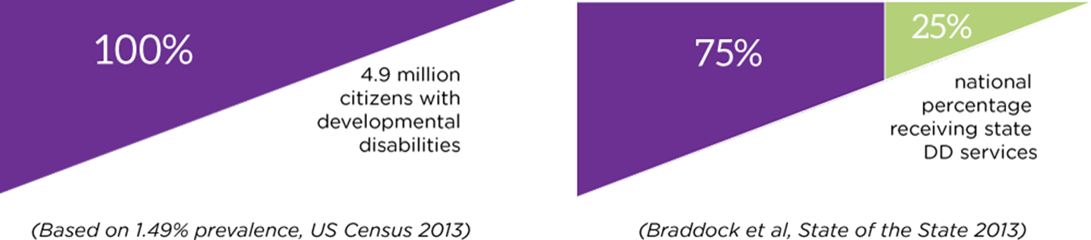
Community of Practice Principles:
Focusing on ALL in I/DD
ONLY 25% of people with I/DD receive formal services from state or federal government.
We need to UNDERSTAND and EXPECT this trend to continue.
For this reason, ANY problems we are attempting to “solve” must reflect that:
The ALL will never have access to or desire for government intervention
There is no “will” or realistic way THE GOVERNMENT can serve The ALL
Focus on SUPPORTS – not just services
PLENTY of lessons to learn from the 75% and the 25%...

Slide 6
We have so much to learn from THE ALL:
From those receiving services:
Are they the RIGHT services, or were they simply what was available? Did we ask the right questions before providing services?
Are we isolating them from their communities or “natural” community-based supports?
Are the services person-centered? Do they honor what’s important to a person and what’s important for a person?
Could their lives be enhanced by discussing community supports as a supplement to services?

Slide 7
We have so much to learn from THE ALL:
Those on “Waiting Lists”:
What services and supports ARE they receiving?
What could enhance their services while they wait – or what could STOP them from WAITING?
Do they understand what they are waiting for? Is what they are waiting for realistic? Could those needs be met other ways?

Slide 8
We have so much to learn from THE ALL:
Those neither receiving services nor on the waiting list:
What’s keeping them from asking for services?
What’s working for them, and what’s NOT working for them?
How can we support the individual and family so they don’t experience a crisis that would lead them to need formal services (probably because of an emergency)?

Slide 9
What parallels are there between those with I/DD and those who are Aging?
Both people with I/DD and Aging persons need/use care-takers – likely family members.
Both people with I/DD and Aging persons wish to live as healthily and independently as possible.
Both people with I/DD and Aging persons would choose to live at home rather than at an institution.
What else? So many parallels!

Slide 10
Community of Practice Principles:
Life Stages and Life Domains
Life Stages
Life Domains
Pre-natal & Infancy
Early Childhood
School Age
Transition Age
Adulthood
Aging
Daily Life & Employment
Safety & Security
Healthy Living
Citizenship & Advocacy
Social & Spiritual
Community Living
Why it might seem that when someone reached the “aging” life stage, all other life stages have are
“over,” there are always LESSONS from our previous life stages that we reflect on or continue to
impact our lives into the next life stage. Those previous life stages are, and will continue to be,
instructive. For those reasons, we ALWAYS keep in mind ALL life stages and all life domains.
How might a situation from “School” impact someone who is Aging??

Slide 11

Community of Practice Principles:
Three Buckets of Support
DISCOVERY AND NAVIGATION: Having the information and tools you need to navigate life
CONNECTING AND NETWORKING: Making connections with peers and resources – to HELP
you navigate
GOODS AND SERVICES: The tangible items you use and buy and the public and private
organizations in your community that you access for support
Think of a three-legged stool!

Slide 12
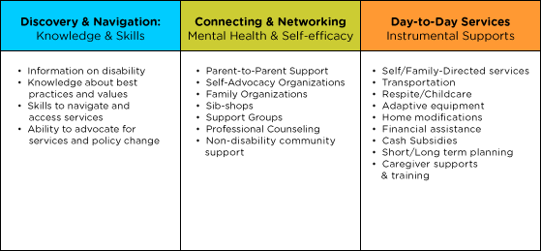
Three Buckets of Support:
Deeper Dive

Slide 13
Trajectory: Toward A Good Life
Friends, family,
enough money,
job I like, home, faith, vacations, health, choice, freedom
Trajectory towards Life Outcomes
Vision of What I Don’t Want
Trajectory towards things unwanted
Notes:
What kinds of things did you say earlier for YOUR good life? PWD and families usually want those same types of things. Everybody “gets” what the good life is. We just don’t usually ask them! What kinds of things do you think PWD and families will say they DON’T want? Sometimes you need to start there – they may not know what they want (because they are thinking in disability world) but they almost always can tell you want they don’t. FAMILY should have a good life trajectory too.
TRAJECTORY is the path that will either lead you toward the good life or toward things you don’t want. Think about throwing a football – the path that the ball takes on it’s way to the receiver is the trajectory. If you shoot an arrow, or a nerf gun – the path that the arrow follows is the trajectory. CAN START at ANY AGE!!!!
Support coordinators, providers, DSP’s, VR counselors, teachers….. ALL have the power to impact someone’s trajectory, sometimes negatively, by their actions or words. We must be very careful and mindful of the impact we can have. Are we nudging person and family toward what they want or what they don’t want?? EACH interaction, think about which way it pointed their trajectory!
KINDERGARTEN story – segregated class and safer special bus
Trajectory isn’t always straight
Bumps in the road – you can get back on track
VISION and TRAJECTORY can be very broad or very specific and time limited. Might be what are we doing/what’s happening this wee

Slide 14
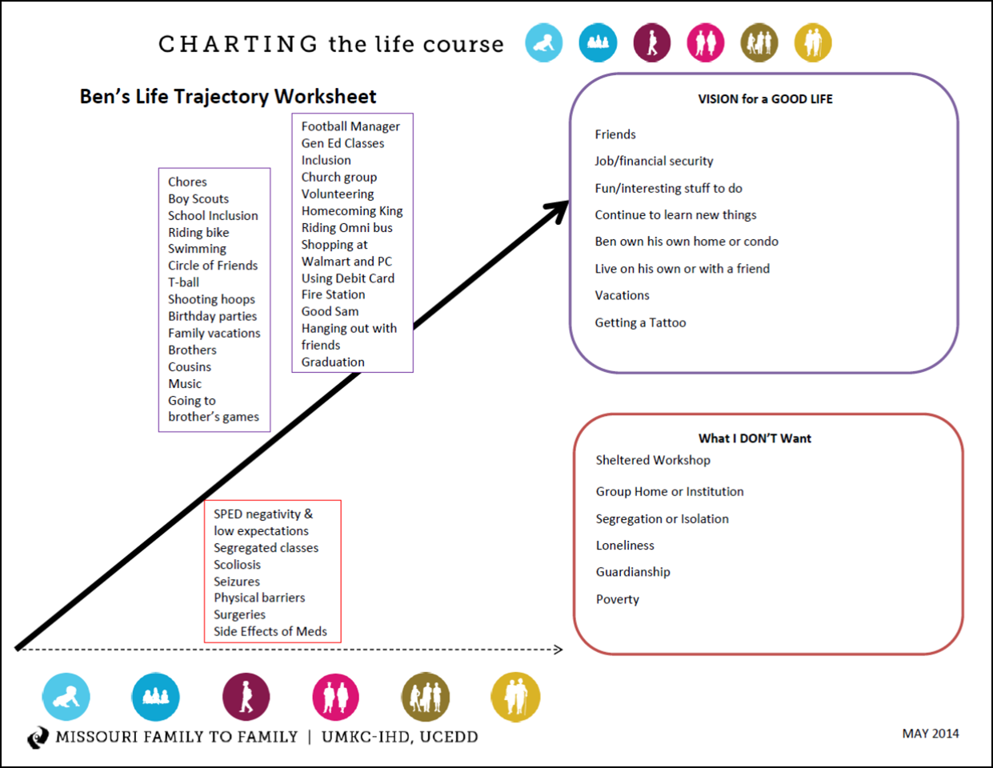
Community of Practice Principles:
Trajectory

Slide 15
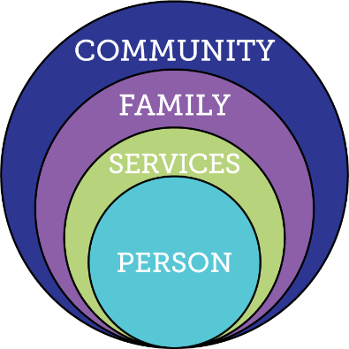
Current Reality of Services and Supports
Demand for Services
Expectations, Values, Culture
Federal Budget
Federal Policy
Capacity of
Work Force
15
Notes:
-DEMAND for services going UP, while BUDGET is going DOWN. Workforce – females between 25 and 45, going DOWN. Elderly using $ and people resources that IDD also uses.
-Expectations of younger generation that has grown up with FULL iinclusion.
-Policy – moving away from institutional and congregate settings, and employment and community inclusion is an expectation.
-Providers expected to do MORE for less
Key Federal Policy:
Developmental Disability Act
Individuals with Disabilities Education Act
Family and Medical Leave Act
Lifespan Respite Act
Older American’s Act
HCBS rules
Key Federal Initiatives
Medicaid Money Follows the Person
SSA Ticket to Work
Aging and Disability Resource Centers
HHS Community Living Initiative
Other Key Initiatives:
National Governors Association initiative “A Better Bottom Line: Employing People with Disabilities”

Slide 16
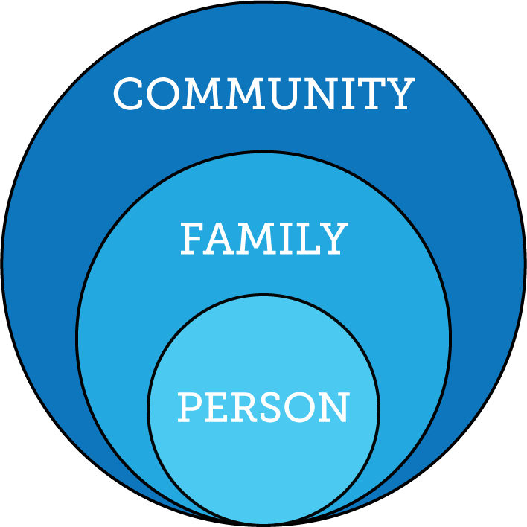
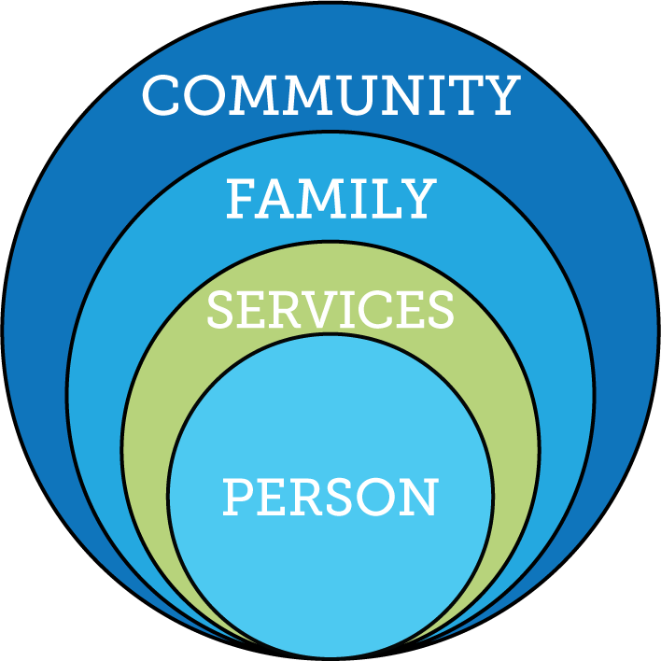
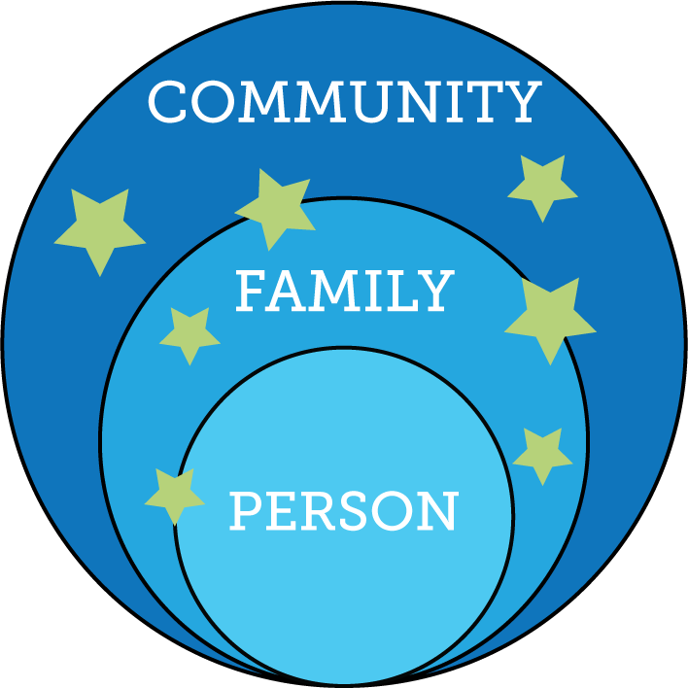
Community of Practice Principles:
Rethinking Traditional Services
Some of the unintended consequences of our service systems:
Puts a barrier between an individual and his/her family – when we KNOW 80%+ of people
with disabilities live with family
Establishes formal service systems as THE expert and source of “what’s best”
Devalues the role of family and community – in every way possible

Slide 17
Defining “services” and “supports”
SERVICES
Definition: “The supplying of commodities or utilities as required or demanded by the public”
Services are formal
When we speak of “services” for people with I/DD we speak of Medicaid- or other government-funded services administered by a state agency
Services are eligibility-based, typically around income and disability type
SUPPORTS
Definition: “Give assistance to, to enable to function or act”
Supports can be either formal or informal
When we speak of “supports” we recognize that there are disability-specific community supports, but can also mean those free- or fee-for-service types of assistance available to everyone in the community – such as a bank or health care clinic
Eligibility typically not an issue

Slide 18
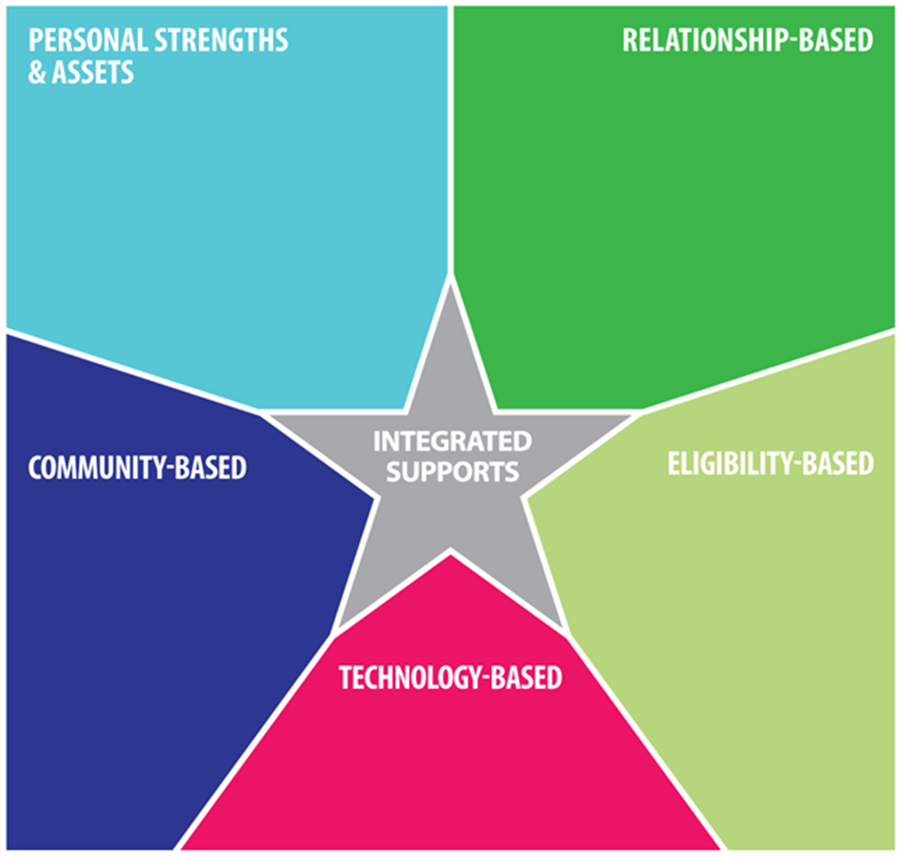
Community of Practice Principles:
The Integrated Support Star
What are you good at? What are your hobbies and interests?
What are your goals?
Who’s in your life and how can they support you to reach your goals?
What organizations are available in your community? How can they help you reach your goals?
Formal, eligibility-based services, typically offered by state agencies or schools are JUST ONE part of this picture!
What technology can support you? Low-, medium, and high-tech

Slide 19
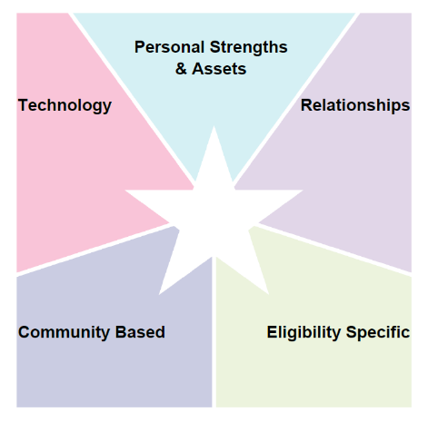
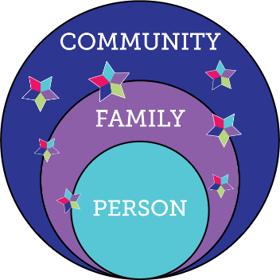

LifeCourse Integrated Supports STAR
resources, skills, abilities characteristics
i-pad/smart phone apps, remote monitoring, cognitive accessibility,
Adaptive
equipment
family, friends, neighbors, co-workers, church members, community members
school, businesses, church faith based, parks & rec, public transportation
SHS services, Special Ed, Medicaid, Voc Rehab, Food Stamps, Section 8
R
Notes:
MAPPING
PROBLEM SOLVING
PLANNING LTSS
PLANNING ACTIVITIES
We ALL do this without even thinking about it

Slide 20
More Information,
Training & Graphics!
There is SO MUCH information, and so many COOL graphics on the Community of Practice Websites:
www.supportstofamilies.org
www.lifecoursetools.com
Following are screen shots of some of the tools – all available FREE!

Slide 21
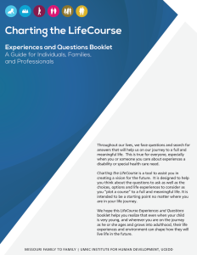
The Tools: Lifecourse Booklet
(a full explanation of the principles, plus a matrix of questions for discussion within a family or a more formal planning session with field professionals)

Slide 22
Trajectory Worksheets
(Planning and discussion tool for individuals and families)

Slide 23
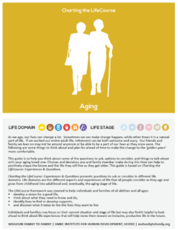
Aging “Guide”
(A portion of the Lifecourse Booklet, focusing only on Aging)

Slide 24
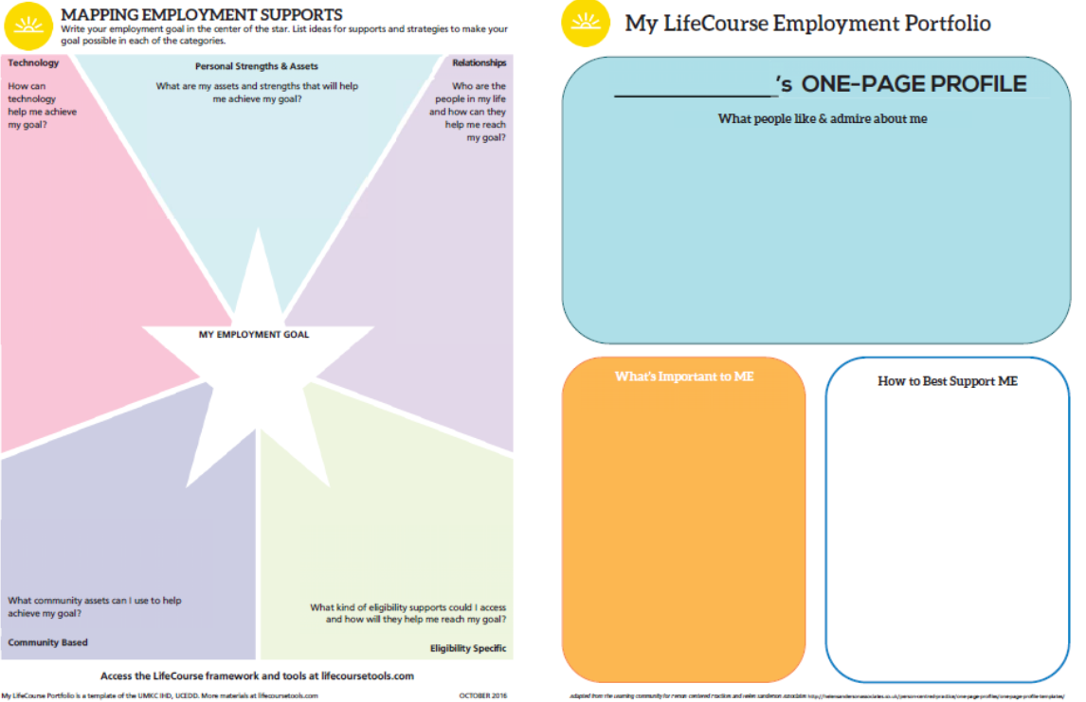
LifeCourse Portfolios
(one document that includes a person-centered profile, integrated star worksheet, and trajectory worksheet)

Slide 25
Portfolio, side 2

Slide 26
Portfolios available on-line
(portfolios are really four tools on one sheet)
General (basic)
General (expanded)
Employment
Discovery and Planning for Individual Support Plans
School
Healthy Living
Advocacy

Slide 27
Integrated Star “Cheat Sheets” and Templates

Slide 28
Integrated Stars available on-line
Daily Life and Employment
Community Living
Safety & Security
Healthy Living
Social & Spirituality
Citizenship & Advocacy
Employment (only)
Supported Decision-making

Slide 29
Know the Principles;
Use the Tools!
The principles under-gird the tools – you must know and understand the Principles to fully benefit from the Tools
The possibilities are ENDLESS for these tools
This stuff is ALL public domain – FREE!!
If your state is among those that is part of the Community of Practice, contact your state’s Developmental Disabilities Council for more training and support!

Slide 30
As Advocates for People who are Aging
Where can you use/teach these tools?
What additional information or materials would be helpful to you?
Are you affiliated with an organization that should receive training?
Are you aware of any organization that should join the Learning Community?

Slide 31


Stay in touch!
Wanda Felty
Center for Learning and Leadership/OUHSC
Wanda-Felty@ouhsc.edu
405-271-4500
Ann Trudgeon
Oklahoma Developmental Disabilities Council
Ann.Trudgeon@okdhs.org
405-521-4966

