Slide 1
Policy Update for the
NACDD Policy Update
February 5, 2024
Erin Prangley, Director, Public Policy
Eprangley@nacdd.org
Notes:
NACDD serves as the collective voice of the nation’s 56 DD Councils. The mission of DD Councils (and therefore ultimate goal of NACDD) is Systems Change. VABPDD is one of the councils we serve.
I'm here today for a purely selfish reason – we need more self advocates.
Why? Because in order to change systems, we need to change minds. In order to change minds, we need to change hearts.
Heart – Mind – System change.
There is NO ONE who get to the heart of a politician or any decision maker better than a self advocate.

Slide 2

Take Action! Protect Medicaid!
National Call In Day to Protect Medicaid, Tomorrow, 2/6
New NACDD Protect Medicaid Fact Sheet with Links to State Data
February Action: Organize In District Meetings for the Week of February 16!

Slide 3

National Call-In Day to Protect Medicaid
When: Tomorrow, Thursday, February 6, at 1 PM (ideal) or anytime
How:
Call the “Hands Off Medicaid Hotline” at 866-426-2631. (Options are available in English and Spanish.)
Follow the prompts when asked for your zip code.
Your call will be automatically directed to your representative.
You may either speak with a staff member or be directed to voicemail. If you reach voicemail, please leave a message with your name and zip code!

Slide 4
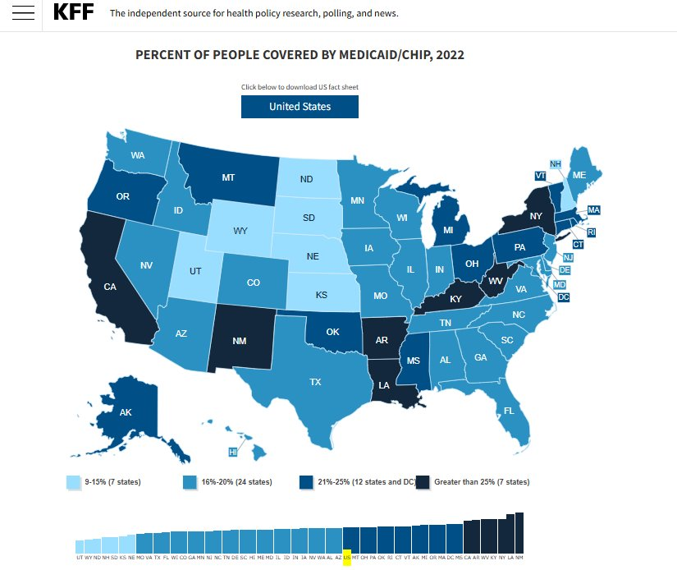
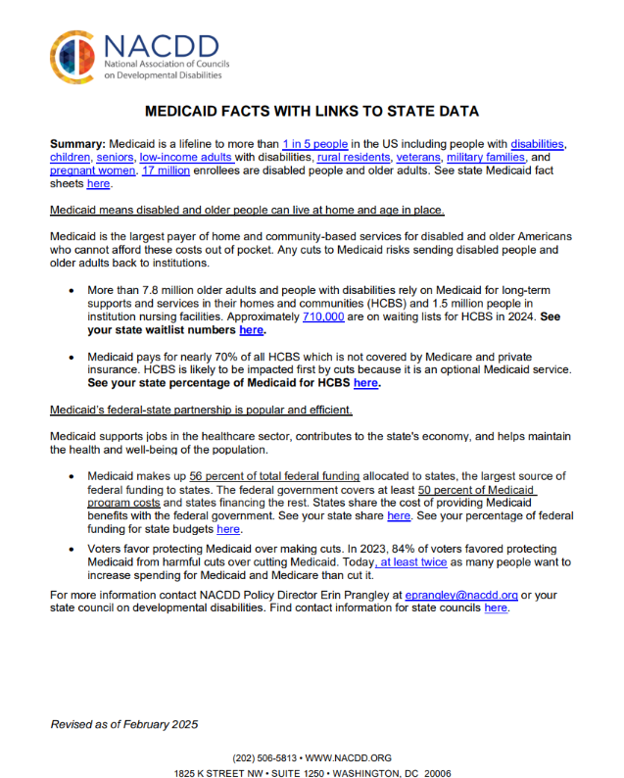
NACDD Talking Points with Links to State Fact Sheets
https://nacdd.org/nacdd-medicaid-fact-sheet/
https://www.kff.org/interactive/medicaid-state-fact-sheets/

Slide 5
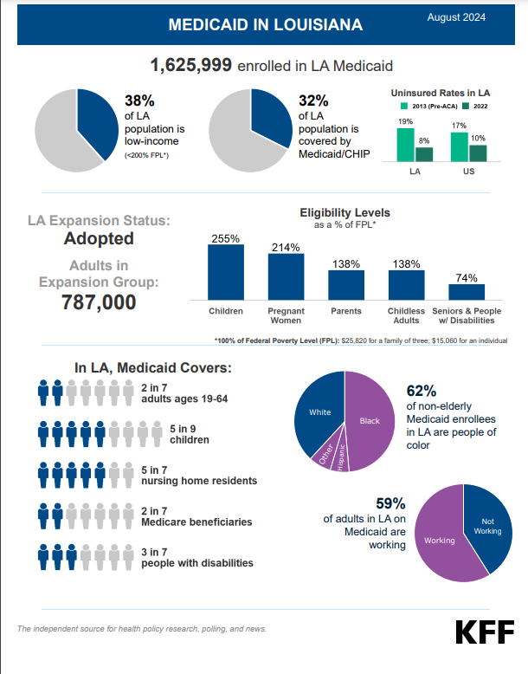
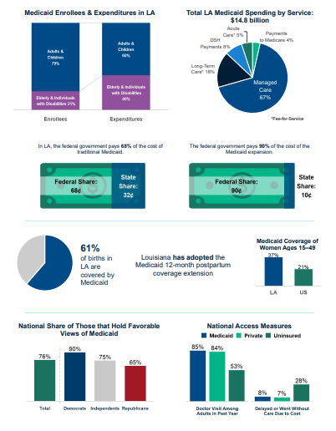

Slide 6
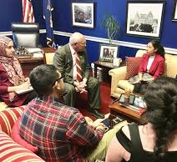
February Action:
In District Meeting with Your Member of Congress
Gather Friends
Contact congressional office for meeting with Congressman
Set Date and Time and let NACDD know at http://bit.ly/40EbwoY
Schedule a zoom to prepare for meeting
Meeting Agenda
  Introduce constituents
  Share personal story (1 or 2)
  Share state talking points (see state fact sheet)
  Make ask – No cuts to Medicaid
  Get the PICTURE
Send a thank you note to the congressman, specifically naming the staff who met with you.
Share picture on social media with #HandsOffMedicaid and tag the congressman

Slide 7
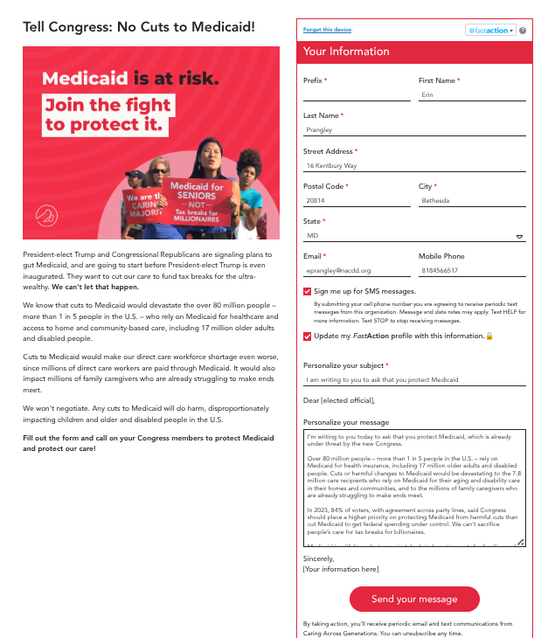
Act Now!
Send a message to the new Congress that cutting or defunding Medicaid would create major gaps in state funding and devastate state budgets.
Any type of cut – whether as block grants, per capita caps, work requirements, or other changes – will take critical care away from millions of people.
Go to this link: https://bit.ly/40bpOgQ

Slide 8
Join US!! NACDD Policy Regular Meetings
These meetings are open to all NACDD members, which include state councils on developmental disabilities, members, staff and leaders with lived experience (self-advocates).
NACDD Policy Committee Monthly Meeting NACDD Policy Committee members meet to discuss federal policy priorities. When: First Thursday of the month, 2pm EST Next Policy Committee meeting is February 6 Link: https://us02web.zoom.us/j/89564062154?pwd=UPZtNla5DJpObNMRQFkTGf8Wp9htxb.1 Meeting ID: 895 6406 2154 | Passcode: 219550 | NACDD State Policy Task Force Meeting This task force focuses on state policy issues and advocacy strategies. Topics include alternatives to guardianship, state budgets, state legislative days, organizing state networks (coalition building) and more. When: Last Tuesday of the month at 12:30pm Next State Task Force meeting is February 25. Link: https://us02web.zoom.us/j/83256338381?pwd=jKSTrPSAdlRClpEiKPNuUJBcj7a22t.1 Meeting ID: 832 5633 8381 | Passcode: 777838
NACDD Medicaid Task Force Meetings This task force focuses on Medicaid issues including federal legislation and agency activities as well as expertise on advocating within state Medicaid plans. When: Last Tuesday of the month at 2:00 PM EST Next Medicaid Task Forcemeeting is February 25 Link: https://us02web.zoom.us/j/85956647049?pwd=ohNhTF9CL2JOVyBK3VHPaO6vsolGFp.1 Meeting ID: 859 5664 7049 | Passcode: 923280 | NACDD Public Policy Hours NACDD staff are available to discuss all things policy every other week. Please send an email toeprangley@nacdd.org if you have any issues you want to discuss during this time. When: Every other week on Fridays at 2-3pm Next Policy Hours is February 28 Link: https://us02web.zoom.us/j/87599614475?pwd=dE9uNTdES09OUzMzV2VIa0JSWUZWdz09 Meeting ID: 875 9961 4475 | Passcode: 318439

Slide 9
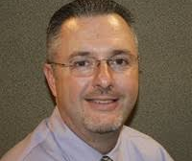

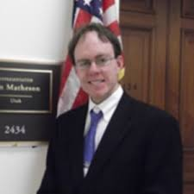
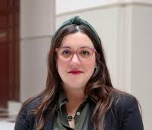
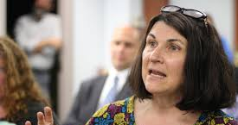
Join our email list!
NACDD's Policy email list is open to all NACDD members (council members, staff and self-advocates). To join go to https://bit.ly/3Ux1PEN

