Slide 1
Policy Update for the
NACDD Board Meeting
January 22, 2024
Erin Prangley, Director, Public Policy
Eprangley@nacdd.org
Notes:
NACDD serves as the collective voice of the nation’s 56 DD Councils. The mission of DD Councils (and therefore ultimate goal of NACDD) is Systems Change. VABPDD is one of the councils we serve.
I'm here today for a purely selfish reason – we need more self advocates.
Why? Because in order to change systems, we need to change minds. In order to change minds, we need to change hearts.
Heart – Mind – System change.
There is NO ONE who get to the heart of a politician or any decision maker better than a self advocate.

Slide 2
Overview
Budget, Reconciliation and Appropriations
NACDD Public Policy Priorities for the 119th Congress
Protect Medicaid Update

Slide 3

Budget, Reconciliation, Appropriations (FY24/25)
January 27: House Budget blueprint released
February 3: House Budget Committee mark up
February 10 (week of): House Budget Resolution vote
Senate must pass a budget resolution before any reconciliation. Senate has not released a timeline.
March 14: FY 2025 CR (containing debt ceiling deal) expires
April: Reconciliation bill
April 30: FY 2025 CR Caps Hit Without Appropriations (1% cuts to all)
Debt Ceiling reached???
October 1: Start of FY 2026

Slide 4
Definitions
Budget: The federal budget is a plan for how the United States government will spend its money over the next fiscal year. It outlines how much money the government will collect in taxes and how that money will be allocated to various programs and agencies.
Reconciliation: A procedureal short cut to bring spending, revenue, and the debt limit into alignment with the targets set in the Congressional budget resolution. Quick – no hearings/breifings. Limited debate. Limited amendments. In the Senate, reconciliation bills can pass with a simple majority vote (51 votes), bypassing the 60-vote threshold typically required for most legislation.
Appropriations: Legislation that provides budget authority to specific federal government departments, agencies, and programs. Appropriations bills allocate funding for the operations, personnel, equipment, and activities of federal agencies. Congress passes 12 annual appropriations acts, as well as supplemental appropriation acts, each year. These acts provide budget authority to obligate and expend funds from the U.S. Treasury for specified purposes.

Slide 5
NACDD Public Policy Priorities Matrix
9 Key Factors
Viability
Will Congress Act?
Strong Member Interest
Are several Councils advocating for this?
This is an "all hands on deck" issue. (e.g. Medicaid)
Critical Need
Unique DD Voice?
Is there a need for DD Councils to advocate a unique perspective?
Is this primarily for people with DD (as opposed to a broad disability / civil rights issue)?
Directly related to DD?
Does it impact community living?
Is Policy change in line with DD Act?
ROI?
Is there sufficient ROI in terms of balancing issues?
Are states leading in this area and can provide model for legislation?
Is there state legislation?
Bipartisan
Does this have support from both sides of the aisle?

Slide 6
NACDD Public Policy Priorities Matrix
Issue - Grading scores 1, 5, 10, with 10 ranking highest | Viability, Will Congress/Administration act? | Strong Member interest | A critical need? Heavy Focus | Unique Voice from other disability groups | Policy directly related to People with I/DD | Policy change in alignment with the DD Act | ROI = Time | State Legislation | Bipartisan | Score
DD Act | 10 | 10 | 10 | 10 | 10 | 10 | 10 | 0 | 10 | 8.89
HCBS / LTSS | 10 | 10 | 10 | 10 | 10 | 10 | 5 | 10 | 1 | 8.44
Medicaid Cuts | 10 | 10 | 10 | 5 | 5 | 10 | 10 | 10 | 1 | 7.89
Employment | 10 | 10 | 10 | 1 | 5 | 10 | 10 | 10 | 5 | 7.89
Social Security | 1 | 10 | 1 | 5 | 10 | 10 | 5 | 10 | 1 | 5.89
Housing for PWD | 1 | 5 | 1 | 5 | 1 | 1 | 1 | 5 | 5 | 2.78
Disability Civil Rights | 1 | 5 | 5 | 1 | 1 | 1 | 5 | 0 | 1 | 2.22
Transportation | 1 | 1 | 1 | 1 | 1 | 1 | 1 | 5 | 5 | 1.89
Technology | 1 | 1 | 1 | 1 | 1 | 1 | 1 | 1 | 5 | 1.44

Slide 7
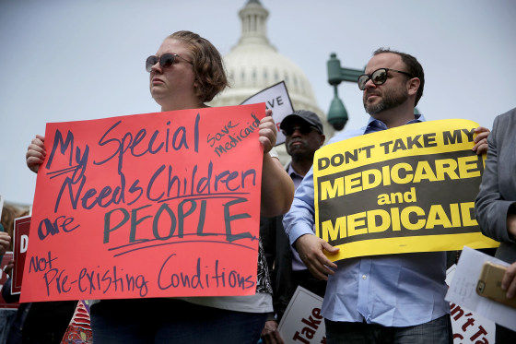
Protect Medicaid
NACDD Strategies
NACDD Hill Meetings
Council Advocacy
Medicaid Threats and Timeline: Congress Budget and Reconciliation
Medicaid Threats and Timeline: Executive Order

Slide 8
Protect Medicaid – NACDD Strategies
Advocating to Members of Congress. NACDD is working with other national cross-disability groups in meetings with members of Congress to express to them the importance of Medicaid.
Researching and Drafting Advocacy Materials. We have sent letters to members of Congress and are in the process of preparing templates for states to use in district meetings.
Educating, Updating and Activating State-Based Advocates. NACDD has regularly briefed our network about threats to Medicaid during all network calls, policy committee meetings and bi-weekly policy office hours. NACDD will prepare and share state templates for councils to use in district meetings.
Preparing for Cross-Disability Medicaid Defense and Public Actions.

Slide 9
Protect Medicaid – NACDD Hill Meetings
All meetings are in person (no virtual option). NACDD staff welcome state specific talking points from councils to prepare for meetings. After meetings, NACDD staff make introductions via email to give ED's the opportunity for future education/outreach.
Completed | Scheduled | Working on scheduling
Miller Meeks (IA-1) Lawler (NY-17) Stauber (MN-8) Valadao (CA-22) Turner (OH-10) (1/21) Baumgartner (WA-5) (1/21) Barrett (MI-7) (1/21) Calvert (CA-41) (1/21) LaLota (NY-1) (1/22) Van Drew (NJ-2) (1/22) | Ciscomani (AZ-6) (1/24) | Begich (AK-AL) Schweikert (AZ-1) Biggs (AZ-5) Kim, Young (CA-40) Hurd (CO-3) Evans (CO-8) Guthrie (KY-2) Massie (KY-4) James (MI-10) Edwards, C (NC-11) Kean (NJ-07) Smith (NJ-4) | Amodei (NV-2) Garbarino (NY-2) Joyce (OH-14) Fitzpatrick (PA-1) Thompson, G.T. (PA-15) Mackenzie (PA-7) Kiggans (VA-2) Newhouse (WA-4)

Slide 10
Protect Medicaid – Council Advocacy
Know the impact of these proposals on your state Medicaid system.
  Use "Medicaid Presentation and Call to Action," a power point used by Wisconsin and Vermont which identifies specific state programs that are impacted by Medicaid cuts. Insert your state data where appropriate and share with your advocates and members of Congress.
  Share any stories and state Medicaid fact sheets with NACDD to use during Hill meetings.
Contact your members of Congress. We encourage all councils to reach out to their members of Congress and remind them of the importance of Medicaid to individuals and state budgets. In person district office meetings are ideal. Take pictures, do the follow up and share with NACDD so we can cross promote with the Washington DC legislative staff. If you don’t know where to start, contact Erin Prangley at eprangley@nacdd.org or attend policy office hours.
Share action alerts! Congressional offices need to hear from advocates. You can share the action alert from our partners at Caring Across Generations at https://bit.ly/40bpOgQ or you can create your own.
Join Protect Medicaid calls for state-based organizations! The next meeting will be January 22 at 1 PM ET / 10 AM PT! By signing up on this list, you will receive the calendar invite. Anyone can learn more and be added to the list through this google form (Link: https://forms.gle/YFznv514UmPYoZhD7)!

Slide 11
Congressional Medicaid Threats and Timeline
The House Republican Budget Committee document includes changes to Medicaid and Medicare that could include Per Capita Caps, Equalize Medicaid Payments for Able Bodied Adults, Limit Medicaid Provider Taxes, Lower FMAP Floor, Special FMAP Treatment for DC, Repeal American Rescue Plan FMAP Incentive, Medicaid Work Requirements. Below is Speaker Johnson's ambitious timeline. Note that the Senate is skeptical that this can get done quickly.
Now ______________________________Opportunities for Advocacy____________________________________>
January 27
February 10 (week of)
February 3
House Budget blueprint passed
House Budget Committee mark up
House passes the budget resolution
Unknown...
House/Senate resolve any differences and send bill to President
April
One big reconciliation bill
Senate passes budget resolution February 24 (week of)

Slide 12
Executive Order Medicaid Threats and Timeline
President Trump executive orders could issue executive orders that would rescind Medicaid policies that are enforced by the Administration. Orders that primarily direct existing agencies to take specific actions or prioritize certain activities can be implemented relatively quickly. Orders that require significant rulemaking, such as those establishing new regulations or creating new programs, can take years to fully implement.
Delays can be caused by: Legal challenges, understaffed or underfunded agencies, resistance from within the agency, administrative procedures when implementing regulations.
Now ______________________________Opportunities for Advocacy____________________________________>
January
Policy experts will review EO's impacting Medicaid.
Agencies prepare plans to comply with APA.
February - ???
Legal Challenges
Public comment available in many instances (not all)
Legal Challenges
Agencies propose rules and changes

Slide 13

Take Away – PACE YOURSELF!
Protect Medicaid Advocacy begins now but
will last through at least April.
Do NOT panic! Stay focused and organize
your grassroots including state coalitions.
Be ready to prioritize multiple issues in addition to Medicaid that will need your attention, including appropriations for DD Councils.
Do NOT let outside organizations steer you away from your strategy. Avoid distractions.

Slide 14
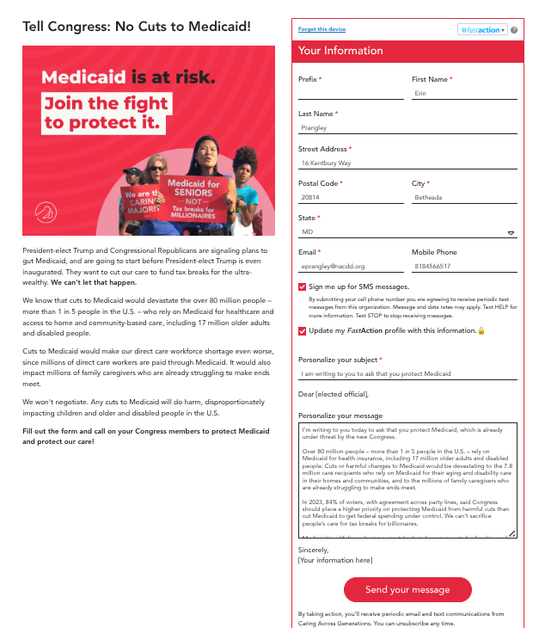
Act Now!
Send a message to the new Congress that cutting or defunding Medicaid would create major gaps in state funding and devastate state budgets.
Any type of cut – whether as block grants, per capita caps, work requirements, or other changes – will take critical care away from millions of people.
Go to this link: https://bit.ly/40bpOgQ

Slide 15
Join US!! NACDD Policy Regular Meetings
These meetings are open to all NACDD members, which include state councils on developmental disabilities, members, staff and leaders with lived experience (self-advocates).
NACDD Policy Committee Monthly Meeting NACDD Policy Committee members meet to discuss federal policy priorities. When: First Thursday of the month, 2pm EST Next Policy Committee meeting is February 6 Link: https://us02web.zoom.us/j/89564062154?pwd=UPZtNla5DJpObNMRQFkTGf8Wp9htxb.1 Meeting ID: 895 6406 2154 | Passcode: 219550 | NACDD State Policy Task Force Meeting This task force focuses on state policy issues and advocacy strategies. Topics include alternatives to guardianship, state budgets, state legislative days, organizing state networks (coalition building) and more. When: Last Tuesday of the month at 12:30pm Next State Task Force meeting is January 28 Link: https://us02web.zoom.us/j/83256338381?pwd=jKSTrPSAdlRClpEiKPNuUJBcj7a22t.1 Meeting ID: 832 5633 8381 | Passcode: 777838
NACDD Medicaid Task Force Meetings This task force focuses on Medicaid issues including federal legislation and agency activities as well as expertise on advocating within state Medicaid plans. When: Last Tuesday of the month at 2:00 PM EST Next Medicaid Task Forcemeeting is January 28 Link: https://us02web.zoom.us/j/85956647049?pwd=ohNhTF9CL2JOVyBK3VHPaO6vsolGFp.1 Meeting ID: 859 5664 7049 | Passcode: 923280 | NACDD Public Policy Hours NACDD staff are available to discuss all things policy every other week. Please send an email toeprangley@nacdd.org if you have any issues you want to discuss during this time. When: Every other week on Fridays at 2-3pm Next Policy Hours is January 31 Link: https://us02web.zoom.us/j/87599614475?pwd=dE9uNTdES09OUzMzV2VIa0JSWUZWdz09 Meeting ID: 875 9961 4475 | Passcode: 318439

Slide 16


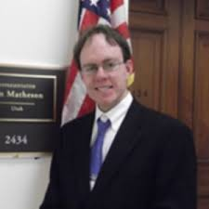

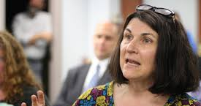
Join our email list!
NACDD's Policy email list is open to all NACDD members (council members, staff and self-advocates). To join go to https://bit.ly/3Ux1PEN

