Slide 1
Federal Policy Update
September 18, 2024
Erin Prangley, Director, Public Policy
National Association of Councils on Developmental Disabilities
Notes:
NACDD serves as the collective voice of the nation’s 56 DD Councils. The mission of DD Councils (and therefore ultimate goal of NACDD) is Systems Change. VABPDD is one of the councils we serve.
I'm here today for a purely selfish reason – we need more self advocates.
Why? Because in order to change systems, we need to change minds. In order to change minds, we need to change hearts.
Heart – Mind – System change.
There is NO ONE who get to the heart of a politician or any decision maker better than a self advocate.

Slide 2
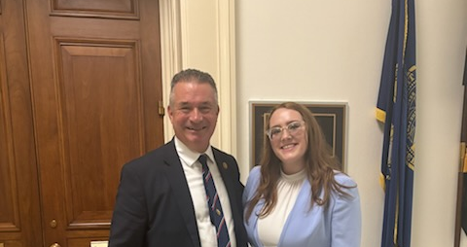
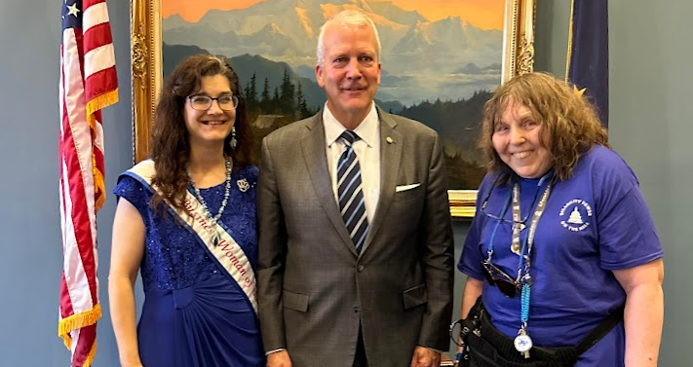
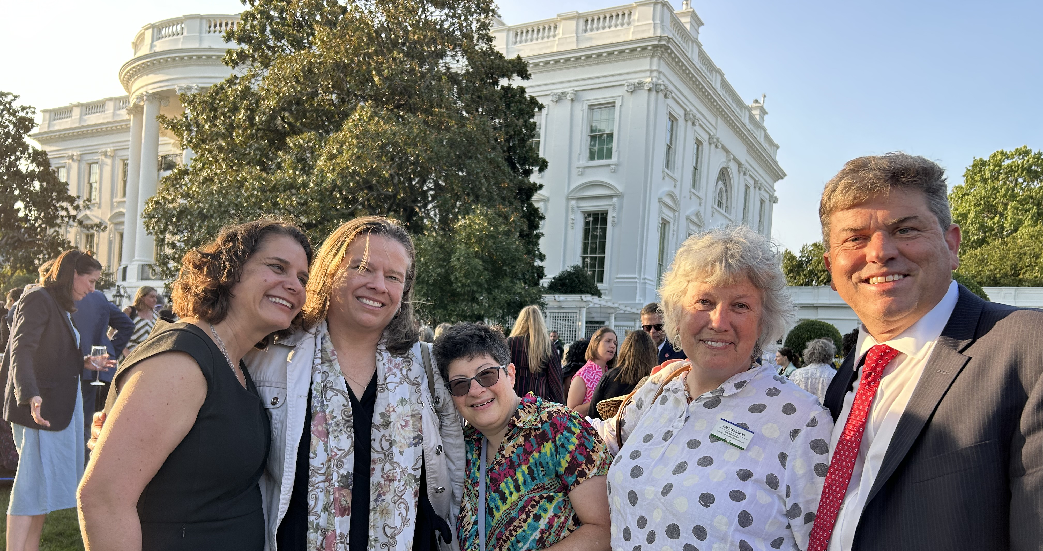
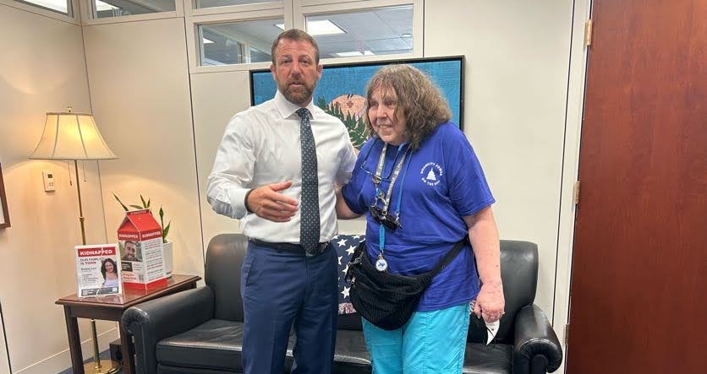
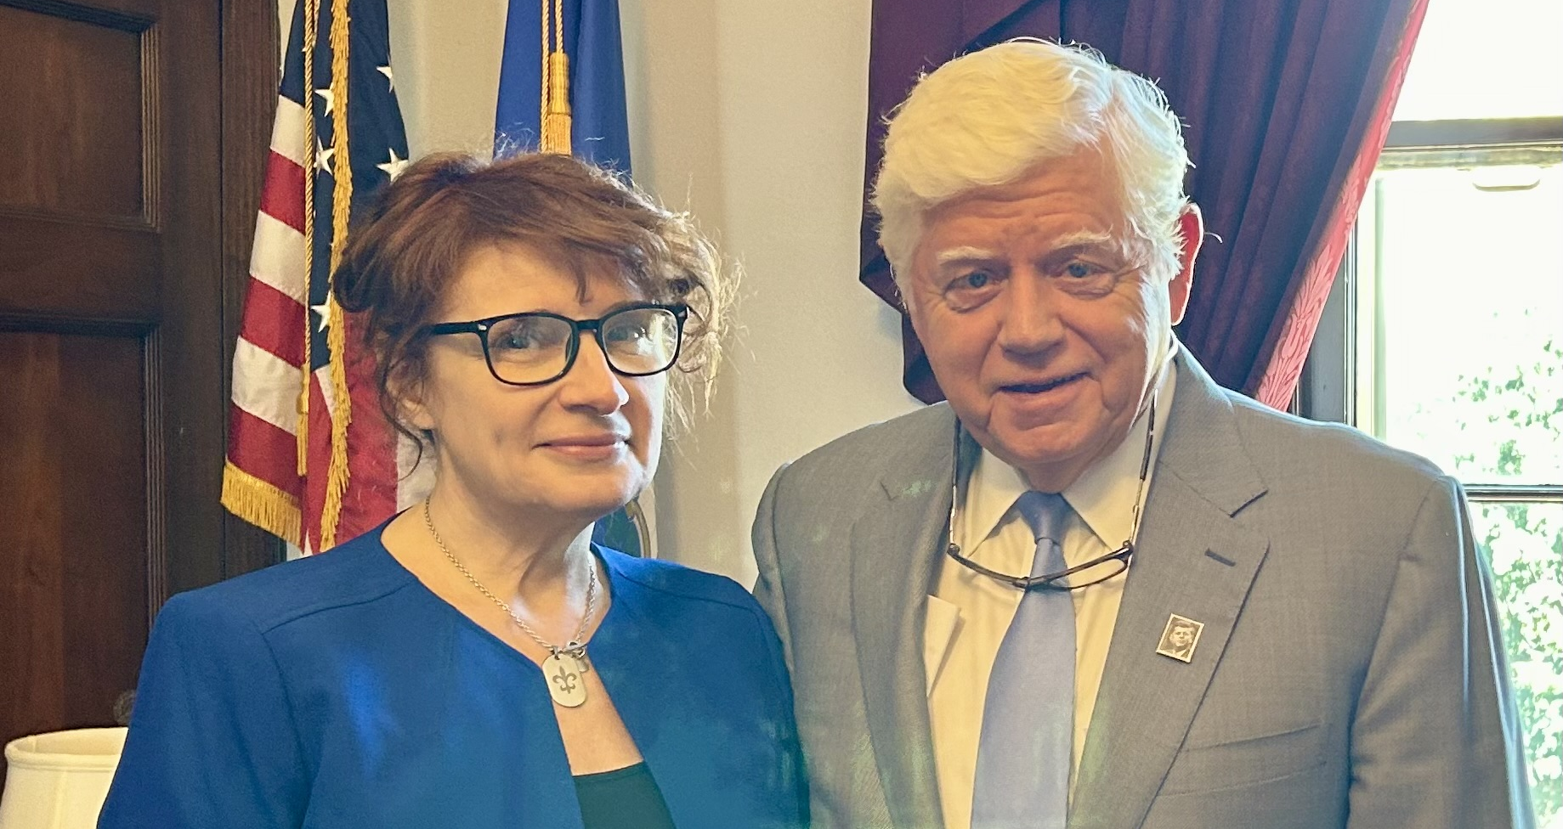
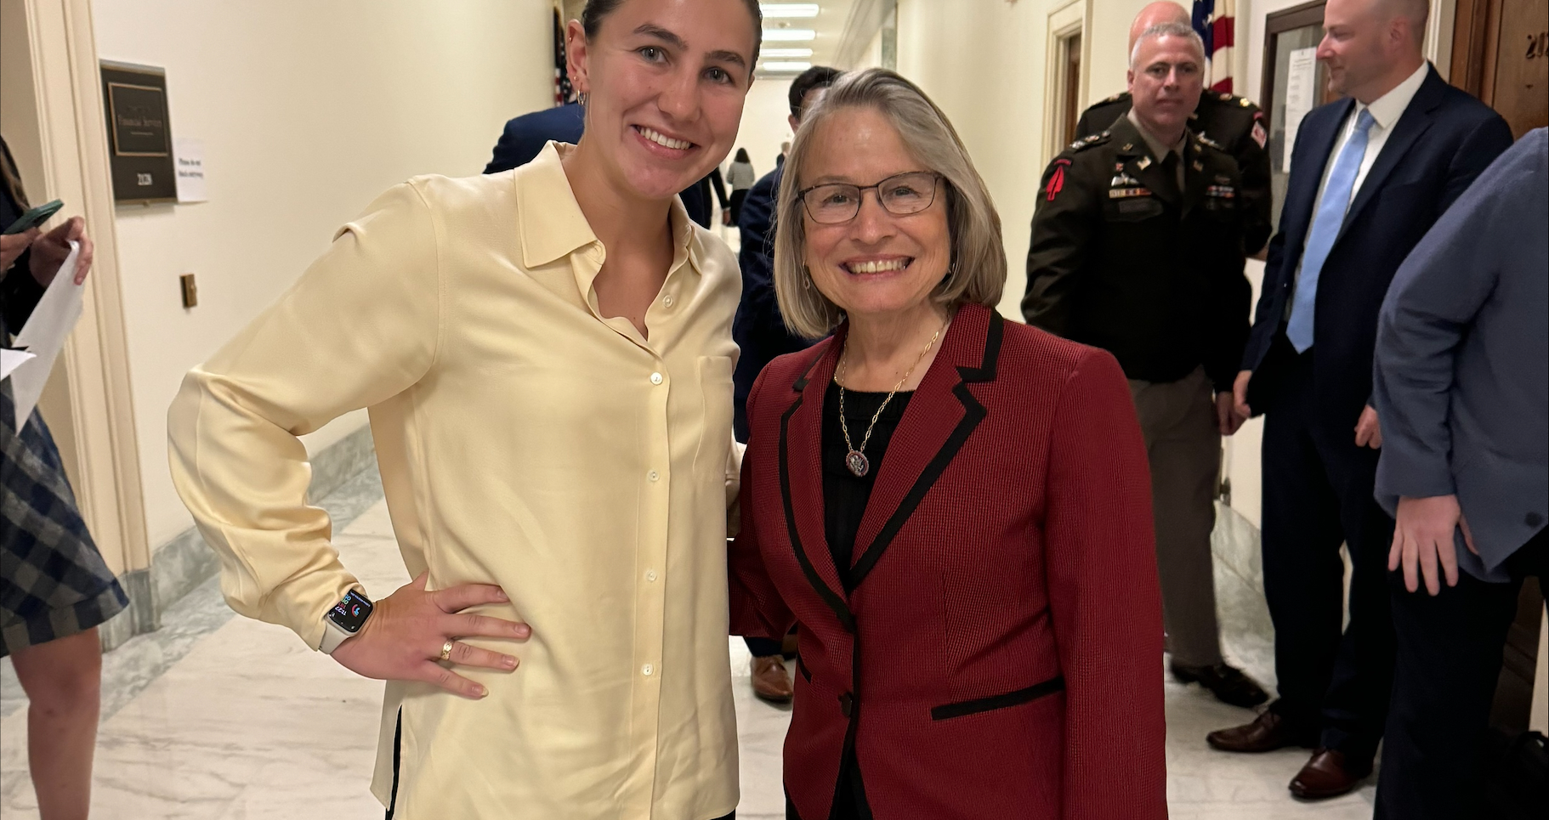
Advocacy Week in Pictures
AAPD Fly-In, White House ADA and Disability Pride Celebration, Hill visits

Slide 3
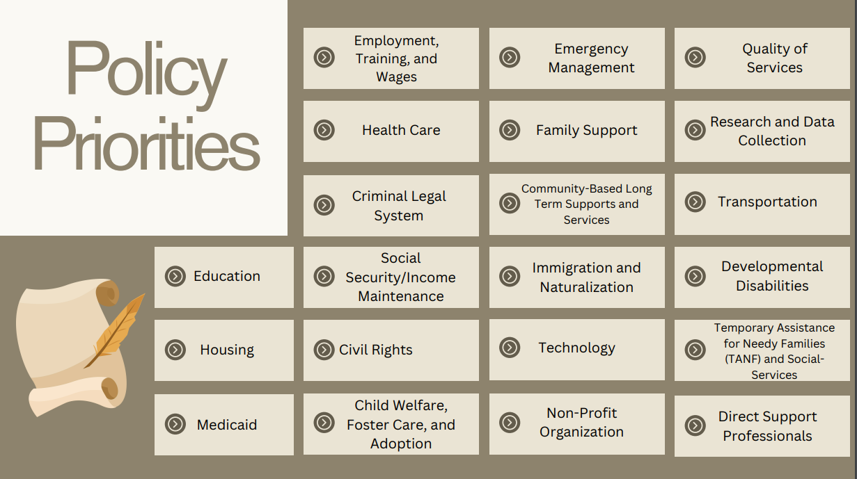

Slide 4

Advocate: Transition to Competitive Integrated Employment Act
What? Ask your senators to support the Transformation to Competitive Employment Act (S.533)(TCIEA).
Why now? TCIEA could be added, as its own separate bill, to the larger workforce package that the Senate Health, Education, Labor & Pensions (HELP) Committee will be marking up in September.
How? Fill out the action alert from the End Subminimum Wage Coalition at https://www.endsubminimumwage.org/ to send your own personal message to your senators!
For more information go to the Senate Committee on Aging TCIEA fact sheet at https://bit.ly/4g9aqZt
Notes:
NACDD serves as the collective voice of the nation’s 56 DD Councils. The mission of DD Councils (and therefore ultimate goal of NACDD) is Systems Change. VABPDD is one of the councils we serve.
I'm here today for a purely selfish reason – we need more self advocates.
Why? Because in order to change systems, we need to change minds. In order to change minds, we need to change hearts.
Heart – Mind – System change.
There is NO ONE who get to the heart of a politician or any decision maker better than a self advocate.

Slide 5

Policy Committee Meeting
**Don’t miss this one as we will be discussing Policy Priorities for the next Congress!
Thursday, October 10, 2pm Eastern
Join Zoom Meeting https://us02web.zoom.us/j/86855422349?pwd=Vjdnc3I0Um90NjVwYzJUdGxDRXJpUT09
Meeting ID: 868 5542 2349
Passcode: 973195
Next Policy Office Hour
Friday, September 27
Join Zoom Meeting
https://us02web.zoom.us/j/87599614475?pwd=dE9uNTdES09OUzMzV2VIa0JSWUZWdz09
Meeting ID: 875 9961 4475
Passcode: 318439
NACDD Public Policy Listservs
Stay up to date on policy issues! Open to Council members, staff and self-advocates.
To join go to https://bit.ly/3Ux1PEN

