Slide 1
Federal Policy Update
June 26, 2024
Erin Prangley, Director, Public Policy
National Association of Councils on Developmental Disabilities
Notes:
NACDD serves as the collective voice of the nation’s 56 DD Councils. The mission of DD Councils (and therefore ultimate goal of NACDD) is Systems Change. VABPDD is one of the councils we serve.
I'm here today for a purely selfish reason – we need more self advocates.
Why? Because in order to change systems, we need to change minds. In order to change minds, we need to change hearts.
Heart – Mind – System change.
There is NO ONE who get to the heart of a politician or any decision maker better than a self advocate.

Slide 2
What's going on in Congress right now?
House FY25 Labor, Health and Human Services, and Education, and Related Agencies
Department of Labor (DOL) | -$3B (22%)
Department of Health and Human Services (HHS) | -$7.5B (6.4%)
Department of Education (ED) | -$11B (14%)
Related Agencies | -$453M from the Social Security Administration’s (SSA) operating expenses
FY25 Appropriations will dominate this week and after they return from 4th of July recess.
FY25 Labor, Health and Human Services, and Education, and Related Agencies funding bill includes $198.4 billion, a cut of $24.6 billion, or 11 percent, below the fiscal year 2024 level.
Lots of riders on labor, women’s health (abortion and fetal research), block implementation of antidiscrimination regulations (Section 1557, Title IX, more).

Slide 3
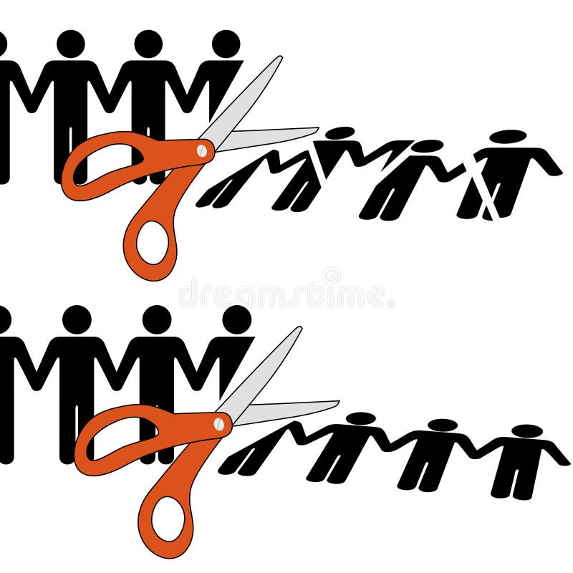
Labor HHS Approps
Administration for Community Living (ACL) – The bill includes $2.5 billion for ACL, a decrease of $21 million below the 2024 level (excluding Community Project Funding) and $136 million below the 2025 request.
We will learn more about programatic cuts in the next few weeks when the committee writes their report.

Slide 4

Stop the Shock Update
Since 2014, NACDD worked with national groups to oppose the use of aversive shock therapy at the JRC. Some members of Congress recently snuck in a provision in the subcommittee passed FY25 Ag-FDA Appropriations bill that would allow this practice to continue.
NACDD is part of the working group meeting with appropriations members to oppose Sec. 722 of the FY25 Ag-FDA Appropriations Bill.
How you can help
A sign on letter for state organizations opposing this rider is open until July 1. https://bit.ly/3XFdfKQ
An action alert you can share with your membership is at https://autisticadvocacy.org/2024/06/action-alert-call-in-days-to-stoptheshock/
Background and talking points from ASAN are available at https://bit.ly/3XB7Moz.

Slide 5

Policy Committee Meeting
Thursday, July 11, 2pm Eastern
Join Zoom Meeting https://us02web.zoom.us/j/86855422349?pwd=Vjdnc3I0Um90NjVwYzJUdGxDRXJpUT09
Meeting ID: 868 5542 2349
Passcode: 973195
No Policy Office Hours next week.
NACDD Public Policy Listservs
Stay up to date on policy issues! Open to Council members, staff and self-advocates.
To join go to https://bit.ly/3Ux1PEN

