Slide 1
Federal Policy Update
May 22, 2024
Erin Prangley, Director, Public Policy
National Association of Councils on Developmental Disabilities
Notes:
NACDD serves as the collective voice of the nation’s 56 DD Councils. The mission of DD Councils (and therefore ultimate goal of NACDD) is Systems Change. VABPDD is one of the councils we serve.
I'm here today for a purely selfish reason – we need more self advocates.
Why? Because in order to change systems, we need to change minds. In order to change minds, we need to change hearts.
Heart – Mind – System change.
There is NO ONE who get to the heart of a politician or any decision maker better than a self advocate.

Slide 2
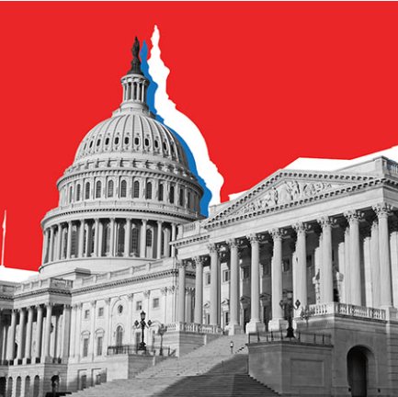
What's going on in Congress right now?
Senate will reconsider the bipartisan Border Control Act which will fail.
House and Senate leave for Memorial Day Recess on Thursday.
Upon their return, they will focus on FY2025 appropriations; the National Defense Authorization Act; Older Americans Act.
CARES Act (HR 7213) was unanimously approved by the House E&C Subcommittee on Health. Deadline for final passage is still Sept. 30

Slide 3
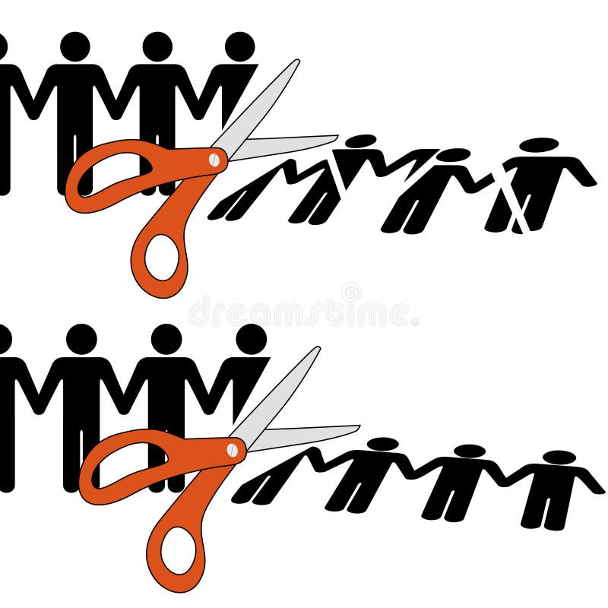
Appropriations - House
New Chairman Cole
House 302B Released
  Fully funded / Increases: Defense (+9B), Homeland Security, Veterans Affairs.
  Cuts: Non-defense programs will be cut effectively by 6%, and those cuts are not evenly distributed. Labor-Health and Human Services-Education -10-11%. Other subcommittees will have smaller non-defense cuts, reflecting Republican priorities across the bills.
No “side deal” agreed to in last year's debt ceiling deal.
The Labor HHS bill will be marked up in subcommittee on June 27 and full committee on July 10.

Slide 4

Senate Champions
AZ Mark Kelly (D) AZ Krysten Sinema (I) CA Alex Padilla (D) CO M. Bennett (D) CT R. Blumenthal (D) CT Chris Murphy (D) HI Mazie Hirono (D) HI Brian Schatz (D) MA E. Markey (D) | MA E. Warren (D) MD C. Van Hollen (D) MN A. Klobuchar (D) MN Tina Smith (D) MT John Tester (D) NH M. Hassan (D) NJ Cory Booker (D) NM Ben Lujan (D) NY K. Gillibrand (D) | OH Sherrod Brown (D) OR Jeff Merkley (D) OR Ron Wyden (D) PA Bob Casey (D) RI Jack Reed (D) VA Tim Kaine (D) VT Bernie Sanders (I) VT Peter Welch (D) WA Maria Cantwell (D)
New Signers in italics.
Lost: MD Ben Carden (D); NH Jeanne Shaheen (D); NV Catherine Cortez Masto (D)

Slide 5

Policy Committee Meeting
Thursday, June 6, 2pm Eastern
Join Zoom Meeting https://us02web.zoom.us/j/86855422349?pwd=Vjdnc3I0Um90NjVwYzJUdGxDRXJpUT09
Meeting ID: 868 5542 2349
Passcode: 973195
Policy Office Hours
Friday, May 24, 2pm Eastern
(Every other Friday.)
Join Zoom Meeting
https://us02web.zoom.us/j/87599614475?pwd=dE9uNTdES09OUzMzV2VIa0JSWUZWdz09
Meeting ID: 875 9961 4475
Passcode: 318439
NACDD Public Policy Listservs
Stay up to date on policy issues! Open to Council members, staff and self-advocates.
To join go to https://bit.ly/3Ux1PEN

