Slide 1
Federal Policy Update
May 1, 2024
Erin Prangley, Director, Public Policy
National Association of Councils on Developmental Disabilities
Notes:
NACDD serves as the collective voice of the nation’s 56 DD Councils. The mission of DD Councils (and therefore ultimate goal of NACDD) is Systems Change. VABPDD is one of the councils we serve.
I'm here today for a purely selfish reason – we need more self advocates.
Why? Because in order to change systems, we need to change minds. In order to change minds, we need to change hearts.
Heart – Mind – System change.
There is NO ONE who get to the heart of a politician or any decision maker better than a self advocate.

Slide 2



HCBS Report Update
THANK YOU!
All 51 states + DC responded to the survey – ensuring every council is represented in the results!
DRAFT
First draft of the report has been created, and we are in the process of editing.
FOLLOW-UPS
As some states may have noticed, we are following up via email with questions for clarification and/or expansion.
Please be on the lookout for any emails asking follow-up questions or to set up a call if we have questions

Slide 3

Section 1557 Final Rule
"Section 1557 prohibits discrimination on the basis of race, color, national origin, sex, age, or disability in certain health programs and activities."
We are really excited about the expansion of antidiscrimination protections!
Vast majority of changes were the reinstatement of the 2016 Obama-era rule
Of note:
  Classifying Medicare Part B funds and federal financial assistance
  Applying Section 1557 to any program or activity that is administered by an executive agency or any entity established under title I of the ACA

Slide 4

See statement and more policy news at https://nacdd.org/publications/

Slide 5
House DD Act Funding Champions
AL Terri Sewell (D) AL Mike Rodgers (R) AZ Raul Grijalva (D) CA Jimmy Pannetta (D) CA Brad Sherman (D) CA Mike Thompson(D) CA Mark DeSaulnier(D) CA Doris Matsui (D) CMNI G. Sablan (D) CT Jahana Hayes (D | DC Eleanor Norton (D) DE Lisa Blunt-Rochester (D) GA Lucy McBath (D) GA Nikema Williams (D) IL NIkki Budzinski (D) IL Sean Casten (D) IL Danny Davis (D) IL Jonathan Jackson (D) IL Jan Schakowsky (D) KS Sharice David (D) | MA Seth Moulton (D) MA Stephen Lynch (D) MD Glen Ivey (D) MD John Sarbanes (D) MD Jamie Raskin (D) MI Debbie Dingell (D) MI Daniel Kildee (D) MI Elissa Slotkin (D) MN Dean Phillips (D) MN Chellie Pingree (D) | NC Alma Adams (D) NH Annie Kuster (D) NJ J. Gottheimer (D) NJ Andy Kim (D) NJ Thomas Kean (R) NV Dina Titus (D) NY D. Goldman (D) NY Jerry Nadler (D) NY Paul Tonko (D) NY Mike Lawler (R) | NY Marc Molinaro (R) OR Andrea Salinas (D) PA Jen. McClellan (D) PA Brian Fitzpatrick (R) RI Seth Magaziner (D) TN Steve Cohen (D) VA Donald Beyer (D) VA A. Spamberger(D) VT Becca Balint (D) WI Gwen Moore (D)

Slide 6
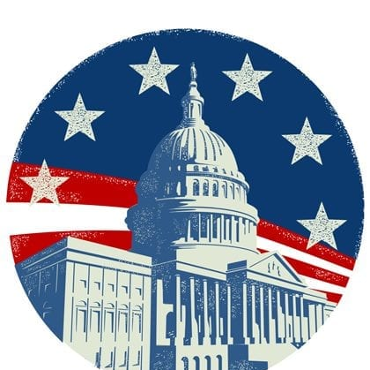
Policy Committee Meeting
Thursday, May 2, 2pm Eastern
Join Zoom Meeting
https://us02web.zoom.us/j/82156490017?pwd=amdsUTliajUrVllwbit1WHR4VmxpUT09
Meeting ID: 821 5649 0017
Passcode: 754454
Policy Office Hours
Friday, May 10, 2pm Eastern
(Every other Friday.)
Join Zoom Meeting
https://us02web.zoom.us/j/87599614475?pwd=dE9uNTdES09OUzMzV2VIa0JSWUZWdz09
Meeting ID: 875 9961 4475
Passcode: 318439
NACDD Public Policy Listservs
Stay up to date on policy issues! Open to Council members, staff and self-advocates.
To join go to https://bit.ly/3Ux1PEN

