Slide 1
NACDD Policy Update
March 6, 2024
Erin Prangley, Director, Public Policy
Notes:
NACDD serves as the collective voice of the nation’s 56 DD Councils. The mission of DD Councils (and therefore ultimate goal of NACDD) is Systems Change. VABPDD is one of the councils we serve.
I'm here today for a purely selfish reason – we need more self advocates.
Why? Because in order to change systems, we need to change minds. In order to change minds, we need to change hearts.
Heart – Mind – System change.
There is NO ONE who get to the heart of a politician or any decision maker better than a self advocate.

Slide 2
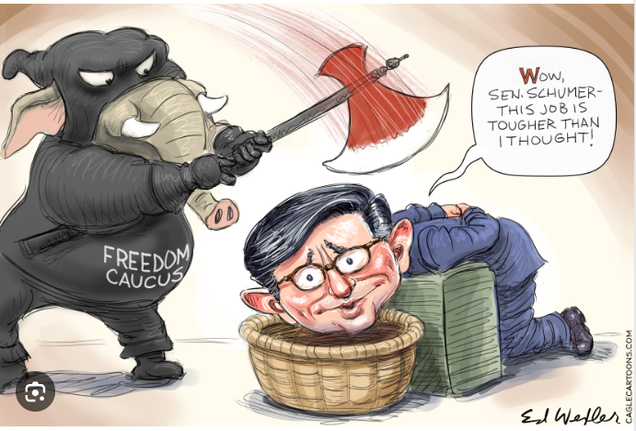
What's going on in Congress right now?
The House and the Senate agreed to two more continuing resolutions since we last met – so we still don't know how funding will be spent for FY2024 or FY2025 for that matter.
On Friday, the Senate is expected to pass funding bills for several departments, but not others. (See next slide.)
The next deadline is March 22, for most of the controversial bills that need to pass including our bill (Labor HHS).
Other issues? Tax bill not finalized; foreign affairs is a mess.

Slide 3
More CR and ½ Way to Appropriations?
New CR's extend shutdown deadline to March 8 and March 22.
Compromise text for six spending bills included good and bad news but will pass this week.
Negotiations continue on our appropriations bill and riders are likely.
Transportation, Veterans Affairs, Energy, Agriculture, Interior, and Housing and Urban Development, Environmental Protection Agency and Food and Drug Administration.
Good +1B for Women, Infants, and Children nutrition assistance program Increases for Homeless Assistance, veterans and youth housing. No Poison pill riders. | Bad $75B total is a 3% reduction from FY23 and $10B less than President’s Budget -3.2B across 19 DOT and HUD grant programs Cuts to the FBI (6%), ATF (7%), and EPA (9.6%).

Slide 4

What does this mean for DD Councils?
DD Council Funding:
The CR continues level 2023 funding through March 22.
The Senate-passed Labor HHS Appropriations bill report language maintains $81M (2023 level).
The House "report" (not official committee report) also maintains $81M (2023 level).
NACDD's take:
Level funding is still supported by the Senate (bipartisan) and the White House, but the House wants more spending cuts and riders (abortion, political). Johnson's compromise on first round will mean a lot of pressure to cut in the second.

Slide 5
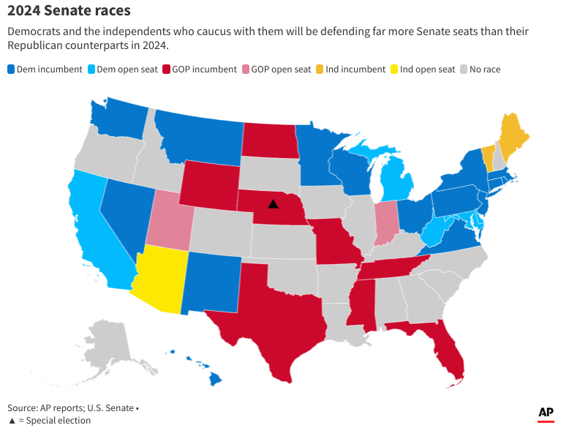
Elections looming...
McConnell steps down from Senate leadership in November.
Sen. Sinema announces she will not seek reelection. Cites incresing partisanship.
R's looking to control the Senate. Democrats will be forced to defend 23 seats, including Sinema’s and two others held by independents who usually vote with Democrats, compared with 10 seats for Republicans.

Slide 6
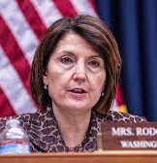
Focus on Employment
Transformation to Competitive Integrated Employment Act (bipartisan/bicameral) - Phases out paying workers with disabilities subminimum wage. TCIEA got a hearing last week in the Senate. See full hearing here https://bit.ly/49X6KGj
NACDD is going to ask the councils at DPS to focus on Transition to Competitive and Integrated Employment during their DPS visits to Capitol Hill.

Slide 7
Other News
Sen. Warnock reintroduced John R. Lewis Voting Rights Advancement Act which would update and restore critical safeguards of the original Voting Rights Act of 1965 that have been eroded in recent years by federal court rulings. There will be a hearing on the bill on Tuesday, March 12.
Updated CDC Covid guidence will now urge individuals with the virus to stay home and away from others, but says they can return to normal activities when they have been fever-free and their symptoms are improving for at least 24 hours, wear a mask, maintain distance from others, practice enhanced hygiene and take other preventive steps for five days. See CDC Press Release at https://www.cdc.gov/media/releases/2024/p0301-respiratory-virus.html

Slide 8

Policy Committee Meeting
Thursday, March 7, 2pm Eastern
Join Zoom Meeting
https://us02web.zoom.us/j/82156490017?pwd=amdsUTliajUrVllwbit1WHR4VmxpUT09
Meeting ID: 821 5649 0017
Passcode: 754454
NACDD Public Policy Listservs
1) Policy List open to all NACDD members (council members, staff and self-advocates)
To join go to https://bit.ly/3Ux1PEN
2) State Policy Committee
To join go to https://forms.gle/yUKXvRRE5cKN1DDi8

