Slide 1
NACDD Policy Update
January 10, 2024
Erin Prangley, Director, Public Policy and
Catherine Citta, LMSW, Joseph P. Kennedy Jr. Foundation Public Policy Fellow
Notes:
NACDD serves as the collective voice of the nation’s 56 DD Councils. The mission of DD Councils (and therefore ultimate goal of NACDD) is Systems Change. VABPDD is one of the councils we serve.
I'm here today for a purely selfish reason – we need more self advocates.
Why? Because in order to change systems, we need to change minds. In order to change minds, we need to change hearts.
Heart – Mind – System change.
There is NO ONE who get to the heart of a politician or any decision maker better than a self advocate.

Slide 2
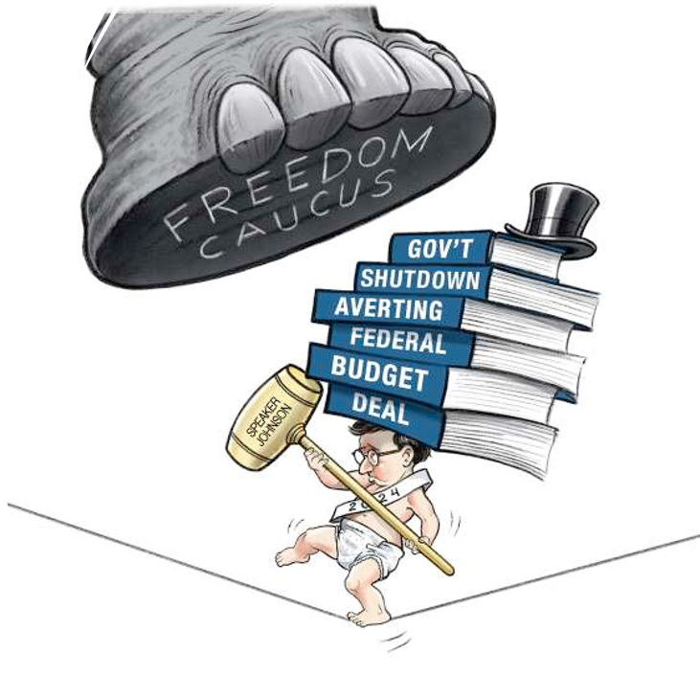

Appropriations: The Big Picture for FY24
Months past due, Congressional leaders have agreed to a "Top Line" Appropriations amount:
$1.659 trillion - $1.59 trillion topline, plus roughly $69 billion in budget tweaks to plus-up nondefense dollars keeping funding relatively flat for 2024.
Additional $10 billion in cuts to IRS mandatory funding and a $6.1 billion clawback of unspent COVID-19 funds.
No agreement on clean bills without policy riders.

Slide 3
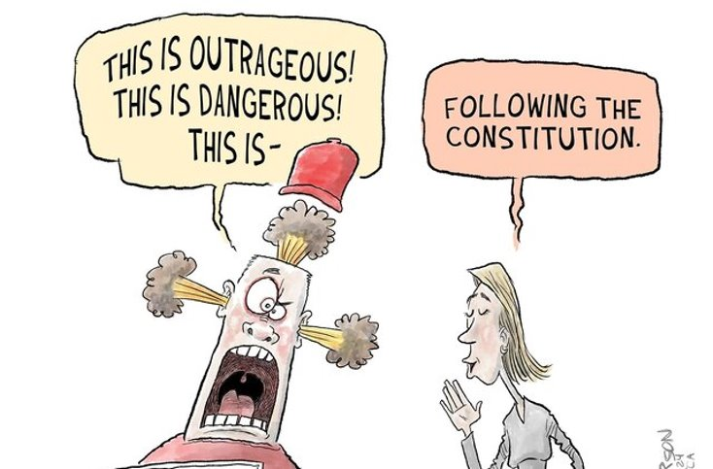
Appropriations: The Big Picture for FY24
"No Money shall be drawn from the Treasury, but in Consequence of Appropriations made by Law..." U.S. Constitution Article I, Section 9, Clause 7 ("Appropriations Clause")
Timeline: Committee needs time to write the bills; likely to push to March with a CR. Must pass before April to avoid sequestration in FRA. (Which would look like a 9% cut to NDD.)
"Poison pill" riders: House bills drafted contained more than 560 poison pill riders – many of them culture war provisions that attack women, immigrants, people of color, and LGBTQ+ Americans. If any are included in House bill, the Senate unlikely to follow and would have to be conferenced.
Weak Speaker: Johnson's inability to lead his Caucus means he needs to work with Democrats or tank the whole thing with a shutdown.

Slide 4
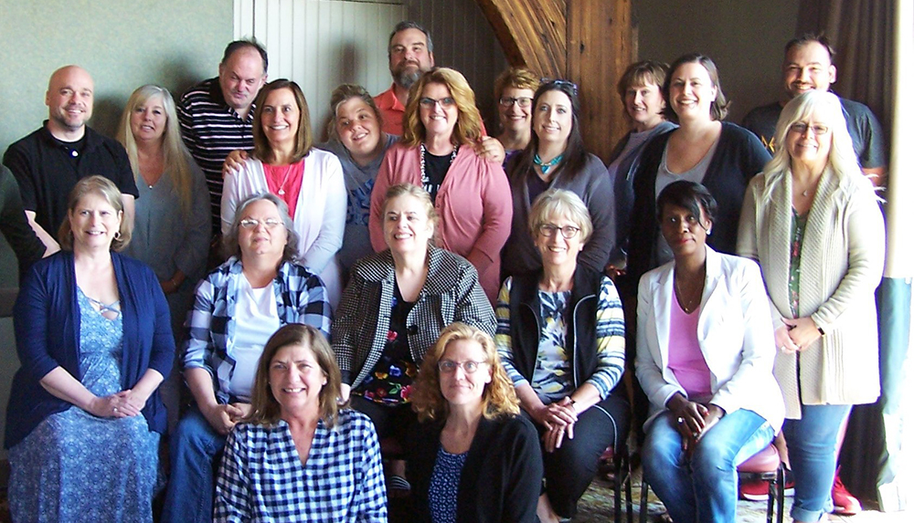
Appropriations: What does this top line deal mean for DD Councils?
  NACDD is in contact with committee staff on program amounts (302B's). The good news is that both the House and Senate support level funding at $81M in their previously reported language. We are pressing to keep it that way.
  NACDD continues to work with coalitions on opposing other cuts to programs we care about and partisan riders that have nothing to do with appropriations. Examples: Clean Budget Coalition letter opposing riders; Coalition on Human Needs supporting funding levels for critical programs; WIC Call in Day of Action.
  NACDD is moving forward with FY25 work which will likely be delayed due to failure to move FY24. Councils are providing necessary information for our $85M request.
Missouri Developmental Disabilities Council at https://moddcouncil.org/

Slide 5

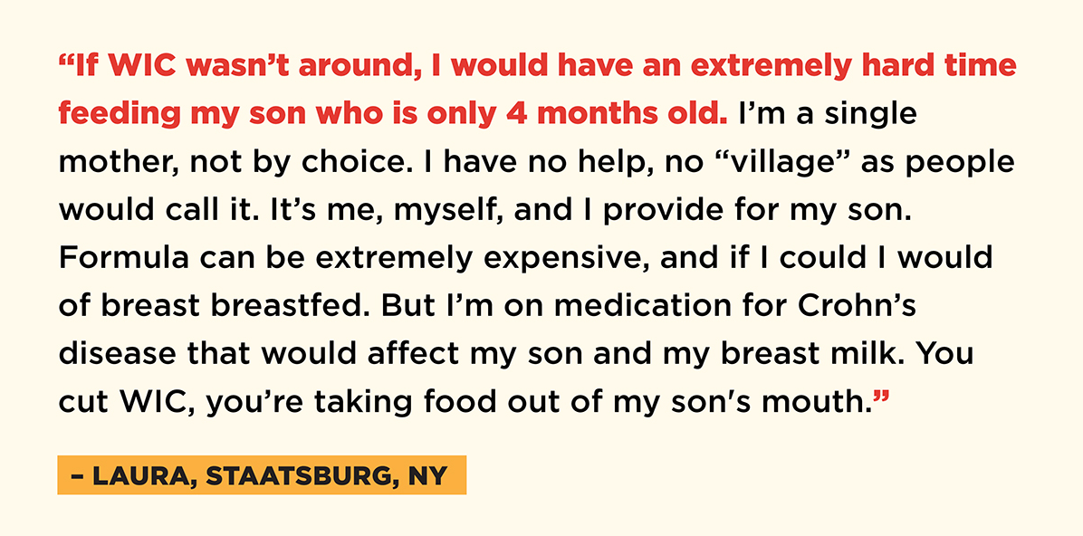
WIC Call in Day
MomsRising Fund WIC Call-In Line for January 10th call-in day (note: the call-in line is active now and can be used at any time):
https://actionnetwork.org/call_campaigns/tell-your-senators-to-fully-fund-wic-immediately/ or text FundWIC to 888-418-5699
Hashtags: #FundWIC #WIC

Slide 6
Policy Committee Updates
Taskforces: State Policy, Medicaid, Universal Changing Tables
Public Policy Office Hours starting February 2, 2pm-3pm Eastern
Developmental Disabilities Awareness Month Resource Fair, March 12
Disability Policy Seminar, April 8-10
https://disabilitypolicyseminar.org/registration-information/
Net Inclusion Panel, February 13. Looking for examples of DD Council best practices to promote digital equity in the states. Please email eprangley@nacdd.org

Slide 7

Policy Committee Meeting
Thursday, February 1, 2pm Eastern
Join Zoom Meeting
https://us02web.zoom.us/j/82156490017?pwd=amdsUTliajUrVllwbit1WHR4VmxpUT09
Meeting ID: 821 5649 0017
Passcode: 754454
NACDD Public Policy Listservs
1) Policy list is open to all NACDD members
(council members, staff and self-advocates)
To join go to https://bit.ly/3Ux1PEN
2) State Policy Committee
To join go to https://forms.gle/yUKXvRRE5cKN1DDi8

