Slide 1
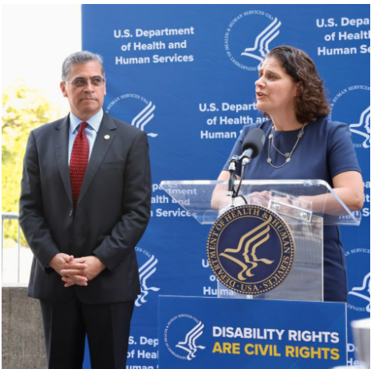
HHS 504 Updated Rule
When people talk about Section 504, they’re talking about Section 504 of the Rehabilitation Act of 1973. Before the Americans with Disabilities Act (ADA) existed, people with disabilities relied on Section 504 to defend ourselves from discrimination in federal programs. Federal program means any program that the US government runs.
Health and Human Services (medical services) is updating their 504 so it covers modern issues like:
Discrimination in Medical Treatment
Child welfare programs and activities (keeping kids with their parents with disabilities)
Web and mobile accessibility
Accessible medical equipment
See Fact Sheet and how to Comment at https://www.hhs.gov/civil-rights/for-individuals/disability/section-504-rehabilitation-act-of-1973/fact-sheet/index.html
Comments on the proposed rule are due November 13, 2023.

Slide 2
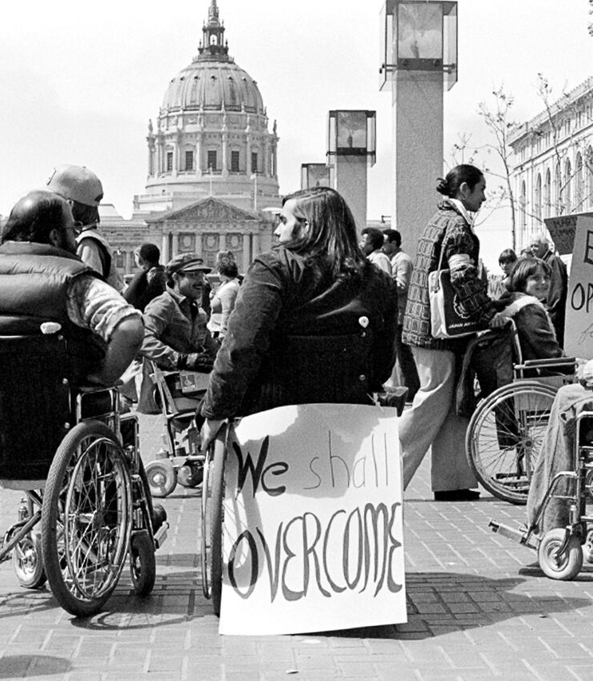
Section 504 NPRM: Updating HHS Anti-Discrimination Regulation
If you want a refresher on 504 watch Drunk History at https://www.cc.com/video/2p86bg/drunk-history-judy-heumann-fights-for-people-with-disabilities Trigger warning: Alcohol use.
The law is so old and needs to be updated. Advocates need to weigh in.
Self-Advocate Toolkits:
Autistic Self Advocacy Network (ASAN) at https://autisticadvocacy.org/2023/10/comment-on-proposed-section-504-changes/
NACDD/Autism Society of America (Expected release: 10/23) We will send the toolkit to you when it is ready.
2) State DD Council Template (Expected release: 11/3). Your council will be encouraged to comment. Talk with them if you have ideas.
3) NACDD Comments (Expected release: 11/13). NACDD will work with national groups to send comments.

Slide 3

NACDD Webinar: Advancing Access and Equity: Moving Away From Sheltered Workshops Towards Competitive Integrated Employment, Thursday, October 19, 3PM EST. ​
Featuring:​
David Pinno, BPDD Board Member and Self-Advocate​
Julie Christensen, Executive Director, Director of Policy & Advocacy at APSE​
Kimberly Palma-Ortega, Public Health Liaison, Nevada DD Council​
Register: https://us02web.zoom.us/meeting/register/tZckceysrT4vEtRBNyGeFEiZeisCeDtqKERS​

Slide 4

Policy Committee Meeting
Thursday, November 2, 2pm Eastern
Join Zoom Meeting
https://us02web.zoom.us/j/82156490017?pwd=amdsUTliajUrVllwbit1WHR4VmxpUT09
Meeting ID: 821 5649 0017
Passcode: 754454
NACDD Public Policy Listservs
1) Policy List open to all NACDD members (council members, staff and self-advocates)
To join go to https://bit.ly/3Ux1PEN
2) State Policy Committee
To join go to https://forms.gle/yUKXvRRE5cKN1DDi8

