Slide 1
Policy Committee Update
September 20, 2023
Erin Prangley, Director, Public Policy
National Association of Councils on Developmental Disabilities
Notes:
NACDD serves as the collective voice of the nation’s 56 DD Councils. The mission of DD Councils (and therefore ultimate goal of NACDD) is Systems Change. VABPDD is one of the councils we serve.
I'm here today for a purely selfish reason – we need more self advocates.
Why? Because in order to change systems, we need to change minds. In order to change minds, we need to change hearts.
Heart – Mind – System change.
There is NO ONE who get to the heart of a politician or any decision maker better than a self advocate.

Slide 2

Appropriations
Gamesmanship is laying the groundwork for serious cuts.
McCarthy struggling to pass 30-day CR that would be DOA in Senate.
Senate could send back a CR that sticks to McCarthy/Biden deal, but McCarthy would need some D's and R's to support.
If the House can't pass anything, Senate can originate a CR but Sen. Schumer needs McConnell and 60 votes to go first.

Slide 3
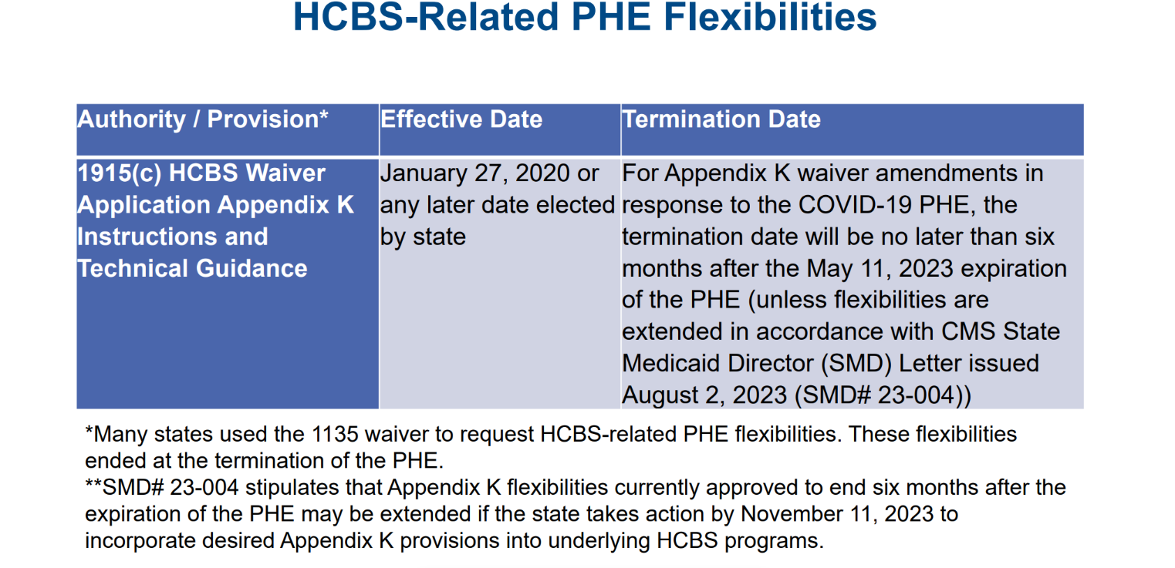
YIKES! Expiration of K waivers

Slide 4
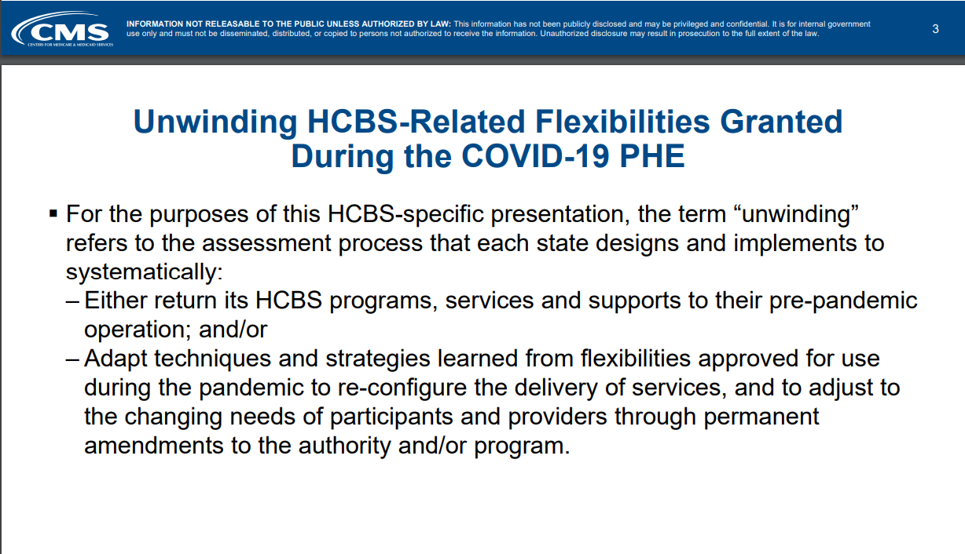
Expiring K waiver options

Slide 5
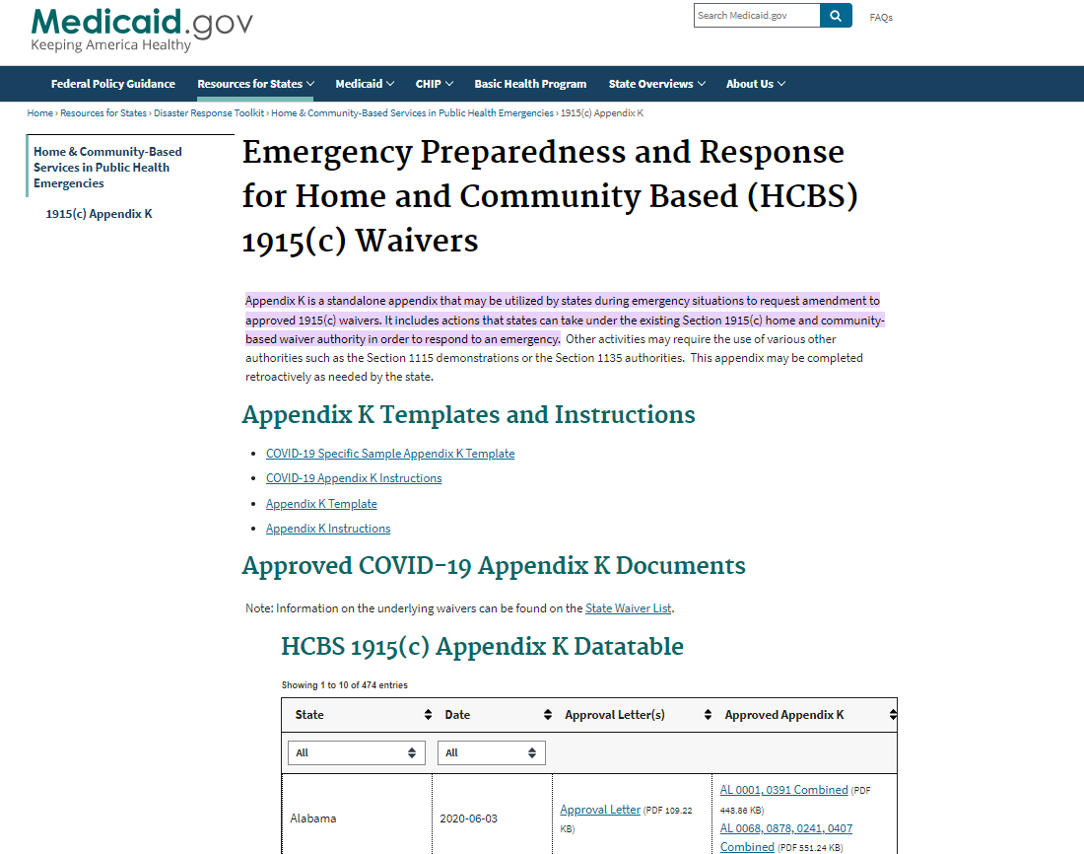
Does my state have expiring K waivers?
Probably.
Some provisions states offered through their Appendix Ks
Include:
Telehealth evaluations, assessments, and person-centered planning meetings.
Thirty-nine states included an expansion of payment of family caregivers for services rendered.
Rate increases for DSPs.
Check whether your state has K waivers at link below.
https://www.medicaid.gov/resources-for-states/disaster-response-toolkit/home-community-based-services-public-health-emergencies/emergency-preparedness-and-response-for-home-and-community-based-hcbs-1915c-waivers/index.html#:~:text=Appendix%20K%20is%20a%20standalone,to%20respond%20to%20an%20emergency

Slide 6
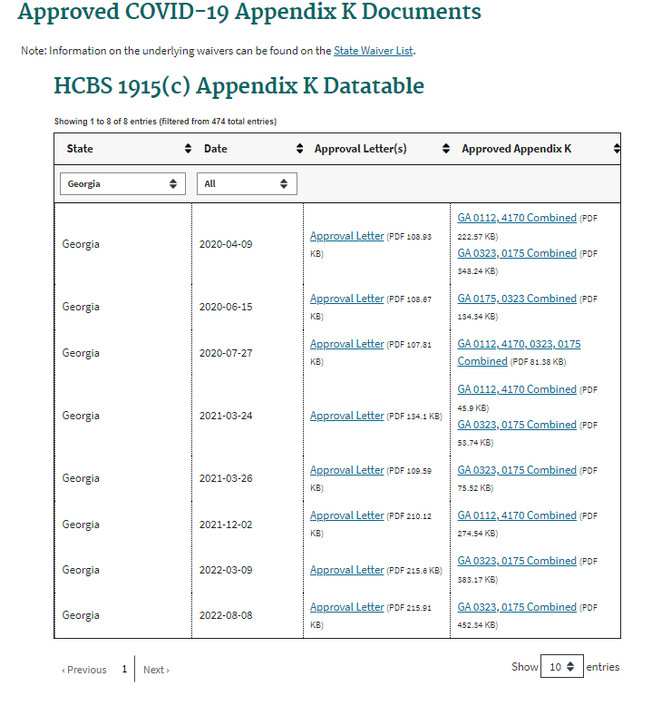
Georgia
Programs impacted:
Elderly and Disabled Waiver (EDWP) Independent Care Waiver Program (ICWP) Comprehensive Supports Waiver Program (COMP) New Options Waiver (NOW)
Medicaid services ending if not extended:
Telehealth
Rate increases
Retainer payments
[Elderly and Disabled and the ICWP waiver programs rate increase of 10% applied to all services in both Waiver Programs. Within six months after the conclusion of the state of emergency, Georgia will submit Waiver Amendment applications for both the Independent Care Waiver Program and the Elderly and Disabled Waiver Program to permanently establish the increased rates.]

Slide 7
Review K waivers
Determine if a specific flexibility had a positive impact on the way HCBS were delivered and should be included in a waiver renewal/amendment or a state plan amendment.
Meet with State Medicaid Director and/or DD Agency to determine status of the K waiver. Can it be part of the 1115 waiver? If so, need to act before Nov. 11.
Prepare to resume operational procedures without COVID-19 PHE flexibilities. – Provide individuals with the training and support needed to re-integrate into their community after the PHE.
K Waiver Plan

Slide 8

504 Updated Rule
Section 504 covers all health care and human services programs and activities funded by HHS, from hospitals and doctors that accept Medicare or Medicaid to states’ child welfare programs.
The proposed rule updates the current Section 504 regulations to clarify several crucial areas not explicitly addressed in that rule:
Medical Treatment
Value assessment methods (QALYs)
Child welfare programs and activities
Web and mobile accessibility
Accessible medical equipment
Integration
See Fact Sheet and how to Comment at https://www.hhs.gov/civil-rights/for-individuals/disability/section-504-rehabilitation-act-of-1973/fact-sheet/index.html
Comments on the proposed rule are due November 13, 2023.

Slide 9
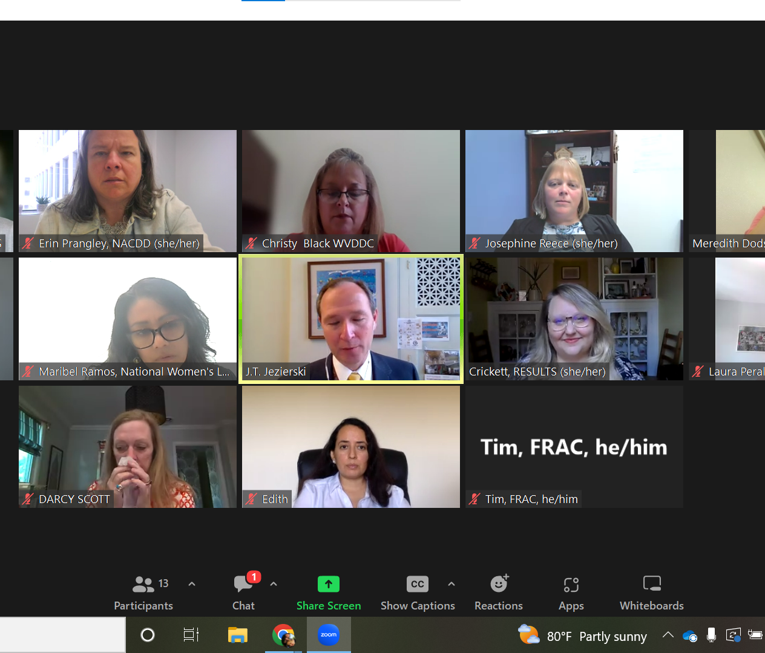
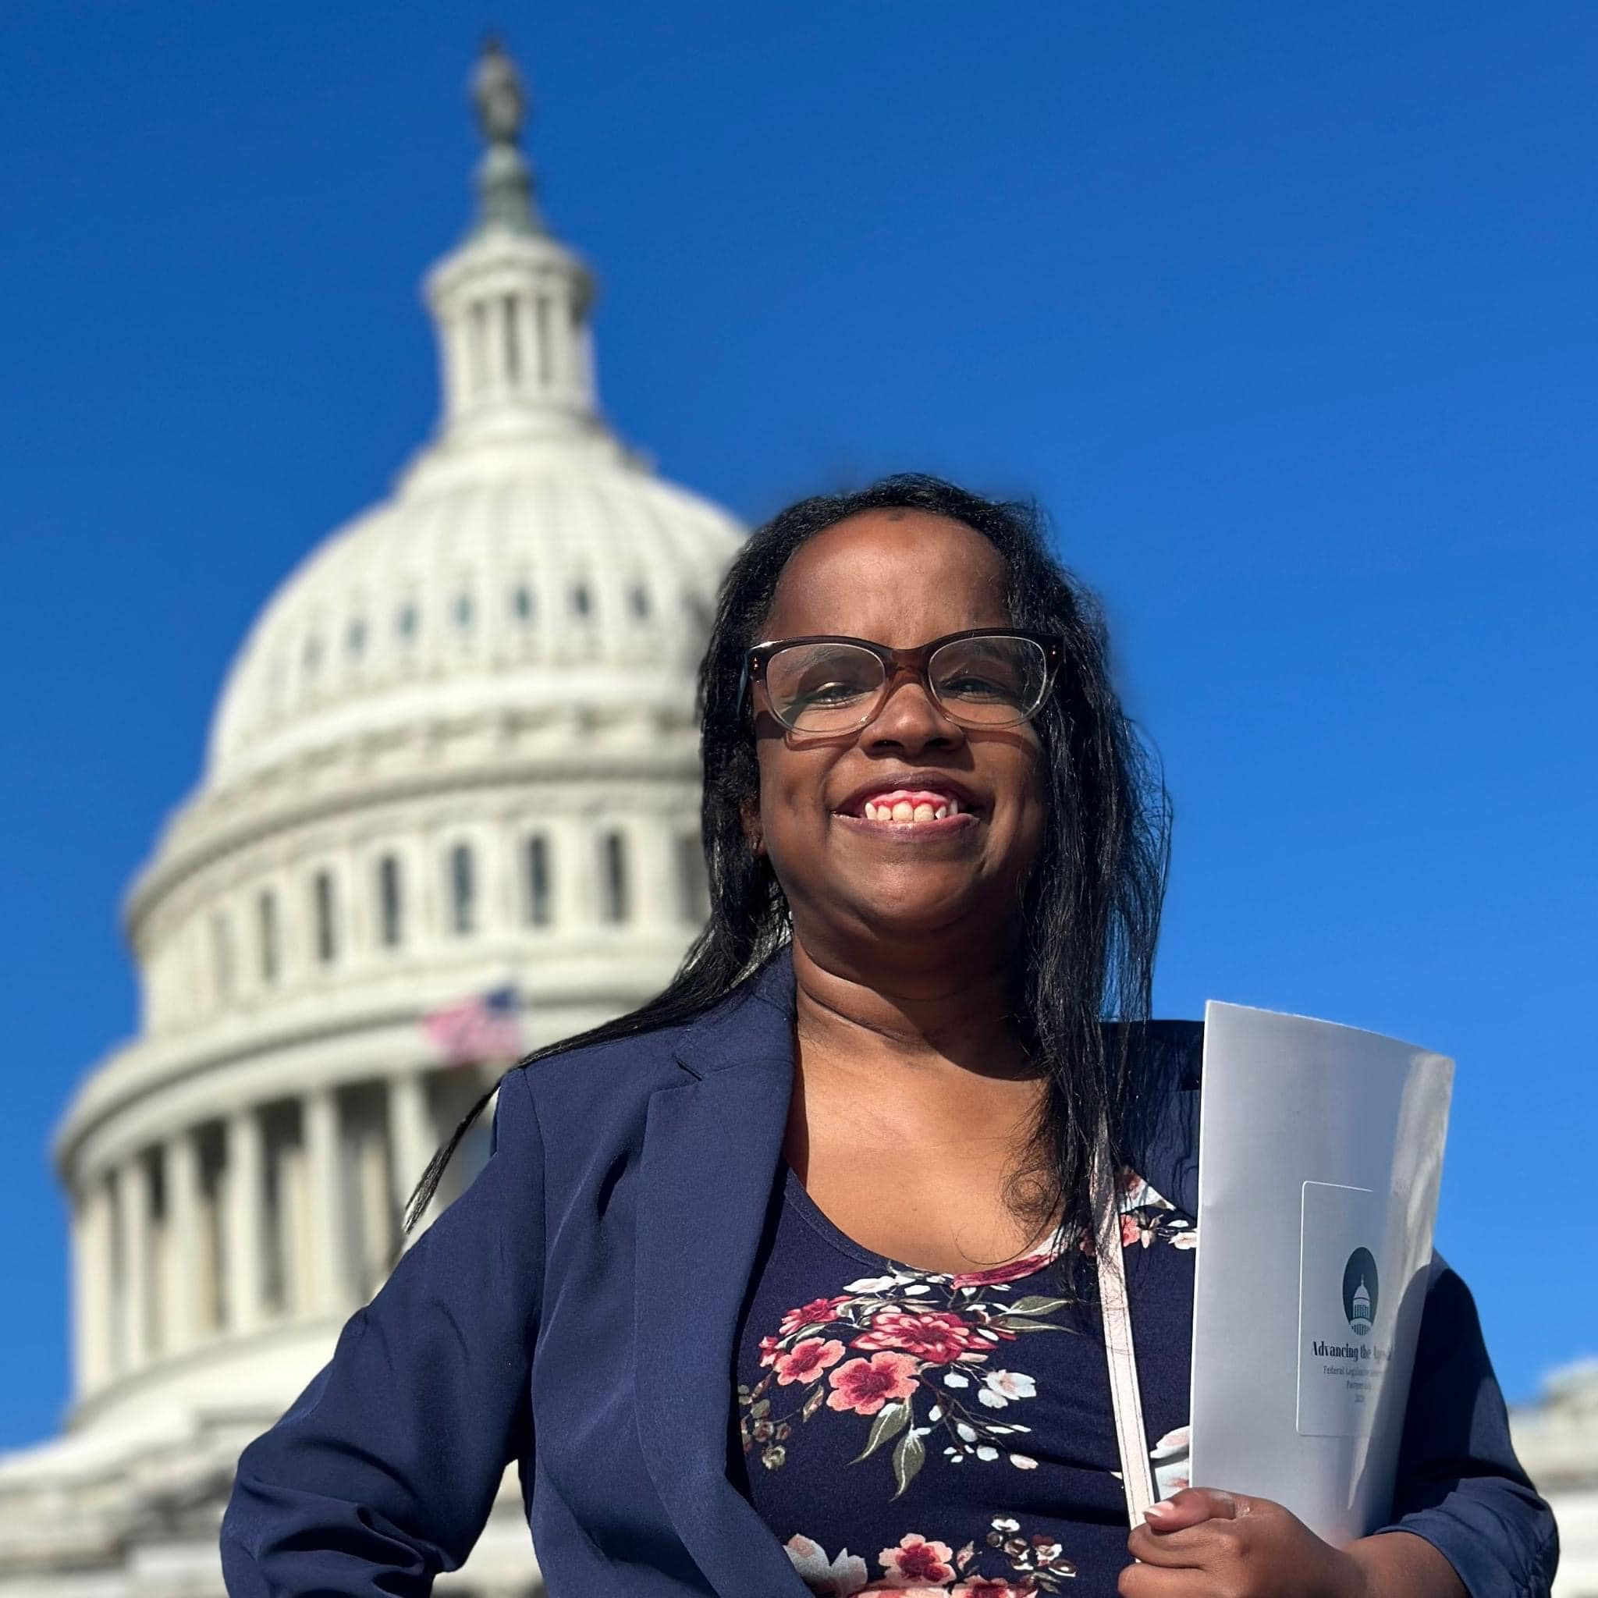
Councils Advocating on the Hill
Christy Black, West Virginia DD Council, spoke with Sen. Crapo's staff about the importance of a "clean" CR and no cuts to safety net programs for the poor.
Kelsey Weaver, OH State Council on Developmental Disabilities, met with lawmakers and staff during the Ohio Fly-In day to advocate for the SSI Penalty Elimination Act.

Slide 10
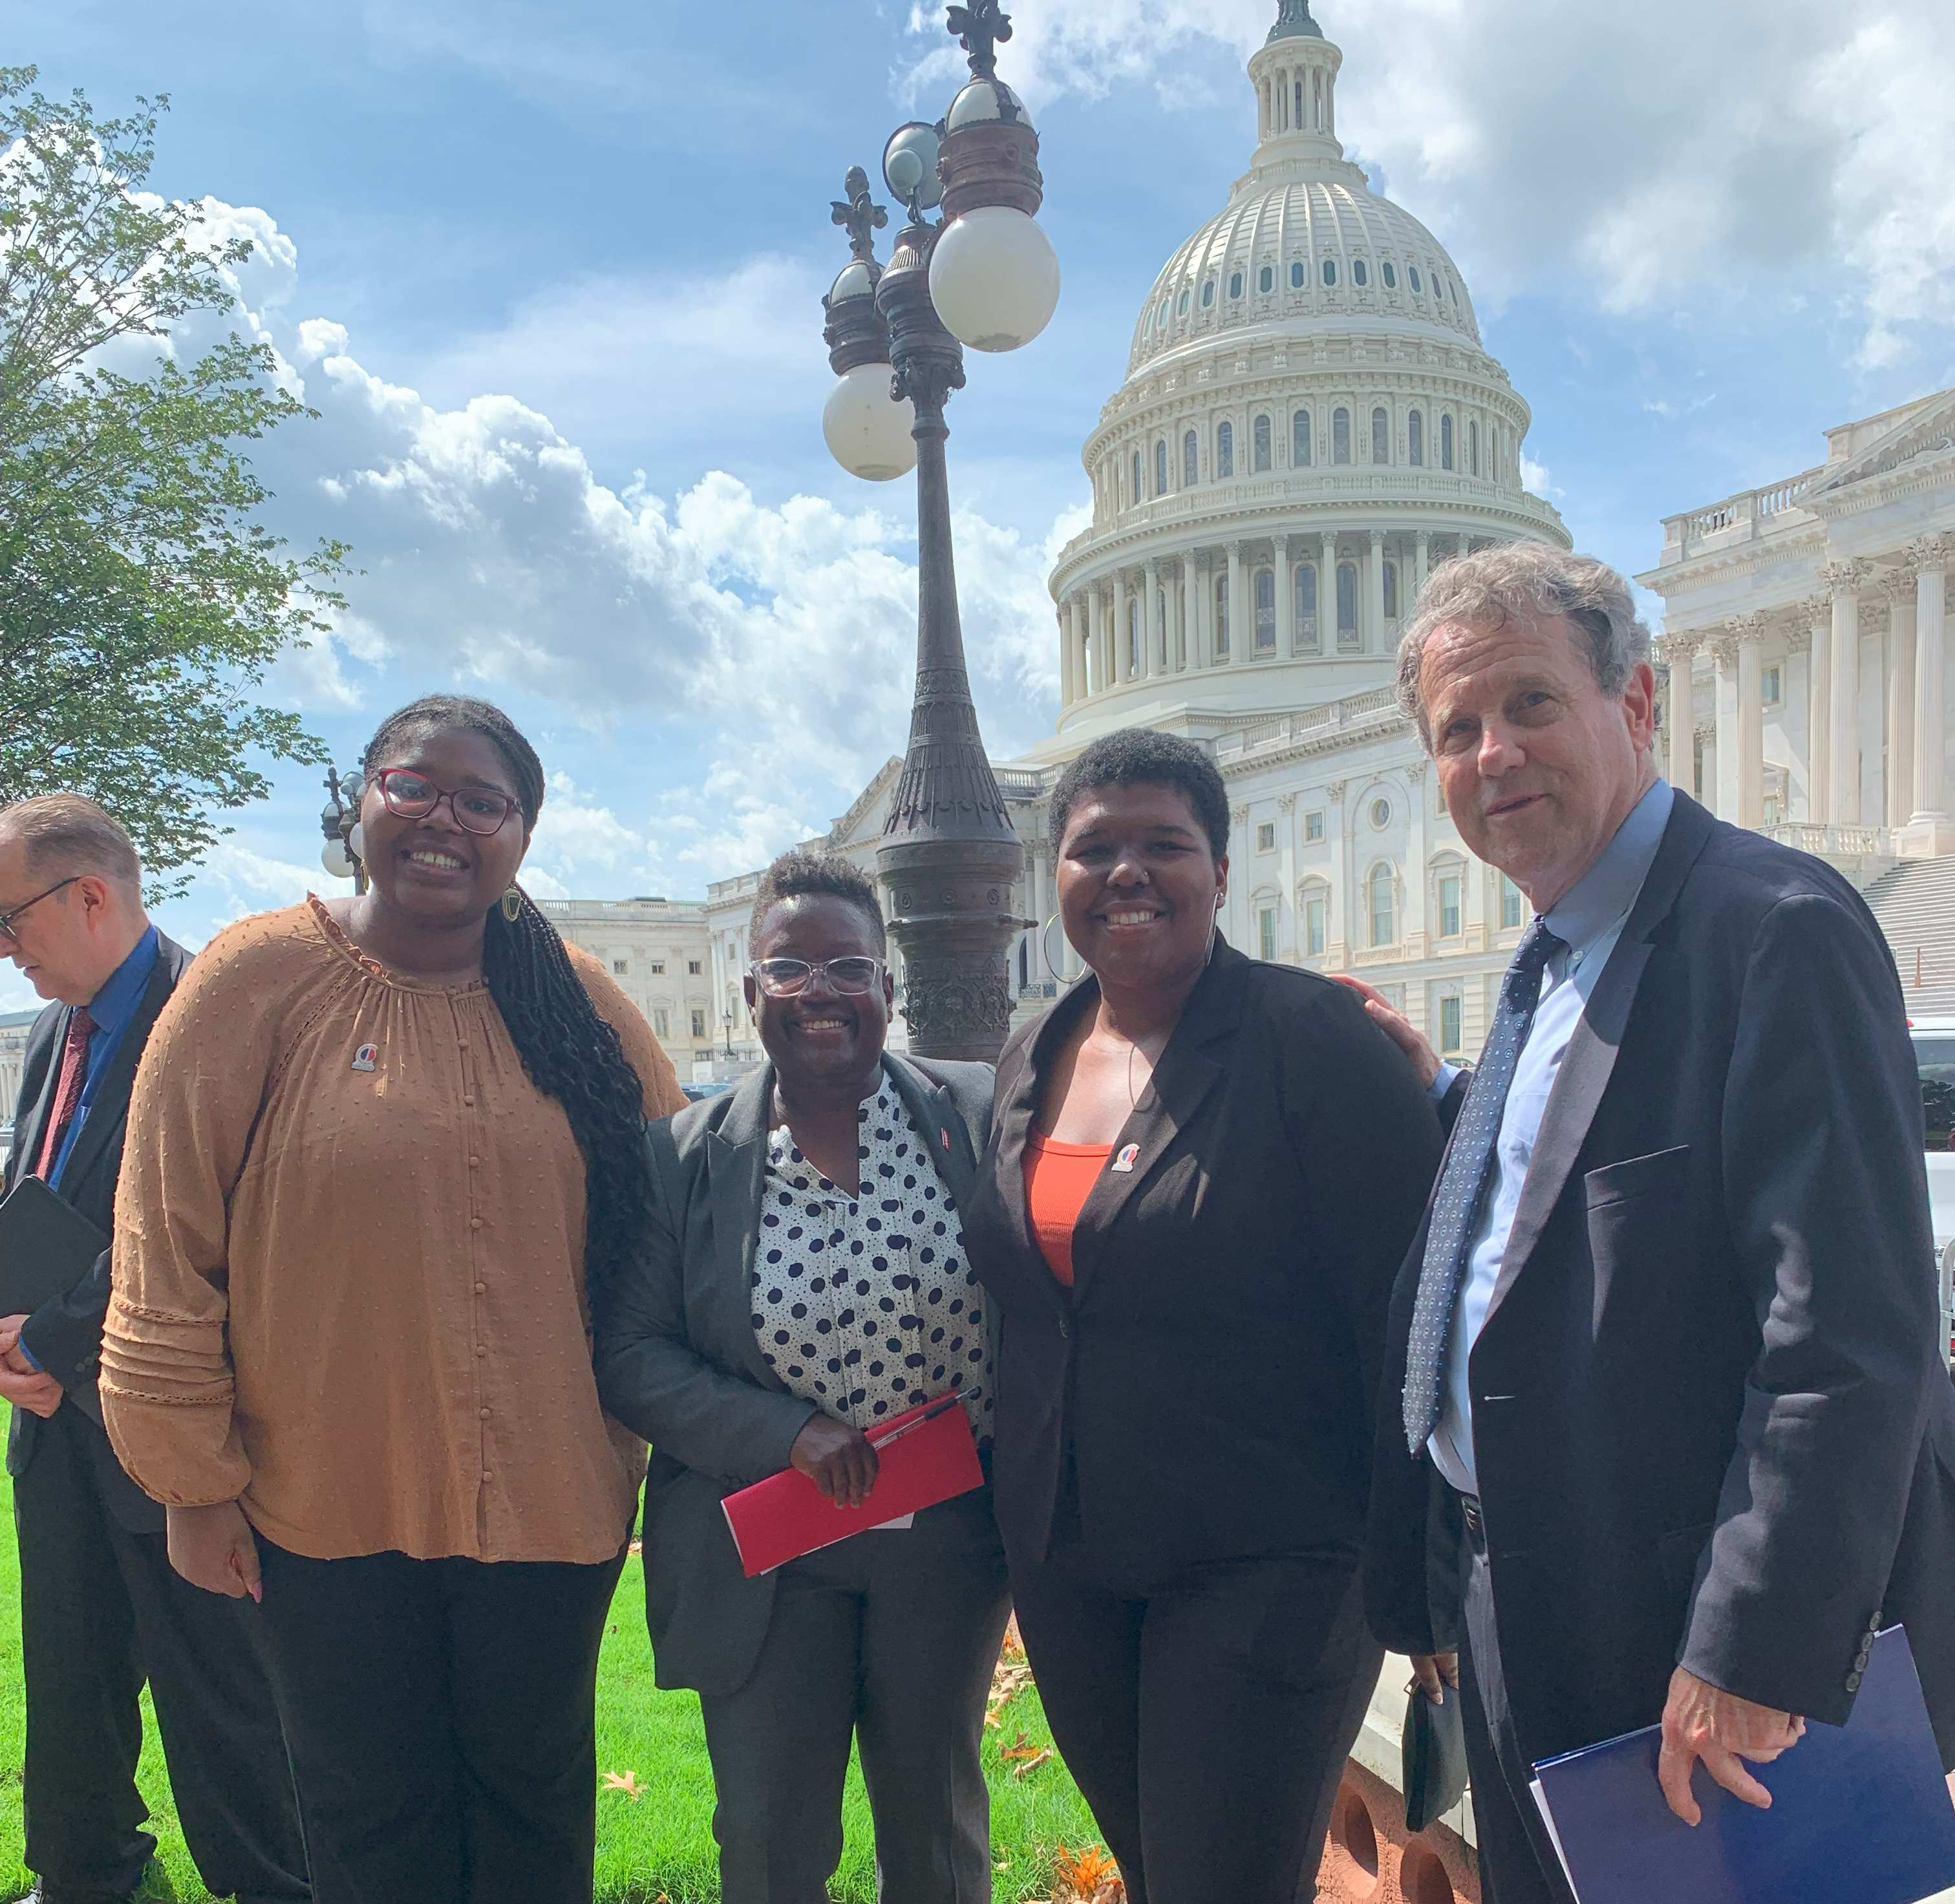

Slide 11

Policy Committee Meeting
Thursday, October 5, 2pm Eastern
Join Zoom Meeting
https://us02web.zoom.us/j/82156490017?pwd=amdsUTliajUrVllwbit1WHR4VmxpUT09
Meeting ID: 821 5649 0017
Passcode: 754454
NACDD Public Policy Listservs
1) Policy List open to all NACDD members (council members, staff and self-advocates)
To join go to https://bit.ly/3Ux1PEN
2) State Policy Committee
To join go to https://forms.gle/yUKXvRRE5cKN1DDi8

