Slide 1
Policy Committee Update July 12, 2023
Erin Prangley, Director, Public Policy National Association of Councils on Developmental Disabilities
Notes:
NACDD serves as the collective voice of the nation’s 56 DD Councils. The mission of DD Councils (and therefore ultimate goal of NACDD) is Systems Change. VABPDD is one of the councils we serve.
I'm here today for a purely selfish reason – we need more self advocates.
Why? Because in order to change systems, we need to change minds. In order to change minds, we need to change hearts.
Heart – Mind – System change.
There is NO ONE who get to the heart of a politician or any decision maker better than a self advocate.

Slide 2
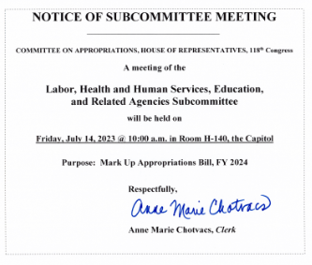
Appropriations 2023: A long and bumpy road (continued)
Subcommittee markup for the Fiscal Year 2024 Labor, Health and Human Services, Education, and Related Agencies Bill, Friday, July 14, at 10am. The bill will be posted here 24 hours before markup: https://docs.house.gov/Committee/Calendar/ByEvent.aspx?EventID=116252
We won’t see a complete picture this week but I imagine they will markup in full committee next week so we should see a report then.

Slide 3
Action for Inclusion: Empowering Developmental Disability Councils in Disaster Preparation.
11:30am -1:00pm, Wednesday, July 26, 2023
This is a working session to inform FEMA of key opportunities for DD Councils to engage, collaborate, communicate with FEMA RDIS, state and local agencies throughout the emergency cycle. Sherman Gilliums, Director, FEMA Office of Disability Integration and Coordination will discuss potential points of inequity that can substantially extend the disaster lifecycle for people with disabilities and then collect examples of best practices from DD Councils on how we are working to shorten the emergency cycle for people with IDD.
Keynote Speaker: Sherman Gilliums, Director, FEMA Office of Disability Integration and Coordination
Panelists: Sue Kabot, Florida Developmental Disabilities Council
Scott Daigle, Texas Council for Developmental Disabilities
Darryle Powell, Alabama Council on Developmental Disabilities

Slide 4
NACDD Public Policy Listservs 1) Policy List open to all NACDD members (council members, staff and self-advocates)
To join go to https://bit.ly/3Ux1PEN 2) State Policy Committee To join go to https://forms.gle/yUKXvRRE5cKN1DDi8

