Slide 1
Policy Committee Update
June 14, 2023
Erin Prangley, Director, Public Policy
National Association of Councils on Developmental Disabilities
Notes:
NACDD serves as the collective voice of the nation’s 56 DD Councils. The mission of DD Councils (and therefore ultimate goal of NACDD) is Systems Change. VABPDD is one of the councils we serve.
I'm here today for a purely selfish reason – we need more self advocates.
Why? Because in order to change systems, we need to change minds. In order to change minds, we need to change hearts.
Heart – Mind – System change.
There is NO ONE who get to the heart of a politician or any decision maker better than a self advocate.

Slide 2
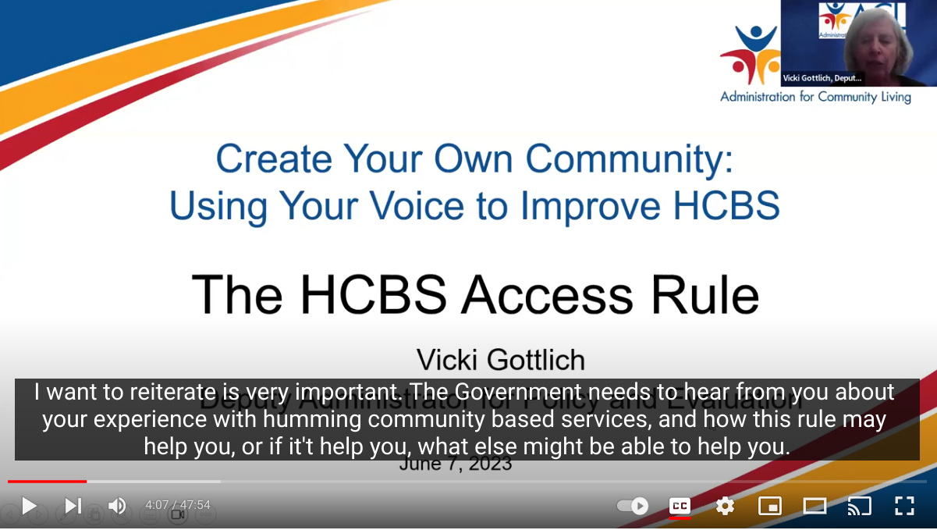
HCBS Access Rule Toolkit and
Action Alert
The Access Rule makes significant improvements and strengthens many aspects of Medicaid HCBS, including the direct care workforce, health and safety protections, quality of services, and state accountability and transparency, by introducing new requirements in each of these areas.
Learn more and share this important opportunity to comment!
Recording: https://www.youtube.com/watch?v=MWUBrRh1W_I
The Toolkit: https://autismsociety.org/wp-content/uploads/2023/06/Access-Rule-Toolkit.pdf
Action Alert: https://www.votervoice.net/AutismSociety/campaigns/105206/respond

Slide 3

Appropriations FY24: Long and Bumpy Road Ahead
Fiscal Responsibility Act
House Bill - "Draconian" cuts
Senate Bill – More likely bipartisan(?)
Dates to remember:
  September 30 – Start of FY24
  January 1 – Automatic cuts if approps bills not completed

Slide 4
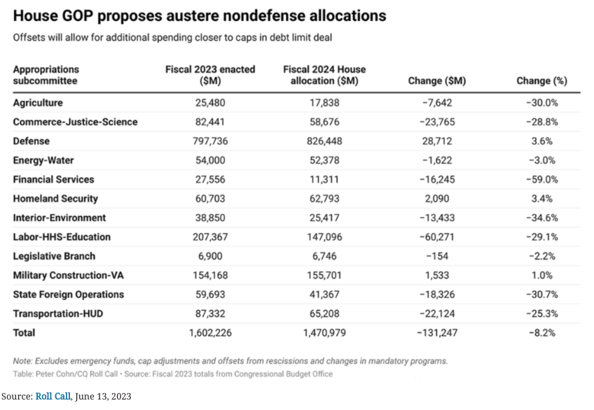


“The Fiscal Responsibility Act set a topline spending cap – a ceiling, not a floor – for Fiscal Year 2024 bills. That is why I will use this opportunity to mark up appropriations bills that limit new spending to the Fiscal Year 2022 topline level. In addition, by clawing back $115 billion in unnecessary, partisan programs, we will re-focus government spending consistent with Republican priorities, keeping total spending 1% lower than if we were operating under a continuing resolution. ” — Rep. Kay Granger

Slide 5

ACL is to plan on FY24 based on March estimates (level funding).
What does a 9% cut look like?

Slide 6
Federal Connection – Weekly Grassroots Updates
Join Zoom Meeting Thursday, June 15, 3:00 p.m. ET; 2:00 p.m. CT; 1:00 p.m. MT; noon, PT
https://us02web.zoom.us/j/81004015063?pwd=WXJ2QUZqZVpDUSttZ0tPVWwreG96QT09
Meeting ID: 810 0401 5063
Passcode: 864714
One tap mobile
+19292056099,,81004015063#,,,,*864714# US (New York)
+13017158592,,81004015063#,,,,*864714# US (Washington DC)
The President has signed the legislation to increase the debt limit, including caps on appropriations. Now, House right-wingers are proposing even deeper cuts – we’re seeing the specifics for the WIC program now and anticipating drastic reductions across human needs programs. At the same time, House Republicans have put forward a costly tax bill that directs benefits to upper income/corporate interests. To help us learn about this, and the consequences for states, we’ve got great experts with great info:
Ellen Nissenbaum, Center on Budget and Policy Priorities (Capitol Hill update with emphasis on appropriations and taxes)
Brian Dittmeier, National WIC Association (details of the proposed extreme cuts to the Women, Infants and Children (WIC))
Kim Johnson of the National Low Income Housing Coalition, the impact of prospective cuts to affordable housing programs

Slide 7

NACDD Public Policy Listserv
Policy List open to all NACDD members (council members, staff and self-advocates)
To join go to https://bit.ly/3Ux1PEN

