Slide 1
Policy Committee Update May 31, 2023
Erin Prangley, Director, Public Policy National Association of Councils on Developmental Disabilities
Notes:
NACDD serves as the collective voice of the nation’s 56 DD Councils. The mission of DD Councils (and therefore ultimate goal of NACDD) is Systems Change. VABPDD is one of the councils we serve.
I'm here today for a purely selfish reason – we need more self advocates.
Why? Because in order to change systems, we need to change minds. In order to change minds, we need to change hearts.
Heart – Mind – System change.
There is NO ONE who get to the heart of a politician or any decision maker better than a self advocate.

Slide 2
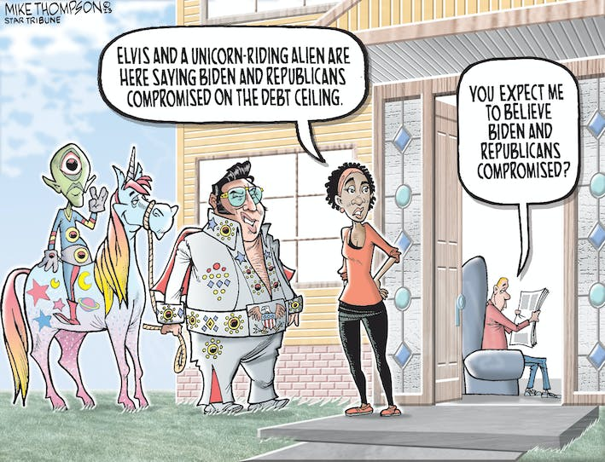
Fiscal Responsibility Act of 2023: What does this mean for DD Councils?
Summary: The bipartisan bill suspends the debt ceiling through 1/1/2025 in exchange for put in place spending caps, add on work requirements for some assistance programs, take back unspent pandemic aid and other political payback.
Analysis: While better than Limit, Save, Grow Act because it extends the debt limit longer, has less drastic cuts to programs, and Medicaid work requirements are not included, it is bad news for DD Councils as it signals cuts to our programs and cuts to programs that support people with I/DD. Conclusion: DD Councils will most likely see a reduction in funding for FY24 and FY25. The extent of the cuts will depend on a variety of factorsj.

Slide 3
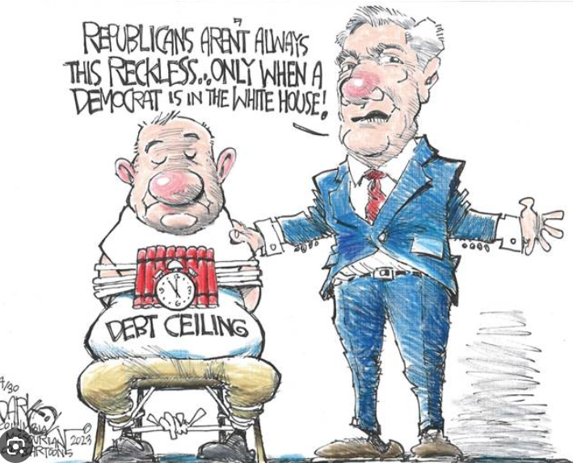
Fiscal Responsibility Act of 2023: Debt Ceiling Suspension
Summary: Suspends the nation’s $31.4 trillion borrowing limit until Jan. 2025. Suspending the debt limit allows the Treasury Department to borrow as much money as it needs to pay the nation’s bills during that time period. (That’s different than the bill passed by House Republicans, which raised the limit by $1.5 trillion or through March 2024, whichever came first.)
Analysis: This provision avoids a default which would have been catastrophic for our economy. It must pass by June 5 to avoid default. Conclusion: This is a better deal than the original House proposal because it covers 2 years and will provide more certainty for the economy.

Slide 4
Fiscal Responsibility Act of 2023: Spending Cuts
Summary: In exchange for raising the debt ceiling, Congress agrees to cut spending for fiscal years 2024 and 2025 by reducing spending on most nondefense discretionary programs for the 2024 fiscal year and limit all discretionary spending to 1 percent growth in 2025, which is effectively a budget cut, because that is projected to be slower than the rate of inflation. (However, Military spending will increase 3% and certain programs are excluded from spending cuts including veterans' health.) Legislative text suggests cuts could be to last year’s spending levels, but there is no guarantee they will not be larger cuts. If Congress cannot pass appropriations by 1/1/2024, then there will be an automatic cut to 1% below the FY2023 base funding levels for all 12 bills. It also takes back $1.38 billion from the IRS and repurposes another $20 billion from the $80 billion it received through the Inflation Reduction Act
Analysis: The legislation is not clear on the extent of the cuts. But White House officials say a series of side deals with Republicans, including repurposing rescinded funding for unspent pandemic funds and "claw back" at least $10B of the IRS, will allow actual funding for the next two years to be closer to this year’s levels. This uncertainty will create a lot of conflict in committees and puts in jeopardy a timely appropriations process.
Conclusion: This is a better deal than the original House proposal because it provides a chance of level funding (as opposed to FY22 levels) and because the caps are for 2 years (instead of 10).
​

Slide 5
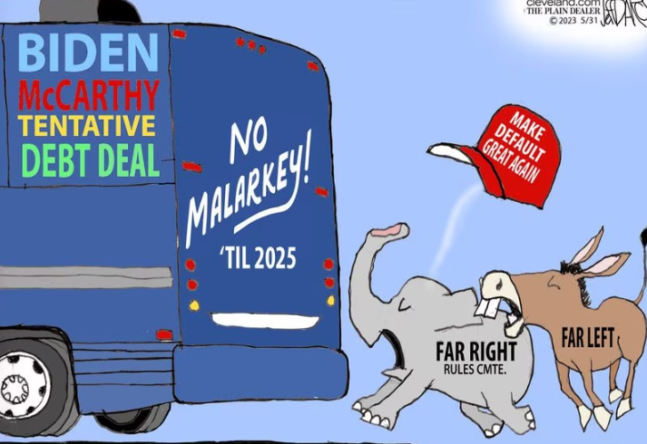
Fiscal Responsibility Act of 2023: Work requirements?
Summary: No changes to Medicaid eligibility! However, it impose new work requirements for SNAP and TANF. Current age for work requirements for people up without children would be raised from 49 to 54. Veterans, the homeless and people who were children in foster care would be exempt from work requirements.
Analysis: The new work requirements are a big step backwards for the progressive community. Many will oppose the legislation because of this and the other cuts. It is also interesting to note that the exemptions do not mention people with disabilities which is unfortunate.
Conclusion: This is a better deal than the original House proposal because the additional new Medicaid work requirements were removed. But it is a big step backwards and indicates a willingness to deal on these programs

Slide 6
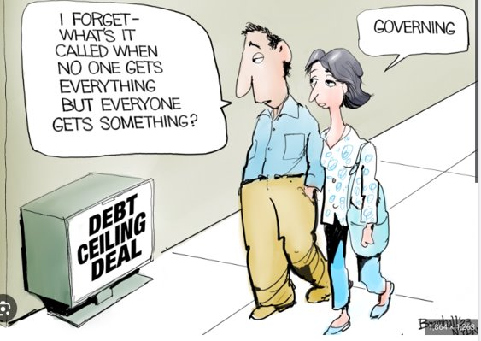
Fiscal Responsibility Act of 2023: Student Loans, Unspent COVID, IRS Claw Back and Environmental Concerns?
Summary: The bill ends the President's suspension of student loan repayments by the end of August; claws back about $30 billion in unspent COVID money; reforms energy project approvals to shorten process; rescinds $1.38 billion from the I.R.S. and repurposes another $20 billion from the $80 billion it received through the Inflation Reduction Act. Also, Sen. Manchin gets his fast track to construction for a new natural gas pipeline from West Virginia to Virginia.
Analysis: This is all political payback.
Conclusion: While the "savings" from these various proposals could ultimately be repurposed to help mitigate the cuts to our programs, the policy behind most of these changes will make it harder to bring our national debt in line. Messaging around these points will be very political.

Slide 7
But is there a path to level spending?
Total NDD, FY24 (Biden budget) | $703.6B
Subtract VA Medical Care | $-121B
Other NDD | $582.6B
Add rescinded unobligated pandemic funds | +28B
Add rescinded IRS | +1.4B
Add more from IRS | +10B
Add savings from mandatory programs, etc. | +15B
Total available for other NDD in FY24 | $637B
Total other NDD in FY23, per Biden budget | $641B

Slide 8
NACDD Public Policy Listserv
Policy List open to all NACDD members (council members, staff and self-advocates)
To join go to https://bit.ly/3Ux1PEN

