Slide 1
Policy Committee Update
May 3, 2023
Erin Prangley, Director, Public Policy
National Association of Councils on Developmental Disabilities
Notes:
NACDD serves as the collective voice of the nation’s 56 DD Councils. The mission of DD Councils (and therefore ultimate goal of NACDD) is Systems Change. VABPDD is one of the councils we serve.
I'm here today for a purely selfish reason – we need more self advocates.
Why? Because in order to change systems, we need to change minds. In order to change minds, we need to change hearts.
Heart – Mind – System change.
There is NO ONE who get to the heart of a politician or any decision maker better than a self advocate.

Slide 2
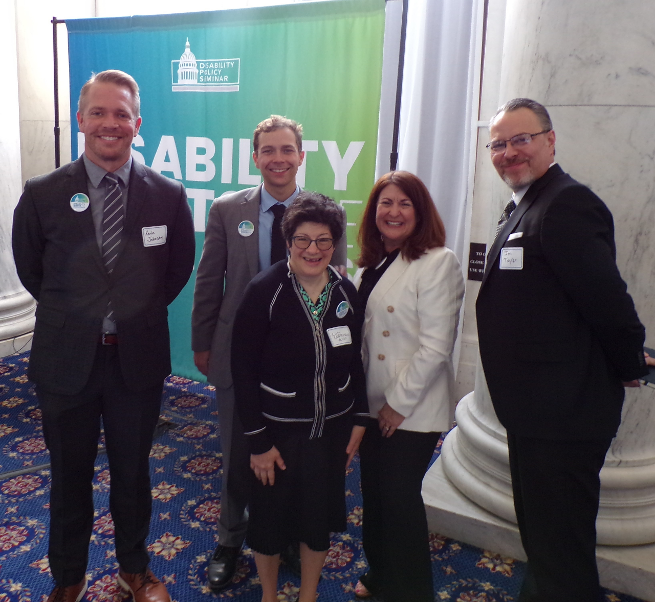
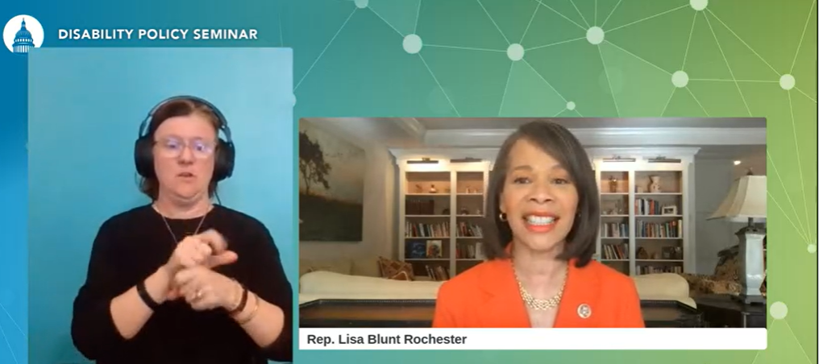
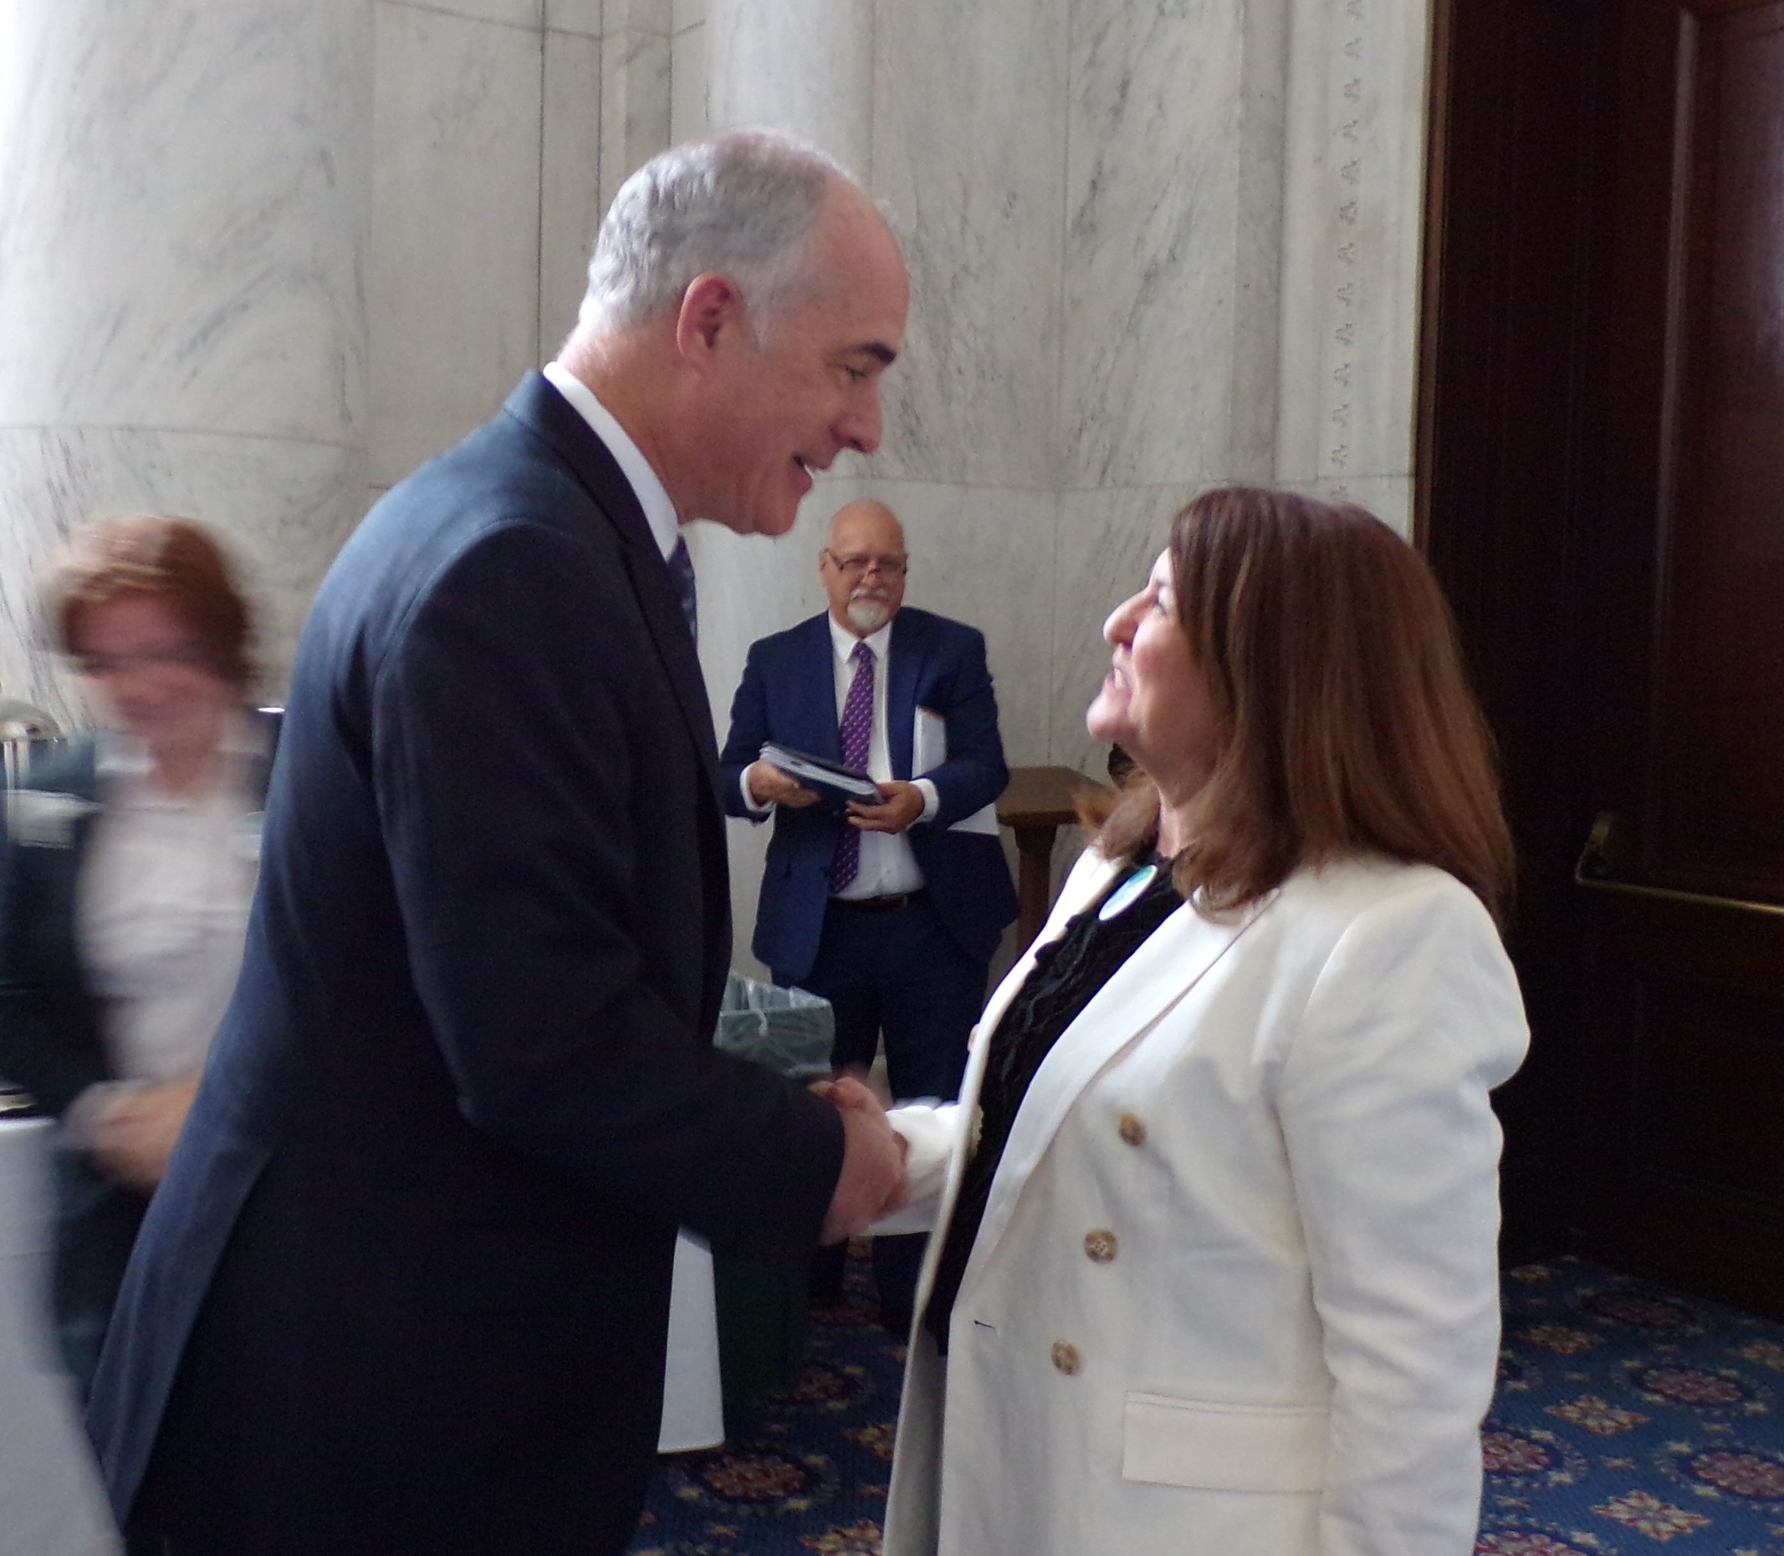
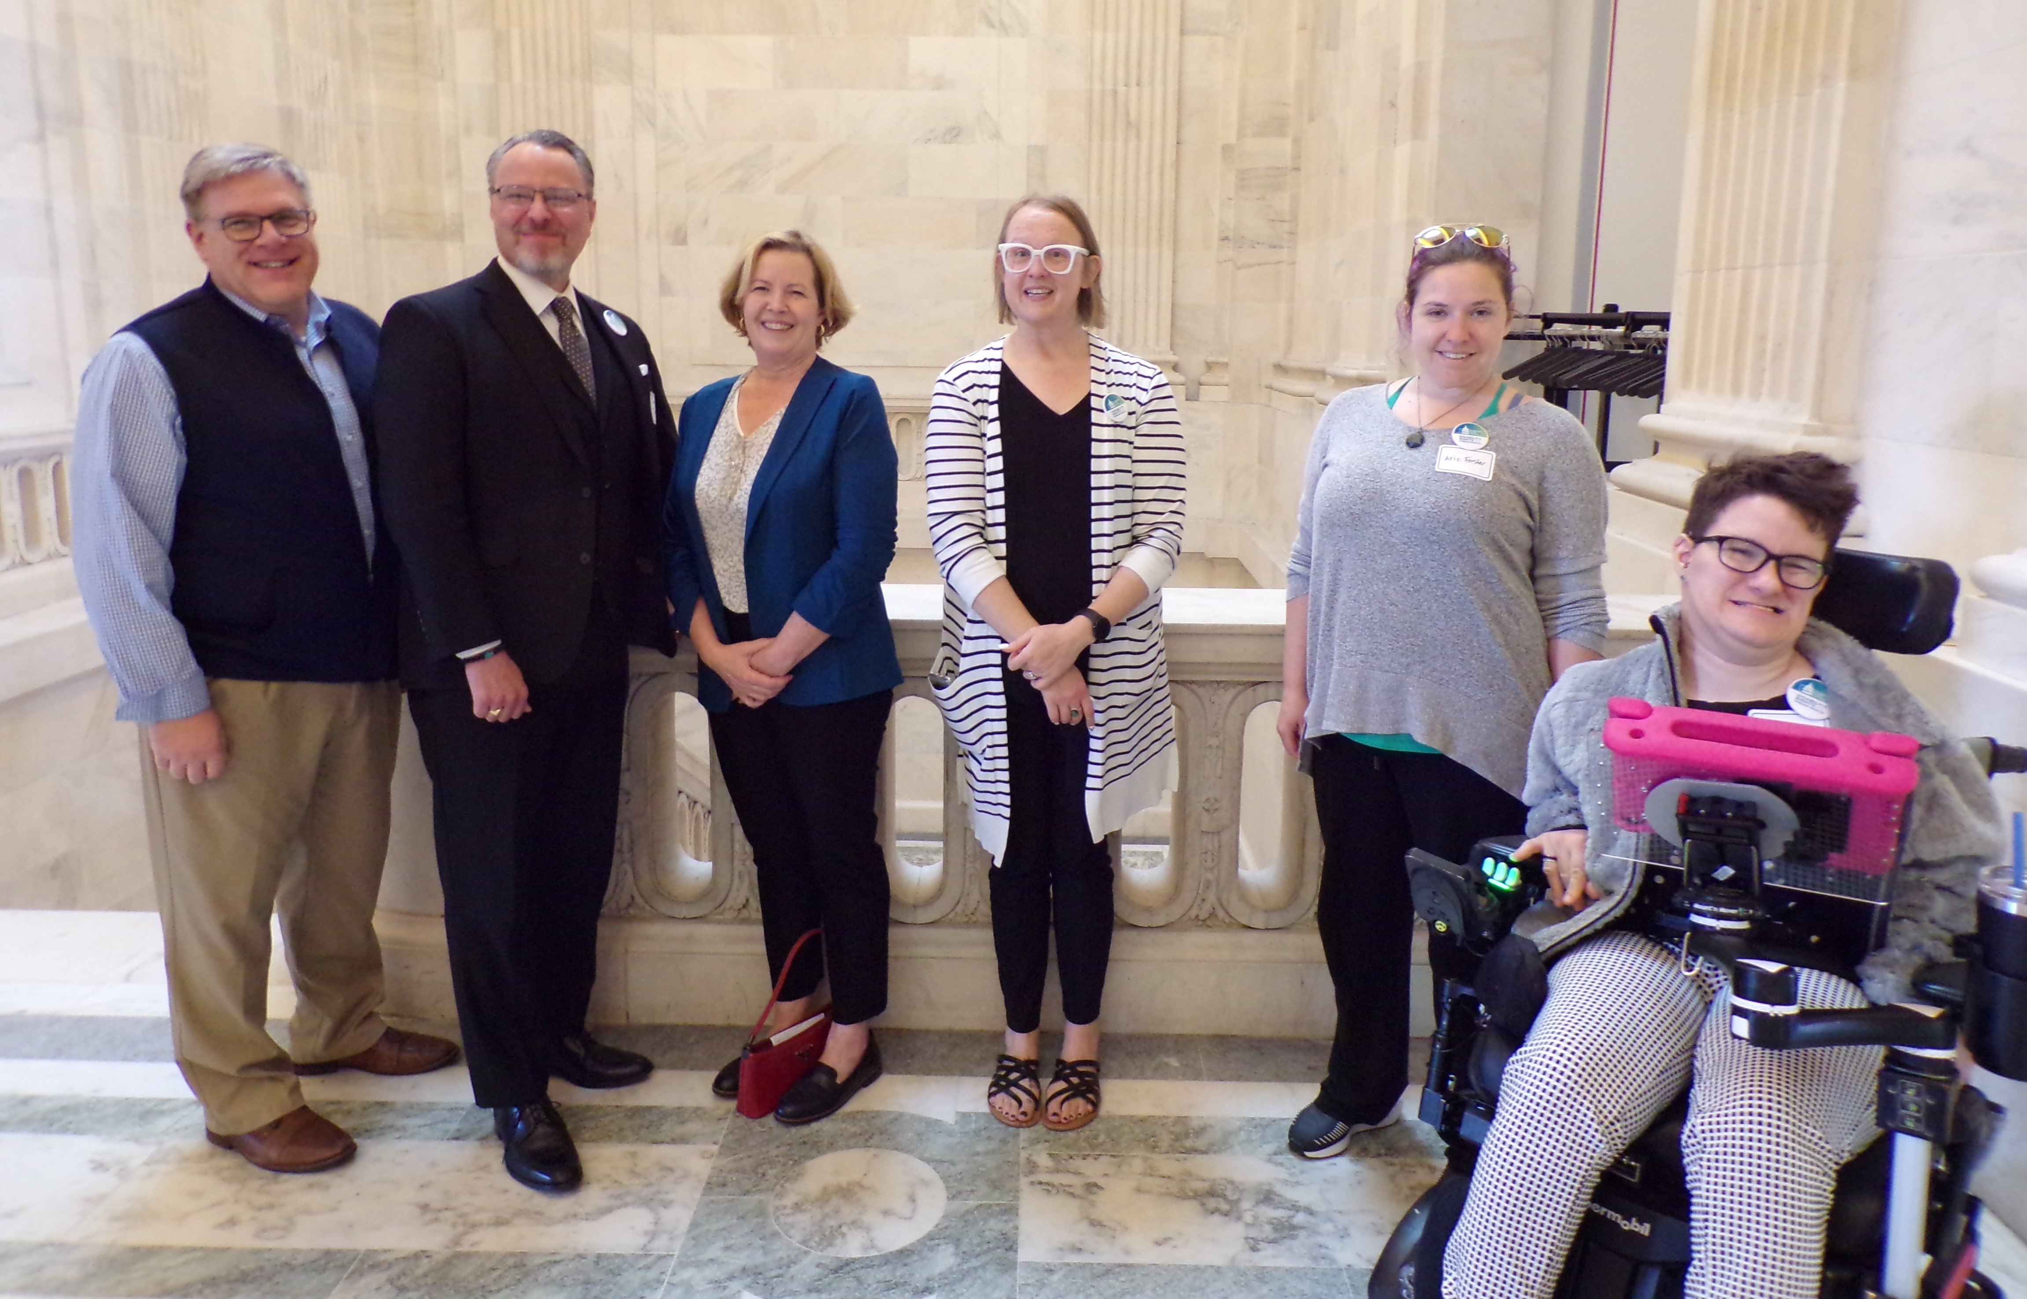
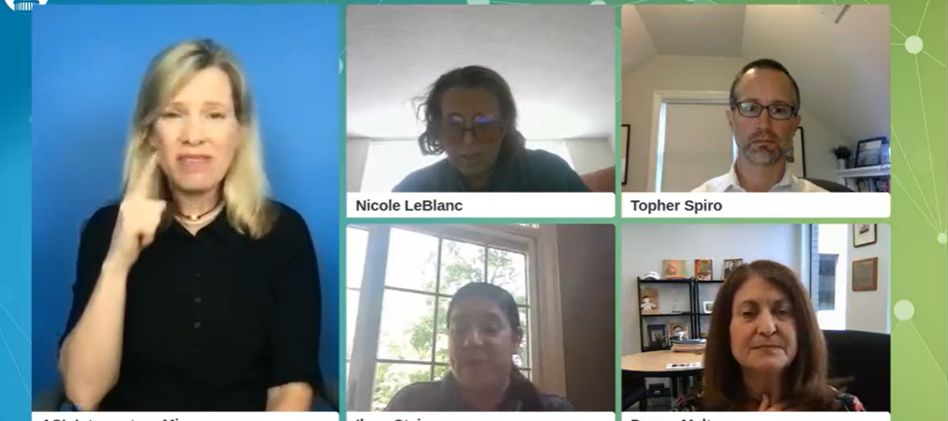
2023 Disability Policy Seminar Wrap-Up
312 attended virtual DPS
Over 100 advocates and 7 members of Congress at the Fly-In Breakfast
Over 50 in-person meetings with members of Congress and many more virtual meetings!

Slide 3
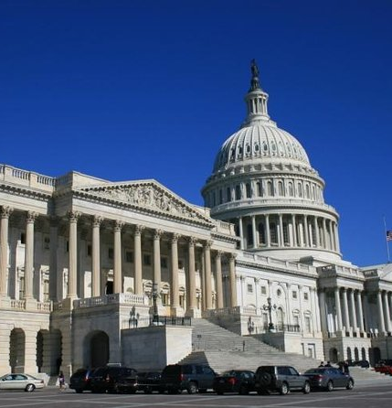
The View from the Hill: Budget/Appropriations/Debt Ceiling
House passed bill raises debt ceiling by 1.4B (or through March 2024) in exchange for:
Return funding for federal agencies to fiscal 2022 levels and limit growth in spending to 1% per year,
Imposes stricter work requirements on Medicaid, food and other assistance for low-income households,
Rolls back much of the Biden’s administration’s agenda on climate change and student lending
rescind the $80 billion set to go to the IRS over the next decade (increase the deficit by $114 billion through 2032)
See White House State Factsheet on House proposal https://bit.ly/411rHeg
Appropriations subcommittee markups will be on May 17 and 18, followed by full committee markups May 23-25. More subcommittee markups would occur June 7 and 8, followed by the final full committee markups June 13-15.

Slide 4
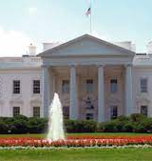
White House Updates: Budget/Appropriations/Debt Ceiling
Treasury Secretary Janet Yellen said debt ceiling could be reached "potentially as early as June 1" without action by Congress.​
Biden meeting with Republican budget negotiators on Tuesday. State and local groups are organizing to make sure the President (and moderate Democrats) sticks to his pledge not to negotiate spending.
Advocacy Resources:
Disability Funding Factsheet https://disabilitypolicyseminar.org/fact-sheets/
White House Factsheet including effect of Republican bill on states https://bit.ly/3LRkIAd
Coalition for Human Needs talking points here: https://bit.ly/3NCBu7A
"The High Cost of Default in Every State." Third Way https://www.thirdway.org/graphic/the-high-costs-of-default-for-americans-in-every-state-and-district

Slide 5

Centers for Medicare & Medicaid Services (CMS) Proposed Access Rule to improve Medicaid services and promote health equity across the Medicaid program. Comments must be received by July 3, 2023.ACL blog https://bit.ly/416nhmm
Highlights
At least 80% of all Medicaid payments for specific HCBS must be spent on compensation for direct care workers.
New state reporting: 1915(c) HCBS waiver waitlists, person centered plans are reviewed and revised annually, grievance process for people receiving HCBS in fee-for-service plans, nationally standardized quality measures specifically for HCBS established by CMS.
Applies to all Medicaid services, including the home and community-based services (HCBS).
NACDD Next Steps
Policy Committee work * Webinar *Comments

Slide 6

NACDD Public Policy Meeting
Tomorrow
Thursday, May 4
2pm Eastern
Join Zoom Meeting
https://us02web.zoom.us/j/82156490017?pwd=amdsUTliajUrVllwbit1WHR4VmxpUT09
Policy List open to all NACDD members (council members, staff and self-advocates)
To join go to https://bit.ly/3Ux1PEN

