Slide 1
Federal Policy Update March 22, 2023
Erin Prangley, Director, Public Policy National Association of Councils on Developmental Disabilities
Notes:
NACDD serves as the collective voice of the nation’s 56 DD Councils. The mission of DD Councils (and therefore ultimate goal of NACDD) is Systems Change. VABPDD is one of the councils we serve.
I'm here today for a purely selfish reason – we need more self advocates.
Why? Because in order to change systems, we need to change minds. In order to change minds, we need to change hearts.
Heart – Mind – System change.
There is NO ONE who get to the heart of a politician or any decision maker better than a self advocate.

Slide 2
Appropriations Timeline
NACDD Hill Meetings
House Dear Colleague (deadline 3/22)
DD Councils call House offices during week of 3/13
Senate Dear Colleague (deadline 4/16)
DD Councils call Senate offices 3/22 - 4/12
Hearings/Markups (House/Senate)
Votes (House/Senate)
President Signs (deadline 9/30)
Continuing Resolution?
Debt Ceiling Negotiations (Default
See "Chicken-or-egg game..." Roll Call at https://bit.ly/3lwBpqi

Slide 3
AK Mary Peltola (D-AK) AL Terri Sewell (D-AL) CA Mark DeSaulnier (D-CA) Jimmy Panetta (D-CA) CNMI Gregorio Kilili Camacho Sablan (D-CNMI) DC Eleanor Holmes Norton (D-DC) | DE Lisa Blunt Rochester (D-RI) GA Lucy McBath (D-GA) Nikema Williams (D-GA) IL Nikki Budzinski (D-IL)* Danny Davis (D-IL) Jan Schakowsky (D-IL) MA Stephen Lynch (D-MA) Seth Moulton (D-MA) ME Chellie Pingree (D-ME) | MI Debbie Dingell (D-MI) Hillary Scholten (D-MI)* NC Alma Adams, Ph.D. (D-NC) NJ Andy Kim (D-NJ) NH Ann Kuster (D-NH) NY Marcus Molinaro (R-NY)* Paul Tonko (D-NY) | OR Andrea Salinas (D-OR)* PA Christopher Deluzio (D-PA)* Brian Fitzpatrick (R-PA) Mary Gay Scanlon (D-PA) VT Becca Balint (D-VT) VA Donald Beyer (D-VA)* WI Gwen Moore (D-WI)
Cosigners by State Delegation
New members indicated by *
Republican offices are italicized
Disability Caucus Cochairs are highlighted
Sponsor Lisa Blunt Rochester is in bold

Slide 4
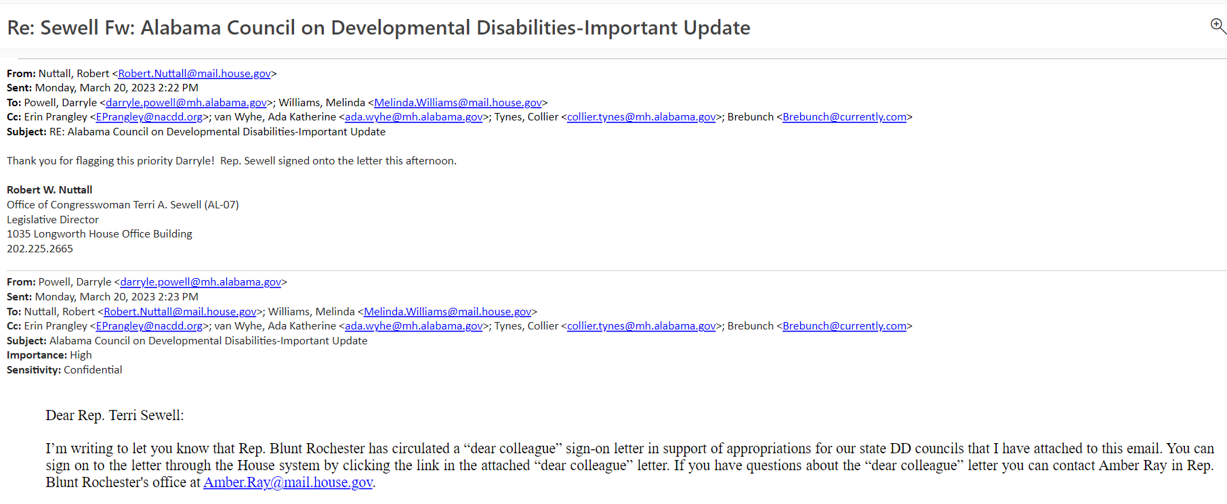
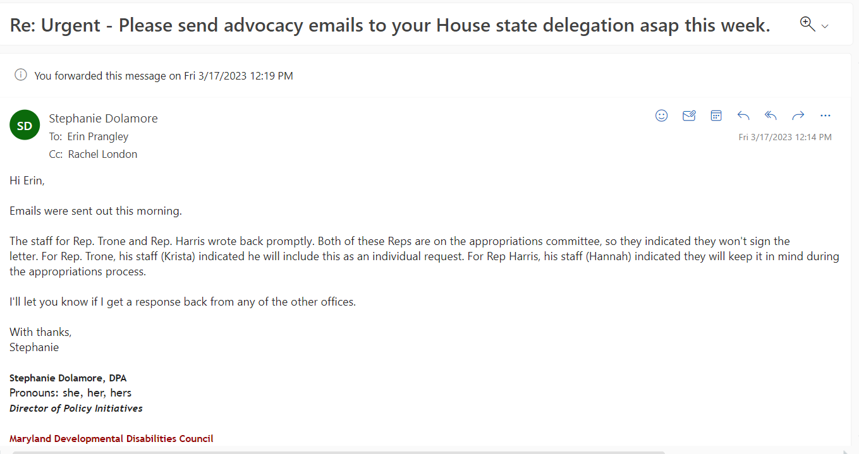
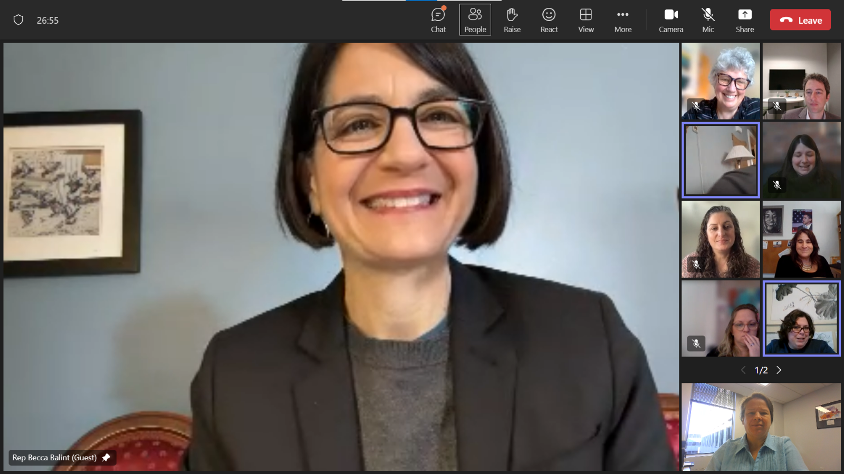
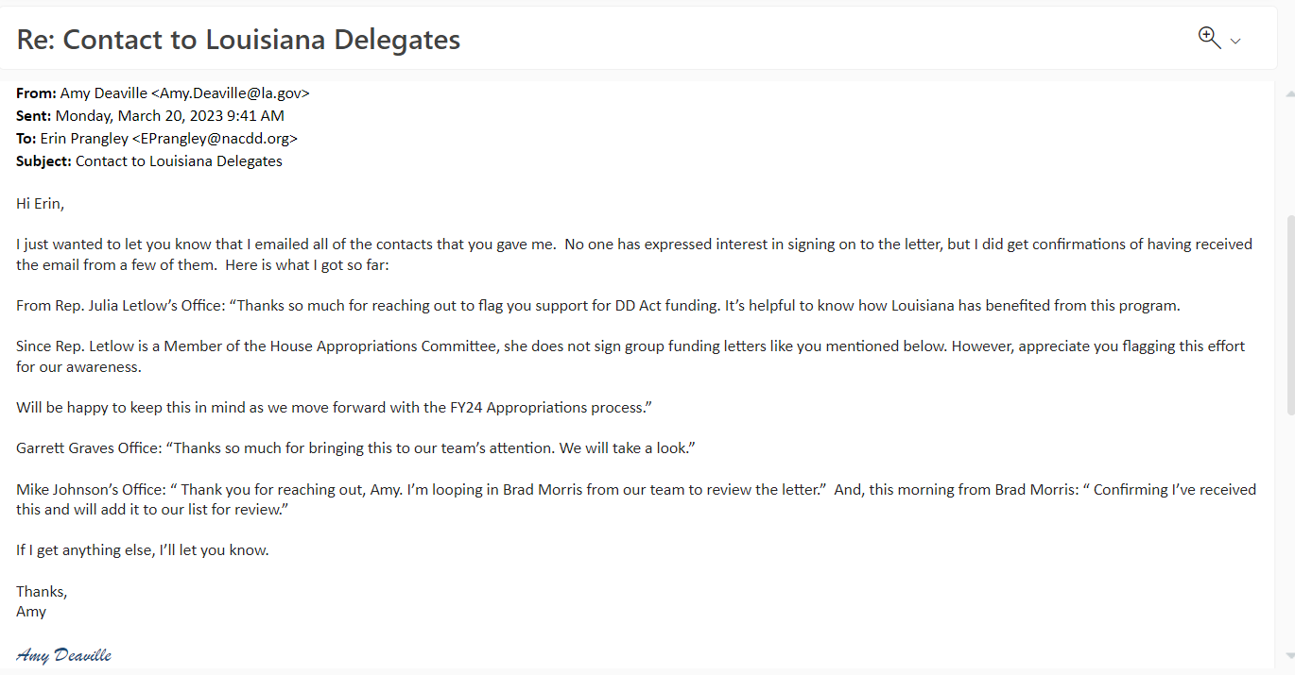
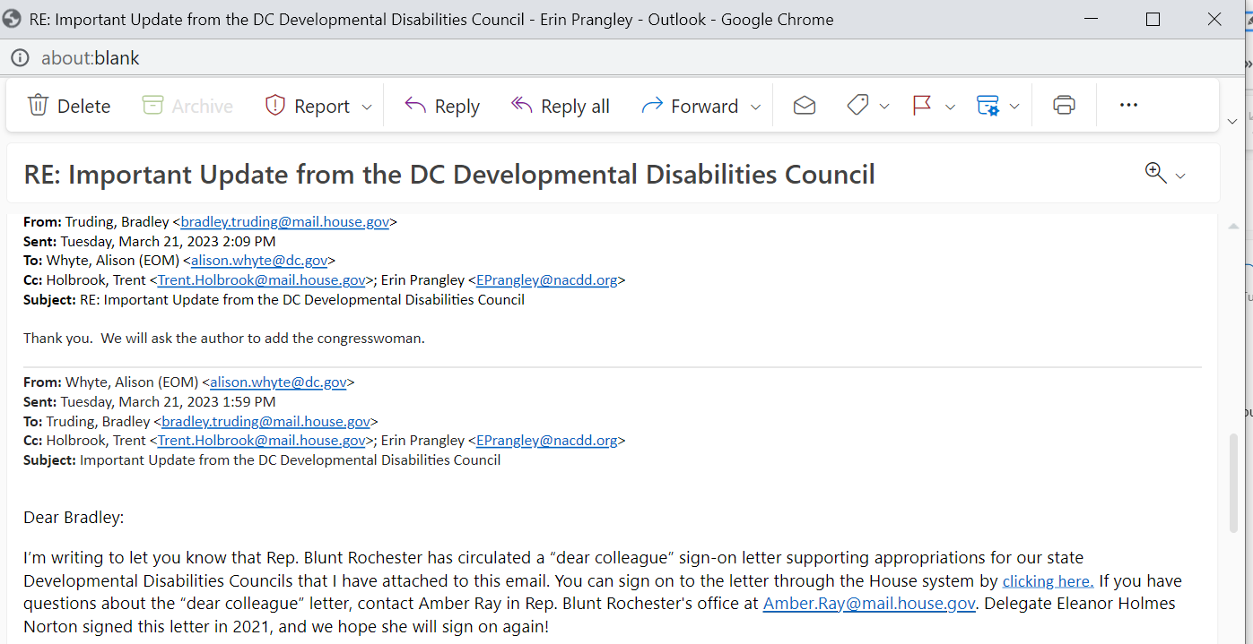
Teamwork makes the Dream Work!
VT meeting; DC and AL record responses; MD sponsor; LA intel

Slide 5
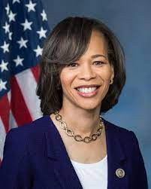
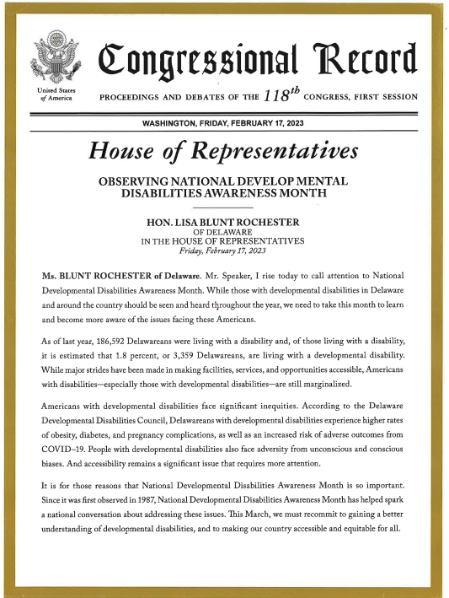

Slide 6
NOTE CHANGED DATE!

Slide 7
NACDD Public Policy Listserv
Policy List open to all NACDD members (council members, staff and self-advocates)
To join go to https://bit.ly/3Ux1PEN

