Slide 1
Federal Policy Update February 22, 2023
Erin Prangley, Director, Public Policy National Association of Councils on Developmental Disabilities
Notes:
NACDD serves as the collective voice of the nation’s 56 DD Councils. The mission of DD Councils (and therefore ultimate goal of NACDD) is Systems Change. VABPDD is one of the councils we serve.
I'm here today for a purely selfish reason – we need more self advocates.
Why? Because in order to change systems, we need to change minds. In order to change minds, we need to change hearts.
Heart – Mind – System change.
There is NO ONE who get to the heart of a politician or any decision maker better than a self advocate.

Slide 2
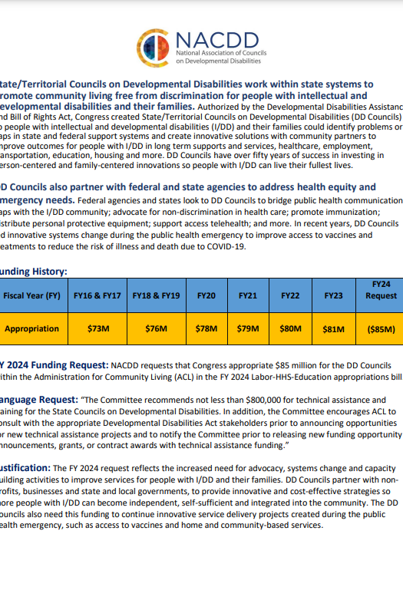
Appropriations

Slide 3
Unwinding PHE

Slide 4
NACDD Public Policy Listserv
Policy List open to all NACDD members (council members, staff and self-advocates)
To join go to https://bit.ly/3Ux1PEN

