Slide 1
Federal Policy Update February 8, 2023
Erin Prangley, Director, Public Policy National Association of Councils on Developmental Disabilities
Notes:
NACDD serves as the collective voice of the nation’s 56 DD Councils. The mission of DD Councils (and therefore ultimate goal of NACDD) is Systems Change. VABPDD is one of the councils we serve.
I'm here today for a purely selfish reason – we need more self advocates.
Why? Because in order to change systems, we need to change minds. In order to change minds, we need to change hearts.
Heart – Mind – System change.
There is NO ONE who get to the heart of a politician or any decision maker better than a self advocate.

Slide 2
Legislative Update
Protecting Health Care for All Patients Act (HR 485)(Eliminates QALYs). Hearing was held on this bipartisan, bicameral legislation. NACDD considering endorsement.
Stop the Wait Act (Phases out the 5-month waiting period for SSDI and eliminates the Medicare waiting period for those who are uninsured or unable to afford health insurance). NACDD endorsed this bill yet to be introduced.
Transition to Competitive and Integrated Employment Act (Provides grants to states or employers currently paying subminimum wage to workers with disabilities if they agree to transition to paying at least minimum wage to workers with disabilities and continue to provide services and supports to workers with disabilities, prohibits new 14c waivers, and phases out subminimum wage practices for all employers over 5 years.) NACDD endorsed this bill yet to be introduced.

Slide 3
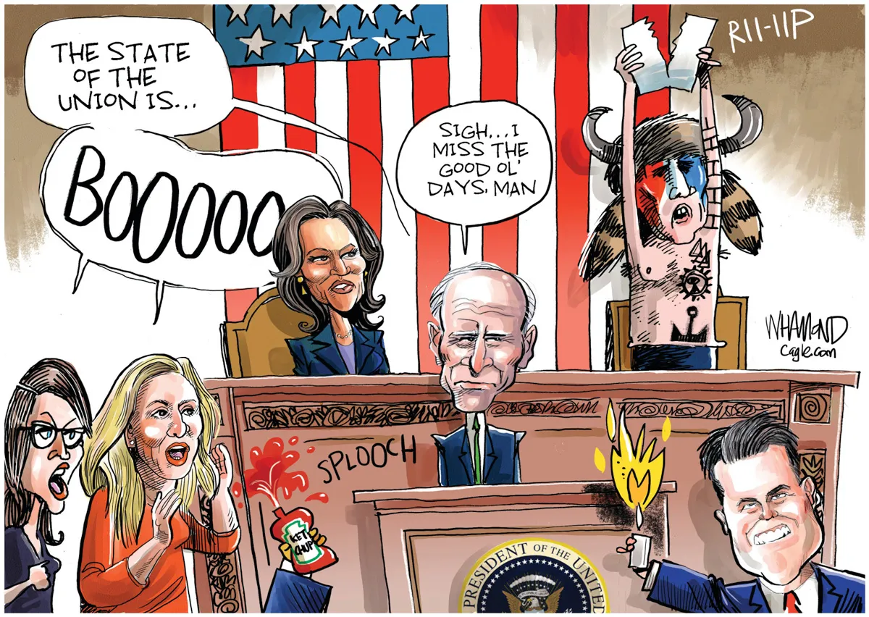

Slide 4
SOTU Quick Takes
Republicans want Medicare and Social Security to sunset every five years... If anyone tries to cut Social Security, I will stop them. And if anyone tries to cut Medicare, I will stop them.
We capped the cost of insulin at $35 a month for seniors on Medicare... Let’s cap the cost of insulin at $35 a month for every American who needs it.
Let’s get seniors who want to stay in their homes the care they need to do so. And give a little more breathing room to millions of family caregivers looking after their loved ones. Pass my plan so we get seniors and people with disabilities the home care services they need and support the workers who are doing God’s work. These plans are fully paid for and we can afford to do them.
And we’re finally giving Medicare the power to negotiate drug prices.
I’m pleased to say that more Americans have health insurance now than ever in history.
A record 16 million people are enrolled under the Affordable Care Act... Let’s finish the job, make those savings permanent, and expand coverage to those left off Medicaid.

Slide 5
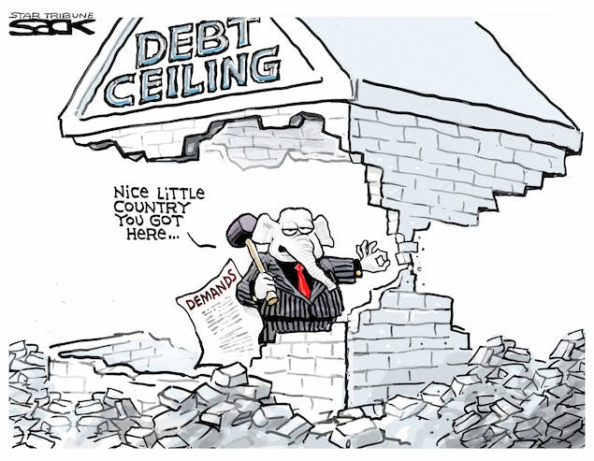
Quick take on Debt Ceiling Negotiations
McCarthy hinting there is possible compromise.
"No Default" messaging by McCarthy and statements that "A path to a balanced budget" is better than previous "balanced budget in 10 years" message.
Rumor is a 2-year agreement on discretionary spending (caps/sequester likely) is in the works.
Social Security and Medicare off the table.
But... Other entitlements are not off the table...
Fear is a per capita cap is in the works that would END entitlement to MEDICAID! Plus, additional flexibility to governors - allowing states to do bad things to undermine Medicaid protections.

Slide 6
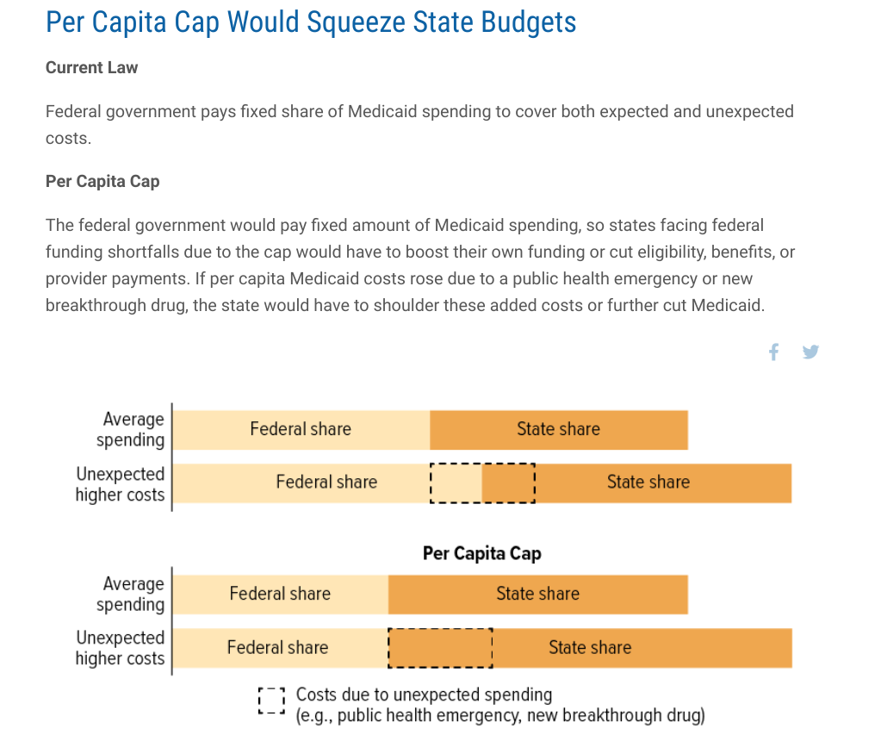
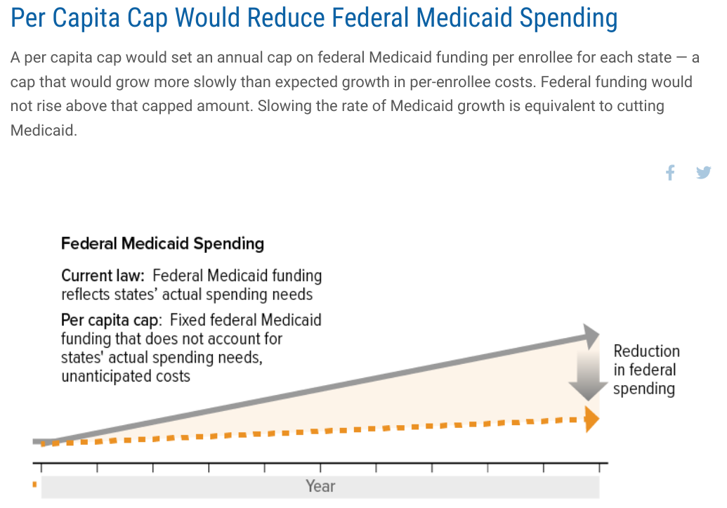
Drastic Medicaid "Caps" Proposal
Social Security and Medicare cuts are off the table. But... Proposal for per capita caps to Medicaid is the end to the entitlement to Medicaid and give more flexiblity to governors - allowing states to do bad things to undermine Medicaid protections.
See CBPP. "Medicaid Per Capita Cap Would Shift Costs to States" at https://www.cbpp.org/research/health/medicaid-per-capita-cap-would-shift-costs-to-states
NACDD signed on to letter to Congressional Leadership urging Clean Bill to Raise Debt Ceiling.

Slide 7
NACDD Public Policy Listserv
Policy List open to all NACDD members (council members, staff and self-advocates)
To join go to https://bit.ly/3Ux1PEN

