Slide 1
Federal Policy Update January 25, 2022
Erin Prangley, Director, Public Policy National Association of Councils on Developmental Disabilities
Notes:
NACDD serves as the collective voice of the nation’s 56 DD Councils. The mission of DD Councils (and therefore ultimate goal of NACDD) is Systems Change. VABPDD is one of the councils we serve.
I'm here today for a purely selfish reason – we need more self advocates.
Why? Because in order to change systems, we need to change minds. In order to change minds, we need to change hearts.
Heart – Mind – System change.
There is NO ONE who get to the heart of a politician or any decision maker better than a self advocate.

Slide 2
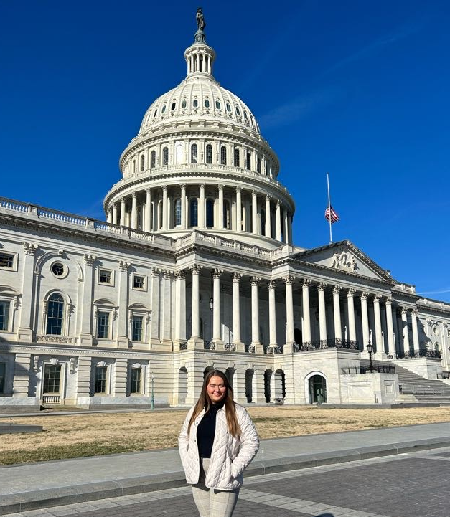
Cayleen Hall
Wofford College, SC

Slide 3
Congressional Meeting Toolkit
What is in it?
How to Build a Relationship with Your Member of Congress!
How to Make an Appointment and What to Expect!
Who will receive emails?
There are 68 new members of Congress in 30 states.
AL, AZ, CA,CO, FL, GA, HI, IL, IN, KY, MD, MI, MO, MS, NC, NJ, NY, OH, OK, OR, PA, RI, SC, TN, TX, VT, WI, WA, WV, WY
Going forward...
A Google Drive has been created for NACDD and information on Congressional Members will be available to all councils through a link. This content is viewable and can be updated as necessary. This is a future project, but for now the 118th Congress new members information is currently available.
All will be able to access the Congressional Meeting Toolkit.

Slide 5
NACDD Public Policy Listserv
Policy List open to all NACDD members (council members, staff and self-advocates)
To join go to https://bit.ly/3Ux1PEN

