Slide 1
Federal Policy Update December 14, 2022
Erin Prangley, Director, Public Policy National Association of Councils on Developmental Disabilities
Notes:
NACDD serves as the collective voice of the nation’s 56 DD Councils. The mission of DD Councils (and therefore ultimate goal of NACDD) is Systems Change. VABPDD is one of the councils we serve.
I'm here today for a purely selfish reason – we need more self advocates.
Why? Because in order to change systems, we need to change minds. In order to change minds, we need to change hearts.
Heart – Mind – System change.
There is NO ONE who get to the heart of a politician or any decision maker better than a self advocate.

Slide 2
Legislative Update
Appropriations FY2023: Likely 1.7T omnibus (Senate and Pelosi agreement; Granger likely to oppose). Challenge is they did not release top line non-defense discretionary numbers. Although defense received a 10% increase, it is unlikely to see that level of support for NDD.
House will pass a short-term CR through Dec 23 today. Possible pit falls on in final passage: Senate must have unanimous consent to move the bill and Pelosi can only lose 2 votes.
Current numbers: Senate $82M (+2M over FY22); House $85 (+5M); WH $88.48 (+8.48M).
Policy riders: Puerto Rico Medicaid agreement with FMAP level is likely to stay at the current 76%; less likely Money Follows the Person and ABLE Age Adjustment.
Notes:
EARN Act contains changes to various tax provisions in retirement accounts – increases age of mandatory withdraws of IRAs, ect. https://www.finance.senate.gov/imo/media/doc/EARN%20Act%20section%20by%20section%20summary.pdf

Slide 3
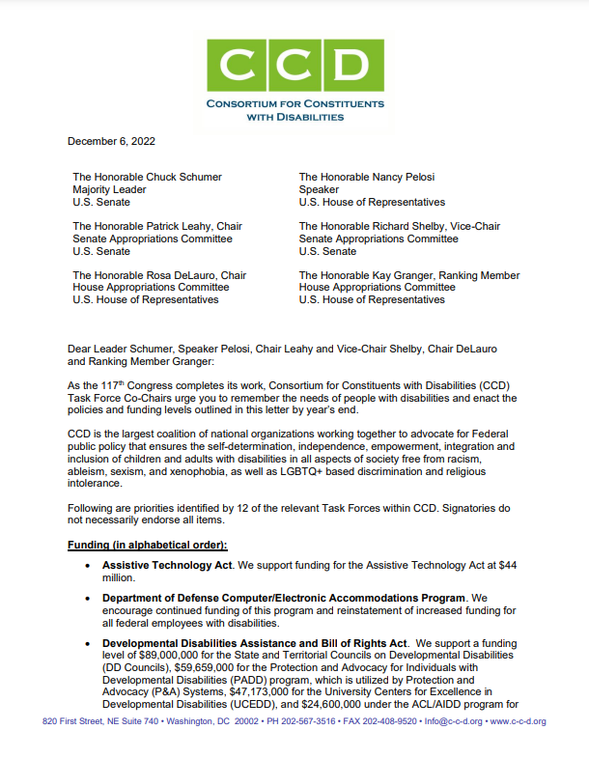
End of Year Legislative Push
NACDD contributed to CCD's End of Year Letter advocating for our appropriations and legislative priorities including DD Act Program funding, IDEA full funding, HCBS funding, Money Follows the Person, Ending Marriage Penalty, and so much more! Read the full letter here https://www.c-c-d.org/fichiers/CCD-2022-End-of-Year-Letter-Final.pdf

Slide 4
NACDD Public Policy Listserv
Policy List open to all NACDD members (council members, staff and self-advocates)
To join go to https://bit.ly/3Ux1PEN

