Slide 1
Dive into the DETACs Resources and More!
Tools and Technical Assistance Offerings
October 12, 2022

Slide 2
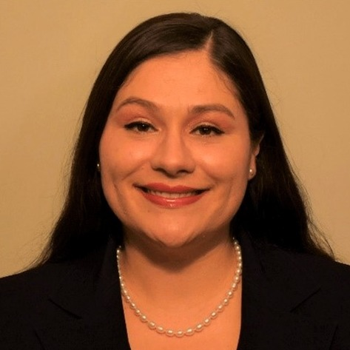
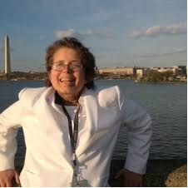
Today’s DETAC Speakers
Amy Gonzalez – Project Manager
Nicole LeBlanc – Self-Advocate Adviser

Slide 3
National Disability Employment Awareness Month (NDEAM)!
Celebrating the contributions of America’s workers with disabilities past, present and future!

Slide 4
Agenda
DETAC Overview
Results in Systems Excellence (RISE) eLearning Communities
Resources
Tips from Nicole
Questions and Comments

Slide 5
About the Disability Employment TA Center (DETAC)
Established in October 2020
Mission to provide TA to AoD grantees focused on improving competitive integrated employment (CIE) and economic outcomes for all people with disabilities across America.
Focus on improving partnerships within the grantee network to increase CIE.
Grantees: Centers for Independent Living, State Councils on Developmental Disabilities University Centers for Excellence in Developmental Disabilities, State Protection & Advocacy Systems, Traumatic Brain Injury State Partnership Programs and Projects of National Significance – Community Collaborations for Employment.

Slide 6
Technical Assistance Themes
Systems Change: Building professional competencies through e-learning, skill expansion, peer-to-peer mentoring, and resource dissemination.
Innovation: Build network capacity through identification, development, scalability, and sustainability of evidence-based practices.
Collaboration: Leverage unique talents & contributions of the grantee network through partnership development that leads to CIE improvements at individual and state levels.

Slide 7
Modes of Technical Assistance
National Community of Practice
National Webinars - Learning Management System
Technical Assistance Briefs - Blogs
Podcasts
Newsletters
Results & Innovation in Systems Excellence (RISE) eLearning Communities
High-impact, SMEs and peer-to-peer engagement, achieve 1 goal

Slide 8
Poll Question 1
Would small allotment Councils be interested in participating in an eLearning Community to get help to achieve one goal around employment?
Yes
No
I am interested but I need to learn more about the time commitment and structure.

Slide 9
Poll Question 2
Can Councils commit to a four-session eLearning Community at 1 hour per session?
Yes
No
That seems doable but I need the dates.

Slide 10
Poll Question 3
What would be the ideal timeframe for Councils to participate in the eLearning Community?
Starting in January after the New Year
Starting in April 2023
Starting in June 2023
Starting in August-September 2023

Slide 11
Publications
Helping State Councils Accelerate their Employment First Systems Change Efforts
Collaborating with Other Partners in the DD Network and Beyond to Further Employment First Systems Change
How State Councils on Developmental Disabilities can Invest Effectively in Employment Systems Change and Provider Transformation Efforts

Slide 12
Publications
The Role of State Councils on Developmental Disabilities in Improving Employment Outcomes for Individual with Disabilities in Managed Long-Term Services and Supports
Self-Employment Brief
Building Capacity for Financial Well-Being
Engaging Families and Raising Expectations around Employment

Slide 13
Publications
Why Employment Matters: A Resource Guide by and for Self-Advocates Interested in Pursuing Competitive, Integrated Employment
By: Nicole LeBlanc
Focus: A person with a disability is never too disabled to work and live in the community!
Promoting Self-Advocacy in Employment and Community Living

Slide 14
More About the Resource Guide by and for Self-Advocates Interested in Pursuing CIE
Intended for self-advocates and families with a goal to pursue CIE
Intended for self-advocates transitioning from sheltered work to CIE
Intended for youth in transition and families looking for post-secondary opportunities or CIE

Slide 15
Nicole’s Tips to Supporting Self-Advocates to Achieve CIE
Control Your Own Destiny or Someone Else Will
Believe in abilities
Let self-advocates be heard
Keep advocates in the conversation – Nothing About Me Without Me
Peer Support and Peer-led classes and services are important!

Slide 16
DETAC Offers Free Technical Assistance!
Submit your request to the: on-demand TA request page
Reach out by emailing: AoDemploymentTA@gmail.com

Slide 17
Questions or Comments

Slide 18
DETAC Contact Information
Email: AoDemploymentTA@gmail.com
Website: https://aoddisabilityemploymenttacenter.com
DETAC Publications:
https://aoddisabilityemploymenttacenter.com/detac-publications/

