Slide 1

Policy Update
September 28, 2022
Erin Prangley, Director, Public Policy
National Association of Councils on Developmental Disabilities

Slide 2
Legislative Update
Continuing Resolution (CR) to December 16 draft released in Senate. Includes funding for Ukraine, domestic disaster relief. Does not include funding for COVID or monkeypox supported by President. Likely to be signed by President before 10/1 deadline.
Senate committee reached a bipartisan agreement on the Electoral Count Reform Act (ECRA) to ensure states, Congress and future vice presidents can never overturn presidential election results. It also raises the number of congressional objectors required to challenge a state's election results -- up from one lawmaker in each chamber to 20% of members in both the House and Senate and clarifies that states may not select electors after Election Day. Expect a vote later this year after election.
Notes:
EARN Act contains changes to various tax provisions in retirement accounts – increases age of mandatory withdraws of IRAs, ect. https://www.finance.senate.gov/imo/media/doc/EARN%20Act%20section%20by%20section%20summary.pdf

Slide 3
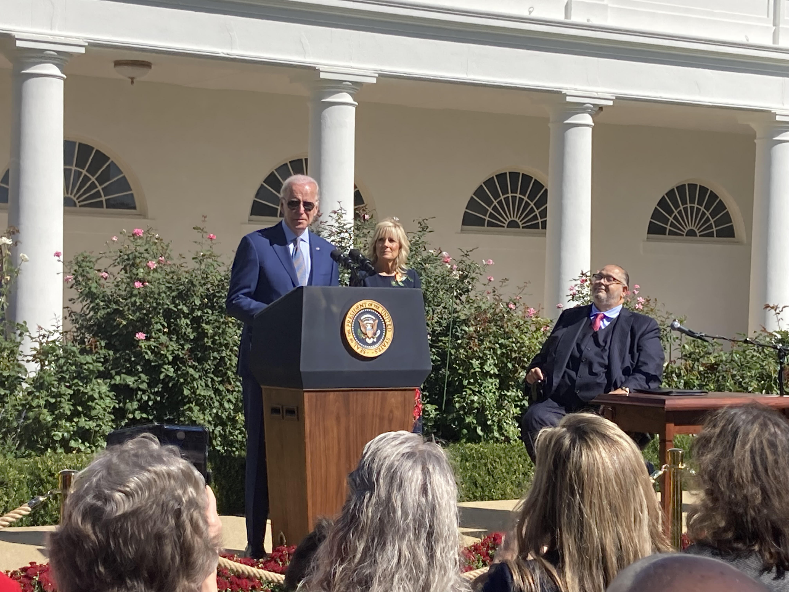
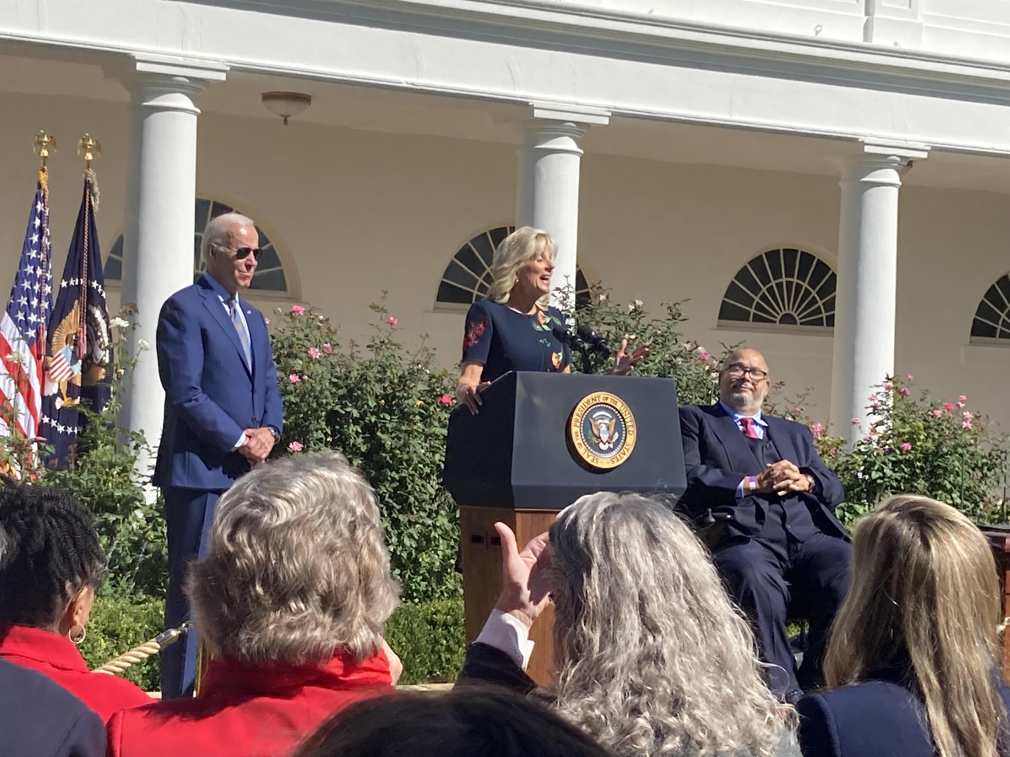
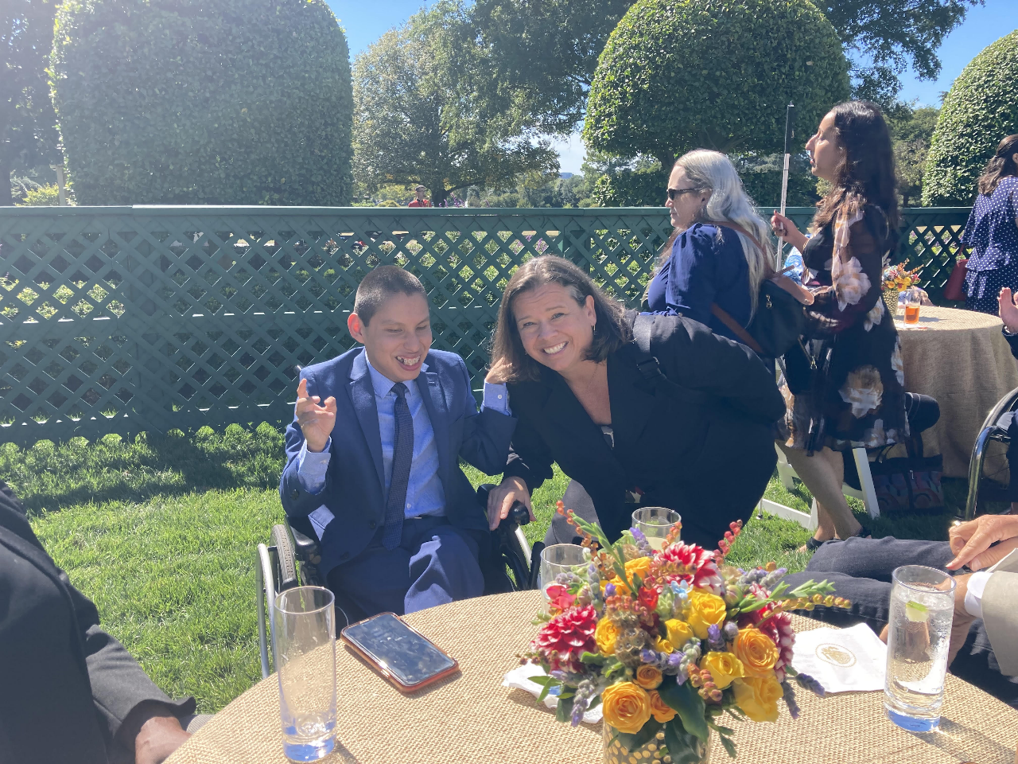
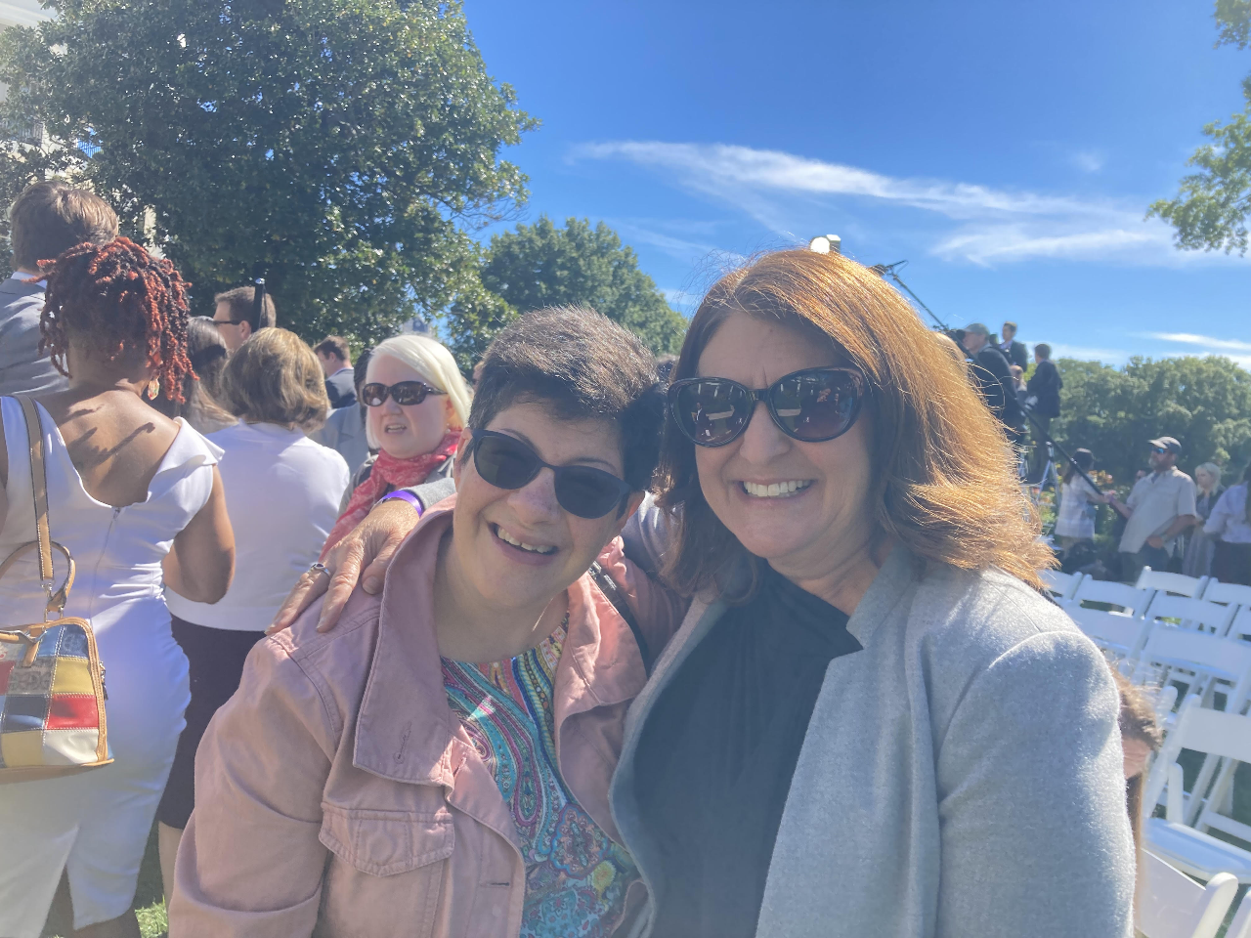
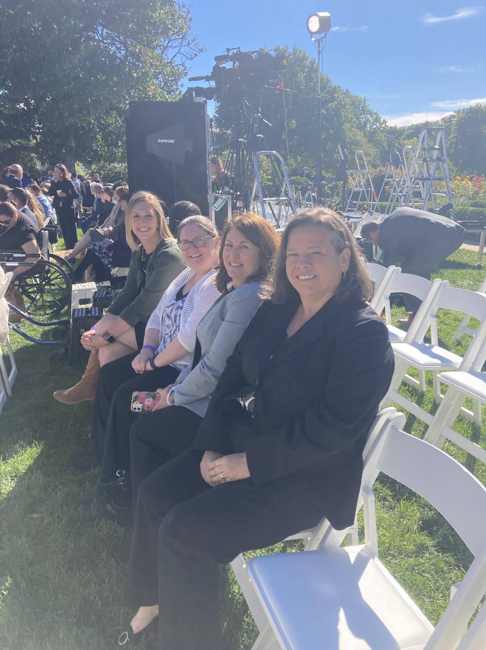
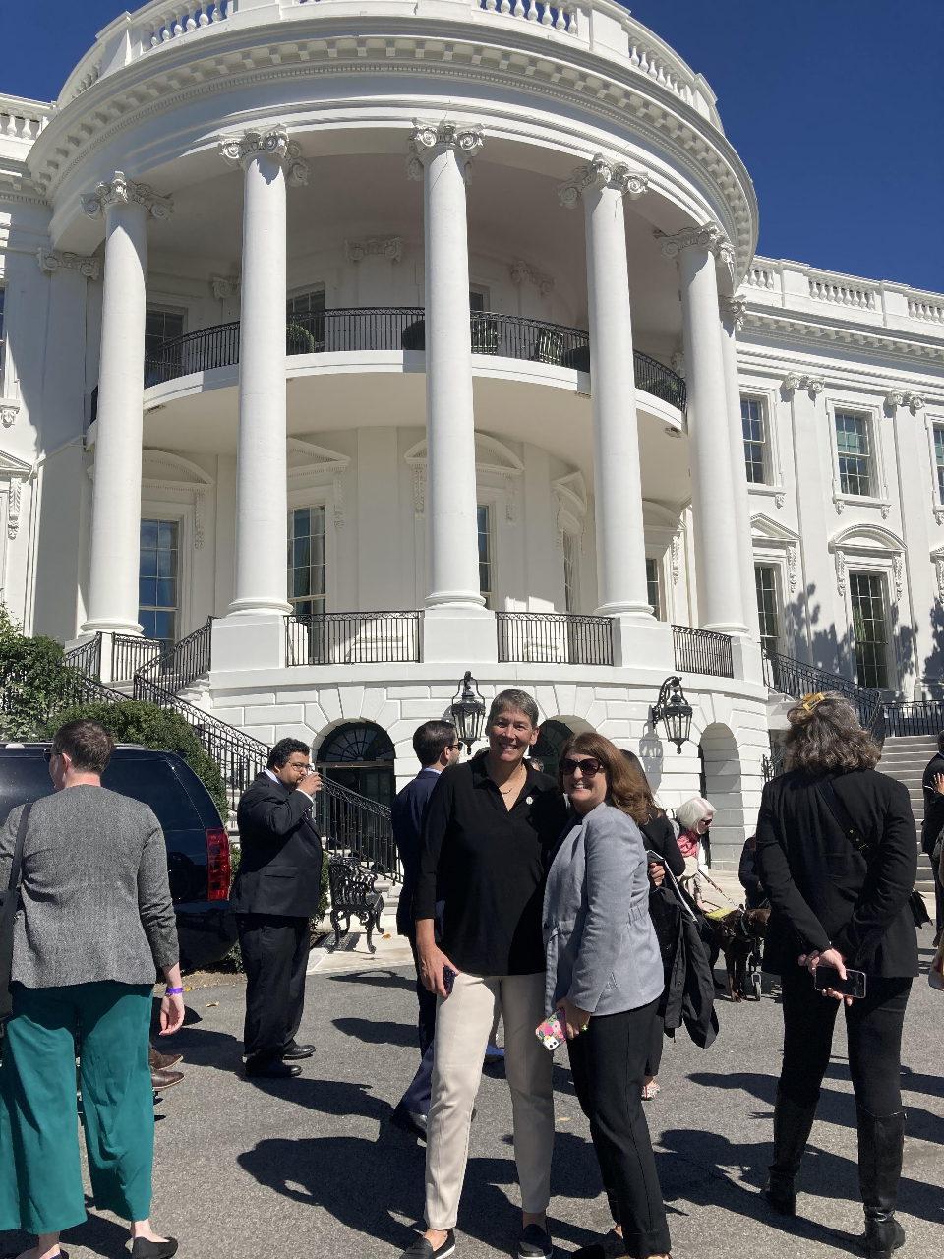
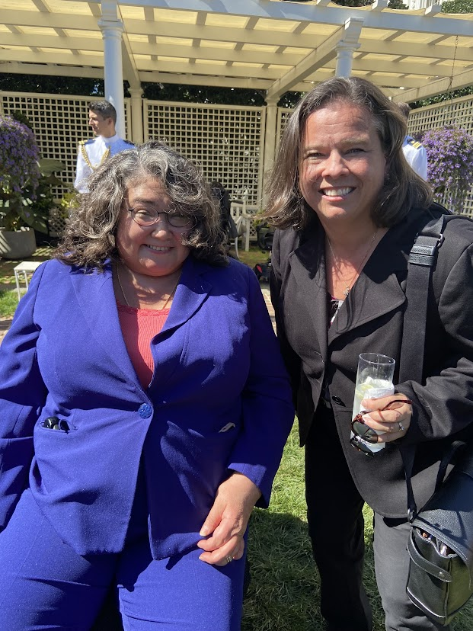
NACDD at the White House
Celebrating ADA and Disability Pride
September 28
Invitation is a recognition of our network value
Lots of work gets done with ACL and other in attendance
Event is an opportunity to network with new partners
-Rahnee Patrick, Director, Division of Rehabilitation Services at Illinois Department of Human Services
-Kim Musheno, Autism Society
-Liz Weintraub, AUCD
-José André Montano, Jazz Musician
-

Slide 4

Updates for 118th Congress
Civil Rights
*Bodily autonomy is fundamental to disability rights and self-determination.
*Access to a full range of education, health information and reproductive services, including birth control, family planning and abortion care.
*Support incentives to states to provide Alternatives to guardianship.
*Access to the ballot for people with disabilities.
*Data collection for racial, ethnic, and other marginalized communities.
Developmental Disabilities
*Ensure measures intended to protect safety of people with IDD do not violate civil liberties/contribute to profiling (e.g. tracking devices)
Direct Support Professionals
*Data collection for direct support professionals.
*Data collection for unpaid supports and strategies when family caregivers can no longer provide adequate care.
*Ensure adequate funding so that direct support professionals are paid a living wage, or as much as other jobs in the area that require the same skills (market wage), whichever is greater, including appropriate benefits.
*Require CMS to collect data on the number of unpaid hours assigned to “natural supports” such as family members and unpaid caregivers in care plans and assign a risk factor based on ages of caregiver and care needs of the participant.
https://nacdd.org/policy/

Slide 5
Updates for 118th Congress
Education
*Sexual education for all students with disabilities.
*Oppose federal funding for violence risk assessments or threat assessments.
*IEP includes provisions for emergency management.
*Oppose federal funding targeted to states, districts and/or schools to support the hiring of law enforcement, including school resource officers, and support funding for the training of mental health professionals and to support mental health crisis intervention including for students with IDD.
*Data collection on the number of lead tests done by schools, number of tests with elevated lead levels discovered broken down by lead level ranges, demographic data (age, race) of students, and proportion of students with elevated blood lead levels who have IEPs.
Employment, Training, and Wages
*Disaggregate data by race so that we can identify potential inequity.
*Ensure that employees with disabilities in all settings benefit from federal labor laws, including working to end subminimum wages by providing comprehensive transition services to competitive integrated employment settings.
Health Care
*Long COVID research and other policy responses include people with IDD
*New section on maternal health priorities.

Slide 6
Updates for 118th Congress
Social Security/Income Maintenance
Reject proposals that increase the amount of withholding by SSA in the event of an overpayment.
Ensure SSA provides equitable access to its programs, addresses systemic barriers to program participation, and collects the appropriate data necessary to achieve equity.
Child Welfare, Foster Care, and Adoption
Add protections for parents/guardians with disabilities
Criminal Legal System
Support crisis response to decrease interactions between IDD/disabled communities and law enforcement.
Support community-based infrastructure that can effectively respond to individuals in crisis, and avoid inappropriate institutionalization, hospitalizations, or incarceration
Promote accountability in federal funding to support and expand best practices for successful law enforcement interaction with people with disabilities.

Slide 7

State Policy Task force meeting [new link]
Tuesday, October 4, 4-5pm Eastern
Join Zoom Meeting
https://us02web.zoom.us/j/84651471241?pwd=ZDkzQnpsSnZ6UWtXT2k5VldheHI3dz09
Meeting ID: 846 5147 1241
Passcode: 209952
Policy Meetings Next Week
Public Policy Committee meeting​
Thursday, October 6, 2pm Eastern
Join Zoom Meeting​
https://us02web.zoom.us/j/82156490017​
Meeting ID: 821 5649 0017​
​

Slide 8
Thank you.
Erin Prangley, Director, Public Policy
eprangley@nacdd.org

