Slide 1
NACDD Policy Update May 25, 2022
Erin Prangley, Director, Public Policy National Association of Councils on Developmental Disabilities

Slide 2
Legislative Update
Appropriations FY2023
Murphy "Dear Colleague" submitted
On hold.
Build Back Better / Reconcilliation
Baby Formula Shortage
House testimony submitted
Biden authorized priority determinations under the Defense Production Act for Abbott Nutrition and Reckitt, and began flying in formula from overseas.
Legislation passed and signed streamlines WIC administrative requirements for formula during or up to 60 days after a national emergency, disaster or supply chain disruption.
The House last week also passed HR 7790 (NACDD endorsed) that would provide $28 million in emergency appropriations for the FDA to address the shortage. No Senate votes have been scheduled on the legislation.

Slide 3
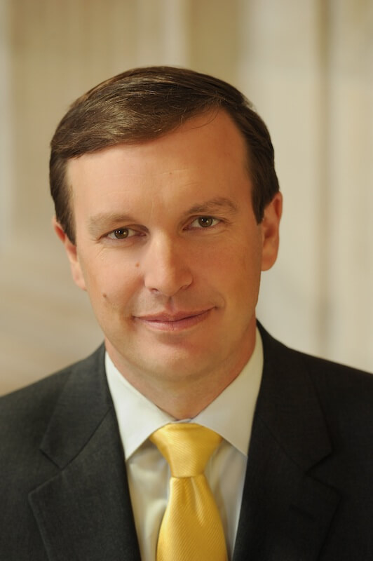
36 Senators support DD Act Appropriations Request
Markey (MA)​ Merkley (OR)​​ Murphy (CT)​​ Reed (RI)​​ Sanders (VT)​ Schatz (HI)​​ Shaheen (NH)​​ Sinema (AZ)​​ Smith (MN)​ Tester (MT)​ Van Hollen (MD)​ Warren (MA)​ Wyden (​OR) ​​
Baldwin (WI)​ Blumenthal (CT) Booker (NJ)​ Brown (OH)​ Cantwell (WA)​ Cardin (MD)​ Casey (PA) Hassan (NH)​ Hirono (HI) Kaine (VA)​ Klobuchar (MN)​ Lujan (NM) Padilla (CA)
Sen. Chris Murphy led the effort to request funding for the DD Act programs for FY2023.

Slide 4
New CMS/ACL Guidance on HCBS Rule Implementation
CMS and ACL are moving forward with state compliance activities that balances the need for the rule with the realities of the direct-service workforce crisis exacerbated by the COVID-19 PHE.
"Corrective Action Plans" will be available to allow states to continue work on certain requirement even after the 3/17/2023 deadline.
No CAP for civil rights requirements:
1) Privacy, dignity, respect, and freedom from coercion and restraint and control of personal resources.
2) A lease; Privacy in their unit, including lockable doors, and freedom to furnish or decorate the unit; Access to food at any time; Access to visitors at any time; Physical accessibility; and Person-centered service plan documentation of modifications to relevant regulatory criteria.
See CMS/ACL slides at https://www.medicaid.gov/medicaid/home-community-based-services/downloads/hcbs-settings-rule-imp.pdf

Slide 5
Next Public Policy Committee Meeting
Thursday, June 3, 2pm Eastern
Join Zoom Meeting https://us02web.zoom.us/j/82156490017
Meeting ID: 821 5649 0017
One tap mobile
+13017158592,,82156490017# US (Washington DC)

