Slide 1
Adult-Sized Changing Tables The Council leads effort to expand access across Tennessee

Slide 2
A key priority of the TN Council on DD
Notes:
Lauren gives intro remarks

Slide 3
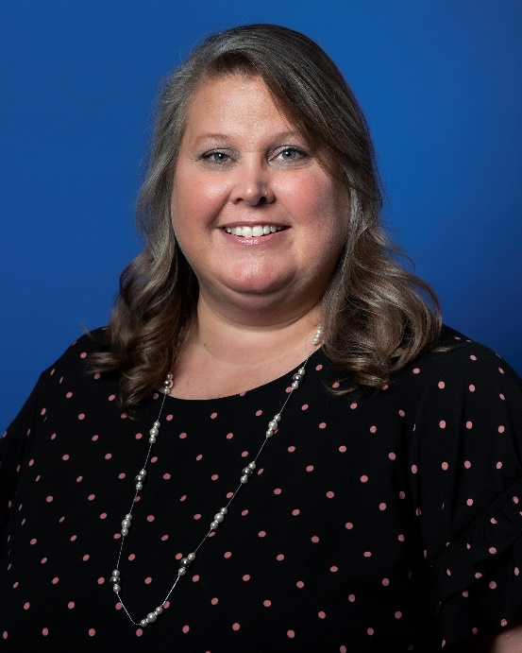
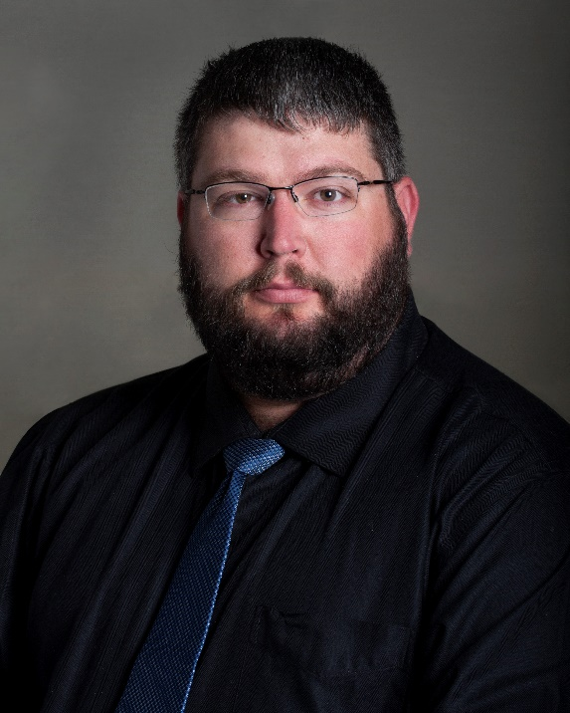
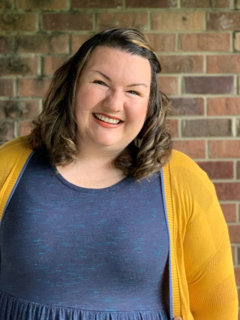
Led by Governor appointed members
Chrissy Hood
Council member
South Central TN
Roddey Coe
Council member
Southeast TN
Alison Bynum
Council member
Mid-Cumberland TN
Notes:
Lauren

Slide 4
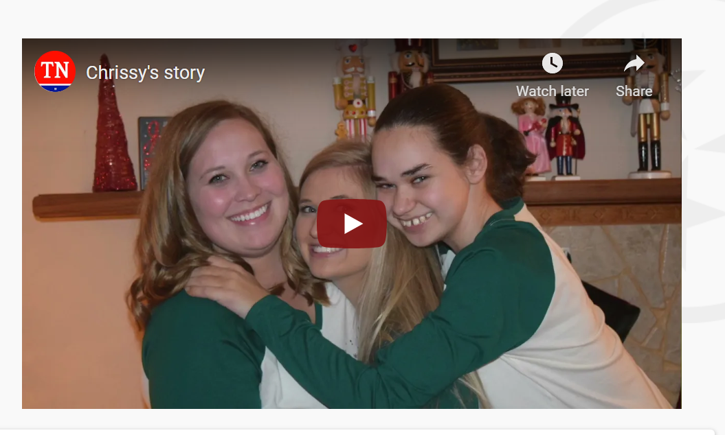
Lived experience is the best advocacy.
Notes:
Lauren plays video

Slide 5
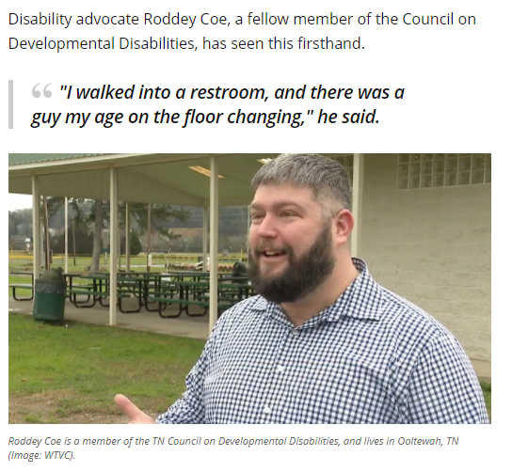
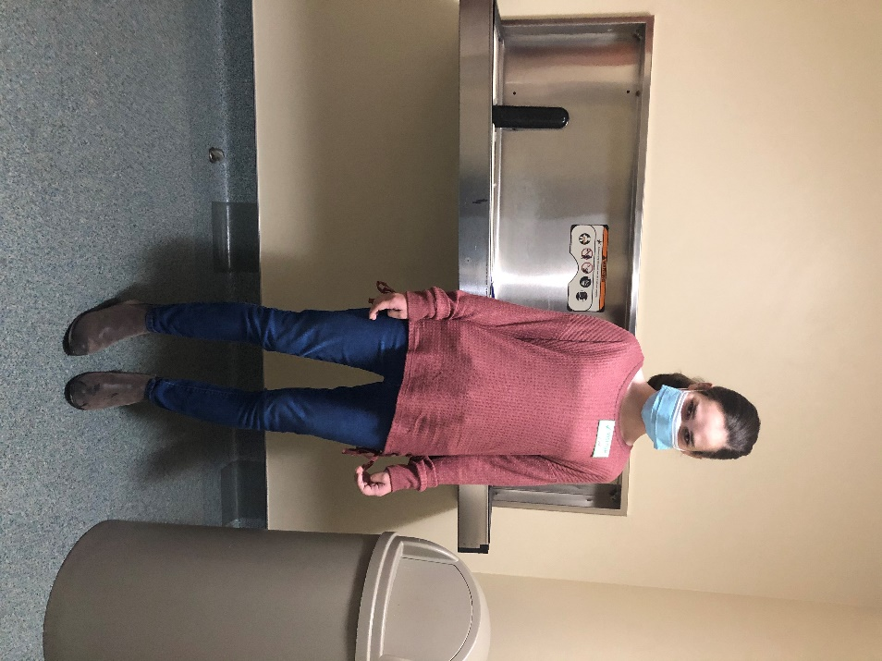
Lived experience is the best advocacy.
Notes:
Lauren

Slide 6
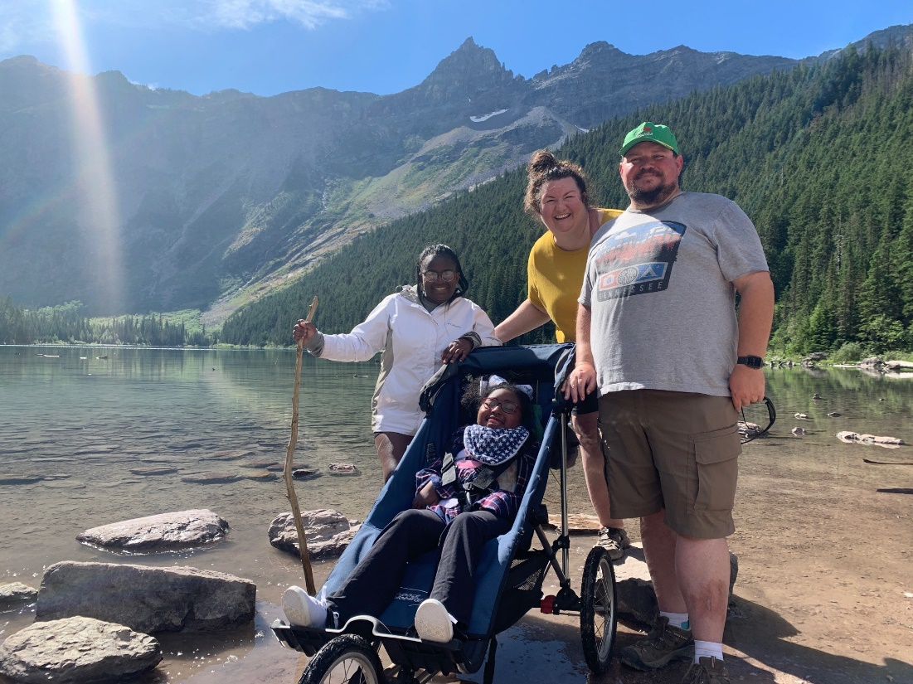
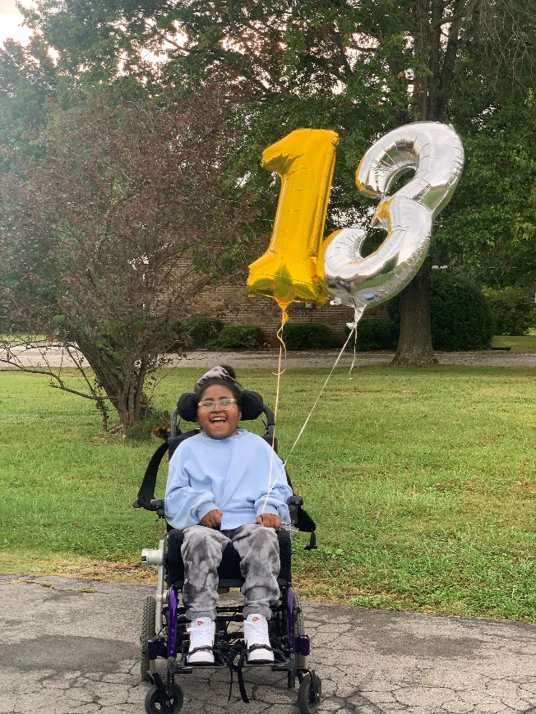
Lived experience is the best advocacy.
The Bynum Family
Charlotte Bynum, 13
Notes:
Lauren

Slide 7
Telling Our Stories
Notes:
Lauren

Slide 8
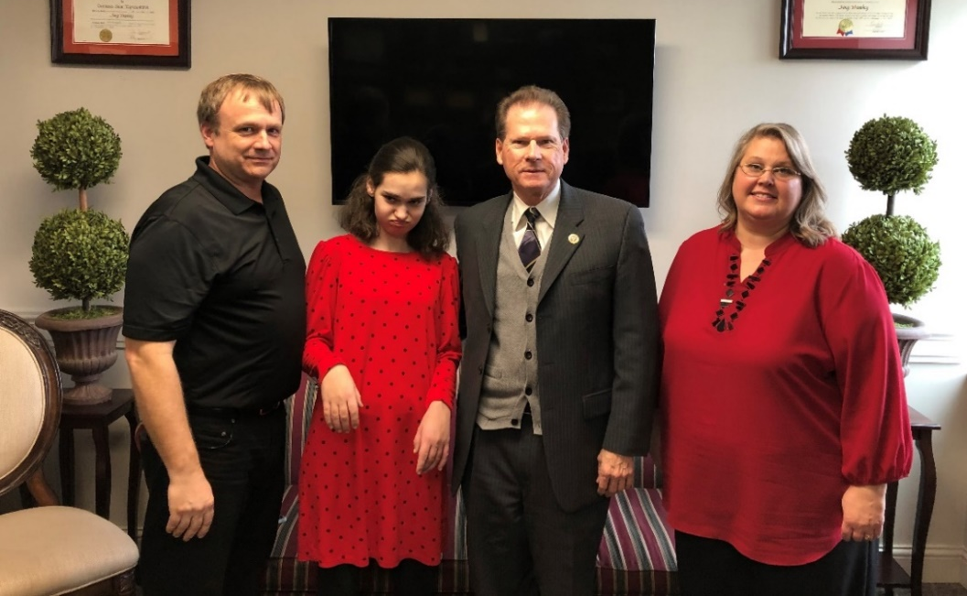
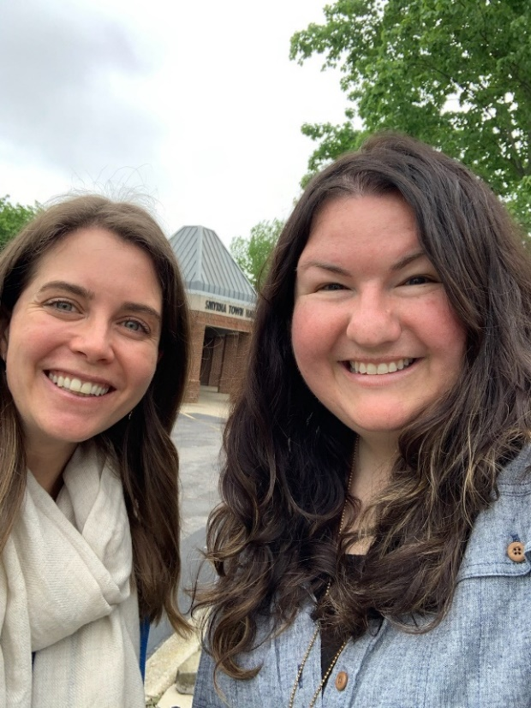
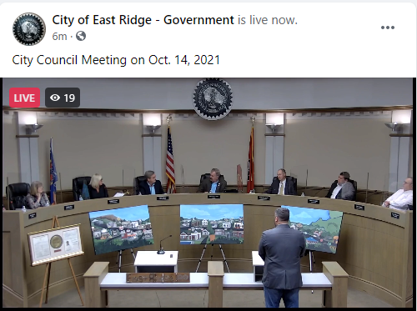
Educating and Advocating with Elected Officials
Notes:
Chrissy / Lauren

Slide 9
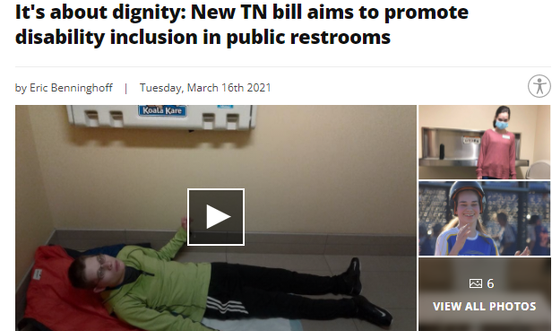
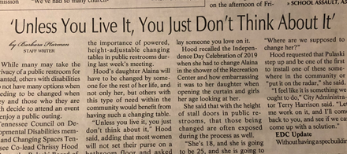
Media Publicity
Notes:
Chrissy / Lauren

Slide 10
Billboard campaign
Notes:
Chrissy / Lauren

Slide 11
Awareness to Action
Notes:
Lauren

Slide 12
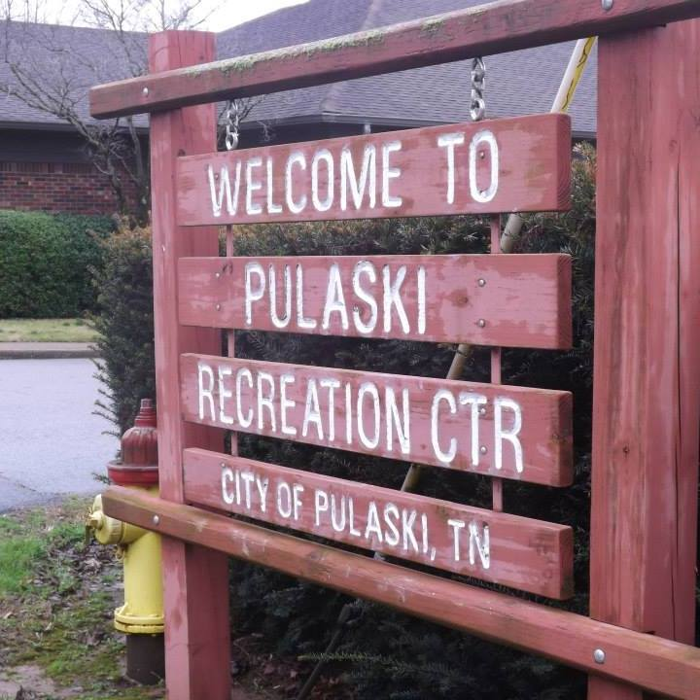
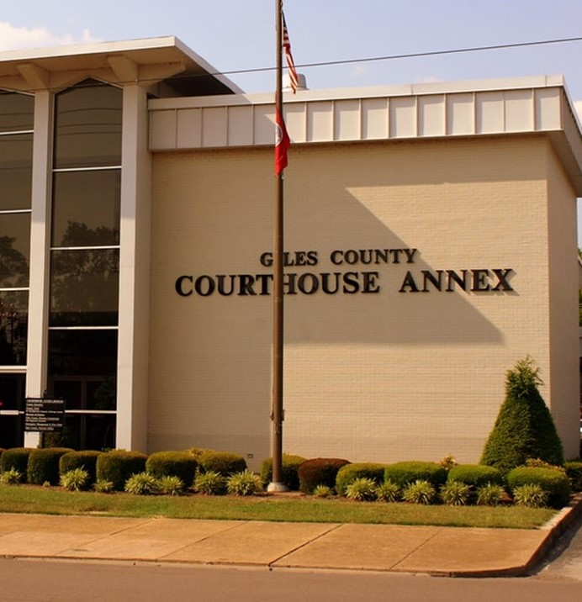
Local Efforts
Notes:
Chrissy / Lauren

Slide 13
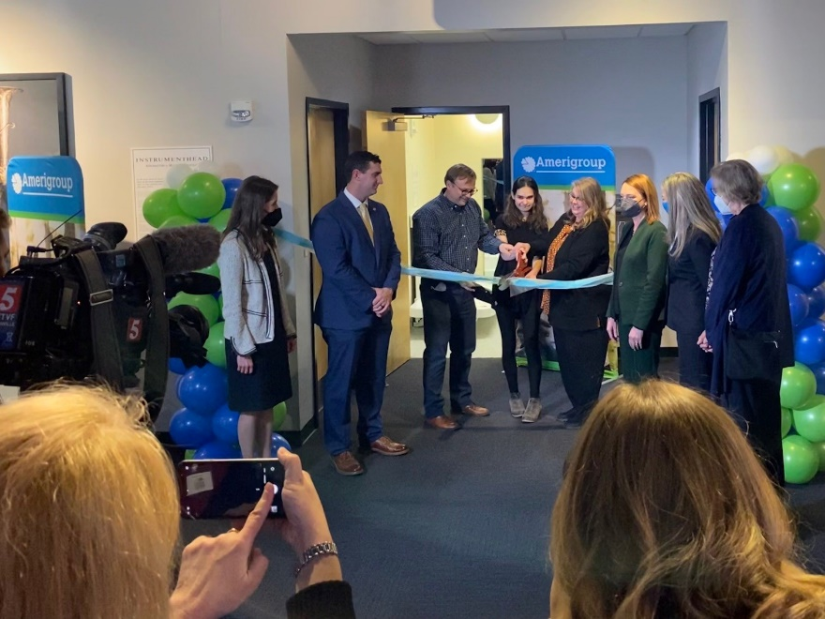
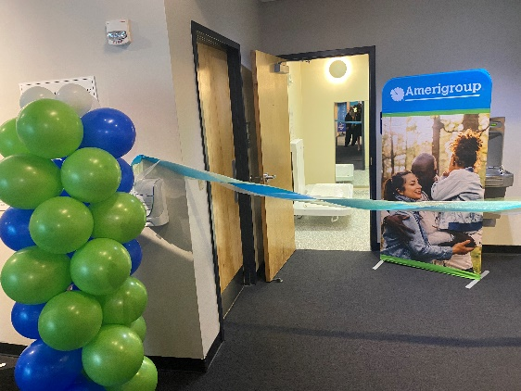
Local Efforts
Notes:
Chrissy / Lauren

Slide 14
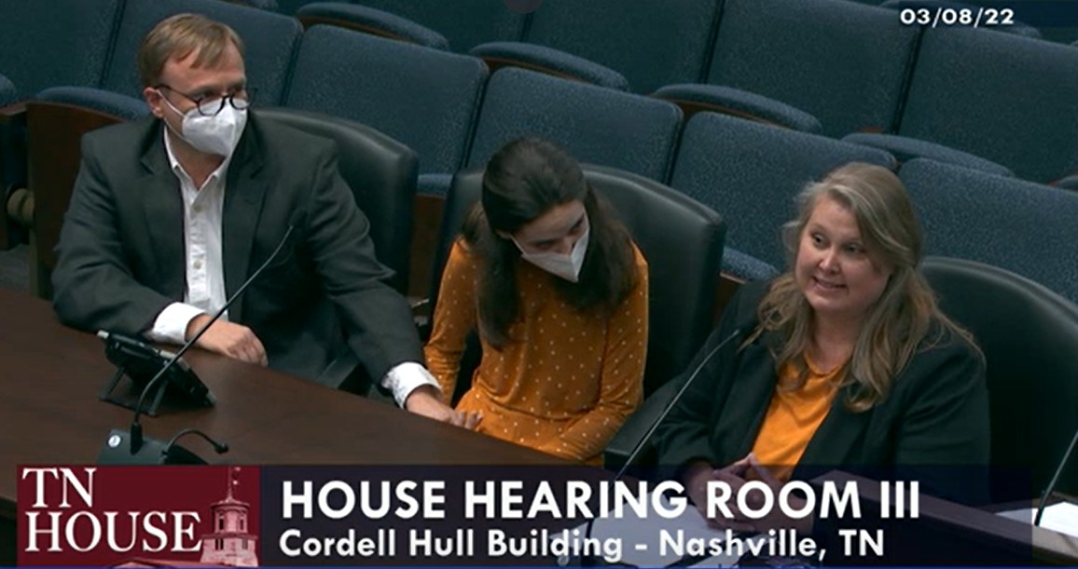
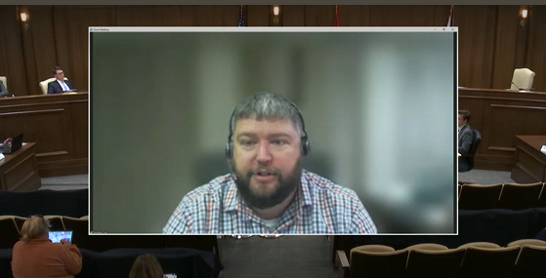
Legislation in Tennessee
Notes:
Chrissy / Lauren

Slide 15
Bill Timeline
Spent 2018-2019 educating lawmakers, the public
Introduced bill in 2020 (TN has a two-year session)
Spent 2020-2021 educating, adjusting, testifying
Pivotal meeting in December 2021 with legislator and constituent/Council member in his community; made key decision to change from mandate to permissive approach
Requirement for businesses changed to optional grant program for businesses
Commitments without legislative requirements made for tables in all Welcome Centers, State Parks, and Rest Stops by 2030
Unanimous support from legislators and additional commitments from state agencies in 2022
Notes:
Chrissy / Lauren

Slide 16
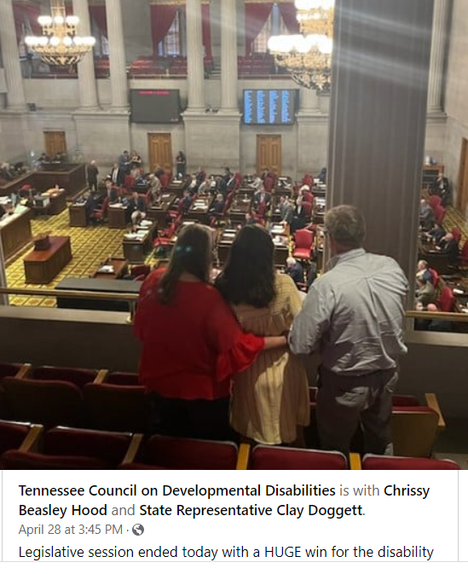
Success
Notes:
Chrissy / Lauren

Slide 17
Looking Ahead
Notes:
Lauren

Slide 18
Looking ahead
The Council will continue to lead implementation efforts:
Business community outreach with goal to use all 200 grants available
Accountability for state agency commitments
Recurring appropriation in Governor's budget
Notes:
Lauren

Slide 19
Contact us directly
Chrissy Hood, South Central TN (Pulaski) connectingthejourney@gmail.com
Roddey Coe, Southeast TN (Chattanooga) roddey.coe@comcast.net
Alison Bynum, Mid-Cumberland (Smyrna) alison.bynum@comcast.net
Lauren Pearcy, Public Policy Director lauren.j.pearcy@tn.gov
Notes:
Lauren

Slide 20
Questions?
Notes:
Lauren

