Slide 1
NACDD Policy Update May 4, 2022
Erin Prangley, Director, Public Policy National Association of Councils on Developmental Disabilities

Slide 2
Legislative Update
Appropriations FY2023
Langevin "Dear Colleague"
Murphy "Dear Colleague" in the works.
DD Council "Sign On Letter" circulating.
On hold.
Build Back Better
FY23 Budget
ACL +$727.618M
DD Councils +$9.480M

Slide 3
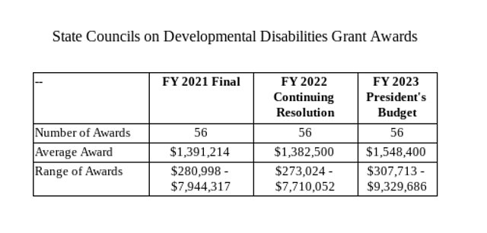
ACL Budget Justification
A budget justification is an explanation of each of the components of the budget, which “justifies” the cost in terms of the proposed work.
ACL's justification includes statistics showing need (increased DD population and COVID), examples of DD Council work, tables of funding histories, and state allocations.
See ACL Budget Justifications at https://acl.gov/sites/default/files/about-acl/2022-02/FY2023_ACL-BudgetJustification.docx

Slide 4
House Appropriations Request
20 Members of Congress from 13 States
CA: Reps. Julia Brownley, Mark DeSaulnier, Jackie Speier
GA: Rep. Nikema Williams
IL: Reps. Danny Davis, Marie Newman, Janice Schakowsky
KY: Rep. John Yarmuth
MA: Reps. Stephen Lynch, Seth Moulton
MD: Reps. Anthony Brown, John Sarbanes
ME: Rep. Chellie Pingree
NJ: Reps. Chris Pappas, Andy Kim, Tom Malinowski
NMI: Del. Gregorio Sablan
NV: Rep. Steven Horsford
RI: Rep. James Langevin
TN: Rep. Steve Cohen
VA: Rep. Beyer, Donald

Slide 5
DD Council Sign on Letter
NACDD Public Policy Committee asks that your DD Council sign on to a letter to the House and Senate Appropriations Committees' leaders to provide them with information they need as they begin consideration of the FY23 appropriations requests.
To read the full text of the letter and sign your council on go to https://forms.gle/nM6XGKLPxdMzsYN76
or Send an email with your council's name as you would like it to appear on the letter to Erin Prangley at eprangley@nacdd.org by Friday, May 6.
If you have any questions, please contact Brett Williams at williamsb18@michigan.gov or Erin Prangley at eprangley@nacdd.org.

Slide 6
Alabama Council on Developmental Disabilities
Alaska Governor’s Council on Disabilities and Special Education
Arizona Developmental Disabilities Planning Council
California State Counil on Developmental Disabilities
CNMI Council on Developmental Disabilities
Developmental Disabilities Council of Oklahoma
Developmental Disabilities Council of Oklahoma
Georgia Council on Developmental Disabilities
Governor's Council on Developmental Disabilities
Hawaii State Council on Developmental Disabilities
Illinois Council on Developmental Disabilities
Indiana Governor's Council for People with Disabilities
Iowa Developmental Disabilities Council
Maine Developmental Disabilities Council ​
Massachusetts Developmental Disabilities Council​
Michigan Council on Developmental DIsabilities
Minnesota Governor’s Council on Developmental Disabilities​
Missouri Developmental Disabilities Council​
Nebraska Council on Developmental Disabilities
Nevada Governor’s Council on Developmental Disabilities​
New Hampshire Council on Developmental Disabilities​
New Jersey Council on Developmental Disabilities​
New York State Developmental Disabilities Planning Council ​
North Carolina Council on Developmental Disabilities​
North Dakota State Council on Developmental Disabilities​
North Dakota State Council on Developmental Disabilities​
Puerto Rico Developmental Disabilities Council ​
South Dakota Council on Developmental Disabilities​
Texas Council for Developmental Disabilities​
Utah Developmental Disabilities Council​
Vermont Developmental Disabilities Council​
Virginia Board for People with Disabilities​
Washington State Developmental Disabilities Council​
Wisconsin Board for People with Developmental Disabilities​

Slide 7
Next Public Policy Committee Meeting
Thursday, May 5, 1pm Eastern
**New Time: Starting an hour earlier! Join Zoom Meeting https://us02web.zoom.us/j/82156490017
Meeting ID: 821 5649 0017
One tap mobile
+13017158592,,82156490017# US (Washington DC)

