Slide 1
NACDD Policy Update April 20, 2022
Erin Prangley, Director, Public Policy National Association of Councils on Developmental Disabilities

Slide 2
Legislative Update
Appropriations FY2022
Appropriations FY2023
Langevin "Dear Colleague" support letter circulating.
Bipartisan and bicameral omnibus appropriations and Ukraine supplemental package signed March 15.
DD Councils received $1M funding increase.
Murphy "Dear Colleague" in the works.
DD Council "Sign On Letter" circulating.
On hold.
Build Back Better

Slide 3
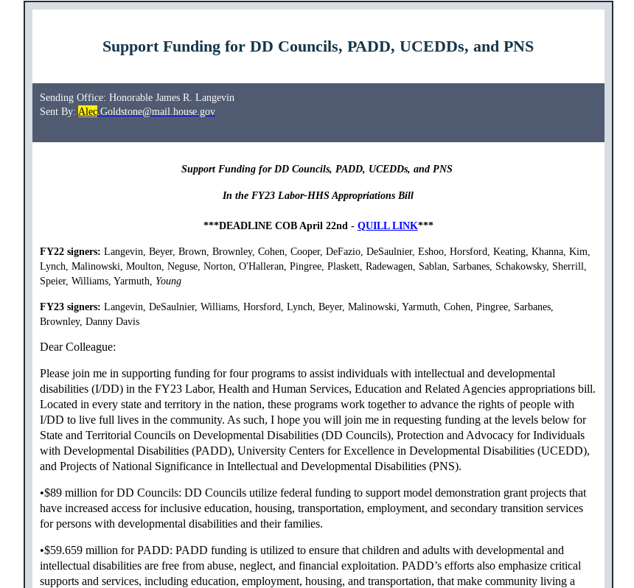
Rep. Langevin "Dear Colleague"
Action Steps:
1) Check to see if your member of Congress has signed on to the FY23 letter.
2) If not, contact their office and tell them: "Congressman Langevin has circulated a "Dear Colleague" letter in support of DD Council appropriations. Members can contact Alec Goldstone in his office to sign on. His email is Alec.Goldstone@mail.house.gov. Would you like me to send you a copy of the "Dear Colleague" letter?"
3) Let Erin know that you contacted the office so she can follow up.

Slide 4
DD Council Sign on Letter
NACDD Public Policy Committee asks that your DD Council sign on to a letter to the House and Senate Appropriations Committees' leaders to provide them with information they need as they begin consideration of the FY23 appropriations requests.
To read the full text of the letter and sign your council on go to https://forms.gle/nM6XGKLPxdMzsYN76
or Send an email with your council's name as you would like it to appear on the letter to Erin Prangley at eprangley@nacdd.org by Friday, May 6.
If you have any questions, please contact Brett Williams at williamsb18@michigan.gov or Erin Prangley at eprangley@nacdd.org.

Slide 5
NACDD Supported Appropriations Requests
DD Act programs: UCEDDs, P&A's, Programs of National Significance​ Title V Maternal and Child Health (MCH) Services Block Grant ​ National WIC Association to extend the WIC benefit bump Office of Climate Change and Health Equity ​ Social Security supplemental funding to deal with increased backlog of SSI cases. ​ Part B Section 611 (Grants to States): $16.2 billon​ Part B Section 619 (Preschool Grants): $503 million​ Part C (Grants to serve infants and toddlers): $932 million​ Part D (National Activities):​ State Personnel Development: $39 million​ TA and Dissemination: $49 million ​Personnel Preparation: $300 million ​Parent Training & Information Centers: $45 million Media and Technology: $32 million​ Institute for Education Sciences (IES): $815 million National Center for Special Education Research (within IES): $70 million Office for Civil Rights: $161.3 million | ESSA Title I: $36.5 billion ESSA Title II: $2.5 billion Transition Programs for Students with Intellectual Disability (TPSID) Model Demonstrations & TPSID National Coordinating Center (NCC), and National Technical Assistance and Dissemination Center (NDATC): $15.18 million​ Protection and Advocacy for Individual Rights (PAIR) program: $25 million​ American Printing House for the Blind (APH): $57.2 million​ Assistive Technology Act Programs: $60 million​ School Based Mental Health Services Professionals and School Based Mental Health Services grants: At least $111 million.​ Increase funding for the Full-Service Community Schools program to expand support for the collaboration and of community-based mental health resources for students and families in schools. ​ ​

Slide 6
Next Public Policy Committee Meeting
Thursday, May 5, 2pm Eastern Join Zoom Meeting https://us02web.zoom.us/j/82156490017
Meeting ID: 821 5649 0017
One tap mobile
+13017158592,,82156490017# US (Washington DC)

