Slide 1
NACDD Policy Update December 8, 2021
Erin Prangley, Director, Public Policy National Association of Councils on Developmental Disabilities

Slide 2
Legislative Update
Infrastructure (BIF).
Reconciliation (Build Back Better).
FY22 Appropriations
Debt Ceiling
Signed into law November 15.
Passed House November 19.
Continuing Resoution extended to February 18.
Senate to begin consideration December 13.
Likely bipartisan agreement to temporarily allow vote with procedural rule for only 51 vote threshold.
Congress would have to specify the exact dollar amount of a new national debt limit -- likely north of $30 trillion. The fast-track process would expire after January 15.
X
Notes:
Infrastructure: 1.2T over 8 years. Expires 9/30 (not included in House CR)
Enviornmental clean up
$39 billion to modernize public transit, upgrade aging infrastructure & make stations accessible
$65 billion to ensure access to high-speed internet for all
Reconciliation: HCBS funding through Medicaid FMAP ($190B)
Grant program to incentivize phasing out 14(c)
Funding for a direct care workforce grant program
TA Center for direct care at ACL
$297M extra funding IDEA Part D

Slide 3
New: Housing and Services Resource Center
at https://acl.gov/HousingAndServices
Partnership between the U.S. Department of Health and Human Services and the U.S. Department of Housing and Urban Development lead by Administration for Community Living.
Website includes:
Information on developing and expanding partnerships,
Tool kits designed for community collaborations,
Referrals for supports for people with disabilities, older adults, and people experiencing homelessness to get and/or keep affordable and accessible housing and voluntary services, and
Examples of innovative models and strategies.

Slide 4
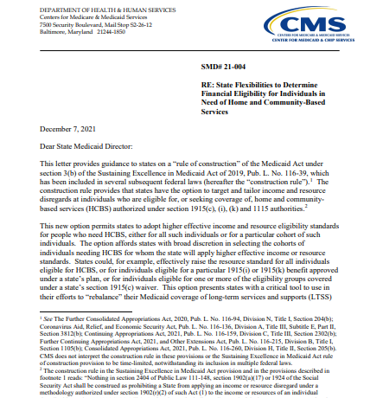
HCBS Funding Flexibility: New rule focuses on eligibility and access
New CMS letter to Medicaid Directors advises:
New construction rule permits states to adopt higher effective income and resource eligibility standards for people who need HCBS under section 1915(c), (i), (k) and 1115 authorities.
For example, "states could effectively raise the resource standard for all individuals eligible for HCBS, or for individuals eligible for a particular 1915(i) or 1915(k) benefit approved under a state’s plan, or for individuals eligible for one or more of the eligibility groups covered under a state’s section 1915(c) waiver." (See p. 1.)
This option presents states with a critical tool to use in their efforts to “rebalance” their Medicaid coverage of long-term services and supports (LTSS).
See letter at https://www.medicaid.gov/Federal-Policy-Guidance/Downloads/smd21004.pdf

