Slide 1
NACDD Policy Update October 27, 2021
Erin Prangley, Director, Public Policy National Association of Councils on Developmental Disabilities

Slide 2
Legislative Update
Infrastructure (BIF).
Reconciliation (Build Back Better).
Continuing Resolution
Debt Ceiling
Summary at https://bit.ly/3BjbMfo
2nd Deadline: December or Early January.
2nd Deadline: December 3
No vote this week.
Possible $1.7T deal could be announced.
HCBS still included but drastically cut.
Could be on the House floor if agreement is made.
Notes:
Infrastructure: 1.2T over 8 years. Expires 9/30 (not included in House CR)
Enviornmental clean up
$39 billion to modernize public transit, upgrade aging infrastructure & make stations accessible
$65 billion to ensure access to high-speed internet for all
Reconciliation: HCBS funding through Medicaid FMAP ($190B)
Grant program to incentivize phasing out 14(c)
Funding for a direct care workforce grant program
TA Center for direct care at ACL
$297M extra funding IDEA Part D

Slide 3
Medicaid HCBS Day of Action Tomorrow, October 28
Message the White House
1
Message the White House
Go to "Be a Hero" to send an instant message to the WH: https://act.newmode.net/action/be-hero-fund/tell-white-house-fight-americans-disabilities
Call Your Congressperson
2
Call or Message to Congress
UseThe Arc action alert at https://p2a.co/IAFTwCz that will connect your call directly.
Use State-by-State fact sheets https://www.aging.senate.gov/press-releases/better-care-better-jobs-act-state-by-state-fact-sheets about the difference the Better Care Better Jobs Act will make in your state
Use Hashtags
3
Post on social media by using Hashtags: #CareCantWait, #BuildBackBetter, #HCBSCantWait #HoldTheLine
Participate in Facebook Event
Go to the event at https://fb.me/e/1YYCmuDCP
Invite your family and friends to join!

Slide 4
NACDD joins Amicus Brief in CVS v. Doe
The Supreme Court will decide whether Section 504 of the Rehabilitation Act of 1973—and by extension Section 1557 of the Patient Protection and Affordable Care Act—provide a disparate-impact cause of action for plaintiffs alleging disability discrimination or whether there is a greater standard which would be much more difficult (if not impossible) to prove that requires showing of discriminatory intent.

Slide 5
CVS v. Doe
People with CVS pharmacy insurance who require expensive medication, want to keep access to local pharmacies to get their prescriptions like everyone else.
CVS changed its policy to require people with expensive medication to get it by mail from specialty pharmacies. This saves CVS a lot of money, but people say this is treating them differently because of their disability and is discrimination.
Is it still discrimination if CVS has another non-discriminatory reason besides disability for treating people differently? Do people have to show CVS intended to harm them because they have a disability?

Slide 6
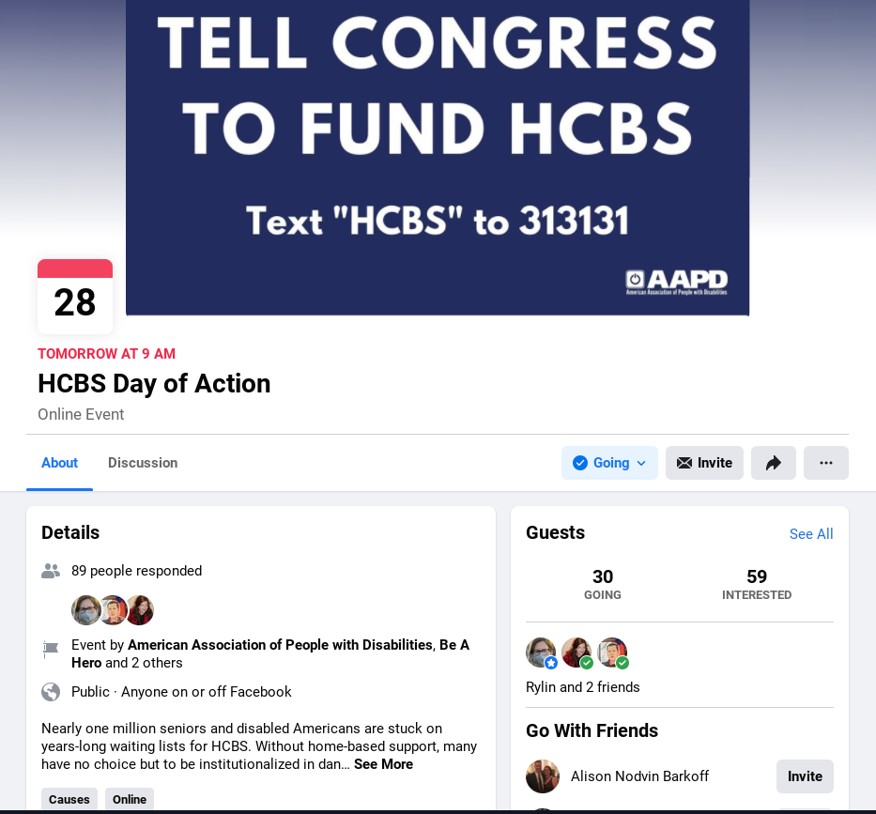
New Resources / Upcoming Events
Need guidance on
State HCBS Activities?
Contact Serena Lowe at ewolaneres@gmail.com or 202-907-8369
Public Policy Committee Monthly Meeting ​
Thursday, November 4, 2pm Eastern​
​
Join Zoom Meeting​
https://us02web.zoom.us/j/82156490017​
​
Meeting ID: 821 5649 0017​
HCBS Day of Action October 28, Starting at 9am
Go to Facebook Event
https://fb.me/e/1YYCmuDCP

