Slide 1
Our Shot:
A Federal Update regarding the Future of Medicaid HCBS

Slide 2
Careful Reflection
Trends in Medicaid HCBS: where we’ve been and where we are today

Slide 3
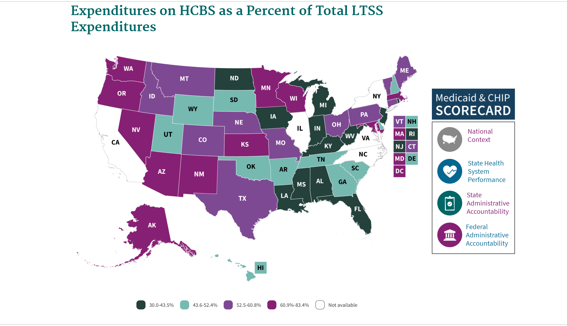
Several states are spending roughly half of all Medicaid LTSS funding on HCBS

Slide 4
We’ve Been Riding the Train of “Rebalancing” LTSS for Awhile…But to What End?
Hospitals, IMDs, Skilled Nursing Facilities, ICF/IID
Large; Insular; Secluded
Facility-based
Non-Profit/For-Profit “Community” Based Providers
Minimal Interaction with Broader Community
Most Services Remain within Four Walls
Highly Congregate & Structured; Ill Equipped for Individualization
Institutional Regulations & Funding Shifted to HCBS
Notes:
From a focus on placements into large, insular institutions to…………
Community-based (non-profit & profit) institutions
Institutional regulations moved to community
Institutional funding move to community
Highly congregate; very little individualization
Most services remain within four walls

Slide 5
Remember these? Federal HCBS Setting Requirements
Is integrated in and supports access to the greater community
Provides opportunities to seek employment and work in competitive integrated settings, engage in community life, and control personal resources
Ensures the individual receives services in the community to the same degree of access as individuals not receiving Medicaid HCBS
Is selected by the individual from among setting options including non-disability specific settings and an option for a private unit in a residential setting
Ensures an individual’s rights of privacy, respect, and freedom from coercion and restraint
Facilitates individual choice regarding services and supports and who provides them
Optimizes individual initiative, autonomy, and independence in making life choices
**Additional Requirements for Provider-Controlled or Controlled Residential Settings**
https://www.law.cornell.edu/cfr/text/42/441.301
Notes:
The HCBS setting requirements establish an outcome oriented definition that focuses on the nature and quality of individuals’ experiences.
The requirements maximize opportunities for individuals to have access to the benefits of community living and the opportunity to receive services in the most integrated setting.
The final rule establishes:
Mandatory requirements for the qualities of HCBS settings including discretion for the Secretary to determine other appropriate qualities.
Settings that are not HCB
Settings presumed not to be HCB
State compliance and transition requirements
Facility-Based Employment: Access to employees without disabilities? Same exposure to typical community settings and the public to the same degree as their non-disabled coworkers? Ability to leave the facility during the day and engage with typical community settings for lunch, breaks, etc.?
Supported Employment: In the case of group supported employment, what steps are the states taking to assess these settings and make any needed modifications?
Aging & Employment: Beneficiaries who wish to be supported in pursuing employment must have access to such supports via HCBS setting offerings, though it is recognized that many aging beneficiaries do not wish to seek employment.

Slide 6
Status of State HCBS Settings Rule Implementation Efforts
21 + DC Final State Transition Plan (STP) Approvals
25 Initial STP Approvals
5 without Initial or Final Approvals
How do you think your state is doing in implementing the federal requirements?

Slide 7
Institutional Model Issues Persist in Current HCBS Infrastructure, 7 Years after Publication of the Federal HCBS Regulation
Normal relationships/natural supports v. paid relationships/supports
Dependency
Limited choices, often not based on exposure to more individualized, inclusive options
Artificial environments
Not within public view
Becomes the provider’s/agency’s source of continued revenue

Slide 8
Bottom Line - Status Quo Persists for a lot of HCBS Participants
People are often left with someone else’s vision or plan for what is best for them:
Doing things they don’t want to do
With people they don’t want to be with
In places they don’t want to be

Slide 9
On the Horizon
We’ve Got a shot at Modernizing HCBS!

Slide 10
Three Important HCBS Developments in the Federal Government
Biden Infrastructure Plan
Reconciliation Bill
American Rescue Plan $$

Slide 11
American Rescue Plan Act provides temporary increased federal funding for Medicaid HCBS
Under Medicaid, state funding is combined with a federal “match”.
ARPA Funding allows states to temporarily get a 10% increased federal match for certain Medicaid expenditures beginning April 1, 2021 through March 31, 2022
Enhanced FMAP requirements includes a broad list of Eligible Services
States must comply with Maintenance of Effort (MOE) requirements specified
Not applicable to HCBS admin expenditures
Notes:
Enhanced FMAP requirements includes a broad list of Eligible Services:
Home Health Care -- 1905(a)(7)
Personal Care Services -- 1905(a)(24
Case management 1905(a)(19) and 1915(g)
School based services that meet the definition of one or more services listed in the appendix and are “furnished to a child with a disability because such services are included in the child’s IEP.”
Rehabilitative services under 1905(a)(13): “medical or remedial services recommended by a physician or other licensed practitioner of the healing arts, within the scope of his practice under State law, for maximum reduction of physical or mental disability and restoration of a beneficiary to his best possible functional level.”
Private duty nursing 1905(a)(8)
ABP services that are described above
HCBS waiver services via 1915(c)
Optional state plan benefit to provide HCBS--1915(i) services
Self directed services-- 1915(j)
Community First Choice--1915(k)
Program of All-Inclusive Care for Elderly (PACE)
Managed Long term services and supports (MTLSS) (any of the above listed services delivered via MTLSS)
Section 1115-- (any of the above-described services delivered via 1115)
Not applicable to HCBS admin expenditures
States must comply with Maintenance of Effort (MOE) requirements specified
No stricter eligibility standards, methodologies, or procedures for HCBS than were in place April 1, 2021
Preserve covered HCBS, including amount/duration/scope as in effect as of April 1, 2021
Preserve HCBS provider rates at least as high as 4/1/2021
Includes maintaining emergency Public Health Emergency (PHE) measures that states have already adopted, at least as long as the authority to do so continues (and most of App K will still be authorized through end of enhanced match)
Other authorities and restrictions (e.g. 1115 budget neutrality) still apply
MOE is not violated if states “experience reductions in HCBS enrollment, services utilization or expenditures unrelated to changes in state policies and procedures.”

Slide 12
Examples of activities states can spend the increased federal match funding on through ARPA:
Adding new CBS services, or increasing amount duration scope to reduce risk of institutionalization during covid
HCBS provider payment rate to increase wages, benefit enhancements, including increasing rates, providing paid leave, hazard pay, etc.
Purchasing PPE
Workforce support, recruitment, training
Caregiver support
Assistive technology -- including internet and support using it, staffing, and other costs due to COVID-19
Transition supports--one time community transition costs, transition coordination.
Mental Health and Substance Use services
Skill rehab to regain skills lost during PHE
Expanding capacity
Outreach activities-- educational materials re Covid 19, and language assistance--ASL and language interpreters
Support for access to vaccines
Build no wrong door systems
Strengthen assessment and person-centered planning process
Quality improvement, Develop cross-system partnerships
Training and respite for caregivers
Reduce or eliminate waiting lists
Implement new eligibility policies or procedures -- like expedited elig for HCBS (subject to CMS approval)
Institutional diversion and community transition improvements
Expand provider capacity
Address SODH
Telehealth

Slide 13
And at the same time this is going on…..
The Congress is working on a comprehensive infrastructure and workforce development package that may include $100-400 Billion in new HCBS investments over the next ten years.

Slide 14
HCBS Provisios in Build Back Better Act (1 of 3)
Purpose of the bill is to enhance Medicaid funding for HCBS. States would be eligible for a permanent 7 percentage point increase in the federal Medicaid match for delivering HCBS as well as enhanced funding for administrative activities associated with improvement efforts.

Slide 15
HCBS Provisions in Build Back Better Act (2 of 3)
States would have to strengthen and expand access to HCBS by:
Expanding financial eligibility criteria for HCBS to federal limits; requiring coverage for personal care services;
expanding supports for family caregivers;
adopting programs that help people navigate enrollment and eligibility; expanding access to behavioral health care;
improving coordination with housing, transportation, and employment supports;
developing or improving programs to allow working people with disabilities to access HCBS.
States would also have to strengthen and expand the HCBS workforce by:
addressing HCBS payment rates to promote recruitment and retention of direct care workers;
regularly updating HCBS payment rates with public input;
passing rate increases through to direct care workers to increase wages; and
updating and developing training opportunities for this workforce as well as family caregivers.
States would also have to show improvement over time by demonstrating:
improved availability of services;
reduced disparities in accessing and using HCBS;
evidence of competitive wages and benefits for workers; and
increases in HCBS spending.

Slide 16
HCBS Provisions in Build Back Better Act (3 of 3)
Comply with a strong maintenance of effort for HCBS eligibility and benefit standards to ensure that additional federal dollars go towards growing and improving HCBS programs.
Encourage innovative models that benefit direct care workers and care recipients: Provide additional incentives to help states build HCBS workforce programs that register direct care workers; help connect them to seniors and people with disabilities seeking care; facilitate coordination between the state and direct care workers; support care safety and quality; and help workers organize, among other functions.
Support quality and accountability: Provide funding to the Centers for Medicare & Medicaid Services to carry out the bill’s programs; conduct oversight and monitoring; and offer technical assistance to states participating in the funding opportunities described above.
Additionally, participating states would be required to establish state HCBS ombudsman programs to support care quality.
The bill would also require all state Medicaid programs to adopt HCBS quality measures.
Facilitate state planning: Provide funding for states to develop HCBS infrastructure improvement plans with public input, to outline how they would expand access to HCBS, strengthen the workforce, and meet requirements tied to increased federal Medicaid funding.
States would be required to develop these plans in order to receive enhanced federal Medicaid funding for HCBS.
Permanent spousal impoverishment protections:
Permanently authorize protections against impoverishment for individuals whose spouses are receiving Medicaid HCBS.
Make Permanent Money Follows the Person: Make the Money Follows the Person Rebalancing Demonstration permanent.

Slide 17
So, What are the Chances of these Bills Becoming Law?
Biden Infrastructure Package
American Rescue Plan
Jobs Plan; Families Plan
Reconciliation Process
Filibuster

Slide 18
What Can You Do?
Actionable steps That DD CouncilS can take to promote access to higher quality HCBS

Slide 19
Key Elements of a Successful Approach to Providing HCBS to PWD

Slide 20
Potential Land-Mines (Threats) to Modernizing HCBS
Lack of Strong PCP, Self-Direction or SDM Models
The Choice Argument
New Legislative Proposals
Revisiting of Federal Regulations
Lack of Accountability for New $$
Reach Challenges with Underserved Indivdiuals and Families

Slide 21
Suggested Actions for DD Council Advocacy
Push your DD Agency to use the extra federal funding coming in from the American Rescue Plan toward:
Encouraging more self-direction and supported decision making
Paying for the training, mentoring, and ongoing professional development of DSPs in evidence-based practices so they can excel in providing supports in the most integrated setting
Use tiered standards to reduce the reliance on large, facility-based congregate settings to provide HCBS, and instead focus on building the capacity of providers to integrated, individualized supports in non-disability specific settings
Investing and supporting people with disabilities to access new technological applications

Slide 22
Suggested Actions for DD Council Advocacy
Think through a strategy with your State on the following --
Priorities for any additional funding that may be on the table as a result of the reconciliation package (Build Back Better Act).
Identifying whether your state has a corrective action plan in place with CMS for any of the following issues – PCP, conflict-free case management, self-direction, etc.
If MFP is extended, expanded or becomes permanent, how can the State use MFP to further advance its systems change efforts to transition more people into community-based settings?

Slide 23
THANK YOU!!!
If you have any questions, please do not hesitate to reach out to me at:
Serena Lowe
EWOLANERES@gmail.com
202-907-8369

