Slide 1
NACDD Policy Update October 13, 2021
Erin Prangley, Director, Public Policy National Association of Councils on Developmental Disabilities

Slide 2
Legislative Update: House and Senate recess until next week
Infrastructure (BIF).
Reconciliation (Build Back Better).
Continuing Resolution
Debt Ceiling
Goal: October 31
Goal: October 31
2nd Deadline: December 3
Summary at https://bit.ly/3BjbMfo
Doesn’t have the House votes unless assurances on BBB.
Pelosi told her conference in a weekend letter that the topline cost of the legislation may need to be slashed from $3.5 to $2.5 trillion.
2nd Deadline: December or Early January.
Extending Government Funding and Delivering Emergency Assistance Act
Passed both chambers; lifts the debt ceiling by $480 billion, which the Treasury Department has estimated is enough to last until at least Dec. 3, but could go into early January.
Doesn’t have the Senate vote unless moderate Dems are on board.
Notes:
Infrastructure: 1.2T over 8 years. Expires 9/30 (not included in House CR)
Enviornmental clean up
$39 billion to modernize public transit, upgrade aging infrastructure & make stations accessible
$65 billion to ensure access to high-speed internet for all
Reconciliation: HCBS funding through Medicaid FMAP ($190B)
Grant program to incentivize phasing out 14(c)
Funding for a direct care workforce grant program
TA Center for direct care at ACL
$297M extra funding IDEA Part D

Slide 3
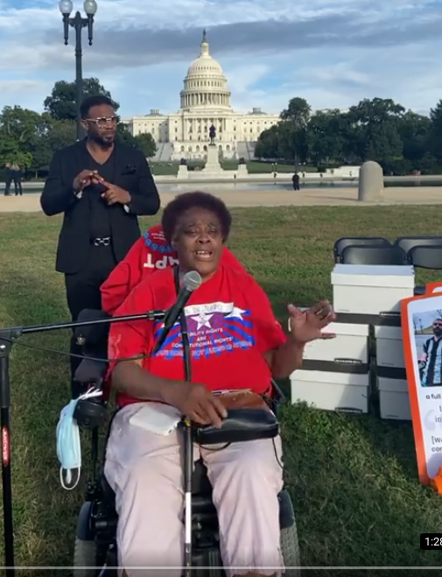
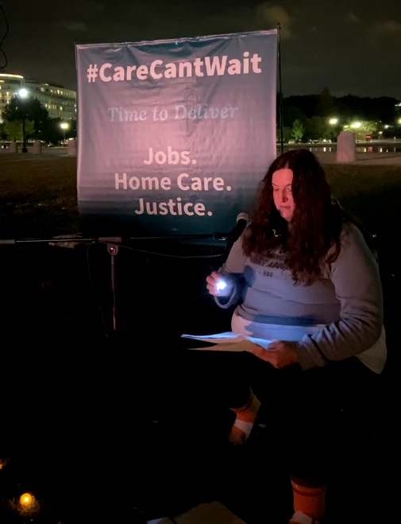
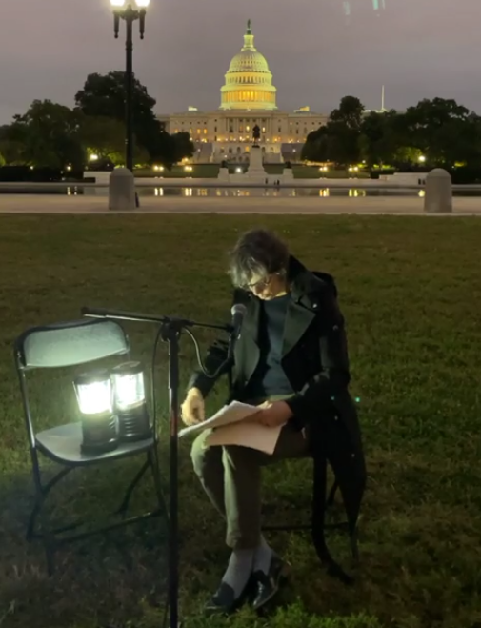
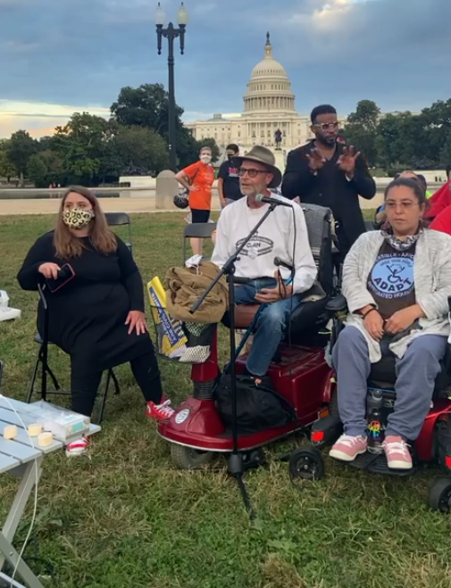
Vigil for HCBS
See videos at https://bit.ly/3iW1drC

Slide 4
So, What are the Chances of these Bills Becoming Law?
Biden Infrastructure Package
American Rescue Plan
Jobs Plan; Families Plan
Reconciliation Process
Filibuster

Slide 5
HCBS Provisios in Build Back Better Act (1 of 3)
Purpose of the bill is to enhance Medicaid funding for HCBS. States would be eligible for a permanent 7 percentage point increase in the federal Medicaid match for delivering HCBS as well as enhanced funding for administrative activities associated with improvement efforts.

Slide 6
HCBS Provisions in Build Back Better Act (2 of 3)
States would have to strengthen and expand access to HCBS by:
Expanding financial eligibility criteria for HCBS to federal limits; requiring coverage for personal care services;
expanding supports for family caregivers;
adopting programs that help people navigate enrollment and eligibility; expanding access to behavioral health care;
improving coordination with housing, transportation, and employment supports;
developing or improving programs to allow working people with disabilities to access HCBS.
States would also have to strengthen and expand the HCBS workforce by:
addressing HCBS payment rates to promote recruitment and retention of direct care workers;
regularly updating HCBS payment rates with public input;
passing rate increases through to direct care workers to increase wages; and
updating and developing training opportunities for this workforce as well as family caregivers.
States would also have to show improvement over time by demonstrating:
improved availability of services;
reduced disparities in accessing and using HCBS;
evidence of competitive wages and benefits for workers; and
increases in HCBS spending.

Slide 7
HCBS Provisions in Build Back Better Act (3 of 3)
Comply with a strong maintenance of effort for HCBS eligibility and benefit standards to ensure that additional federal dollars go towards growing and improving HCBS programs.
Encourage innovative models that benefit direct care workers and care recipients: Provide additional incentives to help states build HCBS workforce programs that register direct care workers; help connect them to seniors and people with disabilities seeking care; facilitate coordination between the state and direct care workers; support care safety and quality; and help workers organize, among other functions.
Support quality and accountability: Provide funding to the Centers for Medicare & Medicaid Services to carry out the bill’s programs; conduct oversight and monitoring; and offer technical assistance to states participating in the funding opportunities described above.
Additionally, participating states would be required to establish state HCBS ombudsman programs to support care quality.
The bill would also require all state Medicaid programs to adopt HCBS quality measures.
Facilitate state planning: Provide funding for states to develop HCBS infrastructure improvement plans with public input, to outline how they would expand access to HCBS, strengthen the workforce, and meet requirements tied to increased federal Medicaid funding.
States would be required to develop these plans in order to receive enhanced federal Medicaid funding for HCBS.
Permanent spousal impoverishment protections:
Permanently authorize protections against impoverishment for individuals whose spouses are receiving Medicaid HCBS.
Make Permanent Money Follows the Person: Make the Money Follows the Person Rebalancing Demonstration permanent.

Slide 8
Suggested Actions for DD Council Advocacy
Push your DD Agency to use the extra federal funding coming in from the American Rescue Plan toward:
Encouraging more self-direction and supported decision making
Paying for the training, mentoring, and ongoing professional development of DSPs in evidence-based practices so they can excel in providing supports in the most integrated setting
Use tiered standards to reduce the reliance on large, facility-based congregate settings to provide HCBS, and instead focus on building the capacity of providers to integrated, individualized supports in non-disability specific settings
Investing and supporting people with disabilities to access new technological applications

Slide 9
Suggested Actions for DD Council Advocacy
Think through a strategy with your State on the following --
Priorities for any additional funding that may be on the table as a result of the reconciliation package (Build Back Better Act).
Identifying whether your state has a corrective action plan in place with CMS for any of the following issues – PCP, conflict-free case management, self-direction, etc.
If MFP is extended, expanded or becomes permanent, how can the State use MFP to further advance its systems change efforts to transition more people into community-based settings?

Slide 10
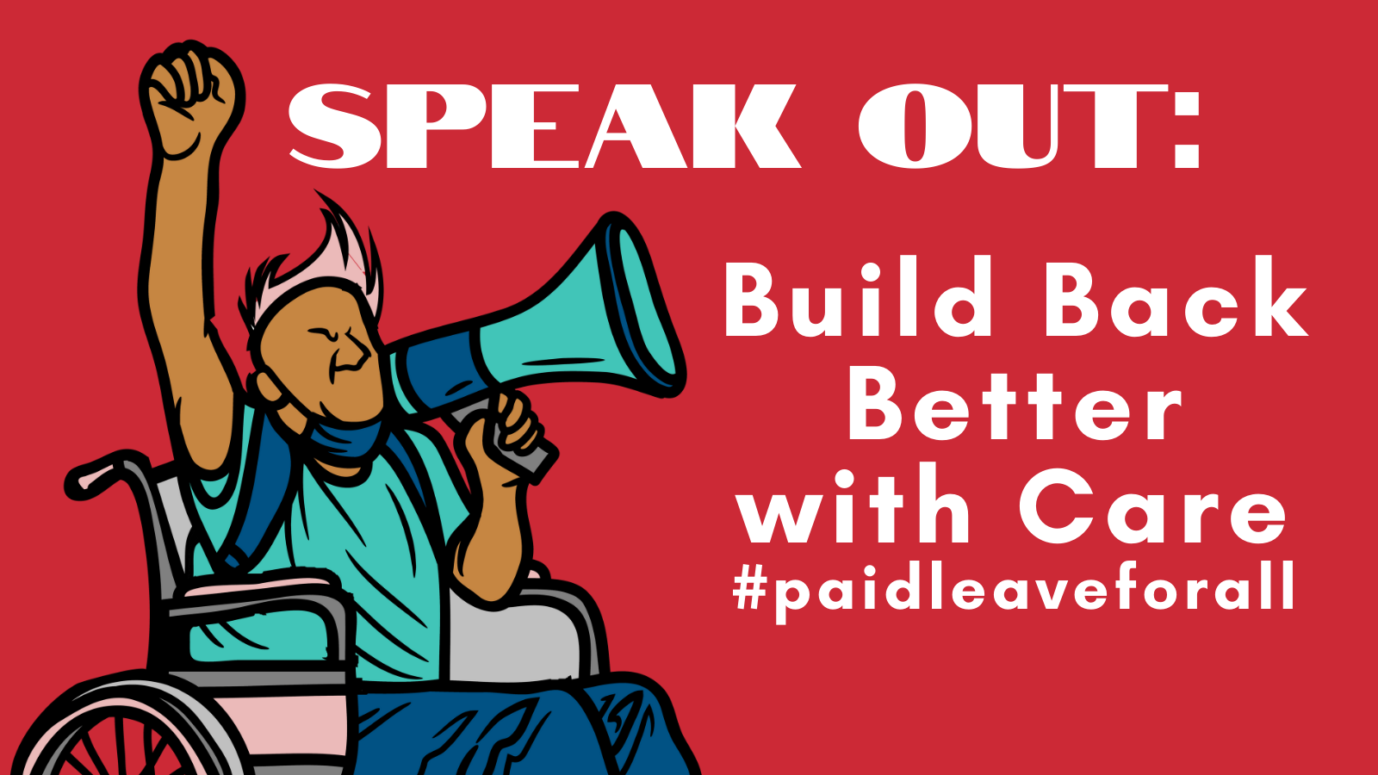
New Resources / Upcoming Events
Need guidance on State HCBS Activities?
Contact Serena Lowe at ewolaneres@gmail.com or 202-907-8369
Public Policy Committee Monthly Meeting ​
Thursday, November 4, 2pm Eastern​
​
Join Zoom Meeting​
https://us02web.zoom.us/j/82156490017​
​
Meeting ID: 821 5649 0017​
Advocacy Event: PAID LEAVE FOR THE PEOPLE RALLY On Thursday, October 14th, at 130pm working families, elected officials, members of the Family Values @ Work network and nearly 30 partner groups will rally to send a clear message to Congress: we need ALL of the provisions in the #BuildBackBetter Act and we need them NOW because #CareCantWait.
PROMOTE SPEAK OUT: PAID LEAVE FOR THE PEOPLE RALLY
Go to https://www.facebook.com/events/1235244626989073/ and participate virtually with t

