Slide 1
NACDD Policy Update September 8, 2021
Erin Prangley, Director, Public Policy National Association of Councils on Developmental Disabilities

Slide 2
Updates
House Labor/Ed mark-up of Build Back Better Act on Thursday (tomorrow) 12noon livestreamed at www.youtube.com/EdLaborDemocrats
Grant program to incentivize phasing out 14(c)
Funding for a direct care workforce grant program
TA Center for direct care at ACL
$297M extra funding IDEA Part D
Next week:
Energy and Commerce mark-up of healthcare provisions (including HCBS)
Ways and Means revenue raisers and refundable credits
House Vote – End of September
Senate – Early October

Slide 3
HCBS Advocacy Needed!
Contact members of Congress and ask them to include full $400B funding for HCBS services in the reconciliation bill and to cosponsor and support the Better Care Better Jobs Act.
Share the Arc's state-based factsheets with yoru members of Congress. Factsheets are available at https://bit.ly/3yXjDNH or by request (email eprangley@nacdd.org).
Share the Arc's action alert with your self-advocates. You can access the alert at https://p2a.co/IAFTwCz

Slide 4
Selected Talking Points from Senate Aging Staff
$400 billion investment in home and community-based services in the American Jobs Plan is necessary to meaningfully expand services for people with disabilities and older adults and build a caregiver workforce. Funding less than the full amount fails to meet the needs of people with disabilities and older adults and should be rejected.
Members of Congress must REJECT funding lessor amounts because:
Congressional Budget Office (CBO) reported that the legislation, as written, would cost roughly $300 billion and that participation among states would likely be high. A marked reduction in funding will not allow for the effective implementation of this policy, if states elect to participate at all, and will creategrave tensions within the broad-based coalition that supports this effort.
Medicaid HCBS are desperately needed by millions of Americans. State waiting lists document at least 820,000 people waiting for services and there are many millions more who need services but are discouraged by the wait time of up to 14 years.
To address the expansion of services, there must bea steady workforce that can deliver the care but job vacancies for home care workers at 20 percent or higher with an annual turnover rateof 40 to 60 percent. We must invest in incentives for providing a living wage.
A permanent, 10-year investment is necessary to carry out thetransformative goals of the Better Care Better JobsAct, which provides for a planning period ofan average of two years and eight years of programimplementation. Briefings with CBO andthe National Association of State Medicaid Directors(NAMD) confirm that states requirecertainty and long-range funding to develop the infrastructurenecessary to support expansion of services and developing a caregiver workforce.

Slide 5
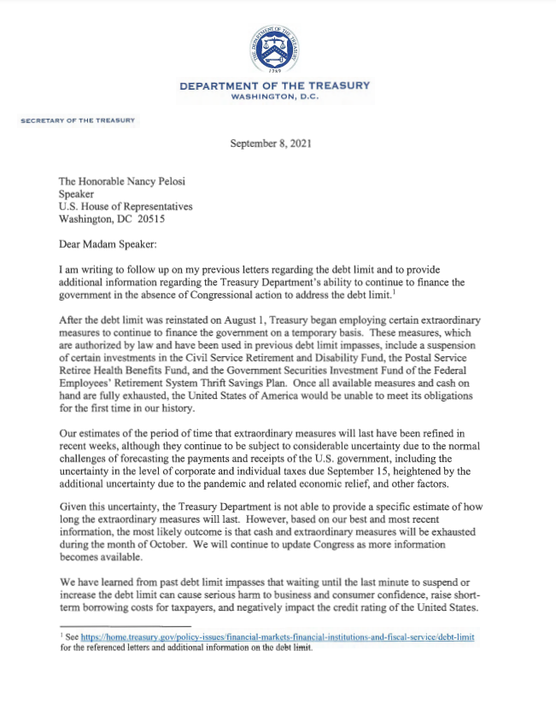
Debt Ceiling must be raised by Mid-October
TBD

Slide 6
New Resources/Events
The Arc has uploaded state fact sheets showing the impact of the Better Care Better Jobs Act (Investment in HCBS). Use these facts to advocate for federal investment in HCBS and the workforce. See https://bit.ly/3tnRuy2
Council of Parent Attorneys and Advocates (COPAA) has released Keeping Students Safe in School: Redirecting School Police Funding to Benefit Students by Supporting Social, Emotional and Behavioral Needs. The report highlights the well documented abuses and long-term negative consequences of police presence in schools on students of color and students with disabilities. See https://bit.ly/2YCDeX4
Disabilty Vote Summit, Tuesday, September 14, 2021 12:00 PM - 4:00 PM EST Register at https://www.ndrn.org/event/disability-vote-summit/ Hosted by The National Disability Rights Network and the American Association of People with Disabilities, the virtual Disability Vote Summit will explore the power of the disability vote, lessons learned from 2020 turnout, how to use data to mobilize the disability vote, and more! ASL and CART will be provided.

Slide 7
https://www.ndrn.org/event/disability-vote-summit/

