Slide 1
NACDD Policy Update September 1, 2021
Erin Prangley, Director, Public Policy National Association of Councils on Developmental Disabilities

Slide 2
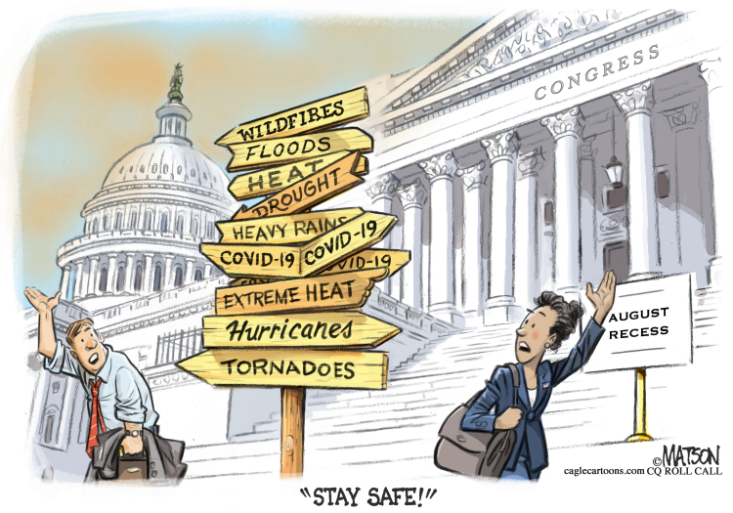
Updates
John Lewis Voting Rights Advancement Act (H.R.4) passed in the U.S. House of Representatives. The legislation provides additional safeguards for voters in states that have a history of voter supression. For backgound see "7 Ways New Voting Laws Can Affect People With Disabilities," Forbes. July 25, 2021 at https://bit.ly/3zD4vWY
Reconciliation Bill / HCBS Funding Instructions Sent to House Committees. Note: HCBS Funding needs a strong advocacy push to maintain $400B amount.
Appropriations still waiting Senate action.
U.S. Department of Education is opening investigations into five states (Iowa, Oklahoma, South Carolina, Tennessee and Utah) where officials say limits on school mask mandates may be in violation of Section 504 of the Rehabilitation Act and the Americans with Disabilities Act. See Disability Scoop. (8/31/21) at https://bit.ly/3zBcbck

Slide 3
HCBS Advocacy Needed!
Contact members of Congress and ask them to include full $400B funding for HCBS services in the reconciliation bill and to cosponsor and support the Better Care Better Jobs Act.
Share the Arc's state-based factsheets with yoru members of Congress. Factsheets are available by request (email eprangley@nacdd.org).
Share the Arc's action alert with your self-advocates. You can access the alert at https://p2a.co/IAFTwCz

Slide 4
FY2022 Appropriations Report
President | House | Senate
$88,480,000 ($9,480,000 above FY2021) | $88,480,000 ($9,480,000 above FY2021) | ???
Included in President's Budget | Passed Committee | Labor-HHS markup delayed until September
Included in ACL Budget Justifications See https://bit.ly/2UzSEJV | House vote week of 7/26 See https://appropriations.house.gov/news/press-releases/house-to-consider-appropriations-bills-next-week | Headed for CR – timing dependent on outcome of Bipartisan Infrastructure and Reconciliation

Slide 5
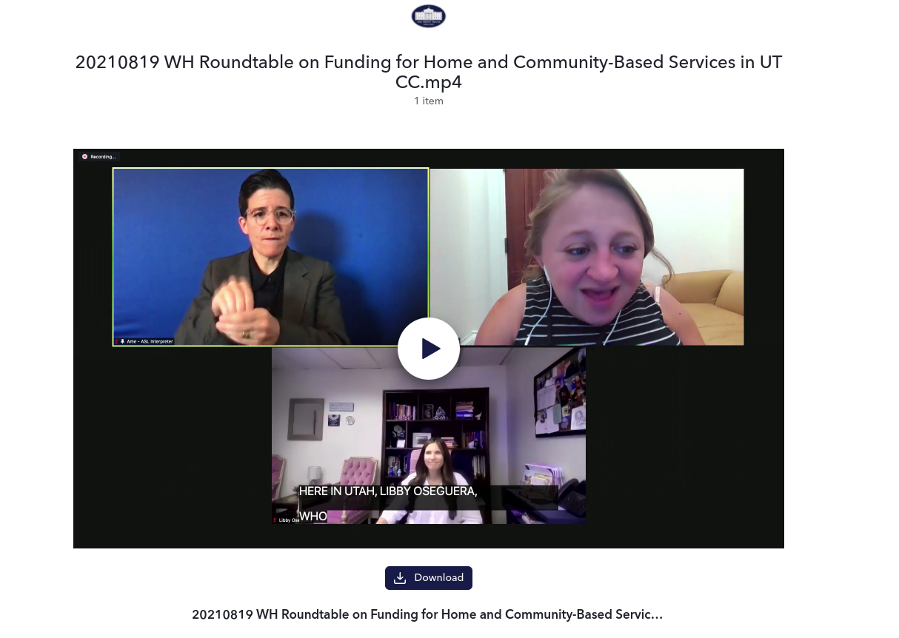
Recess Advocacy Spotlight: Utah

Slide 6
Public Policy Committee Meeting Tomorrow, Thursday, Sept. 2, 2pm Eastern Agenda
1. Appropriations
2. Reconciliation Bill / HCBS Funding
3. Task Force Reports
Join Zoom Meeting
https://us02web.zoom.us/j/82156490017
Meeting ID: 821 5649 0017
One tap mobile +13017158592,,82156490017# US (Washington DC) or +19292056099,,82156490017# US (New York)

