Slide 1
NACDD Policy Update July 20, 2021
Erin Prangley, Director, Public Policy National Association of Councils on Developmental Disabilities

Slide 2
FY2022 Appropriations Report
President | House | Senate
$88,480,000 ($9,480,000 above FY2021) | $88,480,000 ($9,480,000 above FY2021) | ???
Included in President's Budget | Passed Committee | Labor-HHS markup delayed until September
Included in ACL Budget Justifications See https://bit.ly/2UzSEJV | House vote week of 7/26 See https://appropriations.house.gov/news/press-releases/house-to-consider-appropriations-bills-next-week | Headed for CR – timing dependent on outcome of Bipartisan Infrastructure and Reconciliation

Slide 3
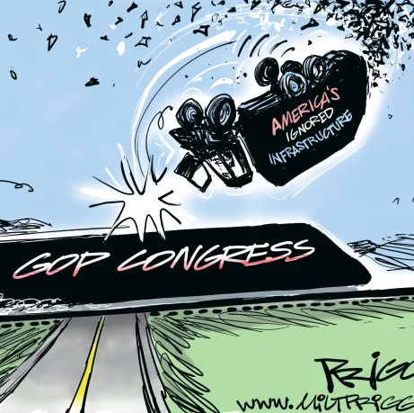
Congress's next steps?
$1.2 T Bipartisan Infrastructure Plan (BIP) likely to fail to pass cloture vote tonight. https://www.cnn.com/2021/07/21/politics/senate-vote-bipartisan-infrastructure-plan/index.html
Reconciliation Bill – Will Dems include infrastructure issues that failed to pass Senate? How will this delay reconciliation instructions? What impact will it have on appropriations deadlines?

Slide 4
Other Updates
NACDD Policy Committee recommendations to improve Better Care Better Jobs Act were included in CCD letter sent to Congress today. Committee suggestions included in coalition letter: language to protect self-direction, broader definition of direct support worker, strengthening the role of the ombudsman program in the bill so they serve similar functions as nursing home ombudsman.
House Education and Labor Committee received information from California State Council on Developmental Disabilities advocate, Liz Grigsby. Her story will be shared with committee members.
Senators Sanders (VT) and Warner (VA) heard from state councils about the importance of securing the $400B for HCBS in the reconciliation bill. Their letters were also shared with Democratic leadership and the White House.

