Slide 1

NACDD
Policy Update
July 13, 2021
Erin Prangley, Director, Public Policy
National Association of Councils on Developmental Disabilities

Slide 2

House LHHS Subcommitee Report
Developmental Disabilities State Councils: $88,480,000 ($9,480,000 above FY2021 enacted level and equal to president's budget
Request).
Developmental Disabilities Protection and Advocacy: $46,798,000 ($5,014,000 above the FY2021 enacted level and equal to president's budget request).
Developmental Disabilities Projects of National Significance: $13,100,000 ($850,000 above
FY 2021 enacted level and equal to the president's request).
University Centers for Excellence in Developmental Disabilities: $47,173,000 ($5,054,000 above FY2021 enacted level and equal to the president's request).

Slide 3
Legislative Paths to Biden's $400B HCBS plan
"Stand Alone" Legislation: Better Care Better Jobs Act
Bi-partisan Infrastructure Plan
Partisan Reconciliation

Slide 4
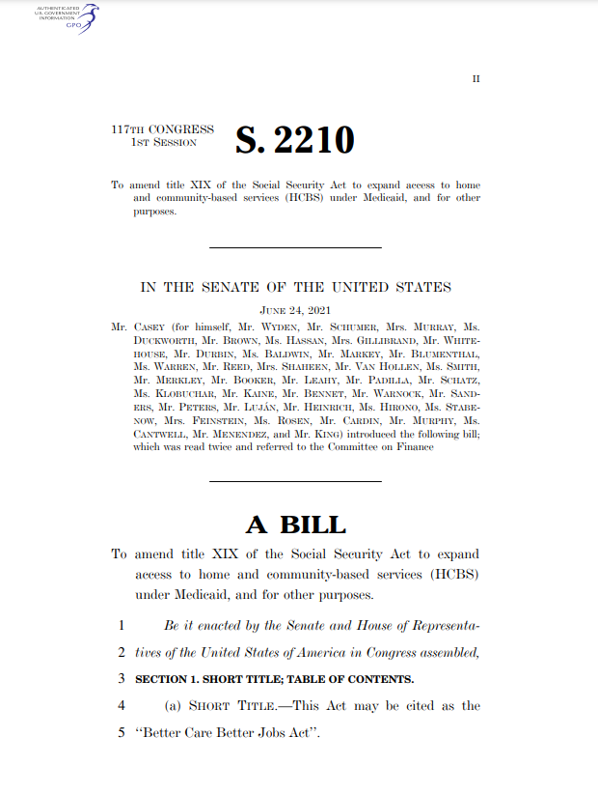
"Stand Alone" Legislation: Better Care Better Jobs Act
Summary: 10% Enhance Medicaid funding for HCBS and enhanced funding for administrative activities and make ​permanent spousal impoverishment protections and the Money Follows the Person Rebalancing Demonstration program. See more at https://bit.ly/3xK7aNx​
Strategy: This stand-alone bill helps us focus the effort on HCBS which is reaching a critical mass after the devastating cost in human life to people in institutional settings. Timing is critical with strong support from the Administration and Democratic leaders who control Congress.
Outlook: Not great. This is long-haul legislation that will only move with considerable pressure from constituents and political will from the Administration. Unlikely to pass in the Senate through regular course of business because of provisions involving union organizing and high price tag.

Slide 5
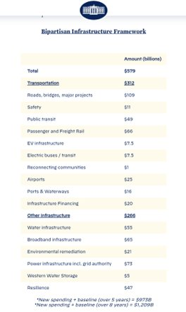
Bi-partisan Infrastructure
Strategy: Reframe the "must pass" infrastructure bill reauthorization to include human infrastructure that would provide $400B increase in Medicaid HCBS.
Status: Scaled down $1.2 trillion Bipartisan Infrastructure Framework does not include $400B for HCBS. (Rest of the package still being negotiated.)
Outlook: No way.

Slide 6
Partisan Reconciliation
  Strategy: Pass HCBS plan through reconciliation.
  Status: Democrats and White House agreed to a separate $3.5 trillion "top line" spending legislation to implement all of Biden's "human infrastructure" policy. The reconciliation of the budget requires all Democrats to agree. This is the same move that Democrats used to pass the president’s $1.9 trillion pandemic aid package in March. We have NOT seen specific HCBS language in the reconciliation bill yet!
  Outlook: Most likely to pass.

Slide 7

Threats to HCBS Funding Plans
Attacks to HCBS funding: ​
David Axelrod Op-Ed in NY Times​ at https://www.nytimes.com/2021/07/04/opinion/disability-funding-medicaid.html?referringSource=articleShare
(Pay wall)
CMS Letter in response to Rep. Fitzpatrick at
https://www.togetherforchoice.org/post/important-letter-from-cms-regarding-the-hcbs-settings-rule?utm_campaign=819ef0a4-8ff0-44b5-89da-4b6749288f4c&utm_source=so&utm_medium=mail&cid=697b3681-559d-4fa2-bd91-b241cbf92db2%20Sent%20from%20my%20iPhone ​

Slide 8
Join the Policy Committee Meeting for more on Better Care Better Jobs Act!
NACDD Public Policy Committee Meeting
Thursday, July 15, 2pm Eastern/11am Pacific
Join Zoom Meeting
https://us02web.zoom.us/j/82156490017?pwd=RXdDckIwUkxuMGo3dkovOW1LWllVZz09
One tap mobile +13017158592,,82156490017#,,1#,465609# US
Better Care Better Jobs Act
  Overview of Democratic legislation to implement Biden's $400B HCBS plan
  Discussion of endorsement or changes needed
  Please read
    Casey Press Release https://www.casey.senate.gov/news/releases/casey-colleagues-unveil-key-legislation-from-president-bidens-american-jobs-plan-to-make-historic-investment-in-care-economy
    Better Care Better Jobs Act Bill Summary https://www.aging.senate.gov/imo/media/doc/Better%20Care%20Better%20Jobs%20Act%20One%20Pager%20SBS%2006223.pdf
    Republican response: https://www.aging.senate.gov/press-releases/ranking-member-scott-releases-report-highlighting-disastrous-biden-administration-policies-for-american-caregivers_

