Slide 1
National Association of Councils on Developmental Disabilities: Self Advocacy Discussion Series
Alternatives to Guardianship and Supported Decision-Making Discussion
Allison Hall and Jordan Anderson
June 17, 2021

Slide 2
What is the Center on Youth Voice/Youth Choice (CYVYC) project?
Goal
Greater use of guardianship alternatives by youth with I/DD
Outcomes
Youth will lead the charge for change in their states.
More students will have more choices after high school.
Fewer youth will have guardians.
Notes:
Allison

Slide 3
What is guardianship?
If you are over 18 years old and under guardianship, it means that someone has gone to court and the judge has decided that someone needs to make your decisions for you.
Notes:
Allison

Slide 4
What are examples of guardianship alternative?
Representative Payee
Healthcare Representative
Powers of Attorney
Supported Decision Making
Notes:
Allison

Slide 5
What is supported decision-making?
Sometimes when we are making decisions we ask friends, relatives, mentors, or other community members for advice.
Sometimes we may have someone, or a group of friends that we ask about medical issues, and another group that we may ask for help with money issues.
Seeking advice, or fact finding, from a specific group is how supported decision-making works.
Notes:
*Self Advocates of Indiana

Slide 6
CYVYC Activities
Research
Conduct a national overview of policies and practices related to guardianship and alternatives
National Coalition
Form a National Coalition that promotes alternatives to guardianship
State CoP
Establish State Teams that will create action plans to increase alternatives to guardianship.
Youth Ambassadors
Develop a Youth Ambassador Program
Dissemination plans
Make sure resources are disseminated widely and to all types of audiences
Develop a website and social media presence
In total 44 youth will participate
16 week online training program, led by SABE
These State Teams will form a Community of Practice (CoP)
50 state analysis; promising practices
Includes medical, legal, disability, military family, advocacy communities

Slide 7
Sneak preview of the website

Slide 8
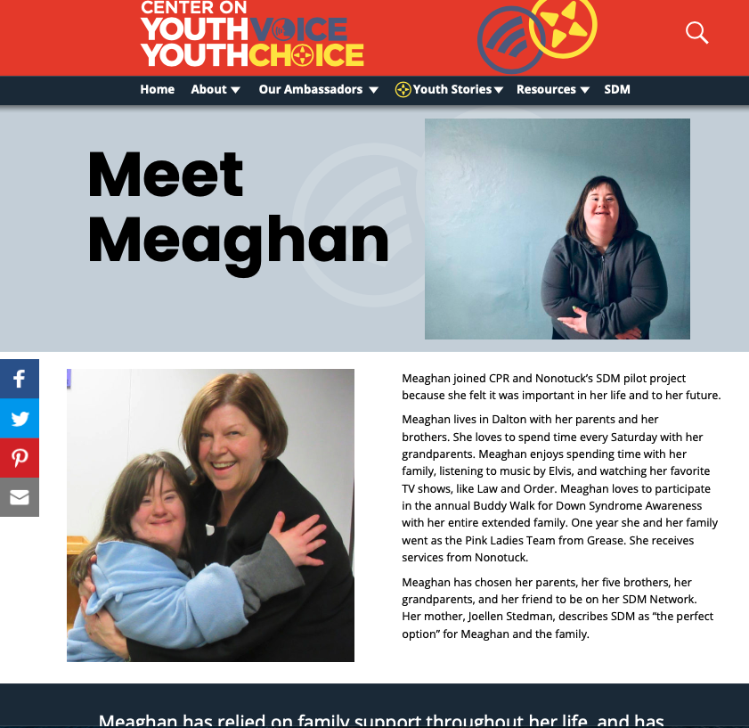
Meet Meaghan

Slide 9
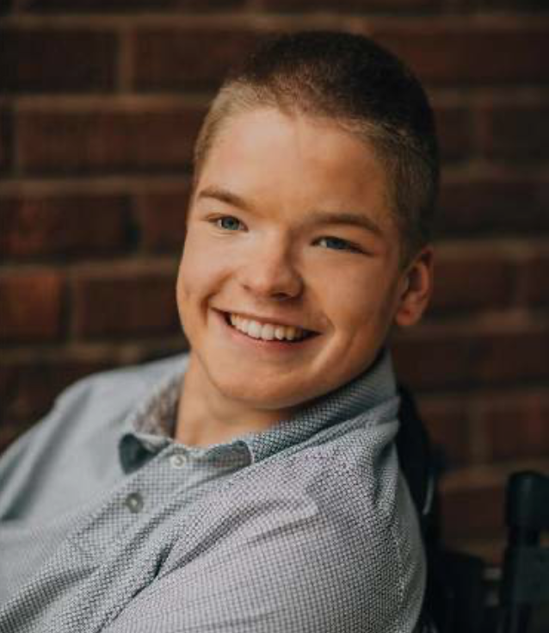
Meet Jordan!

