Slide 1
NACDD Policy Update June 23, 2021
Erin Prangley, Director, Public Policy National Association of Councils on Developmental Disabilities

Slide 2
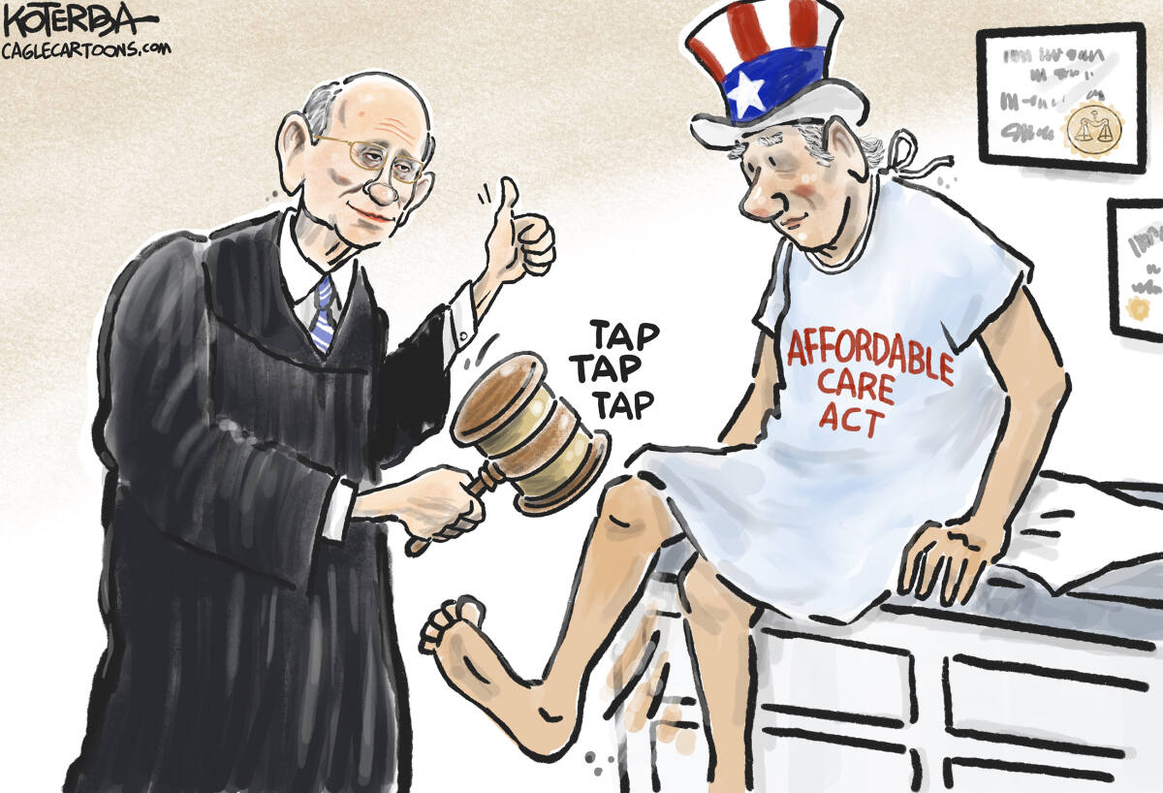
Supreme Court Upholds Affordable Care Act
(again)
California v. Texas (ACA repeal) Issue: Whether the entirety of the ACA was rendered unconstitutional when Congress eliminated the penalty for failing to obtain health insurance.
Holding: The justices ruled (7-2) that neither the states nor the individuals challenging the law have a legal right to sue, known as standing. They did not reach the constitutional question. Read more at https://www.disabilityscoop.com/2020/11/11/disability-groups-worried-as-supreme-court-weighs-affordable-care-act/29080/
Analysis: Once again, the ACA is upheld. NACDD joined disability rights groups in an amicus brief showing how the ACA has benefited people with disabilities and that it would cause harm if eliminated. Read the amicus brief here https://medicaid.publicrep.org/wp-content/uploads/SCOTUS-Amicus-CA-v-TX.pdf

Slide 3
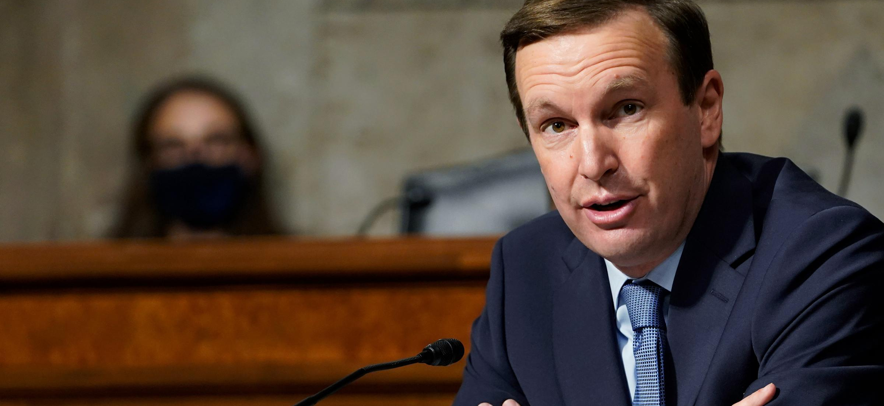
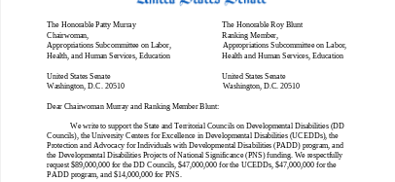
Appropriations Update – Call your Senators!
Signed on: Smith, Shaheen, Hassan, Warren, Kaine, Markey, Schatz, Cortez Masto, Klobuchar, Blumenthal, Baldwin, Cantwell, Hirono
We’re still missing the following from FY21: Duckworth, Rosen, Sanders, Merkley, Brown, Casey, Reed, Cardin, Booker, Sinema, Tester, Gillibrand
Contact Peter Mills in Sen. Murphy's office at peter_mills@murphy.senate.gov
Deadline for sign on is June 25.

Slide 4
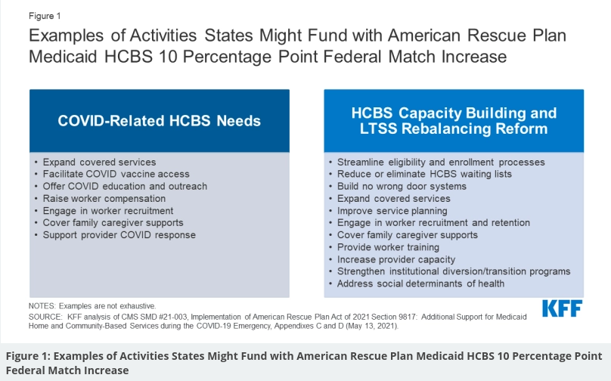
CMS Grants 30-Day Extension on State Spending Plans for Temporary HCBS FMAP Bump
On June 8 CMS announced in a state call that it would grant states an additional 30 days to submit plans on how they intend to spend a temporary 10-percent Medicaid rate increase for the Home and Community Based Services (HCBS) program. The original deadline for the plan was June 12, but states can individually request a 30-day extension.
When creating this funding through the American Rescue Plan Act, Congress stipulated that it must be used to enhance and supplement, not supplant, existing Medicaid HCBS funding
More information is available in:
Slides from CMS state call announcing the extension at https://www.medicaid.gov/state-resource-center/downloads/allstatecall-20210525.pdf
Kaiser Family Foundation brief on the state-by-state impact of the temporary rate increase at https://www.kff.org/medicaid/issue-brief/potential-impact-of-additional-federal-funds-for-medicaid-hcbs-for-seniors-and-people-with-disabilities/

