Slide 1
NACDD Policy Update May 12, 2021
Erin Prangley, Director, Public Policy National Association of Councils on Developmental Disabilities

Slide 2
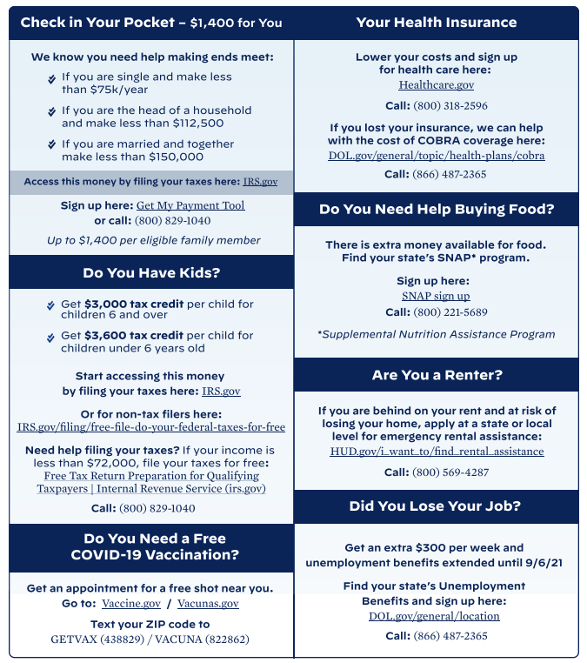
Administration Update
White House factsheets explaining the resources that are now available for low-income folks through the American Recuse Plan.
English https://www.whitehouse.gov/wp-content/uploads/2021/04/American-Rescue-Plan_Help-Is-Here-for-You.pdf
Chinese https://www.whitehouse.gov/wp-content/uploads/2021/05/One-Pager_Help-Is-Here-for-You_chinese.pdf
Spanish https://www.whitehouse.gov/wp-content/uploads/2021/05/One-Pager_Help-Is-Here-for-You_spanish.pdf

Slide 3
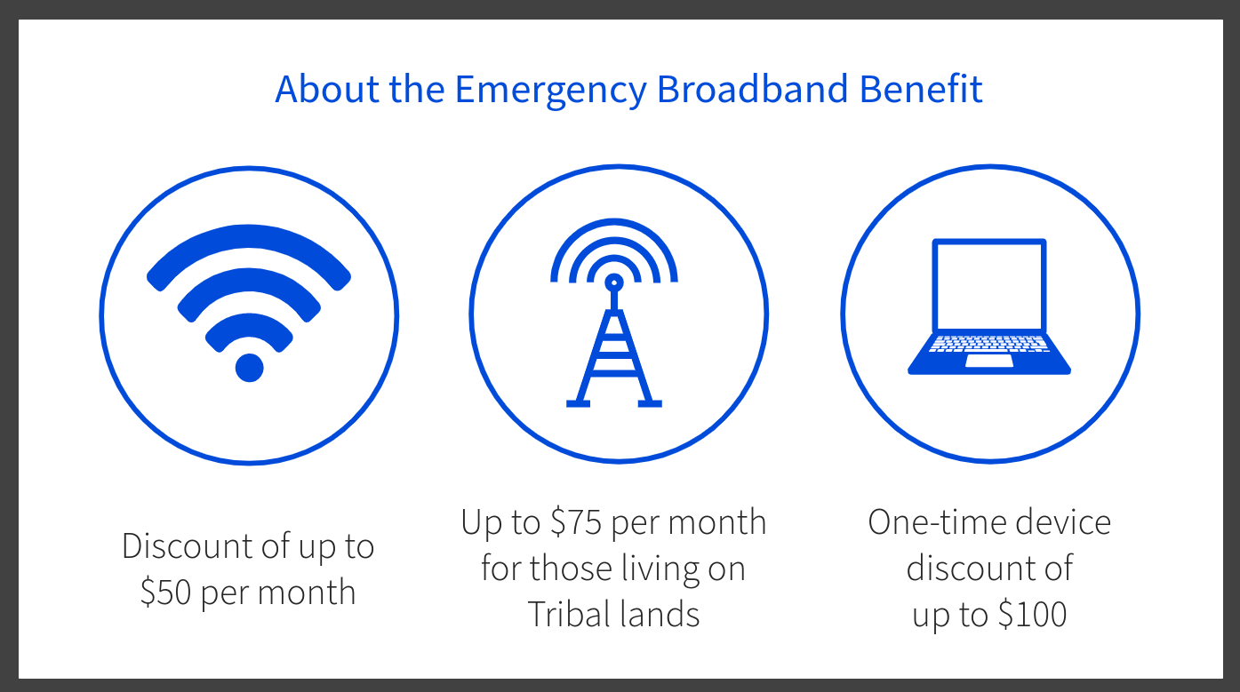
Help with Digital Divide for Medicaid Beneficiaries – Act Fast!
What is the Temporary Emergency Broadband Benefit Program?
Provides a temporary discount on monthly broadband bills for qualifying low-income households; and
A one-time discount of up to $100 for a laptop, tablet, or desktop computer (with a co-payment of more than $10 but less than $50).
Who is eligible?
Households with income at or below 135% of the federal poverty guidelines OR
If any member (including dependents) of the household:
Participates in or qualifies for: Medicaid; SSI; Veterans Benefits; Federal Public Housing Assistance; SNAP; others.
You lost income or job since March 2020 and make less than $99,000 as an individual or less than $198,000 as a family.
How do you apply?
Online at https://getemergencybroadband.org/ (fastest) OR
Call toll free 833-511-0311

