Slide 1

NACDD
Policy Update
May 5, 2021
Erin Prangley, Director, Public Policy
National Association of Councils on Developmental Disabilities

Slide 2
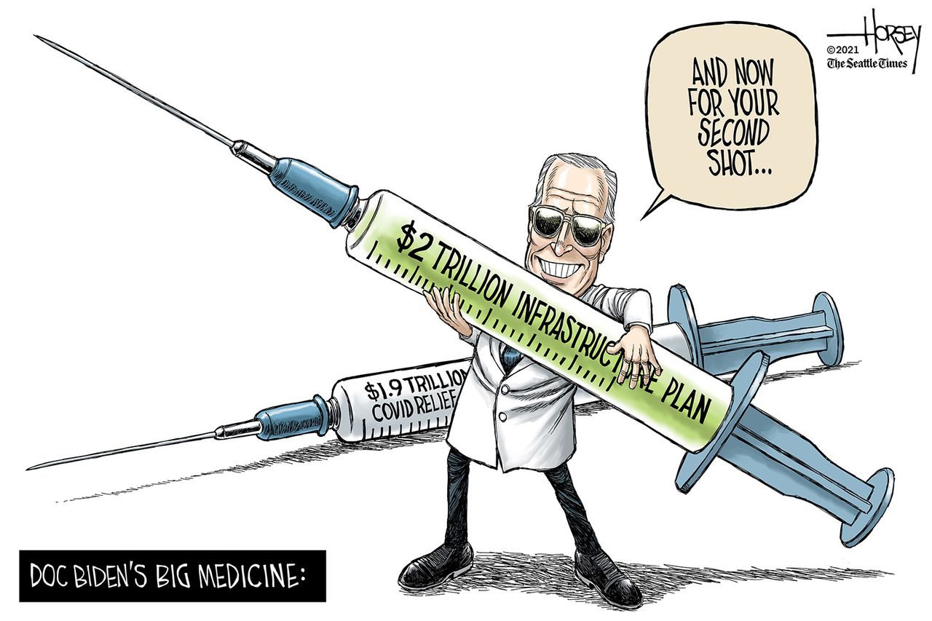
Administration Updates
American Jobs Plan ($2.65T)
$400B for HCBS
Ending sub-minimum wage
American Families Plan ($1.8T)
Federal paid 12 weeks leave program
Universal design for all new housing (1.5M units)
Accessible public facilities built (roads, bridges, ect)
2 ears of preschool to all children
$900 million for the development of special education teachers
$1.6 billion for certifications in high demand areas like special education.
https://www.whitehouse.gov/briefing-room/statements-releases/2021/03/31/fact-sheet-the-american-jobs-plan/
https://www.whitehouse.gov/briefing-room/statements-releases/2021/04/28/fact-sheet-the-american-families-plan/
Executive Order to Raise Minimum wage to $15 for Federal Contractors
Starting January 30, 2022 all federal agencies will need to include a $15 minimum wage in new contract solicitations, and the new minimum wage must be implemented in new contracts by March 30, 2022. Agencies must also implement the higher wage into existing contracts when those contracts are extended or renewed.
https://www.whitehouse.gov/briefing-room/statements-releases/2021/04/27/fact-sheet-biden-harris-administration-issues-an-executive-order-to-raise-the-minimum-wage-to-15-for-federal-contractors/
Ending use of subminimum wages in the federal contract system.

Slide 3
Legislative Update
Appropriations
HCBS Access Act Comments – Thank you to South Carolina, Michigan, California and other councils. Please send your comments to Erin at eprangley@nacdd.org so we can amplify and share with legislators.
Bills introduced
  Accessible Voting Act (S. 1470) establishes the Office of Accessibility, ensure access to accurate information and voter resources, expand the number of options to cast a ballot, establish a national resource center on accessible voting, and increase grants to states to improve accessibility.

Slide 4
Young | AK
Radewagen | AS
O'Halleran | AZ
Brownley | CA
DeSaulnier | CA
Eshoo | CA
Khanna | CA
Speier | CA
Neguese | CO
Norton | DC
Langevin | DE
N. Williams | GA
Schakowsky | IL
Yarmuth | KY
Keating | MA
Moulton​ | MA​
Brown​ | MD​
Lynch​ | MD​
Sarbanes​ | MD​
Pingree​ | ME​
Sablan​ | MP​
A. Kim​ | NJ​
Malinowsk​ | NJ​
Sherrill​ | NJ​
Horsford​ | NV​
DeFazio​ | OR​
Cohen​ | TN​
Cooper​ | TN​
Beyer​ | VA​
Plaskett​ | VI​
House Support for DD Act Programs FY2022 Appropriations Request
30 Members of Congress!

Slide 5
CCD and 24 National Organizations Support the FY2022 DD Act Approprations
American Academy of Pediatrics
American Association on Intellectual and Developmental Disabilities (AAIDD)
American Music Therapy Association
American Network of Community Options & Resources (ANCOR)
American Occupational Therapy Association
American Speech-Language-Hearing Association (ASHA)
American Therapeutic Recreation Association
Association of Assistive Technology Act Program
Association of University Centers on Disabilities (AUCD)
Autism Society of America
Autistic Women & Nonbinary Network
Brain Injury Association of America
Easterseals​
IDEA Infant and Toddler Coordinators Association (ITCA)​
National Association of Councils on Developmental Disablities
National Association of State Directors of Developmental Disabilities Services​
National Association of State Directors of Special Education (NASDSE)​
National Center for Parent Leadership, Advocacy and Community Empowerment (National PLACE)​
National Disability Rights Network (NDRN)​
National Down Syndrome Congress​
National Respite Coalition​
RespectAbility​
TASH​
The Arc of the United States​

Slide 6
Next Steps...
Thank and "spank" emails to House members.
Senate "dear colleague" letter will be out shortly. Time to revisit our senate offices and let them know the great value DD Councils bring to their states.
House and Senate testimony for hearings.

Slide 7
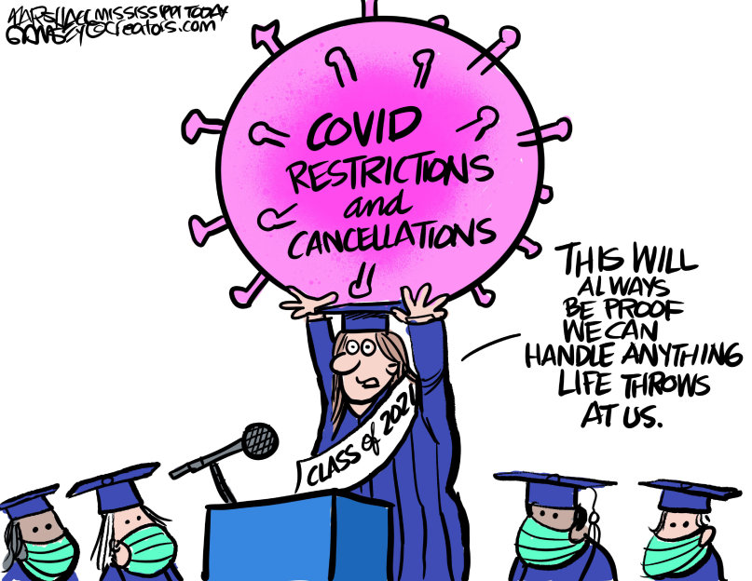
NACDD Public Policy Committee Meeting
Thursday, May 6, 3:00pm Eastern/12:00pm Pacific
NOTE NEW TIME AT 3PM (not 2PM) Eastern
Join Zoom Meeting
https://us02web.zoom.us/j/82156490017?pwd=RXdDckIwUkxuMGo3dkovOW1LWllVZz09
One tap mobile +13017158592,,82156490017#,,1#,465609# US
Agenda
Welcome
Federal Legislative Update
  HCBS Access Act Update
  Biden proposals: American Jobs Act; American Families Act
Appropriations
  House letter update
  Senate up next
Task Forces Updates
  State Policy Task Force
    Vaccine funding best practices
  Medicaid Task Force
Disability Policy Seminar De-Brief
Next meeting: June 3, 2pm Eastern/11am Pacific

