Slide 1
NACDD Policy Update April 7, 2021
Erin Prangley, Director, Public Policy National Association of Councils on Developmental Disabilities

Slide 2
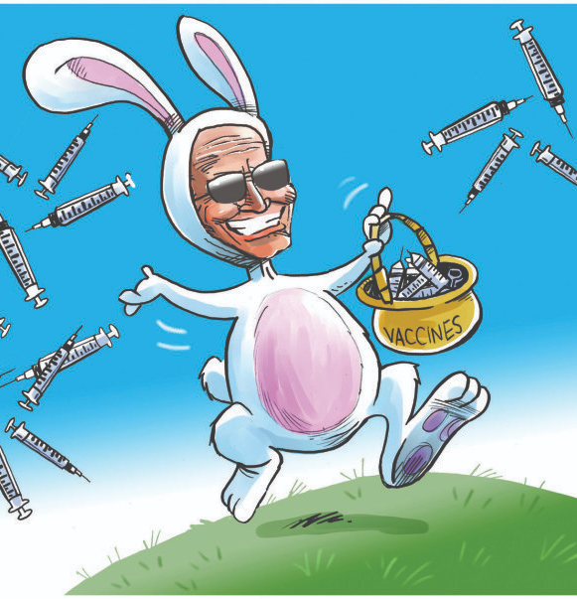
Legislative Update
Congress is in recess until April 12.
Appropriations deadline postponed to April 28. **We will discuss appropriations next week.
Biden "The American Jobs Plan" - $2.25 trillion infrastructure plan that includes many opportuities to build our non-defense decretionary funding back from years of neglect. Democrats could pass with a simple majority under reconcilliation. Biden needs support of all 50 senators who caucus with Democrats, including Sen. Joe Manchin (W.Va.), who has already expressed some reservations. (See next slide.)
Biden Urges Opening Vaccine to All Adults: Biden said yesterday that he wants all American adults to be eligible for a coronavirus vaccine by April 19, citing a target date all but two states are already set to meet. See CNN. "Biden moves deadline for all US adults to be eligible for Covid vaccine to April 19," (4/6/21) at https://www.cnn.com/2021/04/06/politics/coronavirus-vaccine-deadline-biden/index.html How does this impact affect your vaccine campaign efforts?

Slide 3
Disability in American Jobs Plan: Filling gaps in infrastructure caused by years of neglect and creating millions of new jobs.
HCBS $400 billion HCBS (Medicaid); Money Follows the Person program
EMPLOYMENT $100 billion workforce development aimed at underserved groups, including youth; includes wraparound services, income supports, counseling, case management; includes $40 billion dislocated workers program; new subsidized jobs program; programs for formerly incarcerated and justice-involved youth; get rid of subminimum wage; 1-2 million apprenticeship slots; worker protections
HOUSING $213 billion housing (build, preserve, and retrofit 2 million homes; includes $40 billion to improve public housing; extend affordable housing rental opportunities to underserved communities; weatherization)
WATER SAFETY $111 billion drinking water safety (lead pipe replacement) in residences, schools, childcare centers – available to tribes, territories, disadvantaged communities
BROADBAND $100 billion broadband (rural, underserved urban areas, tribal lands)
CHILDCARE $25 billion childcare facilities/increase supply of childcare, esp. for infants and toddlers in high need areas
REVENUE INCRESES THROUGH TAXES $2 trillion in revenue (focused on corporate side; would increase corporate income tax rate to 28% from current 21%; prevent U.S. corporations from claiming international tax havens as their residences)
See more at White House. "Fact Sheet: The American Jobs Plan," (March 31, 2021) at https://www.whitehouse.gov/briefing-room/statements-releases/2021/03/31/fact-sheet-the-american-jobs-plan/

Slide 4
Vaccines: Immediate Short-Term Opportiunity ADRC's and DD Councils
The Aging and Disability Resource Center (ADRC) initiative, a collaborative effort of ACL, CMS and VA, is designed to streamline access to long-term care.The ADRC vision grew out of best practice innovations known as “No Wrong Door” (NWD) and “Single Points of Entry” programs, where people of all ages could turn for objective information and one-on-one assistance on their options. See AUCD. "Bridging the Aging and Developmental Disabilities Service Networks: Challenges and Best Practices," 2012 at https://www.aucd.org//template/news.cfm?news_id=8557
55 states and territories with no wrong door grant. Leadership at the state levels includes 5 UCEDDS. Other grantees are human services agencies. In all initial applications ACL strongly encourages collaboration with DD Councils.
ADRC's received $50M in the CARES Act to coordinate response to the COVID-19 pandemic. They report 18 states are planning projects with DD agencies or councils in AS, AR, AZ, DE, GA, Guam, IL, IA, KS, MO, NE, NH, CNMI, OK, TX, VA, WV, WI. The ADRC Grantee is the UCEDD in the following states: AR, WY, AS, MO, UT.
ACL and ADRC Network invitation for more collaboration. What are next steps?

Slide 5
Reminder: HCBS Access Act
Introduced by Rep. Debbie Dingell (D-MI) and Sens. Maggie Hassan (D-NH), Bob Casey (D-PA), and Sherrod Brown (D-OH). See memo here https://debbiedingell.house.gov/uploadedfiles/home_and_community-based_services_access_act_-_memo_ad.pdf
Proposal would mandate HCBS in Medicaid to provide critical services, creating national, minimum requirements for home and community-based services, and make it possible to enhance those services and the long-term care workforce.
Seeking feedback on:
Provider pay and rate structures of States for HCBS;
Workforce development, including but not limited to, wages and benefits for direct service workers and personal care attendants as well as training and recruitment;
HCBS infrastructure in States that support family caregivers, provider agencies, and independent providers, including but not limited to, housing, transportation, employment and enrollment systems and processes;
Other related policies and programs, such as Money Follows the Person and spousal impoverishment protections.
Many other critical items to further expansion and improve access to HCBS for those who desire the supports.
The offices ask that any feedback be provided, in writing, by Monday, April 26 by sending your comments to HCBSComments@aging.senate.gov.

