Slide 1
NACDD Policy Update March 24, 2021
Erin Prangley, Director, Public Policy National Association of Councils on Developmental Disabilities

Slide 2
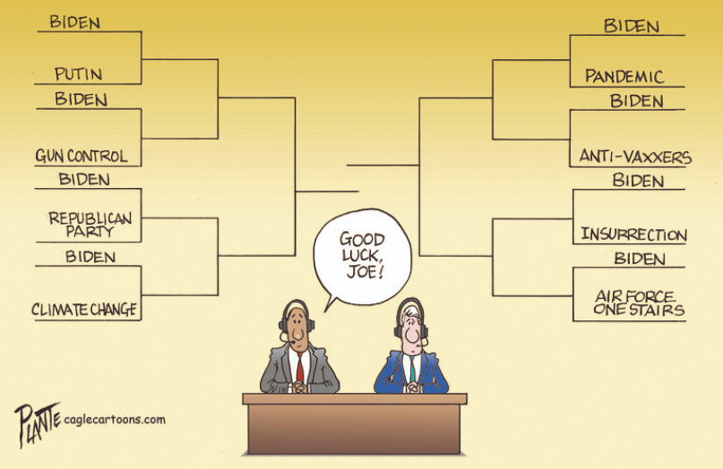
Legislative Update
FY2022 Appropriations - Appropriations deadlines extended: The House Appropriations Committee extended the deadline for submitting fiscal year 2022 appropriations requests to the Labor-HHS Subcommittee. The new deadline is April 28, 2021. **NACDD Appropriations Presentation April 7.**
FEMA Disability Stakeholder Call Observing Developmental Disabilities Awareness Month featuring ACL, CDC and NACDD. Almost 200 people on the call. (Not recorded.)
Notes:
As you know, we expect full Biden-Harris budget in early May and the Approps process is underway.

Slide 3
DD Councils Featured on FEMA Stakeholder Call
State | Phase | Description
Delaware | Response | "Reverse" paratransit delivering nurses and vaccines to people with IDD
North Carolina | Planning | State Disability Integration Specialist embedded in Emergency Manager Office
California | Response | 105M pieces of PPE to people with disabilities, providers and caregivers
Iowa | Response | Coalition work for “pop-up” vaccine clinic in rural areas.
Pennsylvania | Response | Community Response Projects totaling $64,000.00.
Missouri | Recovery | Helping flood survivors locate affordable and accessible housing through the Missouri Inclusive Housing Development Corporation (originally initiated by the council).
Florida | Recovery | DD Councils performed listening sessions and made referrals to help evacuees obtain Medicaid services for people with complex medical conditions, short-term emergency housing, and other services.

Slide 4
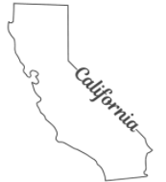
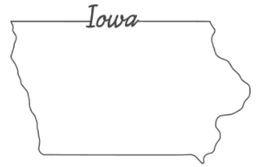
CALIFORNIA After studies emerged showing people with IDD suffering greater loss due to COVID, the state asked the council to lead the effort to identify and distribute PPE to people with IDD. The DD Council worked with over 400 community partners to distribute over 105M pieces of PPE to people with disabilities, providers and caregivers. Notably, making a concerted effort to support indigenous tribal communities and US/Mexico border communities who saw higher rates of COVID.
IOWA
FEMA and DD Councils work collaboratively on a new “pop-up” vaccine clinic specifically serving the Farmworker communities and Spanish speaking families and individuals in the most rural areas. This is real intersection work! IDD families are a tight network but not often plugged in to the usual sources of emergency communication. The DD Council is conducting a public education campaign in Spanish and English to improve confidence in the community to get the vaccine and promoting the sign up throughout their networks. The first clinic is scheduled for Sunday, April 25^{th.}

Slide 5
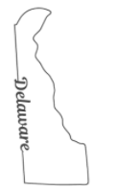
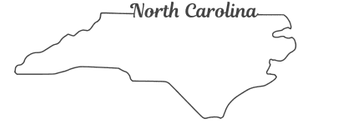
DELAWARE Before the pandemic, many of the individuals served by DDDS followed a daily routine of using DART Paratransit to access their community, whether that meant heading to an employment or rehabilitative program. DART Paratransit was their connection to those sites and their communities. The state incorporated the DD Council's recommendation to use DART Paratransit to reach these individuals with vaccine, effectively running the route in reverse. Rather than picking up passengers, they can deliver nurses and vaccinations. They are now testing the system within western Sussex County for Phase 1B seniors 65 and older who have limited access to other vaccination opportunities because of chronic illness or disability.
NORTH CAROLINA
Hurricanes plague people with IDD in the state. Several years ago, the DD Council worked with the state emergency managers office to create and fund a State Disability Integration Specialist (DIS) position. At the end of the grant period, the project was so successful that NC added position to state budget and continues today to identify and address needs. The DIS was of critical during the aftermath of Hurricane Florence in late 2018 and early 2019. Flooding after the hurricane required individuals to remain in shelters for long periods of time. The DIS lead teams that helped ensure that shelters were integrated and people with disabilities had the accommodations they needed. Also, a grant from the Council developed emergency guidance strategies for people with disabilities that was later used as the framework for the pandemic that became a March 2020 state emergency guidance.

Slide 6
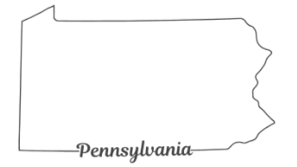
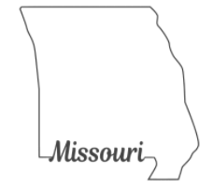
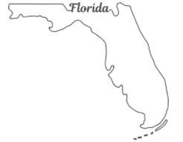
PENNSYLVANIA
Since September 2020, 14 Community Response Projects totaling ($64,000.00) were awarded to community-based organizations serving I/DD populations during emergencies. Projects include employment initiatives, self-advocacy support, disaster planning by specific county, virtual social engagement opportunities to prevent feelings of isolation, and virtual learning for individuals with disabilities, families, and teachers, just to name a few.
MISSOURI
Loss of housing due to flooding affects Missourians regularly. During flood emergency recovery, the Council helps flood survivors locate affordable and accessible housing through the Missouri Inclusive Housing Development Corporation (originally initiated by the council), which assists individuals with disabilities in finding a home that meets their specific needs.
FLORIDA DD Council performed listening sessions and made referrals to help evacuees obtain Medicaid services for people with complex medical conditions, short-term emergency housing, and other services.

Slide 7
Reminder: HCBS Access Act
Introduced by Rep. Debbie Dingell (D-MI) and Sens. Maggie Hassan (D-NH), Bob Casey (D-PA), and Sherrod Brown (D-OH). See memo here https://debbiedingell.house.gov/uploadedfiles/home_and_community-based_services_access_act_-_memo_ad.pdf
Proposal would mandate HCBS in Medicaid to provide critical services, creating national, minimum requirements for home and community-based services, and make it possible to enhance those services and the long-term care workforce.
Seeking feedback on:
Provider pay and rate structures of States for HCBS;
Workforce development, including but not limited to, wages and benefits for direct service workers and personal care attendants as well as training and recruitment;
HCBS infrastructure in States that support family caregivers, provider agencies, and independent providers, including but not limited to, housing, transportation, employment and enrollment systems and processes;
Other related policies and programs, such as Money Follows the Person and spousal impoverishment protections.
Many other critical items to further expansion and improve access to HCBS for those who desire the supports.
The offices ask that any feedback be provided, in writing, by Monday, April 26 by sending your comments to HCBSComments@aging.senate.gov.

