Slide 1
Building Diverse, Equitable and Inclusive Communities
Do you have access to the supports you need for your Health, to increase your Advocacy efforts and More?
Notes:
When we think of diverse – we think of differences. People that maybe look different, worship different, identify with different ethnicities or traditions and other factors. All things that have to do with one’s culture. What do you think of when you think of the word culture? To prepare for today’s discussion, I’m going to review a couple of definitions for us.

Slide 2
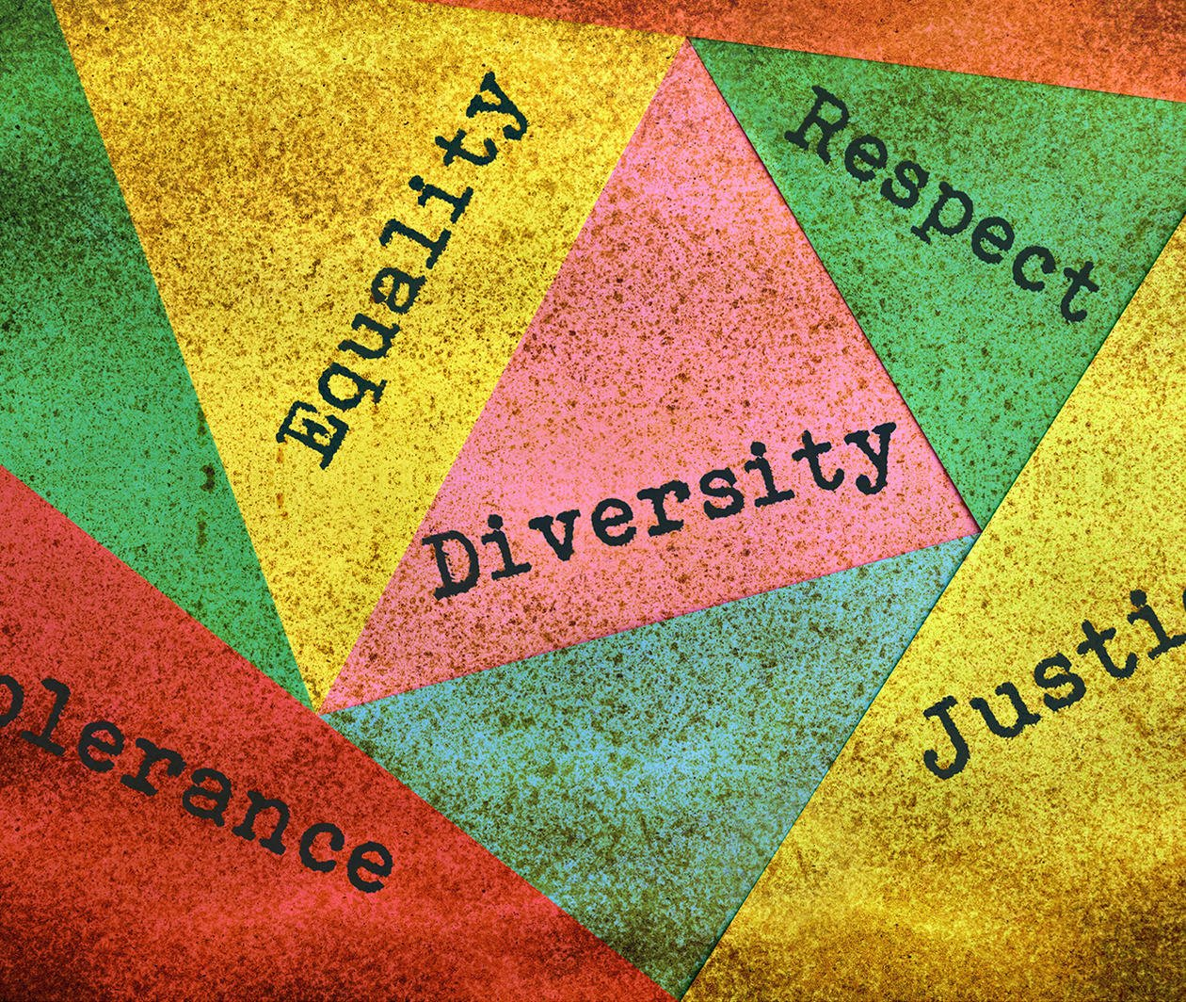
DEFINITIONS (Diversity)
Diversity = All cultures are respectful of each other’s differences:
The idea of including people from many different cultural backgrounds. For example, race, ethnicity, economic status, gender identity or other factors.
Notes:
Other factors can include – where a person lives (rural or urban), education, immigrant status etc. When we say, “including” we mean including in everything from our families, work, SA organizations, education systems, politics, social events and more.

Slide 3
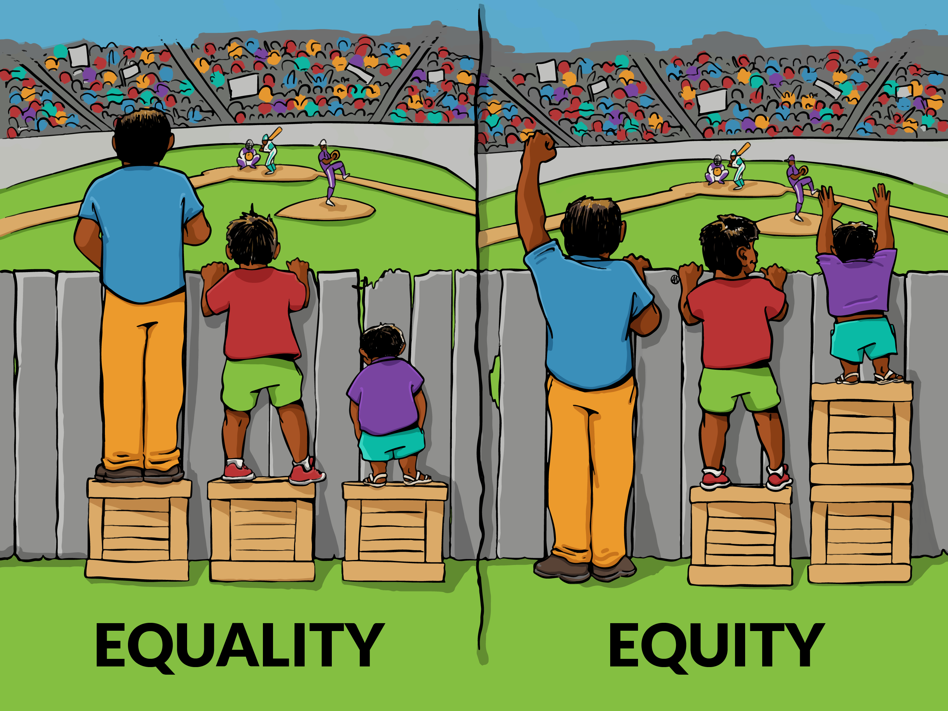
DEFINITIONS (Equity)
Equity = People have the services, supports and resources they need to meet their unique needs.
This means that the services are customized for each individual.
Notes:
This slide includes a picture that explains the difference between Equality and Equity. The picture shows equality as everyone receiving the same exact support (in this case, the same size stool to be able to see over a fence). However, providing everyone with the “same” resources or supports does not necessarily mean that everyone will have what they need. Equity, is the making sure that people have what they need to meet their unique needs. (The picture shows a man that does not need a stool and a shorter person who needed 2 stools)

Slide 4
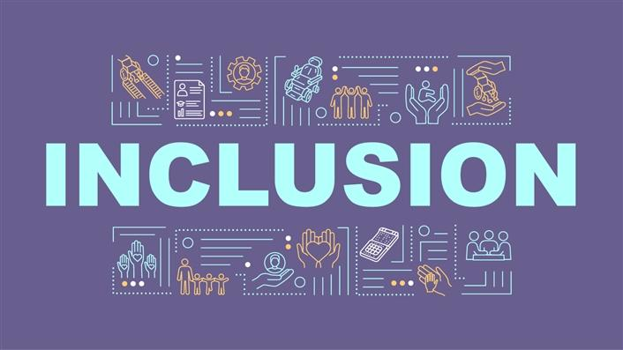
DEFINITIONS (Inclusion)
Inclusion = All people, regardless of their abilities are accepted and encouraged to participate in community life. All people feel welcomed.

