Slide 1
NACDD Policy Update February 17, 2021
Erin Prangley, Director, Public Policy National Association of Councils on Developmental Disabilities

Slide 3
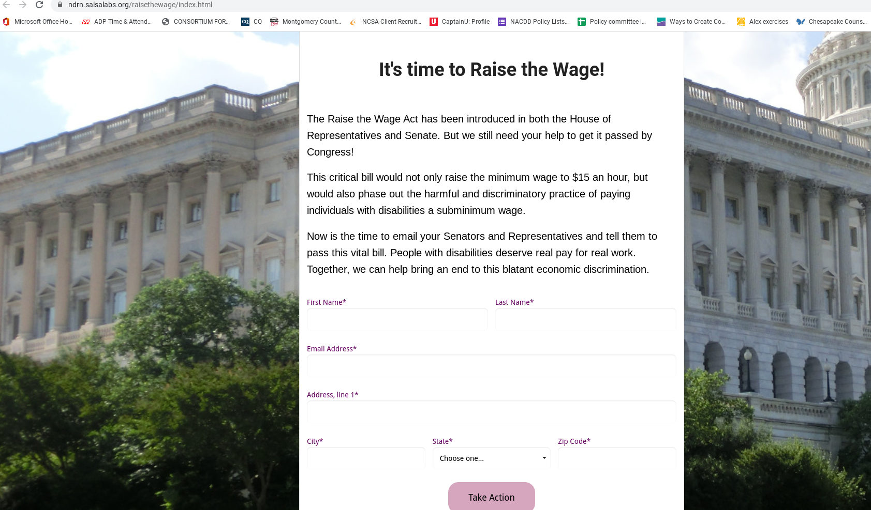
Self Advocate Action this week: Educate House Budget Committee about need to eliminate 14(c)
Link to NDRN alert: https://ndrn.salsalabs.org/raisethewage/index.html

Slide 4
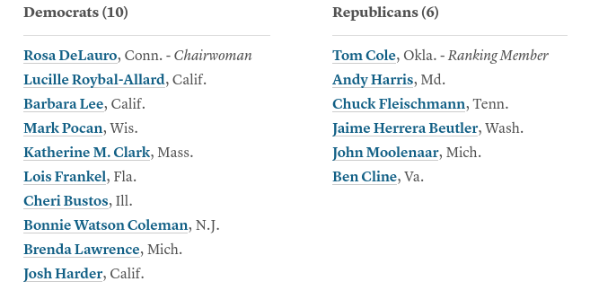
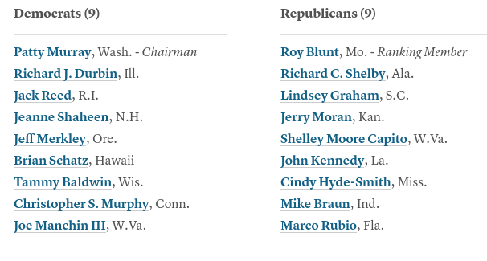
DD Council Action this week: Complete Appropriations Survey
Link to Survey:
https://www.surveymonkey.com/r/7D8XY3Y
House (Sweet 16)
Senate

Slide 5
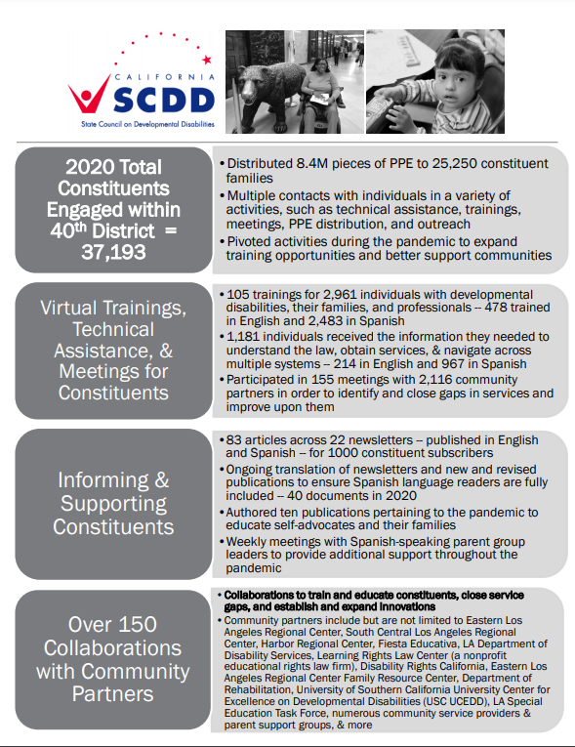
OR Link to Survey:​ https://www.surveymonkey.com/r/7D8XY3Y ​

