Slide 1
NACDD Policy Update January 13
Erin Prangley, Director, Public Policy National Association of Councils on Developmental Disabilities

Slide 2
COVID-19 Relief Bill
New Congress/President
Reconciliation or Stand Alone?
Why does it matter for people with disabilities?
Why does it matter for DD Councils?
Biden expected to release a draft tomorrow.
Aiming to be bipartisan.
Likely smaller in scope with a look towards more bills in the future.
Important Dates
1/31 Eviction Moratorium
3/14 Increased Unemployment Compensation Benefits
3/31 Paycheck Protection Program
3/31 Paid Sick & Family Medical Leave
6/30 Increased SNAP Benefits
7/31 Debt Ceiling
9/30 Funding Government/Appropriations

Slide 3
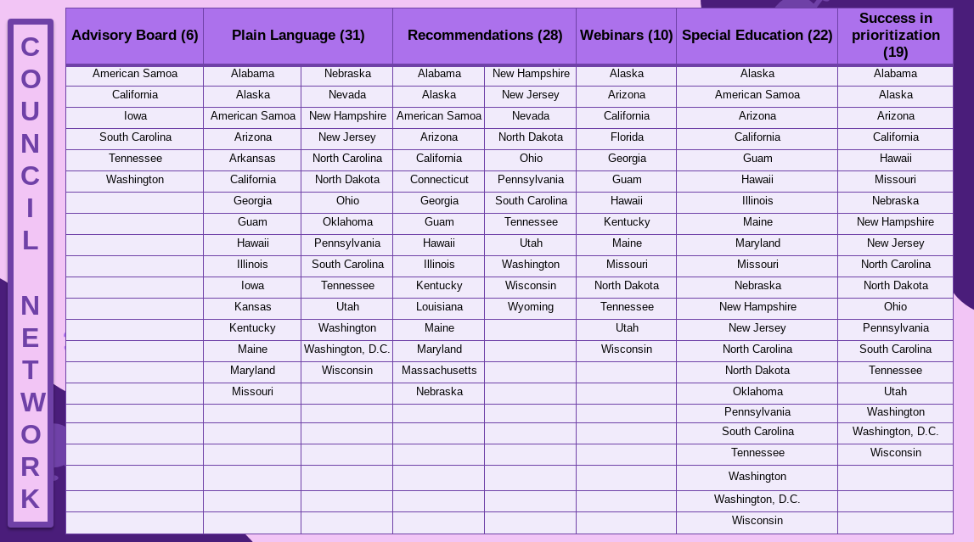
Updated Vaccine Survey – 43 Councils Reporting

