Slide 1
NACDD Policy Update January 6, 2021
Erin Prangley, Director, Public Policy National Association of Councils on Developmental Disabilities

Slide 2
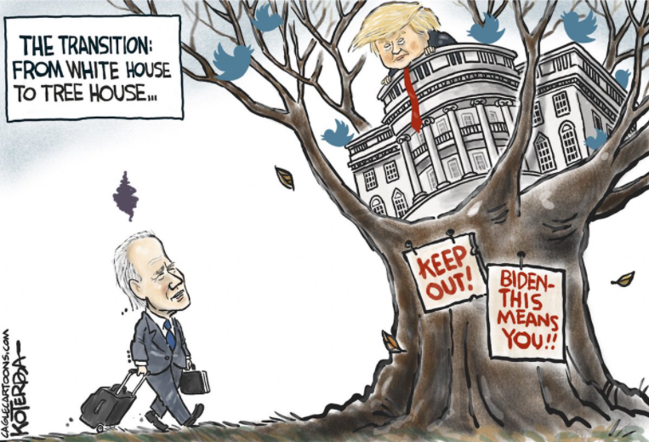
Happy New Year, New Congress, New President!
117th Congress Sworn In. House Dem's with slim majority (222). Senate depends on outcome of GA run-off. (1/3/21)
Congress counts the electoral votes (Constitutional requirement) and officially declares results of President and Vice President election. (1/6/21)
Presidential Inauguration (1/20/21)
President Budget Submitted (Constitutional requirement) (2/1/21)

Slide 3
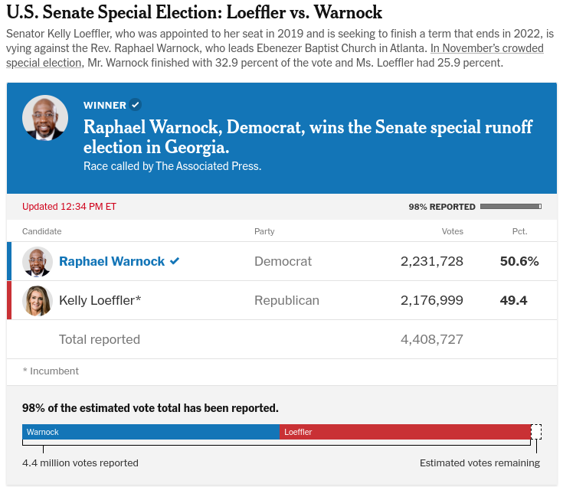
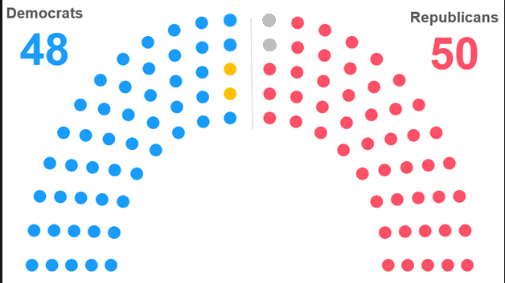
Georgia on everyone's mind...
49
What does this mean for DD Councils?

Slide 4
Out with the old and in with the new... Legislative Update
Stimubus signed into law.
Additional roughly $900 billion COVID relief package.
2021 Appropriations ($1M plus up for DD Councils)
House
“For the People Act of 2019” (H.R. 1) contains several voting protections for people with disabilities that were contained in Accessable Voting Act introduced last Congress.
COVID Relief and Vaccine bill
Reintroduction of priority legislation
Transition to Competitive and Integrated Employment Act.
Senate
Depends on outcome of GA run off.
President-Elect Biden Agenda
COVID Relief and Vaccine bill
Transition meetings continue

Slide 5
Need more public policy in the new year?
Public Policy Committee
Next meeting: January 14, 2-3pm. Join Zoom Meeting at https://us02web.zoom.us/j/82156490017
New list for anyone who wants to receive committee announcements and meeting dates. Complete google form at https://bit.ly/2JTln7e
Medicaid Waivers Task Force
Using Medicaid Waivers to fill gaps in LTSS and more
Strategizing with CMS and others on how to close digital divide
State Budget Task Force
Providing a space for peer-to-peer collaboration on state policy issues
Creating webinars and content for state policy work

Slide 6
