Slide 1
NACDD Policy Update December 23
Erin Prangley, Director, Public Policy National Association of Councils on Developmental Disabilities

Slide 2
Stimubus: COVID-19 Aid + 2021 Omnibus passed by Congress
Omnibus appropriations funding the government through September 30, 2021.
Additional roughly $900 billion COVID relief package, multiple legislative extenders, and legislation that will end surprise billing for emergency and scheduled care.
$600 direct ("stimulus") payments provided to individuals and children. Phases out starting at $75,000 annual income for individuals. But, no stimulus for adult dependents.
$300/week additional unemployment aid for 11 weeks - could last through at least March 14. Similarly, the program providing unemployment benefits for gig/contract/self-employed workers will be continued for 11 weeks.
An extension of CDC eviction moratorium through the end of January, and $25 billion in emergency rental assistance.
MFP extended for 3 years.
Permanent extension of medical expenses tax benefit threshold at 7.5%.
No HCBS or FMAP funding.

Slide 3
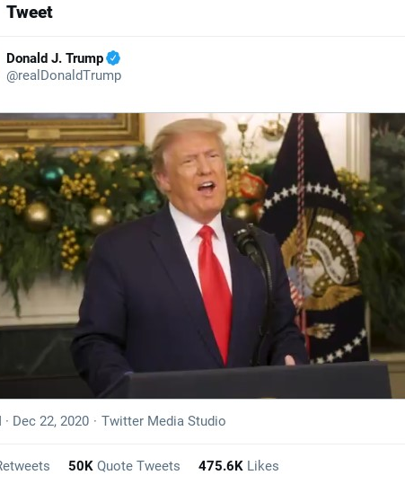
UPDATE: COVID-19 Aid and 2021 Omnibus Appropriations bill stalled after Trump tweet!
In the last 2 days:
Congress passed a bill that included both the COVID relief (including $600 stimulus check) and Omnibus 2021 Appropriations bill. Then they left town. House has yet to "enroll bill."
President Trump posts twitter video demanding changes 1) Increase stimulus checks to $2000 and 2) eliminate appropriations that he doesn't like (foreign aid, environment...)
Read more here https://www.wsj.com/articles/covid-19-aid-package-in-limbo-after-trumps-surprise-demand-to-boost-direct-payments-11608739678

Slide 4
Timeline to avoid a shutdown and pass COVID relief bill.
12/26 House meets "Pro Forma." House leadership might ask for unanimous consent to pass a "stand-alone" bill that includes another Continuing Resolution (date uncertain) and the increased $2000 stimulus check in order to avoid a government shutdown, but probably won't get it -- Senate is even less likely to pass something by unanimous consent.
12/27 COVID relief provisions expire. Enhanced unemployment insurance; eviction moratorium, and other programs will expire if no bill passes to extend them.

Slide 5
Timeline to avoid a shutdown and pass COVID relief bill.
12/28 Congress reconvenes. Congress could take up the "stand-alone" bill to meet the demand for stimulus check but will probably not reopen the carefully negotiated Omnibus 2021 Appropriations bill. They might negotiate another continuing resolution if the President does not agree to entire Omnibus.
1/3 New Congress. If no law by then (for example the President's "pocket-veto"), the new Congress would have to start all over again with a new bill and new members of Congress.
Side note: The stimulus bill did not include funding for adult dependents. We are considering a second bite at the apple to make our case if there is a stand-alone bill on just the stimulus checks.

Slide 6
K Waivers WIN!
CMS guidance is out and extends the termination of Appendix K submissions in response to the COVID-19 public health emergency (PHE), to no later than six months after the expiration of the PHE. You can read details here: https://www.medicaid.gov/federal-policy-guidance/downloads/sho20004.pdf
Congratulations to the NACDD Medicaid Waiver Task Force for their hard work over the past 8 months to make this happen!

