Slide 1
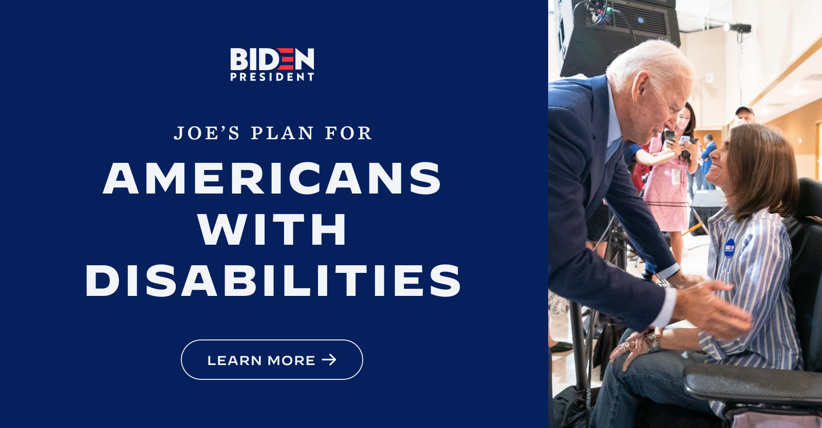
The Biden Plan for Full Participation and Equality for People with Disabilities
So what is the Biden-Harris plan for the disability community?
Ensure full inclusion of people with disabilities in policy development.
Guarantee access to high-quality, affordable health care, including mental health care.
Expand access to home and community-based services and long-term services and supports.
Expand competitive, integrated employment opportunities for people with disabilities.
Protect and strengthen economic security for people with disabilities.
Ensure that students with disabilities have access to educational programs.
Expand access to accessible, integrated, and affordable housing, transportation, and assistive technologies and protect people with disabilities in emergencies.
Advance global disability rights.
You can read the full Biden-Harris plan on disability issues here:
https://joebiden.com/disabilities/

Slide 2
Legislative Priorities for Biden-Harris and the 117th Congress
The Transformation to Competitive Employment Act
The Disability Employment Incentive Act
The ABLE Age Adjustment Act fully fund the Individuals with Disabilities Education Act (IDEA)
The Equality Act
The Paycheck Fairness Act.
Fully implement the Help America Vote Act, to ensure that voting systems be accessible for people with disabilities
Strengthen and expand Violence Against Women Act (VAWA)

Slide 3
Biden-Harris on the Issues – Would you like to know more?
Earlier in 2020, the Biden campaign reached out to voters with disabilities in unprecedented ways. This was spotlighted in some of the candidate questionnaires completed by the campaign.
AAPD/NCIL Presidential Questionnaire: https://www.aapd.com/wp-content/uploads/2020/03/Vice-President-Biden_AAPD-and-NCIL-Presidential-Questionnaire.pdf
RespectAbility’s 2020 Disability Voter Questionnaire: https://therespectabilityreport.org/2020/09/09/joe-biden-questionnaire/

Slide 4
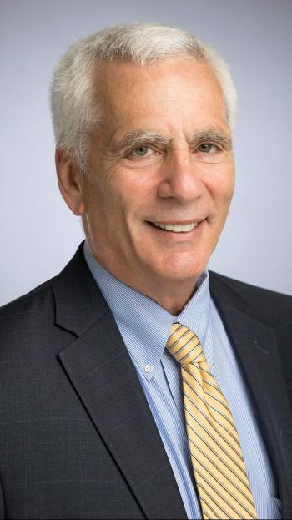
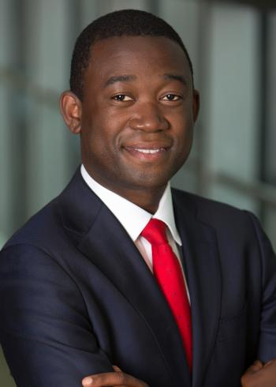
Meet the nominees for Biden’s Economic Team
Janet Yellen, nominated to become Secretary of the Treasury
Cecilia Rouse, Council of Economic Advisors chair
Neera Tanden, head of Office of Management and Budget
Jared Bernstein, Council of Economic Advisors member
Adewale “Wally” Adeyemo, deputy secretary of Treasury
Brian Deese, National Economic Council director
https://qz.com/1939708/who-are-joe-bidens-economic-advisors-and-officials/
Plus Build Back Better Plan
Do you see the problem here?

Slide 5
Personnel *IS* Policy
Without someone with a visible disability or someone with proven experience in disability issues, the incoming Administration runs the risk of leaving their work siloed and ineffective.
How is the strategy team of your company working in a different conference room than the diversity or inclusion team?

Slide 6
Webinar: How To Join The Biden-Harris Administration Or A Key Commission
https://www.respectability.org/2020/12/webinar-biden-harris-administration

Slide 7
By the Numbers: Untapped Talent In the Disability Community

Slide 8
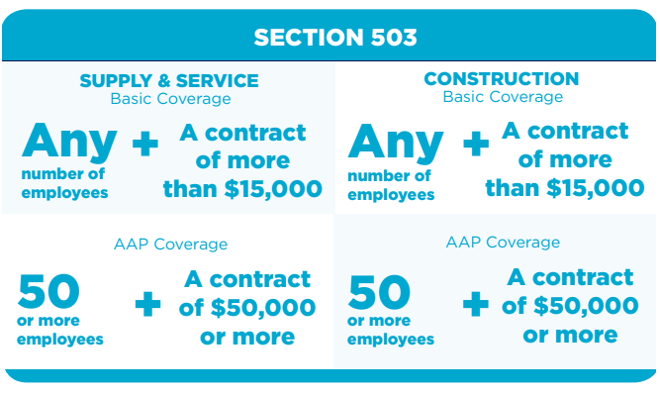
Section 503 Regulations and Federal Contractors
Section 503 of the Rehab Act is a law that prohibits federal contractors and subcontractors from discriminating in employment against individuals with disabilities.
The regs also include a utilization goal for federal contractors to have 7 percent of the workforce be composed of qualified individuals with disabilities in all job categories (from mail clerks to managers to the C-Suite).
FAQ: https://www.dol.gov/ agencies/ofccp/faqs/section-503
Would you like to know more? https://www.dol.gov/agencies /ofccp/section-503
FMI on Section 503 Focused Reviews: https://www.dol.gov/agencies/ofccp/section-503/focused-reviews
https://www.dol.gov/agencies/ofccp/jurisdictional-thresholds

Slide 9
The Federal Government and Workers with Disabilities
Executive Order 13548 entitled, “Increasing Federal Employment of Individuals with Disabilities,” issued in July 2010 emphasized that as the nation’s largest employer, the federal government must become a model for the employment of individuals with disabilities.
The Executive Order called for an additional 100,000 individuals with disabilities to be employed in the federal government by 2015.
Agencies hired about 143,600 persons with disabilities from 2011-2015—exceeding the federal target of 100,000.

Slide 10
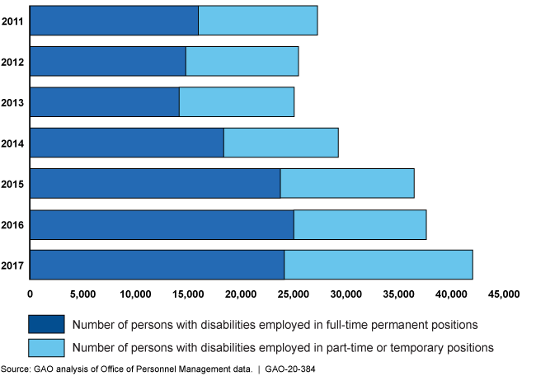
FY 2011-2017
The federal government generally increased hiring of persons with disabilities, fiscal years 2011 through 2017

Slide 11
Now for the bad news…
According to the Government Accountability Office:
About 39% of those with disabilities hired in 2011-2017 stayed less than a year, compared to about 43% of those without disabilities.
About 60% of hires—both those with and without disabilities—stayed less than 2 years.
Source: https://www.gao.gov/assets/710/707504.pdf
Employment focused disability advocates and organizations will be pushing the new Administration to make the federal workforce a better place for workers with disabilities.

Slide 12
Election Omnibus Findings November 2020

Slide 13
Among voters with disabilities and the broader disability community, COVID-19 and the economy and jobs were the most important issues in deciding for whom to vote. Voters with a family member or close friend were likely to list health care as an important issue and voters with disabilities were more likely than voters overall to list Social Security and Medicare as an important issue, too.
I am going to read you a list of issues that may have come up during the election. Please tell me which one or two of these was most important to you in deciding from whom to vote. [TOP TIER]

Slide 14
At least 9 in 10 voters agree that our communities are at their best when all people, including people with disabilities, have opportunities, and that people with disabilities should be at decision making tables just like everyone else. Voters also strongly agree with statements that call for disability issues to be included in national policies and for candidates and their campaigns to include this constituency in their efforts and fight against stigmas and bias.
Now let me read you some statements and please tell me if you agree or disagree with each statement. [TIER ONE]
All Voters
 | Not so strongly agree
 | Strongly agree

Slide 15
A majority of older, African American, Latinx, Democratic, and Biden voters say issues around disability and health care influence how motivated they are to vote. Democrats and Biden voters say candidates’ stances on issues around disability influence how motivated they are to vote, too.
Tell me if you agree or disagree with each statement. [SECOND TIER]
% Strongly Agree | All | Men | Women | <30 | 30-39 | 40-49 | 50-64 | 65+ | Non-College | College | White | AA | Latinx | API | Dem | Ind | Rep | Voted Trump | Voted Biden
People with disabilities bring unique talents to the workplace that benefit employers and organizations | 69 | 67 | 71 | 62 | 63 | 68 | 70 | 77 | 71 | 66 | 68 | 77 | 70 | 58 | 75 | 68 | 63 | 63 | 75
People with disabilities have faced deep inequality, ableism and oppression. They need to be heard | 68 | 66 | 69 | 60 | 67 | 68 | 70 | 71 | 71 | 64 | 66 | 82 | 63 | 70 | 82 | 62 | 57 | 56 | 79
Voting on the issues that matter to the disability community can bring about change | 66 | 68 | 64 | 67 | 64 | 65 | 65 | 68 | 67 | 65 | 65 | 76 | 64 | 56 | 73 | 66 | 58 | 58 | 75
Issues around disability and health care influence how motivated I am to vote* | 43 | 41 | 45 | 34 | 46 | 42 | 41 | 50 | 44 | 42 | 37 | 62 | 50 | 41 | 55 | 41 | 32 | 33 | 53
Candidates' stances on issues around disability influenced who I voted for in the election | 38 | 36 | 39 | 38 | 33 | 33 | 38 | 43 | 39 | 35 | 36 | 50 | 39 | 33 | 49 | 34 | 29 | 29 | 48
Issues around disability influence how motivated I am to vote* | 35 | 36 | 35 | 37 | 30 | 37 | 36 | 37 | 42 | 28 | 33 | 52 | 42 | 31 | 45 | 43 | 21 | 25 | 44
*split sampled question

Slide 16
Voters across demographic subgroups believe it is very important that candidates treat people with disabilities with dignity and respect. We see the greatest intensity of support among the disability community, older voters, whites, African Americans, and Democrats. There is a 13-point gap in intensity between Biden and Trump voters.
How important is it to you personally that candidates treat people with disabilities with dignity and respect?
 |  | PWD | Fam | Friend | All Dis. Com. | M | W | <30 | 30-39 | 40-49 | 50-64 | 65+ | White | AA | Latinx | API | Dem | Ind | Rep | Voted Trump | Voted Biden
Very important | 83 | 90 | 89 | 87 | 88 | 82 | 84 | 80 | 79 | 82 | 85 | 87 | 85 | 86 | 77 | 67 | 89 | 83 | 77 | 77 | 90
Somewhat important | 9 | 5 | 8 | 5 | 7 | 10 | 8 | 11 | 14 | 8 | 10 | 5 | 8 | 8 | 12 | 21 | 6 | 10 | 12 | 13 | 5
A little important | 3 | 2 | 1 | 3 | 2 | 3 | 2 | 3 | 3 | 2 | 2 | 3 | 2 | 3 | 3 | 9 | 2 | 2 | 4 | 4 | 1
Not important at all | 2 | 1 | 1 | 6 | 2 | 2 | 2 | 1 | 2 | 5 | 2 | 1 | 2 | 1 | 4 | 1 | 1 | 1 | 4 | 3 | 1
Important | 93 | 96 | 97 | 91 | 95 | 92 | 93 | 91 | 93 | 90 | 95 | 92 | 93 | 94 | 89 | 87 | 95 | 94 | 90 | 90 | 95
Not important | 5 | 3 | 3 | 9 | 4 | 5 | 4 | 4 | 5 | 7 | 4 | 5 | 5 | 4 | 7 | 10 | 3 | 3 | 7 | 8 | 2
Within the battleground states, 95% of voters with disabilities and the disability community at large say candidates treating people with disabilities with dignity and respect is important. 90% of voters with disabilities and 88% of the disability community in battleground states think it is very important.

Slide 17
High School Graduation Rates for Students w/ & w/o Disabilities – 1990 to 2020
Source: Digest of Education Statistics 1991 to 2018 https://nces.ed.gov/programs/digest / https://nces.ed.gov/pubsearch/getpubcats.asp?sid=091#061

Slide 18
National HS Graduation Rates for Students w/ & w/o Disabilities by Race – Class of 2018
SOURCE: U.S. Department of Education, Office of Special Education Programs, Individuals with Disabilities Education Act (IDEA) Section 618 Data Products https://nces.ed.gov/programs/coe/indicator_cgg.asp

Slide 19
Employment Rates of Minority Populations (Percentage of population) – 2008 to 2018
SOURCES: https://www.statista.com/statistics/793961/employment-among-disabled-us-adults/ https://www.bls.gov/charts/employment-situation/employment-population-ratio.htm

Slide 20
Employment Rates for Working-Age Americans w/ & w/o Disabilities, by Race – 2018
SOURCE: Annual Disability Statistics Supplement: 2019. Univ. of New Hampshire, Institute on Disability.
https://disabilitycompendium.org/sites/default/files/iod/reports/2019-annual-disability-statistics-supplement-pdfs/2019_Annual_Disability_Statistics_Supplement_ALL.pdf?ts=1580831674

Slide 21
Q&A
Questions?
Comments?

