Slide 1
NACDD Policy Update December 16
Erin Prangley, Director, Public Policy National Association of Councils on Developmental Disabilities

Slide 2
Obstacles to COVID Relief Bill
Liability Shield
Businesses can't get sued for COVID issues.
State/Local Aid
"Related to" COVID and not in the state budget or health related.
CARES money was not enough.
Stimulus Checks
White House push to include instead of state and local aid.
Cost is issue.
Good for businesses (nursing homes) bad for people.
COVID Relief
Appropriations
Stimubus

Slide 3
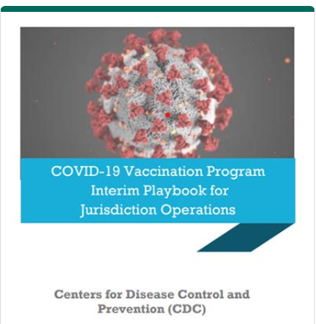
COVID-19 Vaccination Program Operational Guidance
CPR worked with NDRN to compile a "Operational Guidance for Jurisdictions Playbook",
The document’s sections cover specific areas of COVID-19 vaccination program planning and implementation and provide key guidance documents and links to resources to assist those efforts.
Link: https://www.cdc.gov/vaccines/covid-19/covid19-vaccination-guidance.html

Slide 4
ANCOR Report on vaccine allocation
In light of the global COVID-19 pandemic, governments worked with pharmaceutical companies to develop coronavirus vaccine candidates at a record pace.
In the U.S, the breakneck speed of vaccine development has left state and federal health authorities racing to devise frameworks for how to distribute vaccines as efficiently as possible to end of the COVID-19 pandemic.
To aid in the effort to ensure that the most vulnerable populations are appropriately prioritized for vaccination, ANCOR analyzed states’ vaccine allocation frameworks to identify the extent to which people with I/DD have been included.
Link: https://www.ancor.org/sites/default/files/implications_of_state_covid-19_vaccine_distribution_plans.pdf

Slide 5
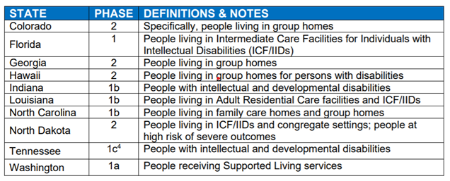
Key Finding:
Few State Plans Explicitly Address People with I/DD Albeit to varying extents, 10 states explicitly addressed people with I/DD in their vaccine allocation plans.
The table indicates which states did so, along with notes about how they defined the population and the phase during which the population would be vaccinated.

Slide 6
States Have Largely Failed to Define “Essential Workers” to Include DSPs
Just as states’ language has been vague about whether people with I/DD are intended for
inclusion in the highest priority tiers, so too have states been vague in defining who counts as an
essential workers
Almost all states identified groups with labels such as “essential workers” or “health care workers” as high-priority populations but neglected to define whether that extends beyond workers in clinical settings such as hospitals’ emergency departments. While the NASEM framework cited by several states specifically identifies “group home staff and home care givers” as “High-Risk Health Workers” to be vaccinated during Phase 1a, states infrequently specified that DSPs who deliver I/DD services were intended to be included in these groups.

Slide 7
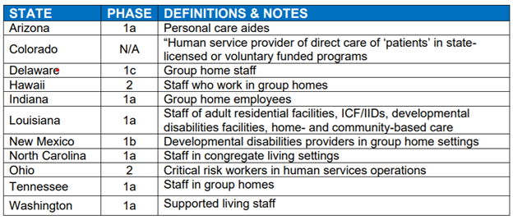
States Have Largely Failed to Define “Essential Workers” to Include DSPs
The table identifies the 11 states that made some reference to the DSP workforce, along with notes about how they defined the population and the phase during which the population would be vaccinated.

Slide 8
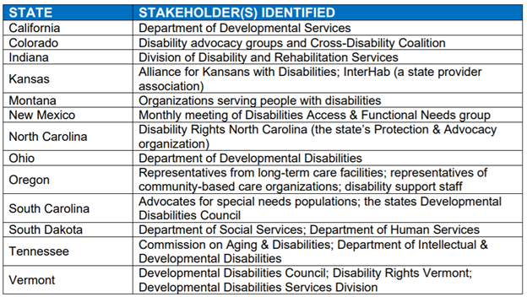
Inclusive Planning
A key element beyond vaccine prioritization that was considered for this overview was the state’s
work to include offices or departments that administer disability-related programs and/or other stakeholders from the disabilities sector in the planning process.
Upon review it was found that several states specifically referenced these stakeholders as having been part of the process, though we do not mean to suggest that these are the only states to have done so.
The table shows states that specifically identified departments or divisions of I/DD services and/or other external stakeholders that participated in the process of developing vaccine allocation plans

