Slide 1
NACDD State Budget Emergency Task Force
December 2, 2020

Slide 2
Agenda
Background (5 minutes)
Breakout Room Discussions (50 minutes)
Closing and Next Steps (5 minutes)

Slide 3
Background
COVID-19 pandemic continues to cause and exacerbate state economic crises.
Continued threat to funding for supports and services for people with developmental disabilities and their families.
NACDD State Budget Emergency Task Force has been meeting biweekly to share information and develop strategies/resources for the network.

Slide 4
Breakout Room Discussions
Each group will address 4 questions
Notes will be combined afterward and synthesized into a resource for the NACDD network
Thank you to our facilitators!
Rachel London (Maryland)
Daintry Bartoldus (Hawaii)
Bill Kallestad (Iowa)
Jason Snead (Arizona)
Katie Bentley (Kentucky)
Craig Knutson (Kansas)
Jeremy Norden-Paul (Washington State)

Slide 5
Breakout Room Discussions
In the context of state budget emergencies:
What are some good strategies for developing relationships with decision makers and serving as a trusted resource for them, including those who may not be particularly interested in our issues?
How do you seek allies and build coalitions, including with both traditional and non-traditional developmental disabilities advocates?
How do you prioritize which issues and parts of the budget to protect?
What tools, technologies, messages, and strategies do you use to rally grassroots advocates around your cause?

Slide 6
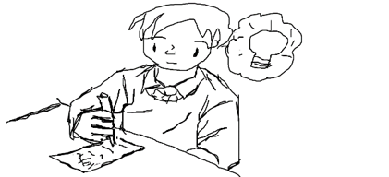
Join Us!
State Budget Emergency Task Force meets every other Tuesday at 12pm PT/3pm ET
Email Jeremy Norden-Paul to be added: jeremy.norden-paul@ddc.wa.gov

